Slide 1
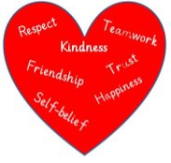
Literacy
Sentence construction – up levelling sentences.
Narrative
Talking and Listening - contribute to
Discussions and share relevant
ideas, information and opinions.
Reading –Develop reading skills and strategies to improve knowledge and understanding a across all areas.
Numeracy
Place value
2 and 3d shape – properties of 2 and 3d shapes.
Read and record time in 12 and 24 hour notation to the nearest minute. Choose the appropriate unit to measure the duration of events.
In Primary 6 this term we are focussing on
Developing our Faith
The Assumption of Mary.
The Book of Exodus : the life of Moses and his importance to Judaism and Catholicism.
The five Biblical stories linked to the Sorrowful mysteries.
Health and Wellbeing
Developing social and emotional awareness working with others.
Developing understanding of emotions and regulation strategies.
Showing respect for myself and others through knowledge of Children’s Rights.
Developing our skills for life, learning and work
I can discuss the relevance of skills to the wider world and make connections between skills and the world of work.
I can use online tools available to me.
I believe I can maximise my potential in any type of work.
Born for Greater Things

