Slide 1
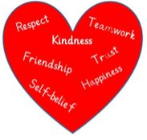
Literacy
Creating and answering different types of questions
Discussing elements of a story e.g. plot, character, setting
Use contents and index pages to help find information
Functional writing
Numeracy
Multiply and divide by at least 2, 5 and 10
Doubles and near doubles to 20
Probability
Area
Directional language
In Primary 2 this term we are focussing on
Developing our skills for life, learning and work:
How are bridges made
How to care for pets
* Research a famous Astronaut
*Learn about the work of
Astronauts and create a job description.
Grow and care for a plant
Developing our Faith
Thanksgiving prayer
Mary, the Mother of Jesus
Learn a hymn to Mary
The mystery of God’s creation
Moses and the burning bush
Health and Wellbeing
Healthy eating and nutrition.
The importance of getting enough sleep
The Body
Safety in the sun
Rights
Born for Greater Things

