Slide 1
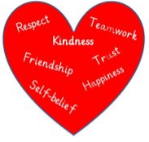
Literacy
Understanding better the differences between fiction and non-fiction texts
Developing our writing strategies to produce a narrative and also an information report
Numeracy
Continue working on subtraction
Learning about multiplication and division and the way they are related
Working with money – paying for items and working out change.
In Primary 3 this term we are focussing on
Developing our skills for life, learning and work
Investigating jobs within our local community/council
Locating places on a map: town, council, nation, country, continent
Developing our Faith
Developing their understanding of the concept of ‘neighbour ’in the commandments and how it refers to all people in the world.
Lent and the story of Easter
Health and Wellbeing
Continue exploring the rights to which we and others are entitled.
Developing awareness of our growing bodies, how to name their different parts and how to properly look after them.
Born for Greater Things

