Slide 1
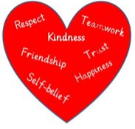
Literacy
Improving the spelling of all types of words.
Learning to identify nouns, adjectives and verbs and understanding their use.
Using more expression when reading aloud.
Numeracy
Understanding that the value of a number depends on where its digits are placed.
Telling the time up to quarter past/quarter to.
Correctly writing and sequencing the days of the week and the months.
In Primary 3 this term we are focussing on
Developing our skills for life, learning and work:
Developing respect for others by listening to them and therefore becoming a quality audience.
Understanding the difference between wanting and needing something.
Developing our Faith
Revising and understanding better the following prayers: Our Father, Hail Mary, Morning and evening Prayers, Grace before and after meals.
Health and Wellbeing
Reflecting on the importance of making good choices and beginning to learn how to control our emotions.
Mental health and its importance for our wellbeing.
Born for Greater Things

