Slide 1
Read Theory
How to sign up and join your class!

Slide 2
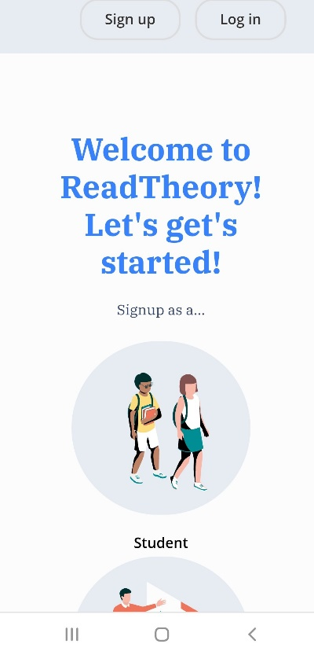
First
Go to https://readtheory.org/app/sign-up/role
Then press ‘Student’→

Slide 3
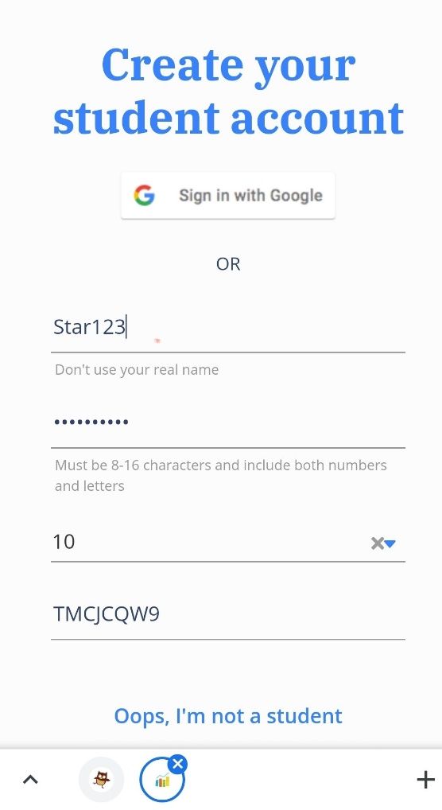
Next…
Add your username: This can be made up but you need to remember it.
Create your own password: Write it down!
Enter your correct age.
And enter our class code: TMCJCQW9

Slide 4
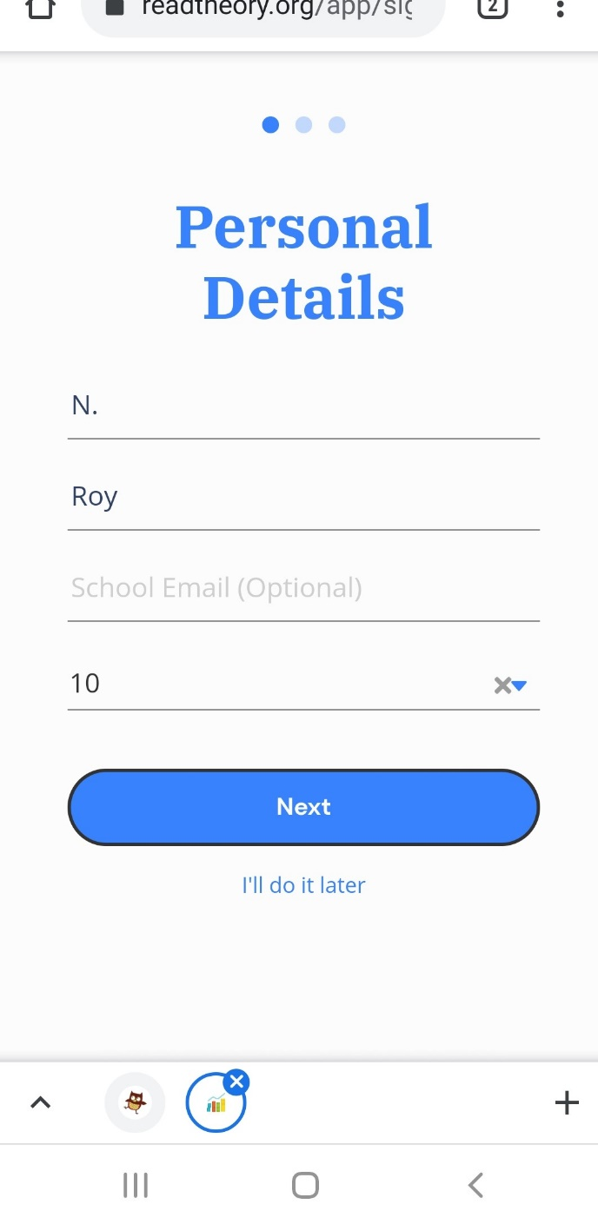
Then…
Add the first letter of your name.
Add your surname.
Press Next!

Slide 5
Finally You will be added to our class and will begin to answer questions. Mrs Roy and Mr Pentland can see how you are getting on!

