Slide 1
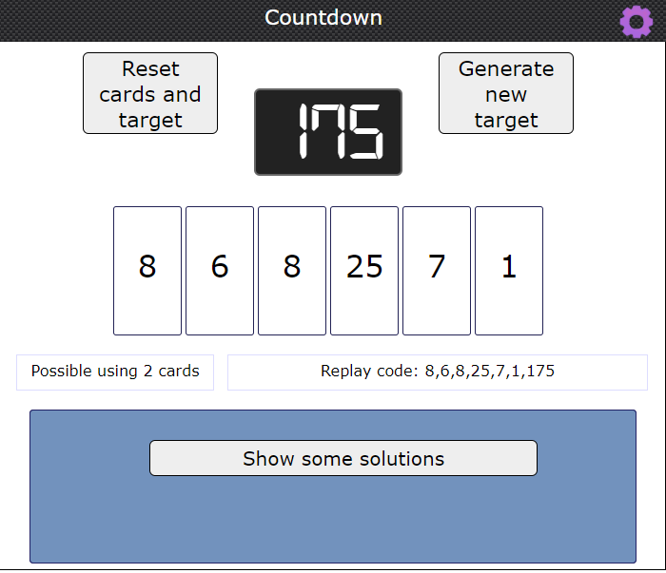
Mental Maths Starter
Pause the video and take 5 minutes to find a solution. Remember you can only use the numbers once.

Slide 2
Identifying fractions
Revising basic fractions

Slide 3
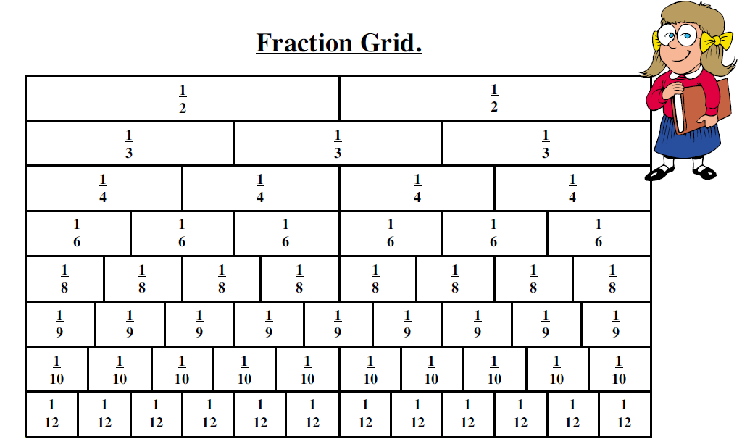
Fractions mean part of a whole
1

Slide 4
Activity – Find the fraction
Suns:
Happy Faces:
Moons:
Red:
Blue:
Yellow:

Slide 5
Watch this 5 minute video revising fractions
https://www.youtube.com/watch?app=desktop&v=YLLGuloswGY

Slide 6
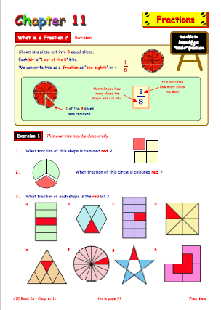
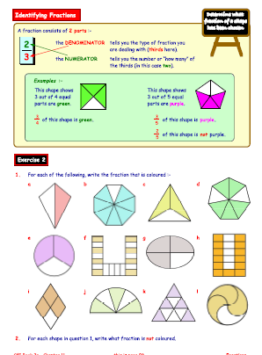
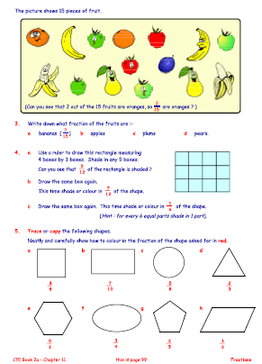
Task
TJ 2A Chapter 11
- Pages 97, 98 and 99.

