Slide 1
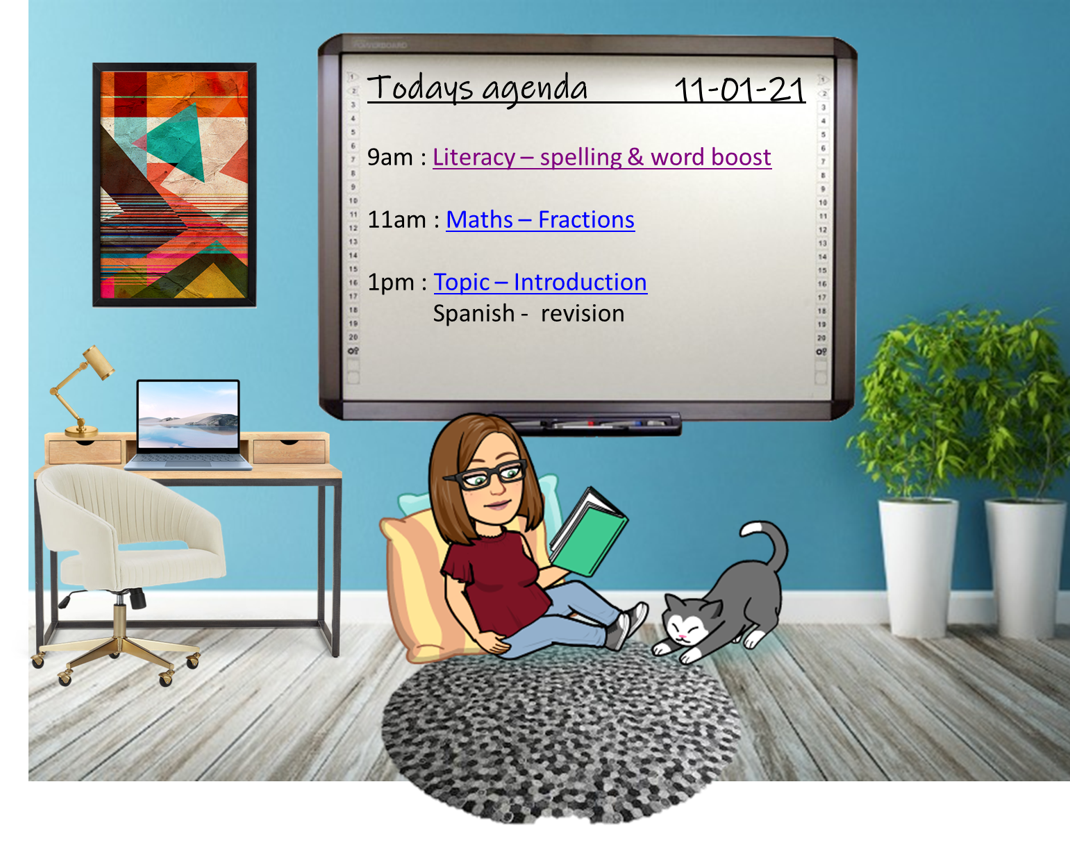

Slide 2
Word Boost
Words have been chosen from the text we will listen to this afternoon.
Write down each boost word, identify whether it is a noun, verb, adjective or adverb (parts of speech).
Write a brief (short) definition. You may use a dictionary if needed.
Then complete the 2 additional tasks.

Slide 3
Word Boost Words
weary
tugged
seething
greed
briars
souvenirs

Slide 4
After Tasks
After identifying parts of speech and writing a definition:
Create questions that contain the boost words
e.g/ Can you gesture without moving?
- Find a synonym for each boost word

