Slide 1
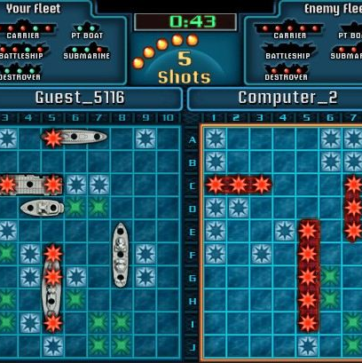
Fitness Battleships
Choose a co-ordinate, do the exercise and then click to see if you have a
OR A

Slide 2
Your Targets are…

Slide 3
1
2
3
4
5
6
7
A
10
press ups
1 min jog
30
sec plank
10 lunges
10 squats
30
sec jog
15
sit ups
A
B
20
star jumps
15
stride jumps
30 lateral jumps
15 crunch
10
press ups
45
sec jog
15 lunges
B
C
15
press ups
20
sec plank
15 squats
20
high knees
20
heel flicks
30
stride jumps
10 crunch
C
D
20 squats
30
star jumps
30
high knees
12 lateral jumps
25
sec wall sit
30 star jumps
30
heel flicks
D

