Slide 1
St Columba’s Primary School
Fitness Fortnight
9th June – 19th June 2020
Week 2

Slide 2
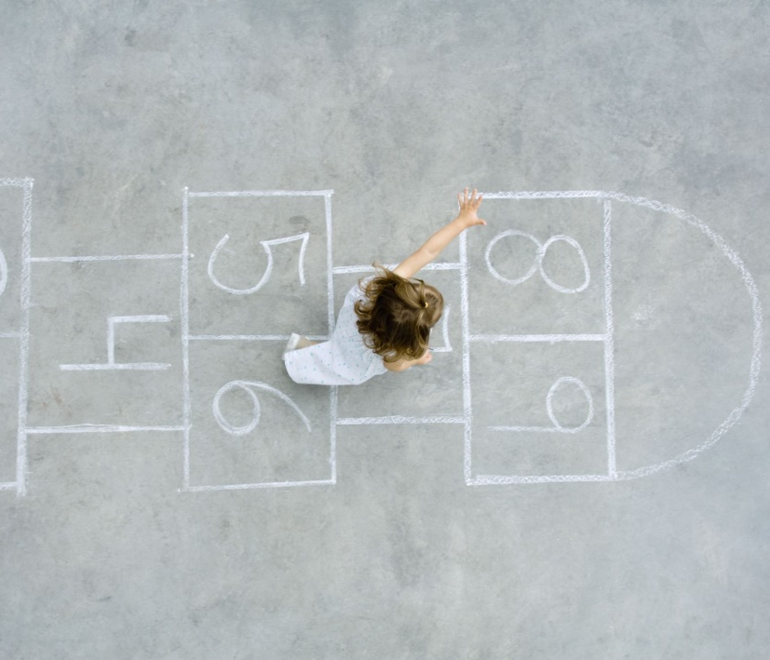
Fitness Fortnight Schedule
This PowerPoint contains a day by day program for pupils and parent/carers to use over the next few days.
All lesson instructions and most resources can be found on here. You can print off any pages or worksheets if you wish but you can record your tasks in whatever way works for you.
If you have any questions, please firstly directly them to your class teacher who will help where required.
We would love to see what you get up to over week 2 so please share with us on the Fitness Fortnight blog posts, with your class teachers and on Twitter @Tennant_PE and @StColumbas2016

Slide 3
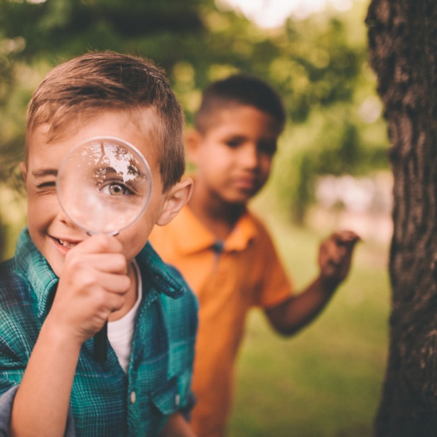
Keep going – you are doing great!
We will continue with our daily tasks for the remainder of this week but please remember we have our overall task to keep working on – Fitness Fortnight Activity Tracker and the Get Set Tokyo website.
You will hopefully have already added to your Activity Tracker. Please remember that once you have completed a day’s daily assignments you are being challenged to complete 1 main Health and Wellbeing activity each day in addition to the tasks detailed on this PowerPoint. The next 2 slides contain the record sheet (which can be printed if possible or recorded in another way) and a list of suggested tasks.
On 29th May you are invited to upload your results by replying to the Fitness Fortnight blog post. Please only use initials in the name box, no full names should be posted.

Slide 4
Name: |  | Class: |  | House:
 | 18th May | 19th May | 20th May | 21st May | 22nd May
Put what you have completed in here.
 | 25th May | 26th May | 27th May | 28th May | 29th May

Slide 5
Fitness Fortnight Activity Grid Please make sure you are being careful when completing any of these activities and that you are supervised by an adult.
SMOOTHIE MAKER Can you make up your own smoothie and share with your family as a healthy start to the day? What ingredients will you put in? | STAMINA Can you cycle, walk, jog, run or scoot for; P1 – 3: 15 minutes without stopping? P4 – 5: 20 minutes P6 – 7: 25+ minutes How far did you go? Who completed it with you? | ASSAULT COURSE Can you design your own assault course? What different things will you include? How long did it take you to complete? Who else can you get to complete it? | VIDEO MAKER Can you create your own; Just Dance Joe Wicks Cosmic Kids What actions will you put in? Would you like to share it with us?
DANCE Can you play a game of musical statues with others in your house? Who stayed still the best? | MINDFULNESS Complete a Cosmic Kids yoga session, here’s some to choose from; FROZEN: https://youtu.be/xlg052EKMtk TROLLS: https://youtu.be/U9Q6FKF12Qs TWILIGHT THE UNICORN OF DREAMS: https://youtu.be/RLOOOjGAM1s | BE THE TEACHER What is your skill? Can you teach someone in your family/house your skill? For example; Sporting skill, karate, dance move, Yoga pose | NATURE WALK Can you take a walk with your family and play eye spy? How many different things did you spy along the way? How many animals? Plants? Water ways?
SPELLING FITNESS CHALLENGE Spell your full name and complete the challenges; A – 10 Jumping Jacks N – 4 Lunges B – 30 Second plank O – 3 Burpees C – Crab walk 5 metres P – 10 second Rocket jumps D – 10 press ups Q – Run on the spot 1 min E – 10 sit ups R – 7 Jumping Jacks F – 5 Cartwheels/egg rolls S – 4 leg kicks G – Headstand/Balance T – 5 sit ups H – 4 rolls of your choice (be careful) U – 15 second plank I – 10 Toe touches V – 3 cartwheels/egg rolls J – 5 tuck jumps W – Arabesque/Starship balance K – 5 press ups X – 2 rolls of your choice (be careful) L – 3 spins Y – 5 lunges M – 10 leg kicks Z – 8 Jumping Jacks |  | SPORTS DAY BANNER: Can you design your own Sports Day Banner. Make sure you include; Your House team Your name Colours St Columba’s Primary School Date Be creative – how will you show off your banner on the 25th May? | DAILY CHALLENGES Go to our Daily PE Challenges on Twitter @WLPENetwork How many challenges can you do? What did you score? Tweet us @Tennant_PE and @StColumbas2016 with your best efforts. Can you challenge someone in your house to complete them too?
SPORTS LEADERS What activities can you think of? Can you make up an activity or a game to share with other boys and girls?

Slide 6
Get Set Tokyo
We have been invited to Travel to Tokyo along with Team GB and ParalympicsGB's and we need you!!
We have turned the school into a Travel to Tokyo team , all you need to do is get active as a family and record your activity on our easy-to use Log Activity page.
All the physical activity your family does will count towards the journey to Tokyo.
You don’t need lots of equipment or space –playing in the garden or having a dance off to your favourite song –if it gets your heart pumping, it all counts!
There will also be great prizes to win each week, like fitness trackers, and Games hampers for the whole family. You can keep track of our Team's progress and check out the weekly prize on our School Dashboard.
Please send us photos and videos of you and your family getting active, so we can share how we’re doing! @StColumbas2016 @Tennant_PE #TTTYourWay
For a rundown how to access and use the website please watch the video on the next slide.

Slide 8
P1-P3, start every morning with your choice of tasks from the table below ☺
Joe Wicks Daily PE Workout https://www.youtube.com/playlist?list=PLyCLoPd4VxBvQafyve889qVcPxYEjdSTl | Cosmic Kids Yoga https://www.youtube.com/user/CosmicKidsYoga | Just Dance https://www.youtube.com/channel/UChIjW4BWKLqpojTrS_tX0mg | Kidz Bop https://www.youtube.com/user/KidzBopKids/videos | Oti Mabuse & Marius Lepure Online Dance Class https://www.youtube.com/user/mosetsanagape/videos
Mindfulness on Go Noodle https://app.gonoodle.com/channels/flow | Super Movers https://www.bbc.co.uk/teach/supermovers | Jumpstart Jonny https://www.jumpstartjonny.co.uk/home | Zumba Kids on Go Noodle https://app.gonoodle.com/channels/zumba-kids | Dance with Maximo on Go Noodle https://app.gonoodle.com/channels/maximo

Slide 9
Monday 15th June

Slide 10
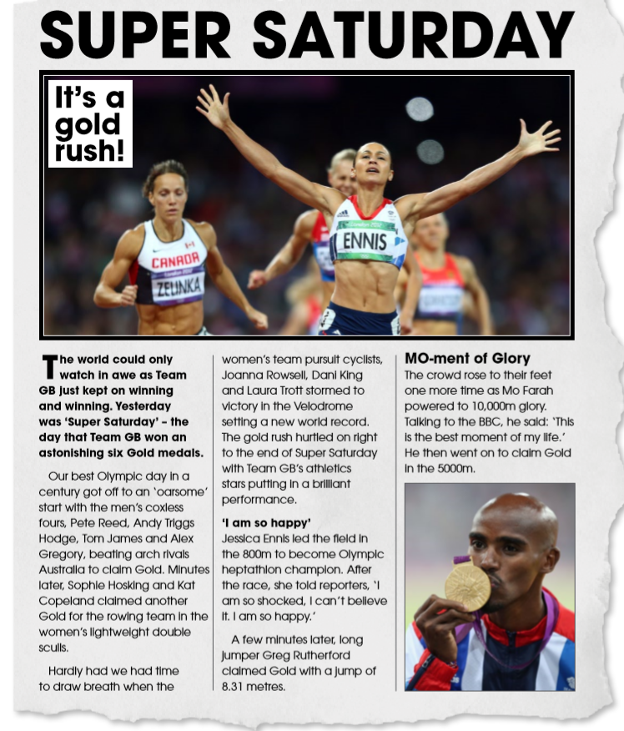
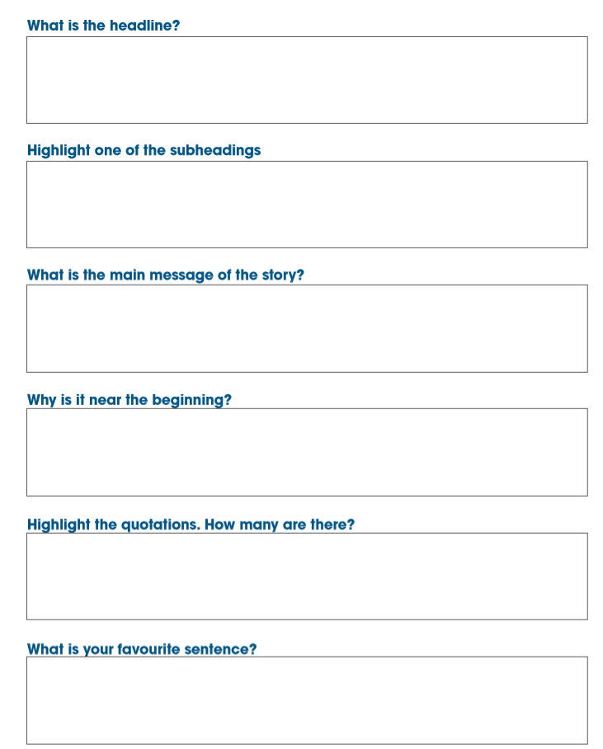
Task 13 – Part 1

Slide 11
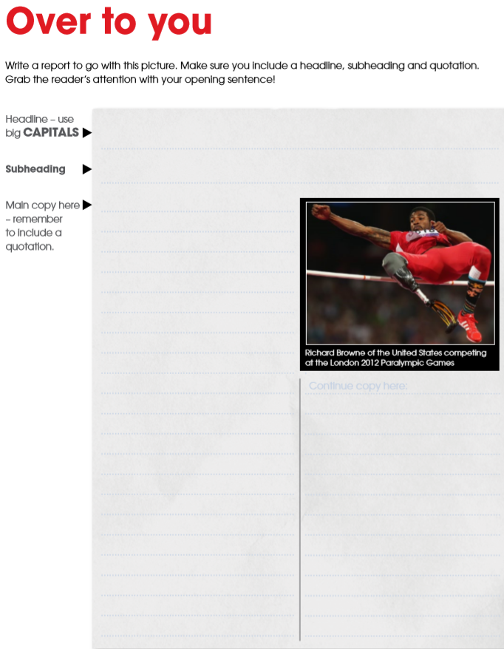

Slide 12
Task 13 – Part 2 - Consider the Emoji clues in the following slide and complete the table below with your answers.
Clue Number | Answer
1
2
3
4
5
6
7
8
9
10
11
12
13
14
15

Slide 13
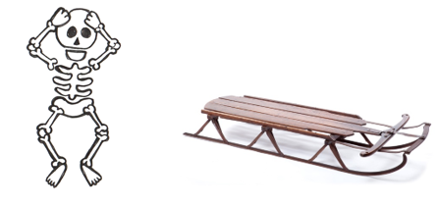
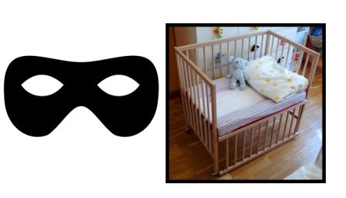
1 | 8
2 | 9
3 | 10
4 | 11
5 | 12
6 | 13
7 | 14

Slide 14
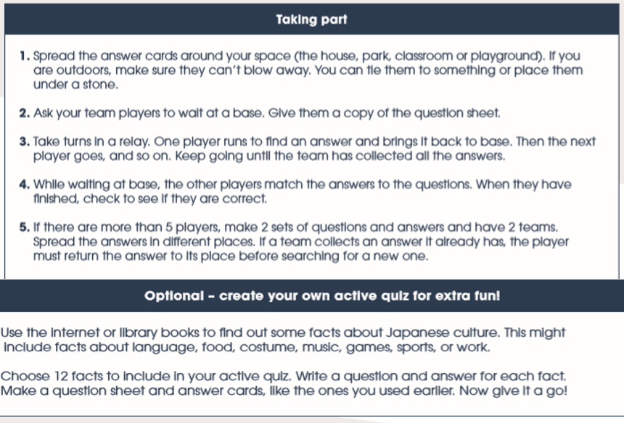
Task 14 - Active Quiz

Slide 15
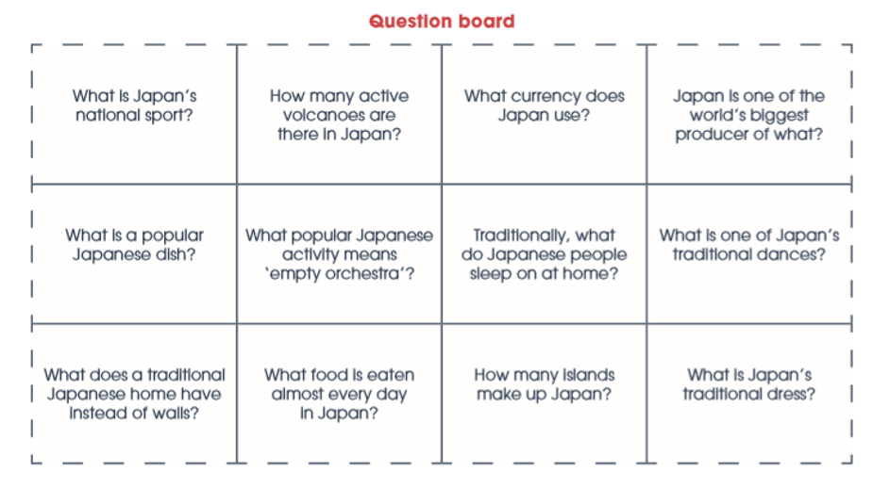

Slide 16
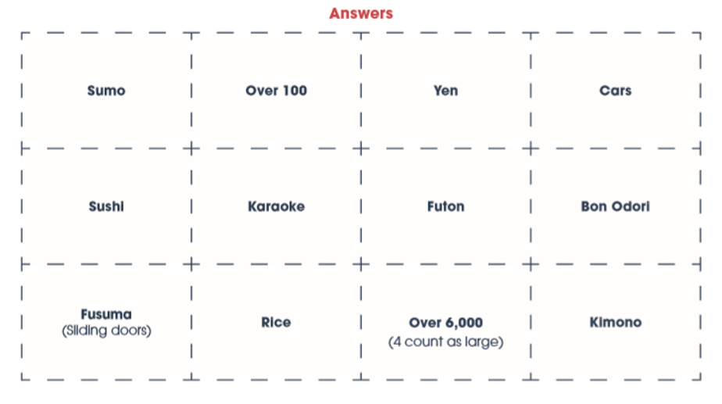

Slide 17
Task 15 – Travel to Tokyo
Can you clock up an hour of activity to contribute to our Get Set Tokyo score?
Let your team know what you are doing and remember to log it on the website posted on teams.
If you need a reminder how to access the website, check back to slide 7 for some help.

Slide 18
Tuesday 16th
June

Slide 19
Task 16
P1 – P3 You should complete the Super Friend
P4 – P7 You should complete the determination bookmark task

Slide 20
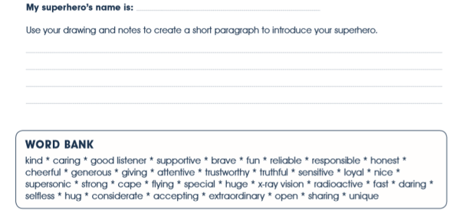

Slide 23
Task 17
P1 – P3 You should complete the Olympic and Paralympic Values task
P4 – P7 You should complete the Business Challenge

Slide 26
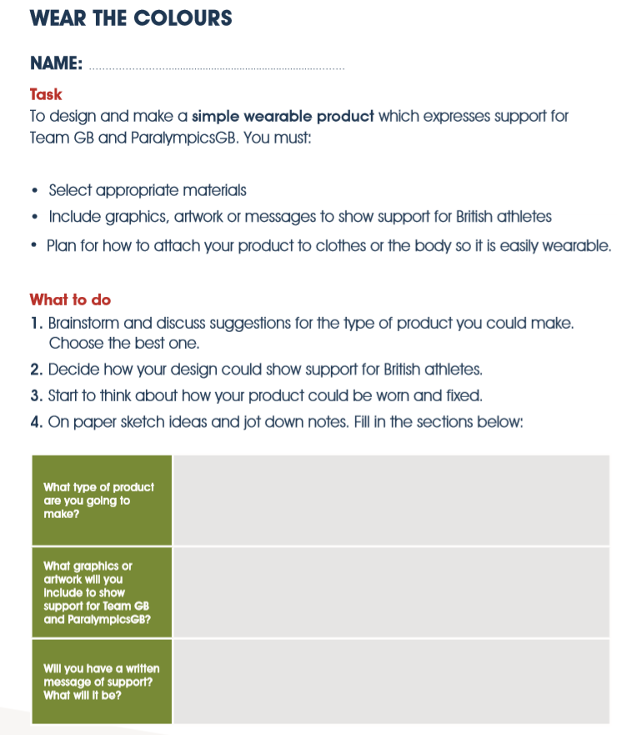

Slide 27
Wednesday 17th June

Slide 29
For 24 hours... it's World Record Day! I have hand selected a variety of different world records we can attempt at home. Not only will you be trying to beat the WR, your teachers will be taking part and posting their scores too and we will crown a St Columba's Primary Record Holder. If you would like Tweet @Tennant_PE and @St Columbas2016 with your attempts too.
First up, watch the World Record Day Intro and Quiz PowerPoint
Have a go at the world record challenges! Remember determination is key and don't give up if you find it difficult, we learn most when we keep trying!
Complete the wordsearches
Try the mindfulness challenge

Slide 31
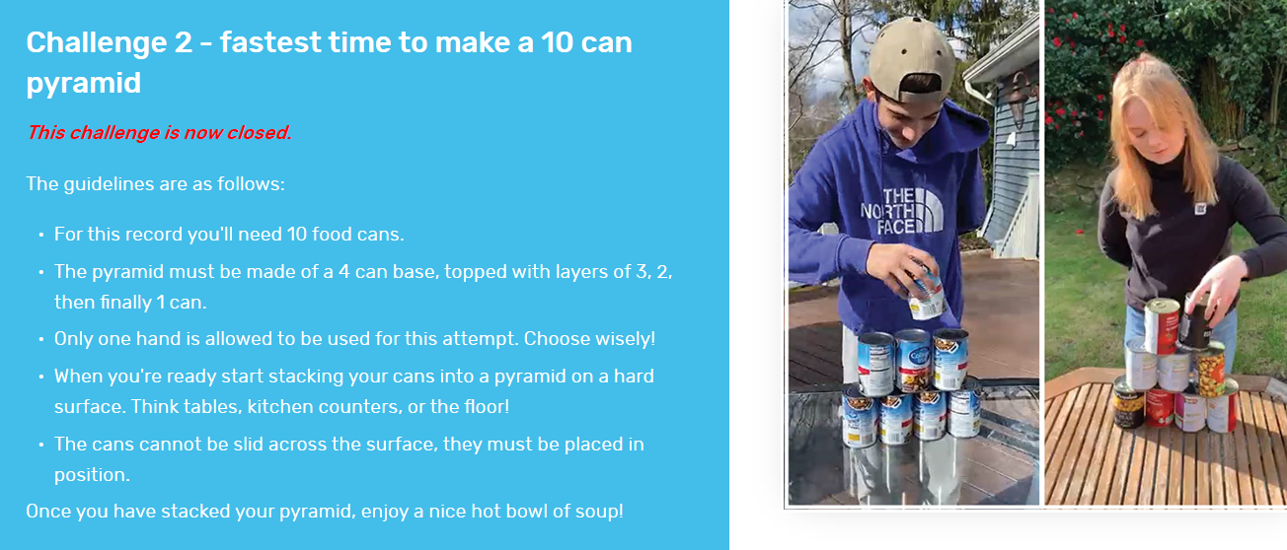

Slide 36
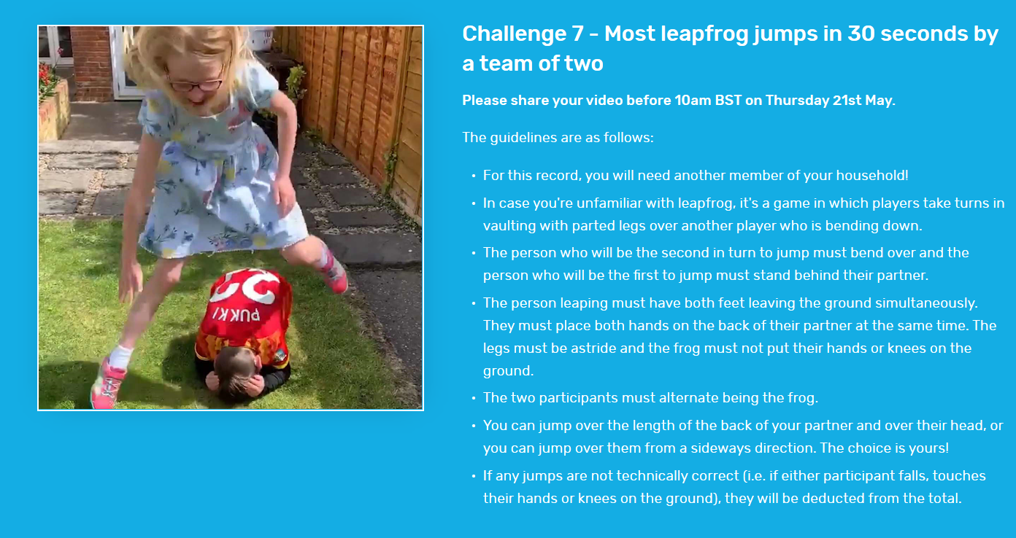

Slide 37
Using the table below, please record your scores and upload a screenshot of this slide with your scores to your teams page. Will you be a St Columba’s World Record holder by the end of Fitness Fortnight?
Challenge | Your Score
1
2
3
4
5
6
7

Slide 39
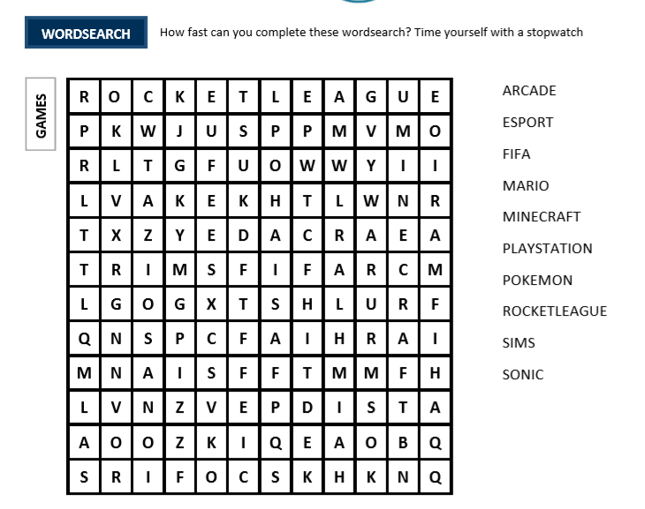

Slide 40
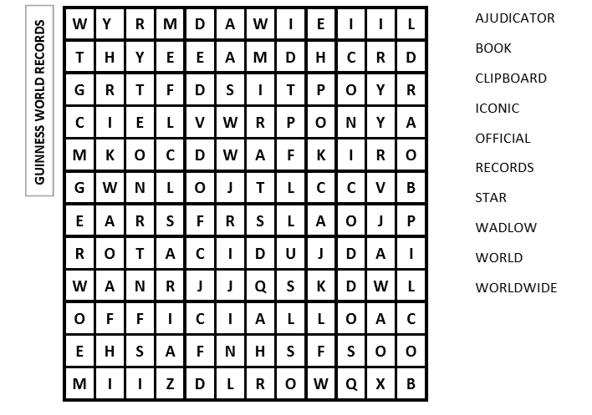

Slide 41
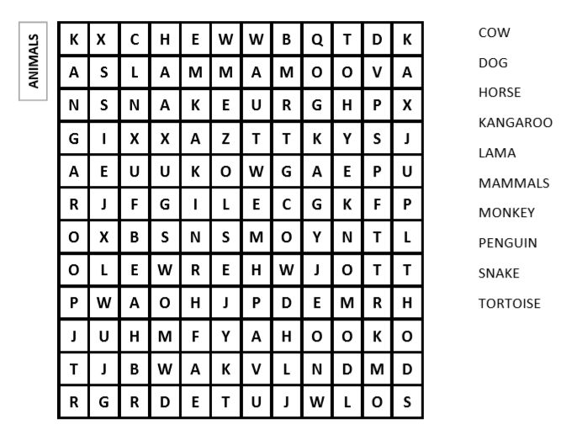

Slide 43
Instead of… | Try…
I can’t do it.
I’ll never be able to learn it.
I take too long to learn new things.
I’ll never be as good as other people.
This work is good enough.
It’s too hard.
I’m not clever enough.
My friends are all better than me.
I made a mistake.
I can’t make this work any better

Slide 44
Please remember…
We are into the final days of Fitness Fortnight, in addition to today’s challenges you can do the following things:
Look to finish off your grid with more choices of activities
Upload any activity yet to be put on Travel to Tokyo
Choose a way to display pictures of what fun you have been up to in the last 2 weeks and share it with your class teacher and I.

Slide 45
Thursday 18th June

Slide 46
Welcome to Sports Day 2020 please check out the PowerPoint and video posted on the PE team for instructions.

Slide 47
Friday 19th June

Slide 48
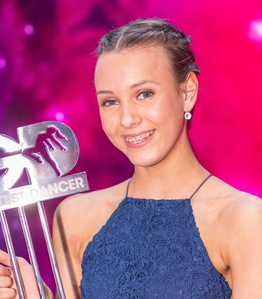
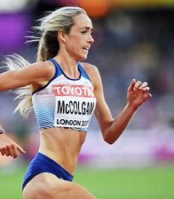
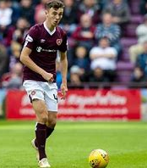
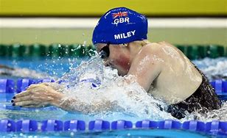
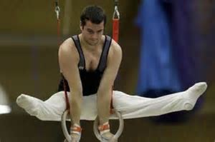
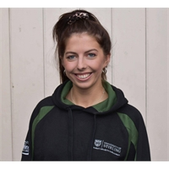
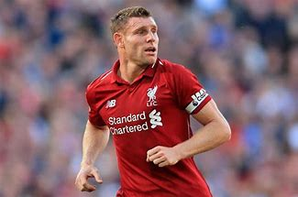
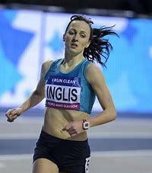
Task 19 -10 Famous Daily Challenges
As part of the @WLPENetwork, Mr Tennant has been setting daily challenges sent in from famous faces across Scotland.
Today’s challenge is for you to compete in as many of these challenges as you can to get a high score within your class, all videos have been posted on the blog and St Columba’s PE team this morning ☺
Once you have competed all challenges, can you tweet @WLPENetwork with your very own challenge?

Slide 49
What an absolutely fantastic effort we have had from all pupils during Fitness Fortnight.
I cannot be prouder of how you have each risen to the challenge and took part in PE based learning across the curriculum.
Please continue to follow our @WLPENetwork on Twitter and check teams daily for Daily PE Challenges.
Well done!

