Slide 1
St Columba’s Primary School
Fitness Fortnight
9th June – 19th June 2020
Week 1

Slide 2
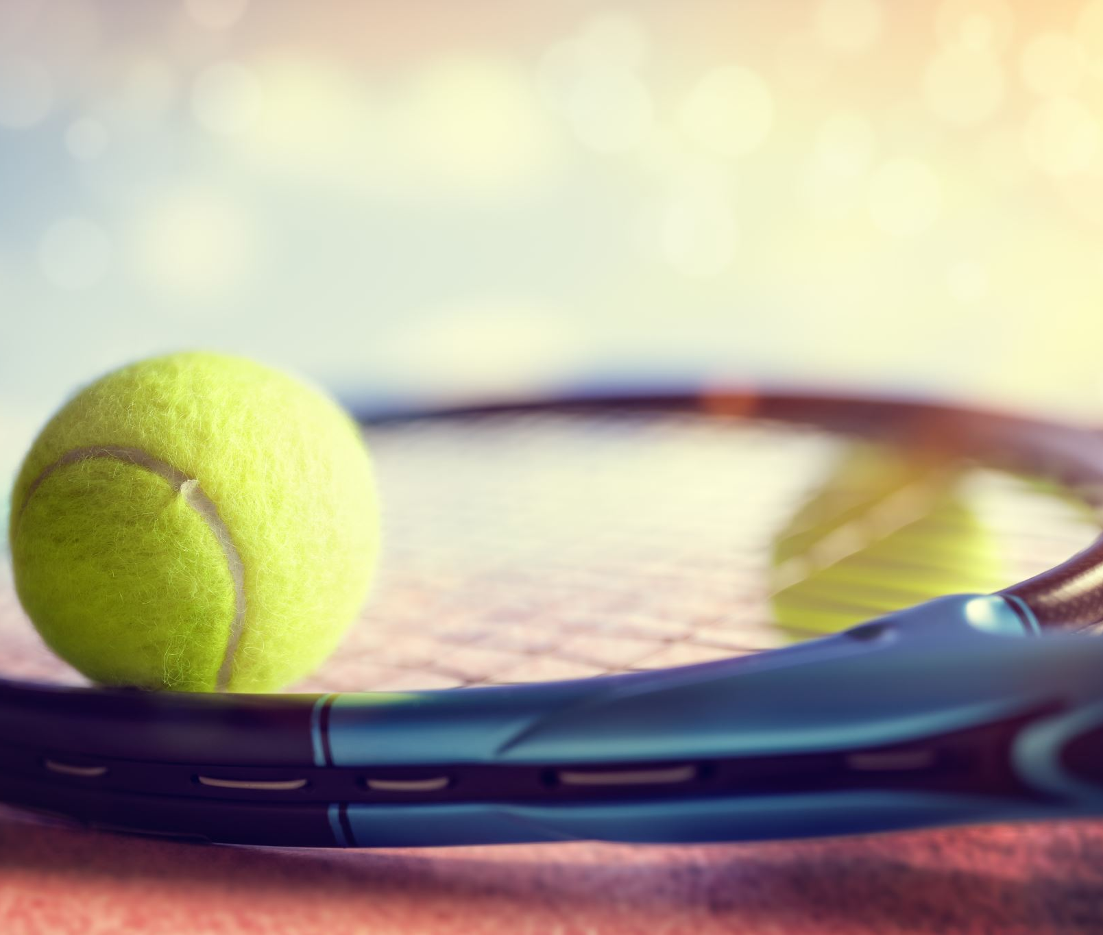
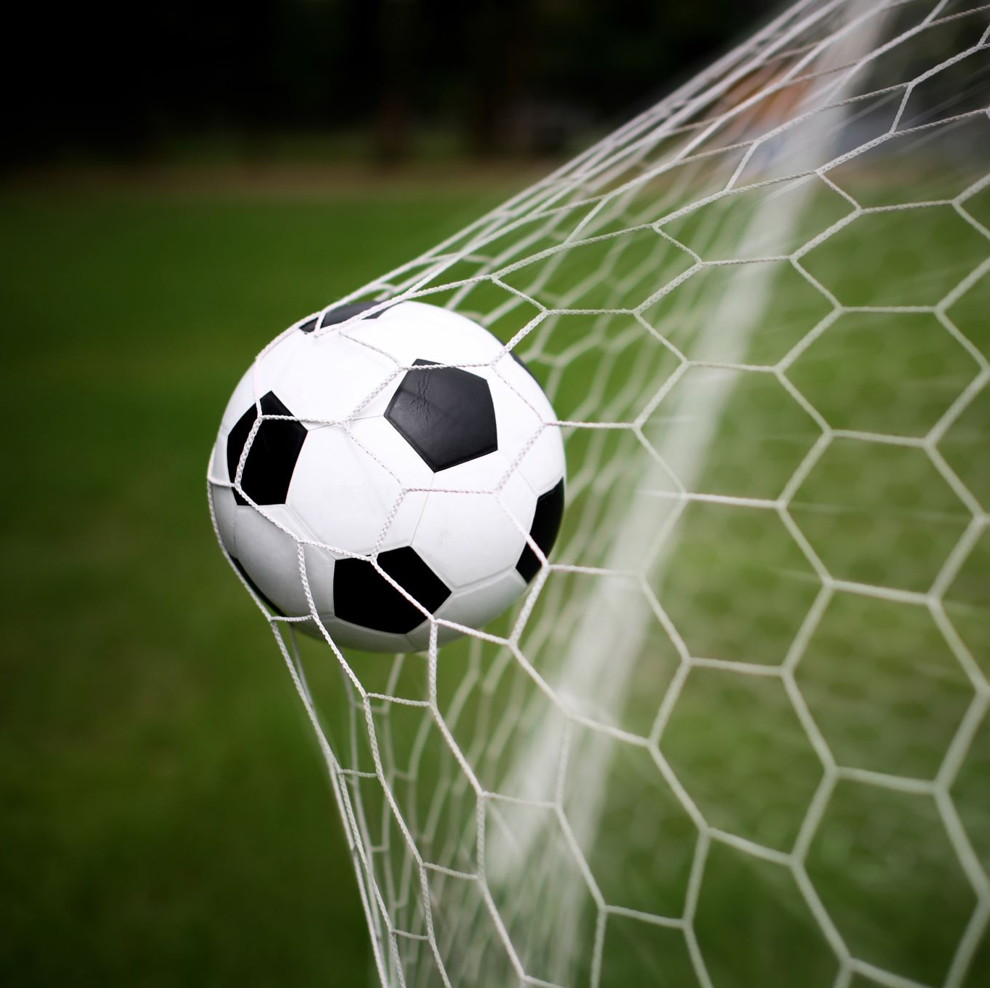
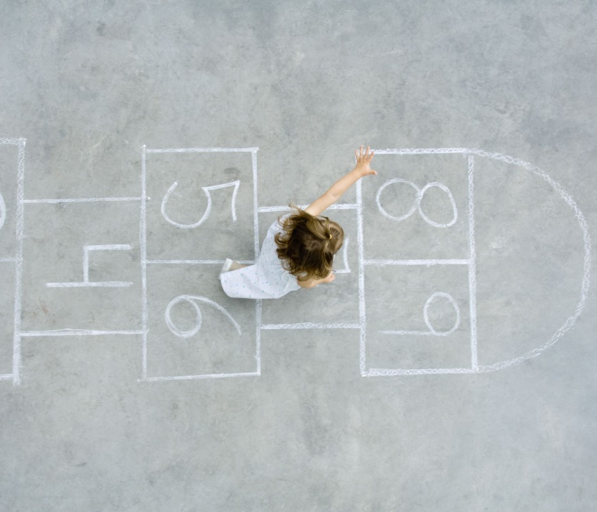
Fitness Fortnight Schedule
This PowerPoint contains a day by day program for pupils and parent/carers to use over the next fortnight.
All lesson instructions and most resources can be found on here. You can print off any pages or worksheets if you wish but you can record your tasks in whatever way works for you.
The first 2 slides will highlight key tasks which will run for the duration of Fitness Fortnight.
If you have any questions, please firstly directly them to your class teacher who will help where required.
We would love to see what you get up to over the 2 weeks so please share with us on the Fitness Fortnight blog posts, with your class teachers and on Twitter @Tennant_PE and @StColumbas2016.

Slide 3
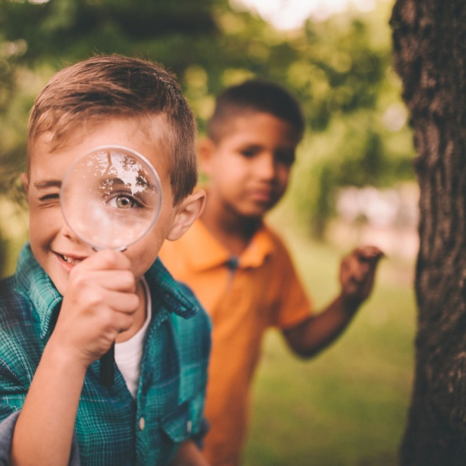
Fitness Fortnight Grid
Pupils are being challenged to complete 1 main Health and Wellbeing activity each day in addition to the tasks detailed on this PowerPoint. The next 2 slides contain a record sheet (which can be printed if possible or recorded in another way) and a list of suggested tasks.
On 19th June you are invited to upload your record sheet by replying to the Fitness Fortnight post on the PE Team. Please only use initials in the name box, no full names should be posted.

Slide 4
Name: |  | Class: |  | House:
 | HOLIDAY | 9th June | 10th June | 11th June | 12th June
Put what you have completed in here.
 | 13th June | 14th June | 15th June | 16th June | 17th June

Slide 5
Fitness Fortnight Activity Grid Please make sure you are being careful when completing any of these activities and that you are supervised by an adult.
SMOOTHIE MAKER Can you make up your own smoothie and share with your family as a healthy start to the day? What ingredients will you put in? | STAMINA Can you cycle, walk, jog, run or scoot for; P1 – 3: 15 minutes without stopping? P4 – 5: 20 minutes P6 – 7: 25+ minutes How far did you go? Who completed it with you? | ASSAULT COURSE Can you design your own assault course? What different things will you include? How long did it take you to complete? Who else can you get to complete it? | VIDEO MAKER Can you create your own; Just Dance Joe Wicks Cosmic Kids What actions will you put in? Would you like to share it with us?
DANCE Can you play a game of musical statues with others in your house? Who stayed still the best? | MINDFULNESS Complete a Cosmic Kids yoga session, here’s some to choose from; FROZEN: https://youtu.be/xlg052EKMtk TROLLS: https://youtu.be/U9Q6FKF12Qs TWILIGHT THE UNICORN OF DREAMS: https://youtu.be/RLOOOjGAM1s | BE THE TEACHER What is your skill? Can you teach someone in your family/house your skill? For example; Sporting skill, karate, dance move, Yoga pose | NATURE WALK Can you take a walk with your family and play eye spy? How many different things did you spy along the way? How many animals? Plants? Water ways?
SPELLING FITNESS CHALLENGE Spell your full name and complete the challenges; A – 10 Jumping Jacks N – 4 Lunges B – 30 Second plank O – 3 Burpees C – Crab walk 5 metres P – 10 second Rocket jumps D – 10 press ups Q – Run on the spot 1 min E – 10 sit ups R – 7 Jumping Jacks F – 5 Cartwheels/egg rolls S – 4 leg kicks G – Headstand/Balance T – 5 sit ups H – 4 rolls of your choice (be careful) U – 15 second plank I – 10 Toe touches V – 3 cartwheels/egg rolls J – 5 tuck jumps W – Arabesque/Starship balance K – 5 press ups X – 2 rolls of your choice (be careful) L – 3 spins Y – 5 lunges M – 10 leg kicks Z – 8 Jumping Jacks |  | SPORTS DAY BANNER: Can you design your own Sports Day Banner. Make sure you include; Your House team Your name Colours St Columba's Primary School Date Be creative – how will you show off your banner? | DAILY CHALLENGES Go to our Daily PE Challenges on Twitter @WLPENetwork How many challenges can you do? What did you score? Tweet us @Tennant_PE and @StColumbas2016 with your best efforts. Can you challenge someone in your house to complete them too?
SPORTS LEADERS What activities can you think of? Can you make up an activity or a game to share with other boys and girls?

Slide 6
Get Set Tokyo
We have been invited to Travel to Tokyo along with Team GB and ParalympicsGB's and we need you!!
We have turned the school into a Travel to Tokyo team , all you need to do is get active as a family and record your activity on our easy-to use Log Activity page.
All the physical activity your family does will count towards the journey to Tokyo.
You don’t need lots of equipment or space –playing in the garden or having a dance off to your favourite song –if it gets your heart pumping, it all counts!
There will also be great prizes to win each week, like fitness trackers, and Games hampers for the whole family. You can keep track of our Team's progress and check out the weekly prize on our School Dashboard.
Please send us photos and videos of you and your family getting active, so we can share how we’re doing! @StColumbas2016 @Tennant_PE #TTTYourWay
For a rundown how to access and use the website please watch the video on the next slide.

Slide 8
P1-P3, start every morning with your choice of tasks from the table below ☺
Joe Wicks Daily PE Workout https://www.youtube.com/playlist?list=PLyCLoPd4VxBvQafyve889qVcPxYEjdSTl | Cosmic Kids Yoga https://www.youtube.com/user/CosmicKidsYoga | Just Dance https://www.youtube.com/channel/UChIjW4BWKLqpojTrS_tX0mg | Kidz Bop https://www.youtube.com/user/KidzBopKids/videos | Oti Mabuse & Marius Lepure Online Dance Class https://www.youtube.com/user/mosetsanagape/videos
Mindfulness on Go Noodle https://app.gonoodle.com/channels/flow | Super Movers https://www.bbc.co.uk/teach/supermovers | Jumpstart Jonny https://www.jumpstartjonny.co.uk/home | Zumba Kids on Go Noodle https://app.gonoodle.com/channels/zumba-kids | Dance with Maximo on Go Noodle https://app.gonoodle.com/channels/maximo

Slide 9
Tuesday 9th June

Slide 10
Task 1
Watch my video posted this morning on the blog and take some time with an adult to explore the Get Set Tokyo website below.
https://www.getset.co.uk/travel-tokyo/log-activity
You will need our postcode to log your activity, our postcode is EH48 1NQ.
Try adding your first piece of activity before you move on to Task 2.

Slide 11
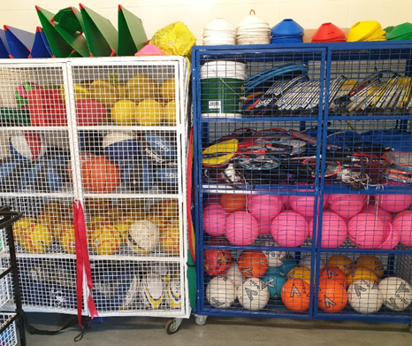
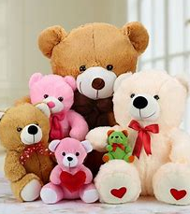
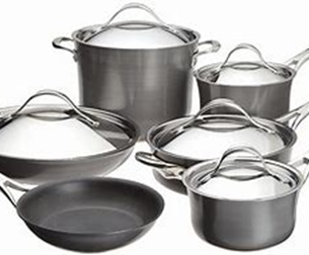
Task 2 – No equipment, no problem!
Being at home without PE equipment can make the challenges I set you difficult. So for this task, look on the next slide to find a list of traditional PE kit.
I would like you to search for and list alternatives to the equipment that you can find around the house.
Be creative with your ideas and think things from all over your house!
When you have a completed list, take a picture of your equipment and upload your completed sheet by replying to the Fitness Fortnight blog post or sending your work to your class teachers in the usual ways.

Slide 12
PE Equipment | Home Equipment | PE Equipment | Home Equipment | PE Equipment | Home Equipment
Football |  | Hula Hoop |  | Goals
Tennis Racket |  | Hockey Stick |  | Sack for racing
Basketball |  | Targets |  | Finish line
Cones |  | Beanbags |  | Baton
Hurdles |  | Parachute |  | Javelin
Shuttlecock |  | Bowling Pins |  | Team bibs
Skipping Rope |  | Bench |  | Scoreboard

Slide 13
Task 3 – Design a mascot
With the Tokyo Olympics and Paralympics postponed for now, you have been given chance to design a new mascot for Team GB at the Paralympics when they are held.
Please watch the PowerPoint attached and/or download the PDF “Task 3” from the blog post and follow the instructions.
There is the option for you to submit your mascot to TeamGB and potentially end up with your design in the athlete’s village in Tokyo!
Please follow the instructions at the bottom of the PDF resource attached to submit your entry to Team GB and share with us your designs via the blog/app and teams too.

Slide 14
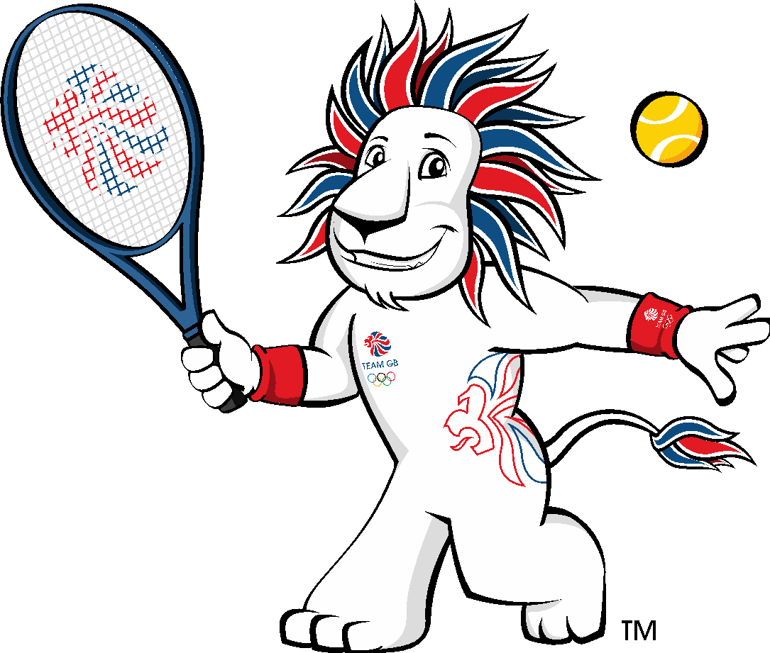
THE MASCOT CHALLENGE
Design a mascot for ParalympicsGB and their supporters

Slide 15
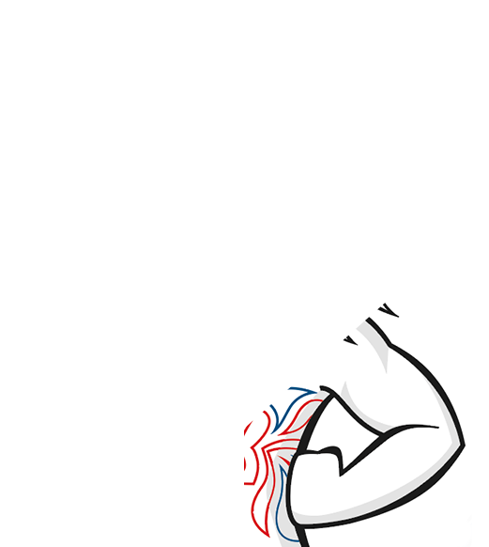
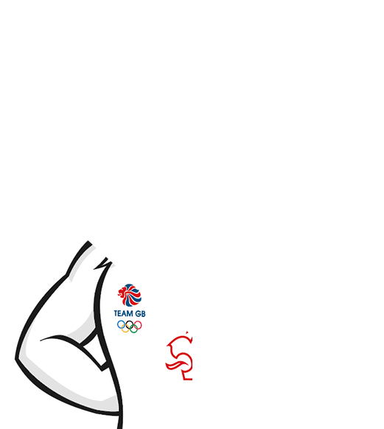
What’s in the picture?
Click to reveal the picture and answer!
Pride, Team GB’s mascot
Notes:
What’s in the picture?
Guess what’s in guess the picture, clicking to reveal square by square. As soon as you think you have the answer, jump up!

Slide 16
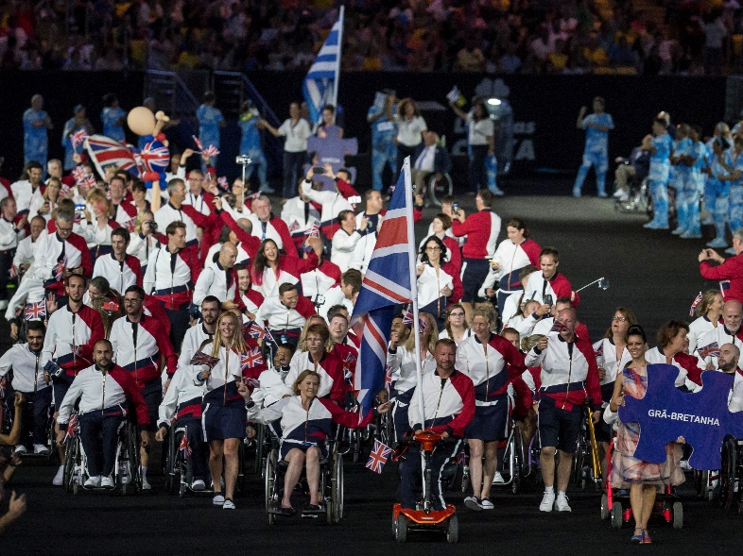
Design a mascot
Team GB has a mascot, but ParalympicsGB do not. Can you design a mascot for ParalympicsGB?
Notes:
Set the challenge
Can you design a mascot for ParalympicsGB?

Slide 17
Who are ParalympicsGB?
Watch the video.
What different sports can you see?
How do you feel watching the video?
What words do you think describe ParalympicsGB?
Notes:
Watch the video
Watch the video and think about:
What sports do you see?
How do you feel watching the video?
What words do you think describe ParalympicsGB?
ParalympicsGB is made up of elite athletes selected to represent Great Britain and Northern Ireland at Paralympic Summer and Winter Games. They are amazing athletes who thrill us with their extraordinary performances. They have often overcome immense hurdles to represent their country and ParalympicsGB. They will be seen in action at the Tokyo 2020 Paralympic Games.

Slide 18
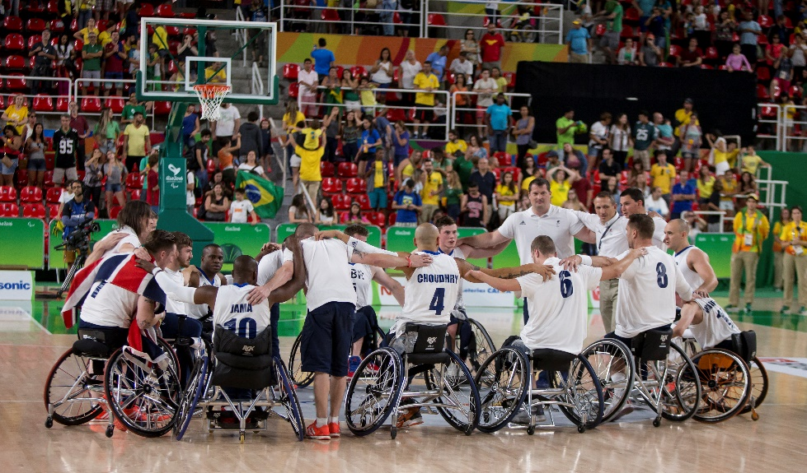
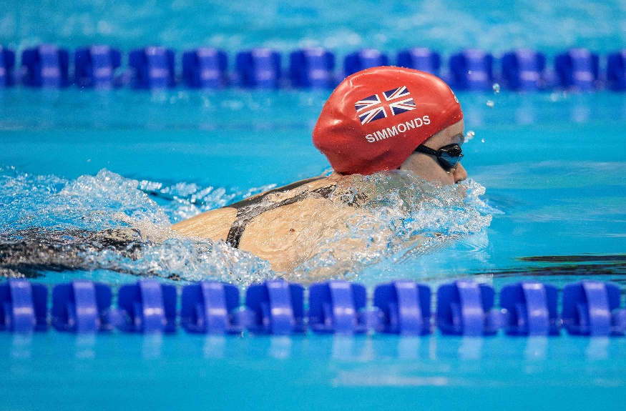
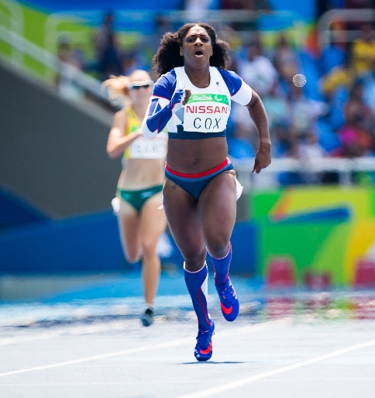
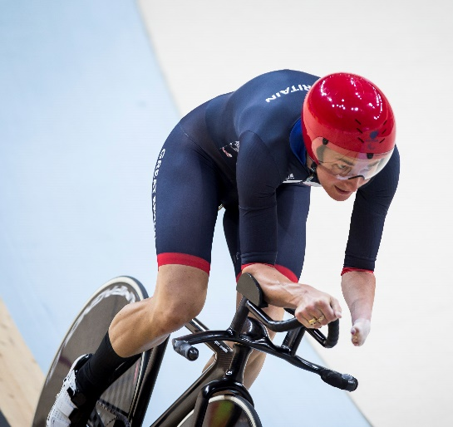
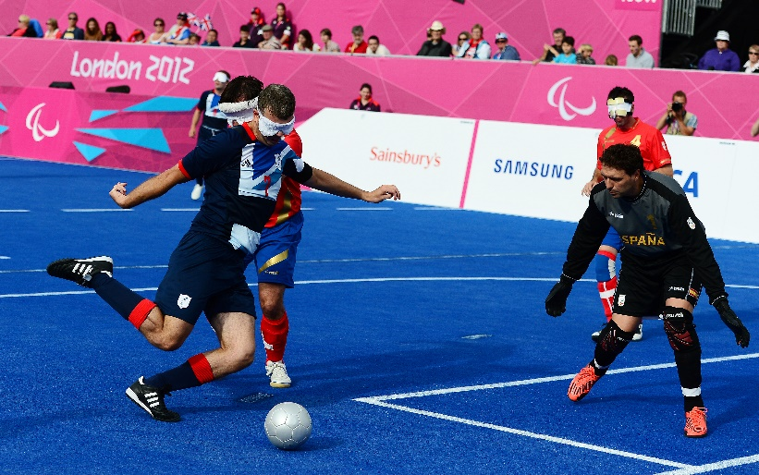
Who are ParalympicsGB?
ParalympicsGB is made up of a range of athletes with different physical impairments, who compete in a wide range of different sports, in different sports classes.
Notes:
Who are ParalympicsGB?
Think about the range of different sports and athletes you saw in the film. ParalympicsGB is made up of a range of athletes with different impairments, who compete in a wide range of different sports.
Support: Paralympic athletes have a range of physical impairments, such as lower and upper limb amputations, poor muscle control leading to loss of leg/arm and/or body control, difficulties walking and balancing, and vision impairments.

Slide 19
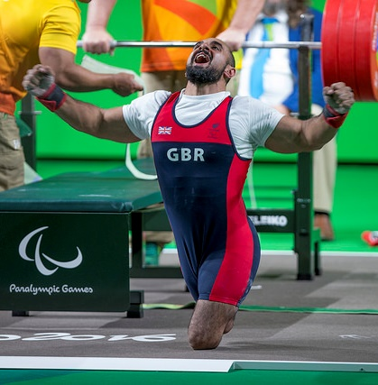
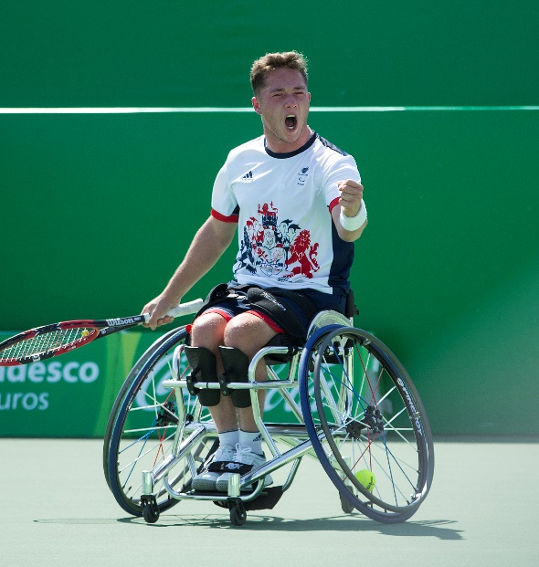
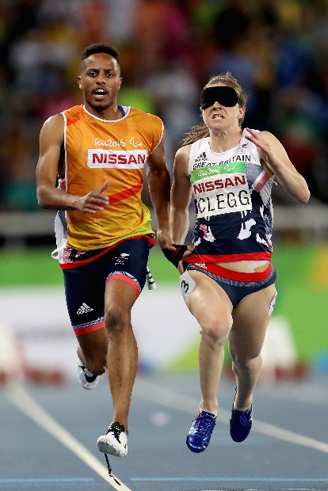
What are sport classes?
Athletes from ParalympicsGB, like all Paralympians, compete in sport classes.
Sports classes are set according to what kind of impairment an athlete has (for instance, prosthetic limb user, difficulty walking, short stature, or a visual impairment) and how much the impairment affects performance in their sport.
Dividing Paralympic Sport into sports classes makes sure competition is fair. It means athletes whose impairment has a similar effect on sports performance compete against each other, and that the best performing athlete wins on the day.
Notes:
What are sports classes?
Read about Paralympic sports classes, finding out how they allow athletes with different impairments to compete fairly.
In Paralympic Sport, athletes compete in sport classes based on the type and degree of their impairment and how much it affects their ability to carry out all the skills and movements required for the different Paralympic events.
Paralympic Sport has ten eligible impairment types. These are: impaired muscle power, impaired passive range of movement, limb deficiency (e.g. upper or lower limb amputees), leg length difference, short stature, hypertonia (abnormal muscle tension, and reduced ability to stretch), ataxia (lack of coordination of muscles), athetosis (generally characterised by unbalanced, involuntary movements and a difficulty in maintaining a symmetrical posture, due to a neurological condition, such as cerebral palsy, brain injury or multiple sclerosis), vision impairment, and intellectual impairment.
Each sport has its own rules for determining which athletes compete together. Some sports only permit specific groups of athletes to compete. For example, the Paralympic Sports of Goalball and Football 5-a-side are played by those with a vision impairment and Boccia is a competitive game for those with impairments that affect motor skill and coordination.
Further information about sport classes can be found at: https://www.Paralympic.Org/classification

Slide 20
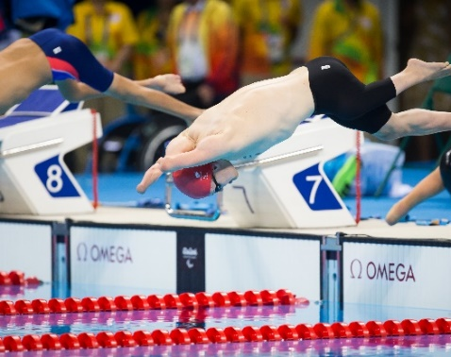
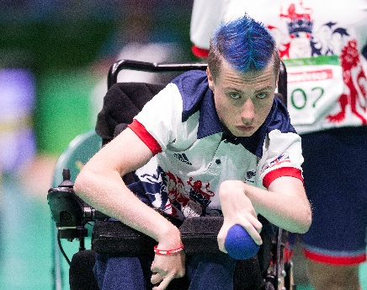
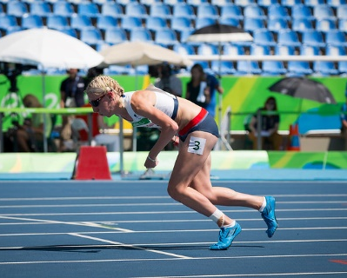
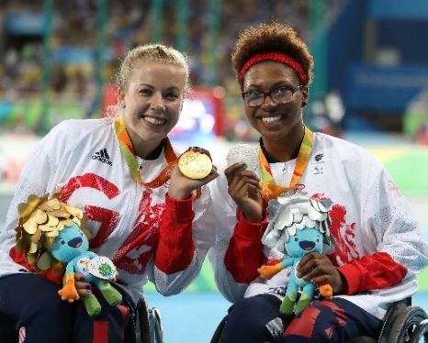
GET
ACTIVE
The athletes of ParalympicsGB demonstrate the Paralympic Values in their sporting and daily lives.
What are the Paralympic Values?
What do ParalympicsGB represent?
Click to reveal the answer!
Courage
Equality
Determination
Inspiration
Which Value do you think is the most important for you? How about for a Paralympian?
Notes:
Discuss the Paralympic Values
Which Value do you think is most important for you or for a Paralympian? Did you pick the same Value, or different Values? Why did you pick each Value?
Support: Look up any words you do not understand in a dictionary. Use the following slide to see examples of different animals/objects/expressions that might show these qualities.

Slide 21
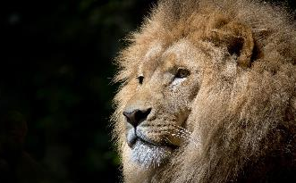
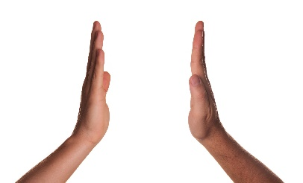
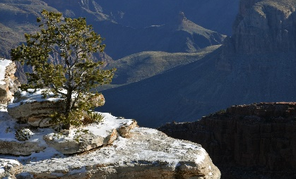
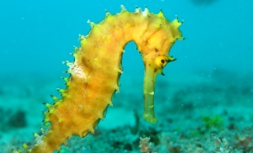
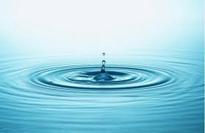
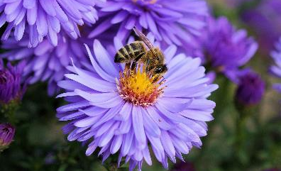
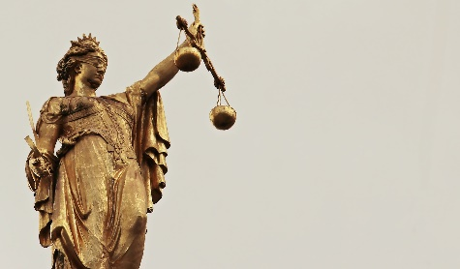
What Paralympic Value could these pictures represent? Think and choose a Value for each.
What could represent the Paralympic Values?
Equality
Determination
Courage
Inspiration
Once you’ve matched the pictures, ask another member of your household to pick a word for each picture. Did you choose the same words for each image?
Notes:
What could represent the Values?
What Value might each picture represent? Explain your answer. (Don’t worry – there is no right or wrong answer!)
Think: How could you design a mascot that portrays one or more of these great values?

Slide 22
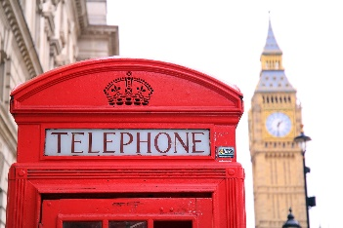
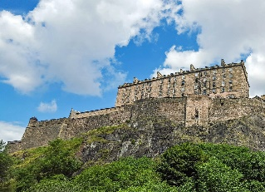
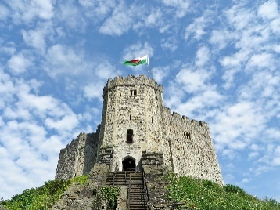
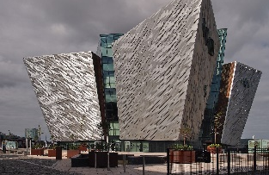
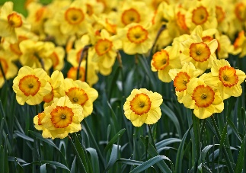
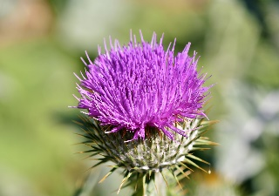
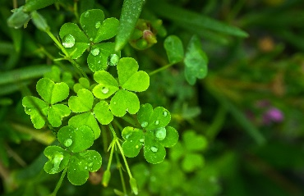
ParalympicsGB represents Great Britain and Northern Ireland.
Which countries does this include?
What represents the United Kingdom?
Click to reveal the answers!
Can you match the symbols and landmarks to the correct countries?
Wales
England
Scotland
Wales
Northern Ireland
England
Scotland
Northern Ireland
Notes:
What represents the UK?
ParalympicsGB is also a national team, it represents Great Britain and Northern Ireland. Can you match the symbol and famous landmark to the correct country?
Think: How will you portray your ParalympicsGB mascot representing Great Britain and Northern Ireland?

Slide 23
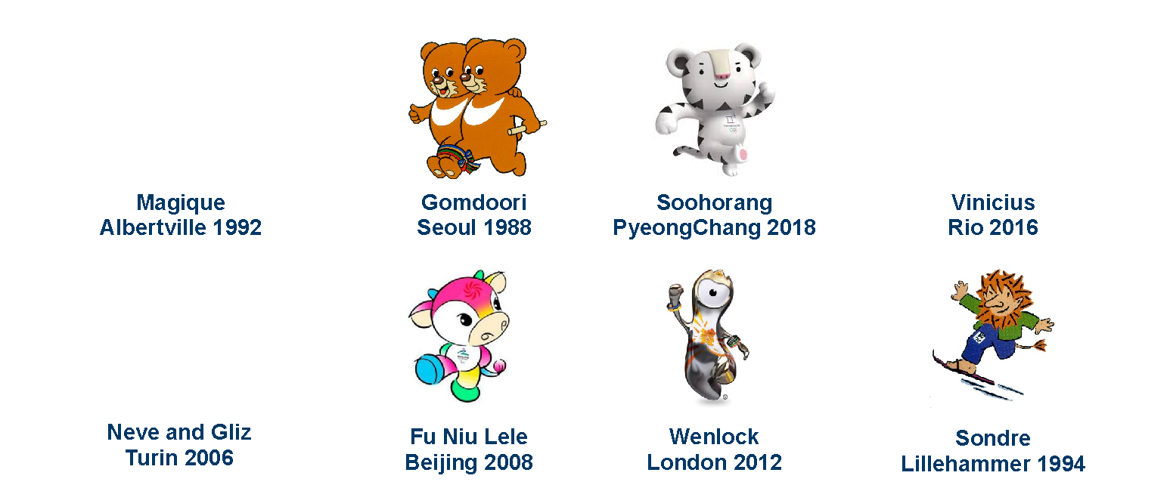
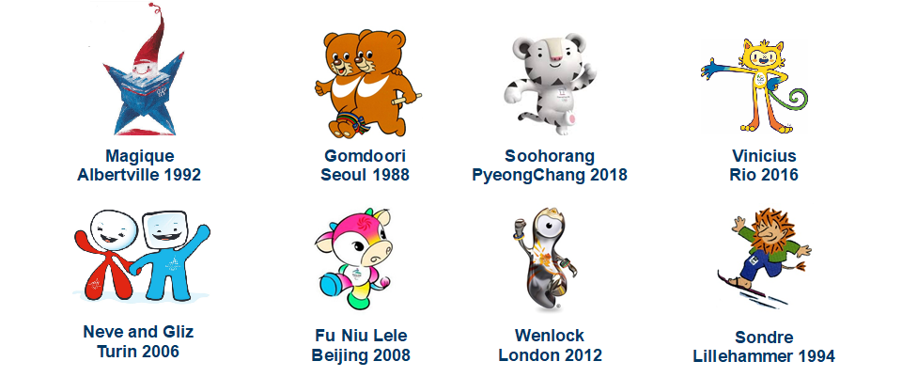
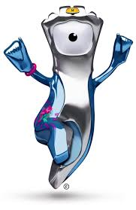
Look at these Olympic and Paralympic Mascots from past Games. What do you like about each mascot design?
What makes a good mascot? The design
Notes:
What makes a good mascot?
What do you like about each design? (Think about the colours, the shapes, the expressions, anything you know about their story.)
What would you change?
Which is/are your favourite mascot(s)?
About the mascots
Magique, Olympic Winter Games, Albertville 1992. The star stands for dreams and imagination and uses the French flag colours.
Gomdoori, Paralympic Summer Games, Seoul 1988. ‘Gomdoori’, which means ‘teddy bear’ in Korean, are two Asian black bears, each representing wisdom and courage. They are running a three-legged race with legs tied together, symbolizing the power of cooperation, of mutual encouragement, and of the ability to create peace and harmony together.
Soohorang, Olympic Winter Games, PyeongChang 2018. In Korean folklore, the white tiger was viewed as a guardian that helped protect the country and its people. ‘Shooho’ means ‘protection’, the tiger helping to ‘protect’ the athletes and visitors at the games, and ‘Rang’ is from the Korean word ‘ho-rang-I’ which means ‘tiger’.
Vinicius, Olympic Summer Games, Rio 2016. Vinicius is made up of different Brazilian animals: the bird, the cat and the monkey, and the name was chosen in honour of the famous Brazilian musician, Vinicius de Moraes. He can stretch his arms and legs as much as he wants. This allows him to jump higher, run faster, and become stronger.
Neve and Gliz, Olympic Winter Games, Turin 2006. ‘Neve’ is the Italian for snow; her fluid, red design embodies elegance of motion and harmony. Gliz is derived from ‘ghiaccio’, meaning ice. He's all compact and blue, as powerful as any Olympic athlete.
Fu Niu Lele, Paralympic Summer Games, Beijing 2008. The cow mascot features colours used in traditional Chinese New Year’s paintings and gifts. The name relates to characters meaning luck and happiness.
Mandeville, Paralympic Summer Games, London 2012. Mandeville, the Paralympic mascot, was named after the Stoke Mandeville Hospital in Buckinghamshire, the birthplace of the Stoke Mandeville Games, the predecessor of today’s Paralympic Games. The three spikes on its helmet symbolise the three Agitos of the Paralympic logo.
Sondre, Paralympic Winter Games, Lillehammer 1994. Sondre is a friendly troll, a creation with origins in Norse mythology. His impairment is a lower leg amputation.

Slide 24
Pride
Team GB mascot
What makes a good mascot? Personality and story
How can you make your character:
fun-loving, playful
friendly-faced and welcoming
appeal to younger children
represent and spread the message and Values of ParalympicsGB?
Notes:
What makes a good mascot? Personality!
Think about your mascot’s personality. You need to bring life to your character and make sure it appeals to younger children as well as the athletes and spectators.

Slide 25
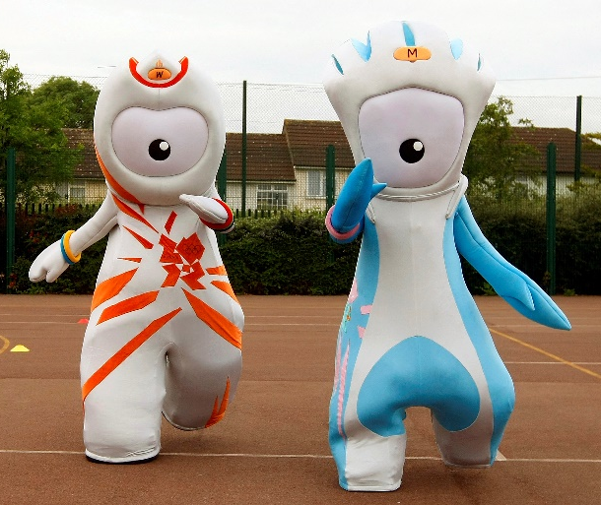
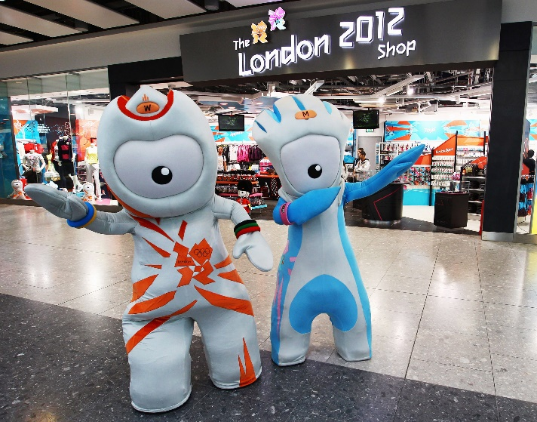
What makes a good mascot? Movement and mime
Remember. Mascots can’t speak. Think carefully about:
facial expressions
mannerisms
gesture
colour
pose
Wenlock and Mandeville
London 2012 mascots
Notes:
How do mascots move?
How can/should a mascot designer consider movement in their design?

Slide 26
The design brief
Your challenge is to design a mascot for ParalympicsGB.
Your mascot could be anything – an animal, an object, or something completely imaginary! Whatever it is, it should celebrate ParalympicsGB and encourage everyone to get behind the team.
Your mascot should:
represent a physical or sensory impairment in some way
celebrate Paralympic athletes and the Paralympic Values
be suitable for use long term (so not Tokyo 2020* themed!)
have a great name!
Think about the colours for your mascot – could you use some of the colours from the ParalympicsGB logo?
*Although the Games will now be held in 2021, they will still be called Tokyo 2020!
Notes:
Read the design brief
Your mascot could be anything (an animal, an object, something more abstract like a flame, or something imaginary). Whatever you design, remember to think about how your mascot could:
represent a physical or sensory impairment (remember to look at slide 6–7 to think about different kinds of impairments)
celebrate the Paralympic Values (determination, inspiration, courage and equality)
be non-games specific (so not Tokyo or Japan themed) so ParalympicsGB could use it long term
have a great name!
Think about the colours of the ParalympicsGB logo – red, white and blue, representing the flag of Great Britain and Northern Ireland, and red, blue and green, the colours of the Agitos, the symbol of the Paralympic Games. How might you use these to colour their mascot?

Slide 27
Initial ideas
Think of four ideas in four minutes!
Fold a piece of paper into four parts and jot down/sketch four ideas – 1 minute for each idea.
What do you like about each design idea?
Notes:
Design your mascot – initial ideas
Start ideas flowing by folding a piece of paper into four parts and jot down/sketch four ideas – 1 minute for each idea.
Support: Find images or objects to help inspire your mascot, e.g. different animals and sporting objects (such as a medal, wheelchair or javelin), or focus on Pride’s red, white and blue hair and think about what other animals could look good with a similar hair style!
Challenge: Think about the audience for your mascot. The mascot should represent athletes, but also inspire young children and their families. What will help young children to get excited about ParalympicsGB?

Slide 28
Develop your design
Pick your favourite design idea to develop. (Or mix the ideas!)
Top tips
What character, animal or thing will you use to represent the Paralympic athletes?
Use pencil to sketch an outline of your mascot.
How will your mascot represent a physical or sensory impairment?
How about giving it a running blade, wheelchair, blindfold or similar?
Give your mascot a great expression.
Wide-eyed, smiley, grinning, happy, cheeky, spiked hair, coloured hair.
Show your mascot to others. What changes do they suggest you make?
Fill in the detail of your mascot.
What colours will you use to make it fun and appealing to younger children?
Remember: this must be your own work.
Notes:
Design your mascot – developing the design
Develop your design. Jot down, sketch or computer-generate ideas. Designs can be hand drawn, produced using computer-aided design or modelled in 3D (with a photograph of the model affixed to the design sheet).

Slide 29
Finalise your design
Use this checklist to make sure your mascot is the best it can be!
Have you given your mascot a great name?
Have you marked where will you put the ParalympicsGB logo?
Does your design represent an impairment?
Can your design be used in the long term, at both the Paralympic Summer and Winter Games?
How does your mascot show the Paralympic Values?
What’s the story behind your mascot?
Notes:
Finalise your design
Think about the names of past mascots, e.g. Pride (named after a pride of lions and the pride we should all feel in Team GB) or Mandeville (named after the Stoke Mandeville Hospital which organised the first Stoke Mandeville Games, considered to be the precursor to the Paralympic Games).
Please note: The ParalympicsGB logo should appear somewhere on the mascot. It is not necessary to draw the logo, although you can if you wish. Use a * to indicate its position. Think about how you can make sure the logo is visible most of the time – including when the mascot is active.

Slide 30
Have you finished your mascot idea? It’s time to complete your design sheet! Be careful, take your time. This is what the judges will see.
Are you ready?
Remember your mascot should:
represent a physical or sensory impairment in some way
celebrate Paralympic athletes and the Paralympic Values
be suitable for use long term (so not Tokyo 2020 themed!)
have a great name!

Slide 31
Once you’re happy with your mascot, how about making it?
Extension Mascot modelling
Art straws
Plasticine
Paper mâché
Junk materials
Knitted
Dough
Make a costume
Notes:
Optional
Making your model
If you want to go further you could bring your mascot to life by modelling them in 3D. A photograph of the model can be included in the design sheet. (Please do not send in 3D models as these will not be selected to take to Tokyo 2020 – only photographs affixed to a design sheet.)
Think about recycling! Make sure you don’t construct a junk model that you can’t take apart to recycle once you’ve finished with it!

Slide 32
The Mascot challenge
Thank you from
ParalympicsGB

Slide 33
Task 4 – Sports Day Project
Over the next few days, you have been tasked with planning your very own At Home Sports Day. But first it needs a name. You might want to include your family name, the name of a pet or the area you live. Be creative with your name.
You should now create a poster to promote your Sports Day. Think about what would make people stop and look at your poster. Could it include colour? Could it be a different shape? Could it include an eye-catching font?
You should choose whether to create your poster online and upload the file or use paper and upload a picture once complete.
Your poster must be informative and should therefore include the following information:
Name of your sports day
Location – consider inside/outside and the weather forecast
Start and finish time
Clothing required
Pictures of potential activities
A ‘tagline’ why your sports day is the one you must take part in
Good luck!

Slide 34
Wednesday 10th
June

Slide 35
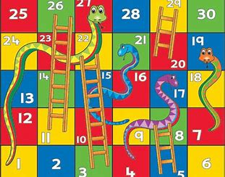
Task 5 – Fitness Board Game
Choose one of the Fitness games attached to the blog post and play it with someone in your house.
Once completed, use the "create a game" file to help design your own Fitness based game.
Once you have created your game, complete the template file to share with the rest of the class.

Slide 36
Task 6 – Part 1

Slide 37
Task 6 – Part 2

Slide 38
Task 7 – Sports Day Project(continued)
Continuing the planning for your Sports Day, you need to have a think about which activities you are going to run on the day for your participants to compete in. Consider the following points:
Is this activity safe to do in the location I have chosen?
Is there any obstacles that might stop a certain activity taking place in my location?
What equipment do I need for each activity?
How long will each activity last?
How many times will each activity be done?
How will I score each activity?
How will I keep score throughout my Sports Day?
Now using the table and spaces on the next slide, complete the following tasks:
Draw your sports day layout ensuring you number each station.
List the equipment you need for each station and gather it in one place to keep safe for your Sports Day.
Create a scorecard to keep track of the scoring for your Sports Day.

Slide 39
Station Number | Activity | Equipment Needed
1
2
3
4
5
6
7
8
9
10

Slide 40
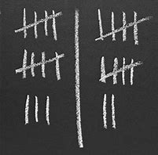
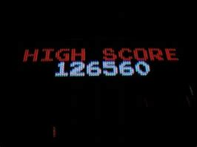
Station Number | How will you score points?

Slide 41
Thursday 11th June

Slide 42
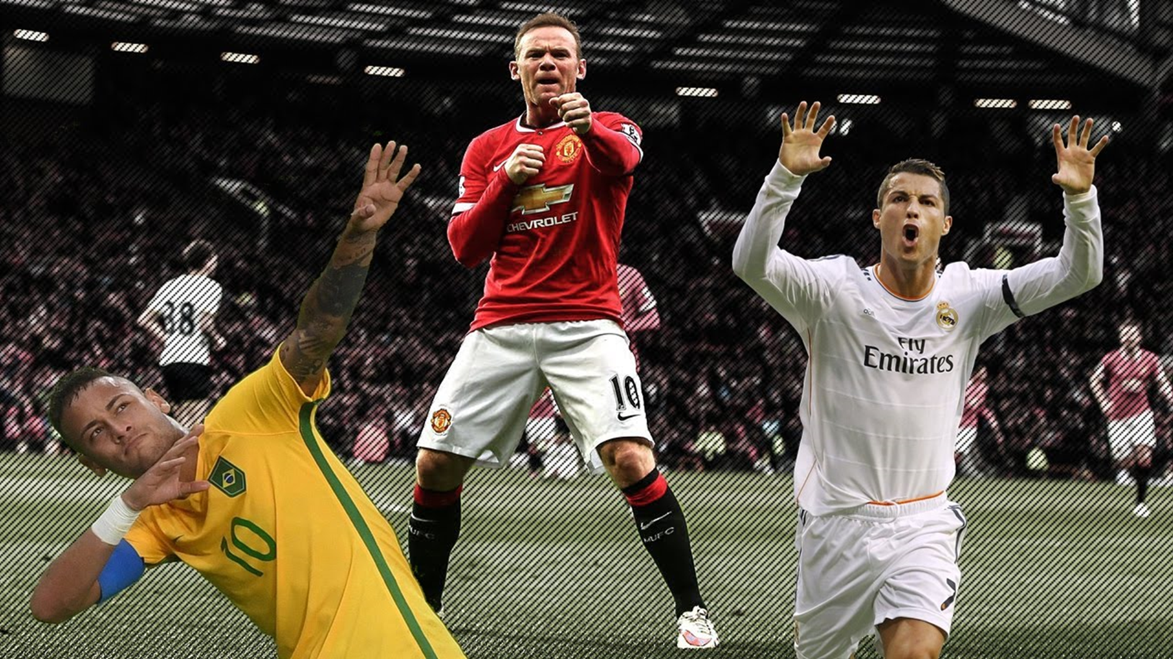
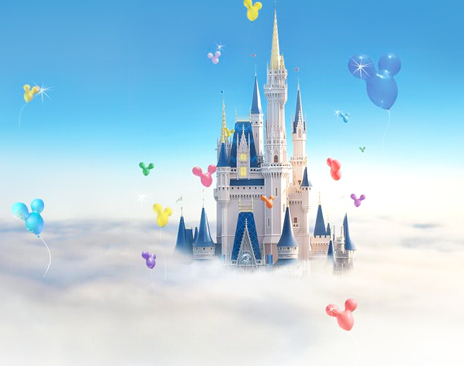
Task 8 – Disney or Football Workout
Today you have a choice for your workout, you can choose to take part in the Disney Workout or the Football Celebration Workout. You have been challenged to complete your chosen workout 2 times with a rest in-between.
If you feel super determined, you could try both!
Both workouts can be found attached to the Fitness Fortnight blog post.

Slide 43
Task 9 – Olympic Research
Follow the instructions on the next slides to conduct your own research on either a Paralympian of Team GB OR A former host city of the games. Then choose a way to present the information you have found (e.g. Sway, poster or a talk)

Slide 44
Option 1

Slide 49
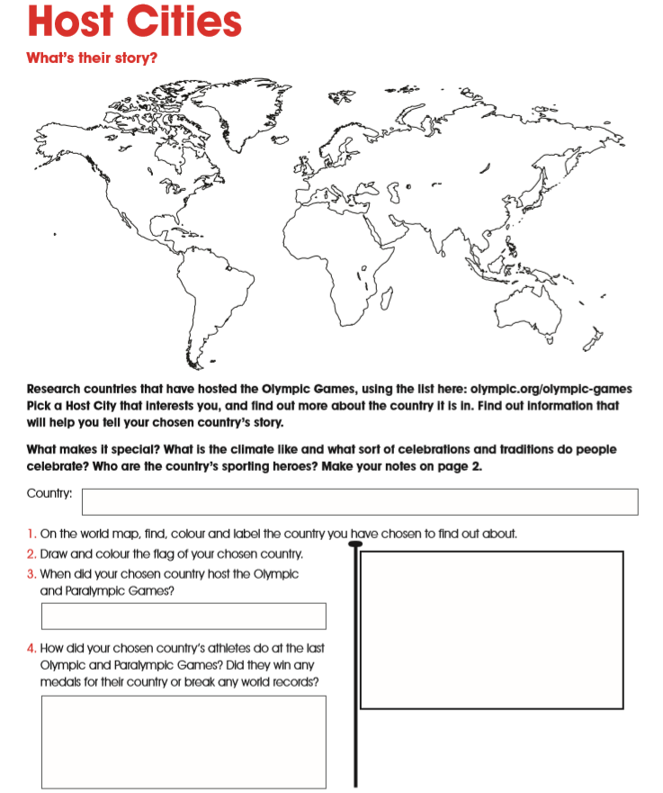
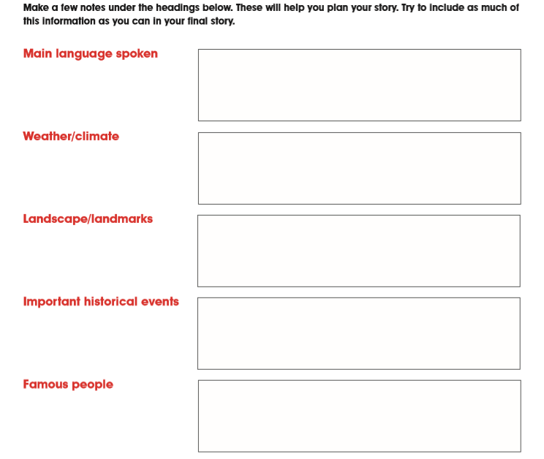
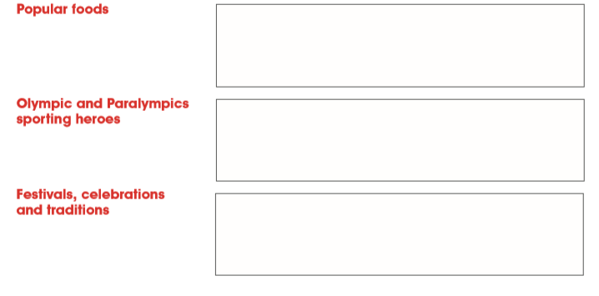
Option 2

Slide 50
Tasks 10 and 11 – Sports Day Project(continued)
So far you have planned and promoted your very own Sports Day. Now it’s time to have a think about the competition itself. First up, Sports Day gives you the chance to have fun, but it also is a time where we like to try our best to win and your participants deserve something for their hard work. So, your first challenge is to design and create prizes for your Sports Day. Check out the templates over the page for some ideas!
Think about the following points when creating your prizes:
Will they be certificates, medals or something else?
How many do you need?
Will everyone who takes part get a prize? How would you feel if you took part and didn’t get a prize?
As you all know, competition is tiring and when you are tired you need to rehydrate, re-energise and get ready to go again.
With that in mind, plan a healthy snack for your Sports Day participants.
Think about what makes something healthy.
Think about why you might choose a certain food or drink over another.
You might even want to ask the participants themselves what they would like as a healthy snack.
Once you have planned your snack, ask an adult if they can help you prepare the snack for your Sports Day.

Slide 51
Certificates
Can you design certificates to be given to your participants for competing fairly in your sports day?
Look at the suggestions opposite and then try to create your own.

Slide 52
Can you create medals just like these ones for 1st, 2nd and 3rd place?

Slide 53
Friday 12th June

Slide 54
Task 12 – Sports Day Project(continued)
Simple one today, today I would like you to run the sports day you have planned!
I would also like you by Friday 19th June to create a sway or poster either on paper or the computer showing what happened on your sports day. You can send pictures on the blog or over on Twitter if you wish ☺

Slide 55
Congratulations for a fantastic effort in Week 1 of our Fitness Fortnight!
Week 2 will begin on Monday 15th June with our Virtual Sports Day being held on Thursday 18th.
Please check the blog, app or teams assignments on Thursday morning for Sports Day instructions.
Have a great weekend and remember, Travel to Tokyo activities can still be completed at on Saturday’s and Sunday’s.

