Slide 1
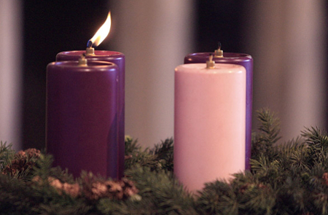
Christmas Traditions in Poland
Advent

Slide 2
In Poland, Advent is the beginning of Christmas Time. It's a time when people try to be peaceful and remember the real reason for Christmas. People try not to have excess of anything. Some people give up their favourite foods or drinks and parties and discos are not widely held. Some people also go to Church quite frequently. There is the tradition of the, special masses (or communion services) held at dawn and dedicated to Mary for receiving the good news from the Angel Gabriel.

Slide 3
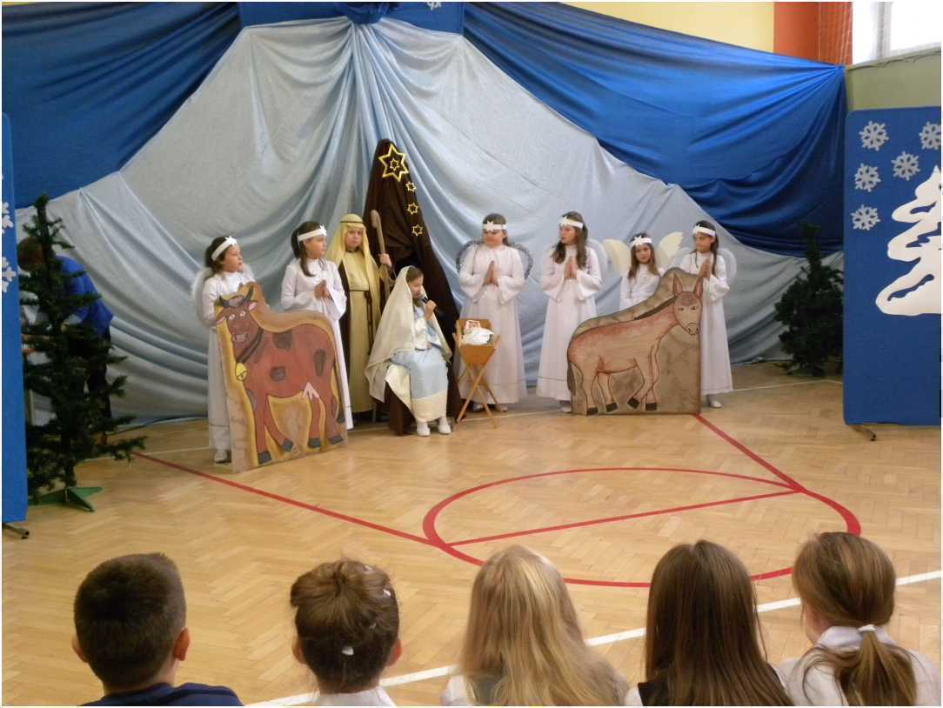
Before Christmas, children in schools and preschools take part in "Jasełka" (Nativity Plays). They are very popular and often more secular than religious. The Christmas story is also sometime put into modern times.

Slide 4
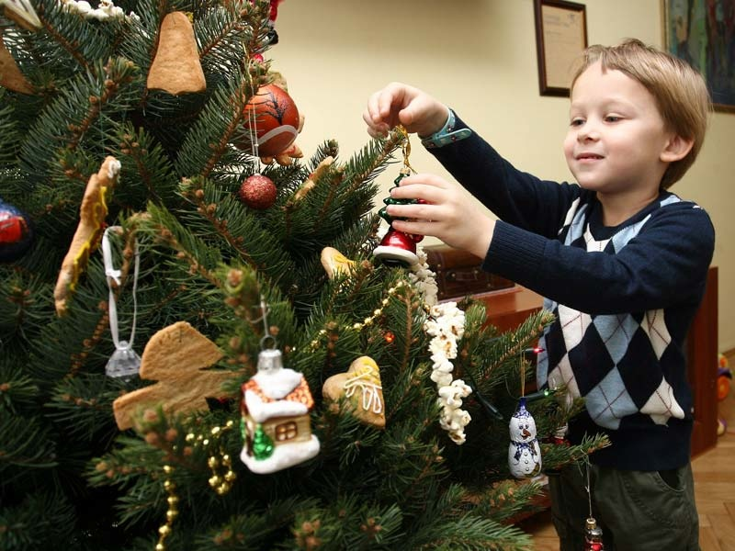
Christmas Eve - Wigilia
Christmas Eve is a very important and busy day. It's now often the most important day over Christmas . Traditionally it was day of fasting and abstinence (not eating anything until the Christmas Eve Supper) and meat is not normally allowed to be eaten in any form.
Christmas Eve is known as Wigilia (pronounced vee-GHEE-lee-uh).

Slide 5
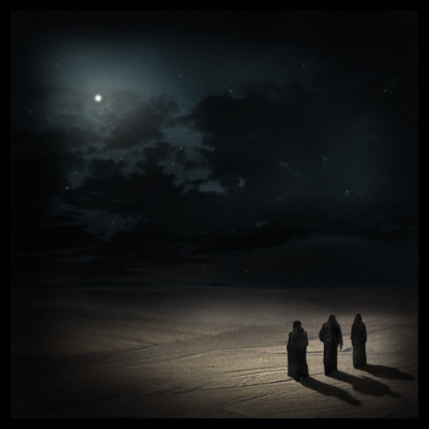
Christmas Eve Supper
The main Christmas meal is eaten in the evening and is called "Kolacja wigilijna" (Christmas Eve supper). It's traditional that no food is eaten until the first star is seen in the sky! So children look at the night sky to spot the first star!

Slide 6
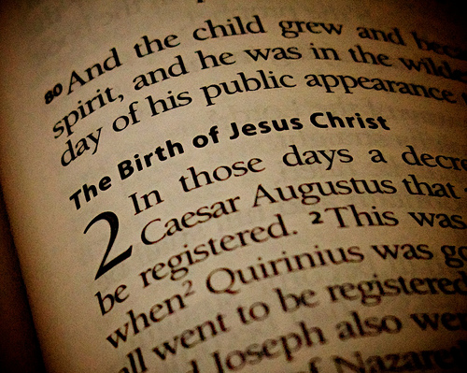
Just before the Supper Reading the Gospel
Before the meal it is a tradition to read the Gospel of Luke – The Christmas Story

Slide 7
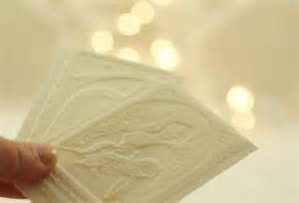
Breaking and sharing “Oplatek”
At the beginning of the meal, a large wafer biscuit called an 'Oplatek', which has a picture of Mary, Joseph and Jesus on it, is passed around the table and everyone breaks a piece off and eats it.

Slide 8
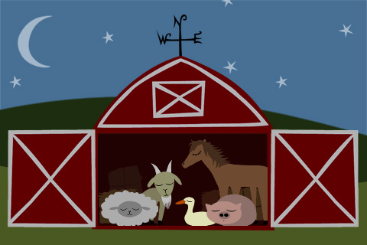
Sometimes a small piece may be given to any farm animals or pets that the family may have.
Some people believe the animals and pets can speak to humans at midnight.

Slide 9
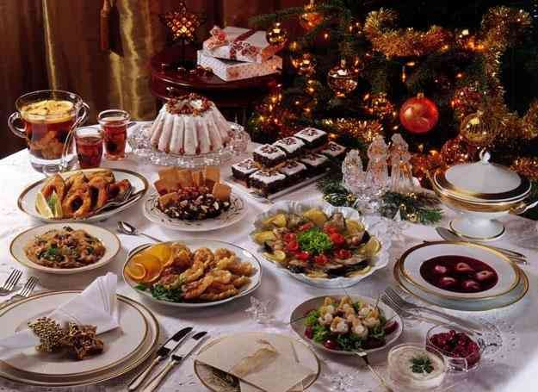
12 Dishes
On the table there are 12 dishes - they are meant to give you good luck for the next 12 months. The meal is traditionally meat free, this is to remember the animals who took take of the baby Jesus in the manger.

Slide 10
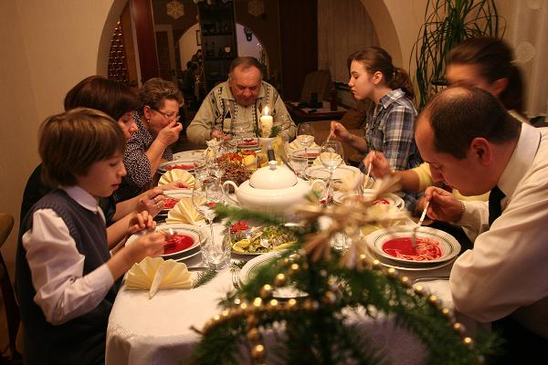
Everybody needs to try everything
Everyone has to eat or at least try some of each dish. For Catholics the 12 dishes symbolize Jesus's 12 disciples.

Slide 11
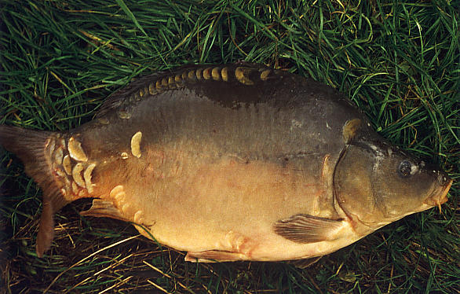
Carp and Beetroot Soup
Carp is the main dish of the meal.

Slide 12
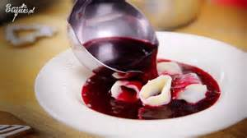
One of the most important dishes is "barszcz" (beetroot soup) and it's obligatory to have it. The barszcz may be eaten with "uszka" (little dumplings with mushrooms).

Slide 13
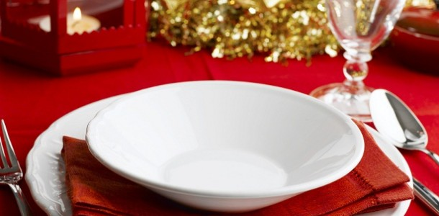
An Empty Place at the table
A place is often left empty at the meal table, for an unexpected guest. Polish people say that no one should be alone or hungry on Christmas Eve, therefore if someone unexpectedly knocks on the door they are welcomed.

Slide 14
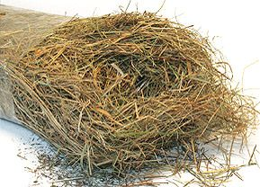
Hay under the table cloth
Sometimes straw is put on the floor of the room, or under the table cloth, to remind people that Jesus was born in a stable or cow shed.

Slide 15
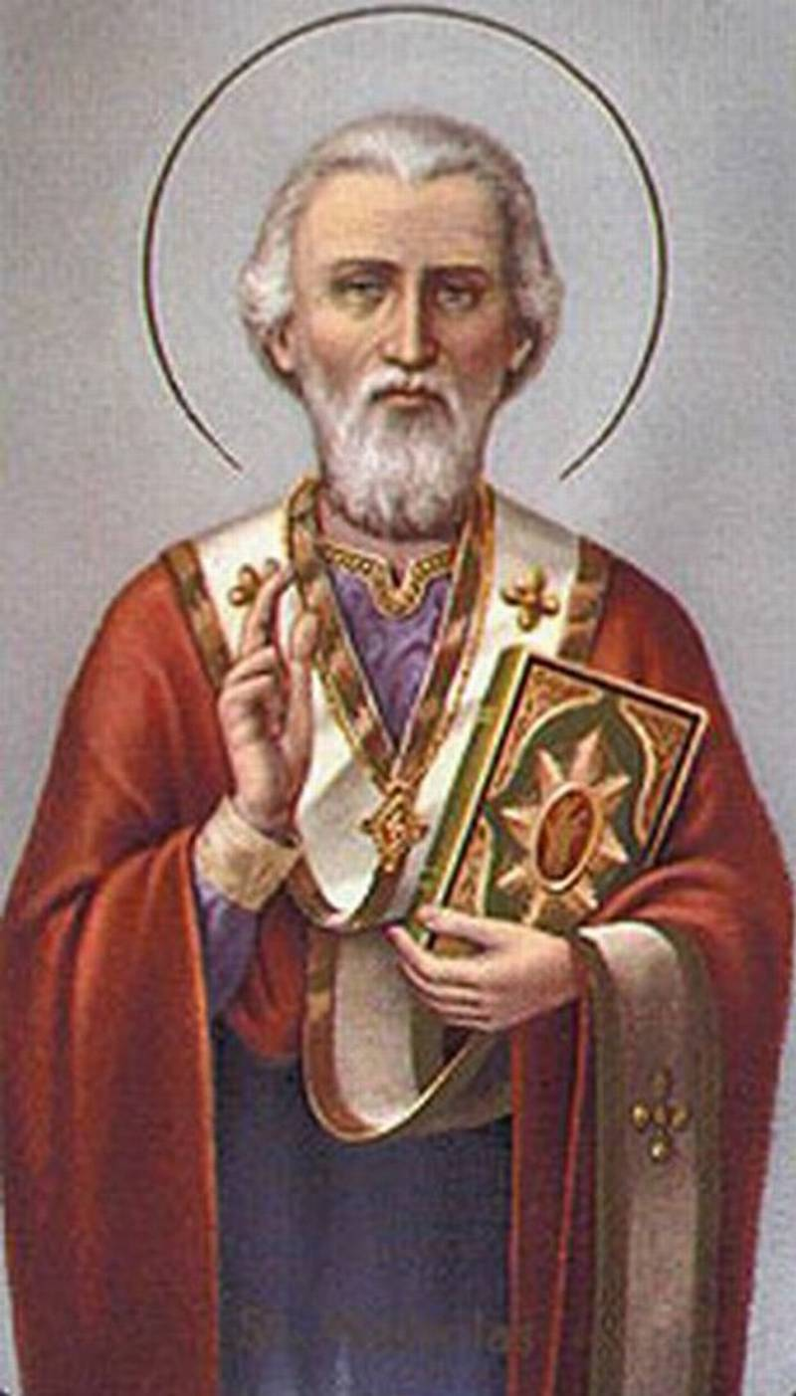
Saint Nicholas brings the presents
St. Nicholas is a legendary figure connected with Christmas gift-givers like Santa Klaus. He is thought to have lived in the 4th century, and to have been born in Lycia in Asia.

Slide 16
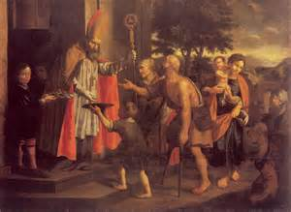
Nicholas is thought to have been wealthy and to have given his gold away to help others.

Slide 17
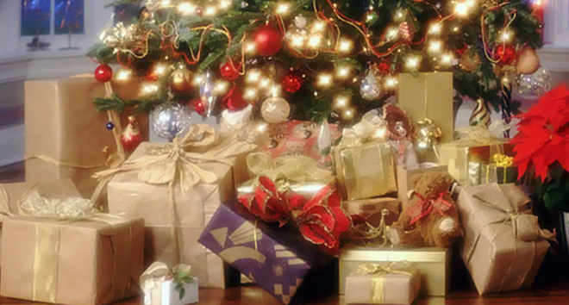
Presents can only be opened after the finished supper

Slide 18
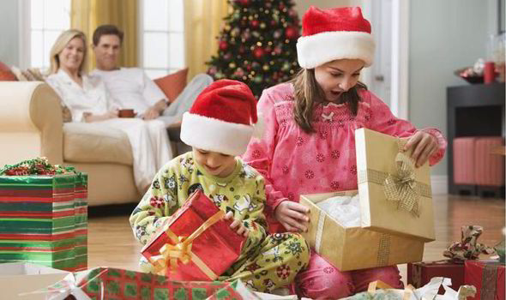

Slide 19
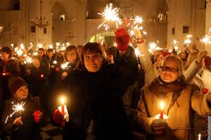
Midnight Mass - Pasterka
Christmas Eve is finished by going to Church for a Midnight Mass service.

Slide 20
The days after Christmas are often spent with family and friends.

Slide 21
People in Poland also like kissing under the mistletoe!

Slide 22
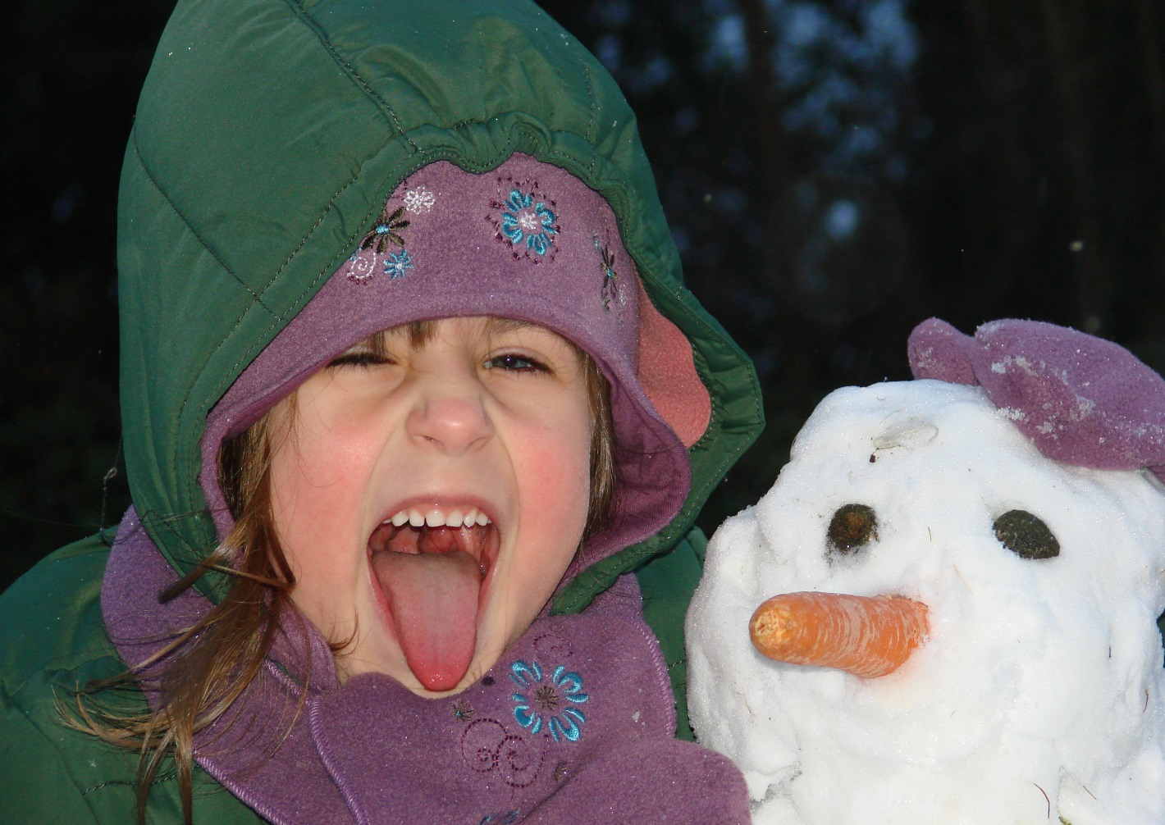
White Christmas in Poland
In Poland Christmas holidays are usually white with loads of snow

Slide 23
Wesolych Swiat! Merry Christmas!

