Slide 1
Advent calendar
2016
27
Nov
28
Nov
29
Nov
24
Dec
30
Nov
23
Dec
1
Dec
22
Dec
25
Dec
2
Dec
21
Dec
3
Dec
20
Dec
4
Dec
19
Dec
5
Dec
15
Dec
16
Dec
17
Dec
18
Dec
6
Dec
7
Dec
8
Dec
9
Dec
10
Dec
11
Dec
12
Dec
13
Dec
14
Dec

Slide 2
Welcome
Hope’

Slide 3
The word Advent...
The word Advent comes from the Latin 'adventus' which means 'arrival' or 'coming'.

Slide 4
Who are we waiting for?
Jesus

Slide 5
What does Advent mean to you?

Slide 6
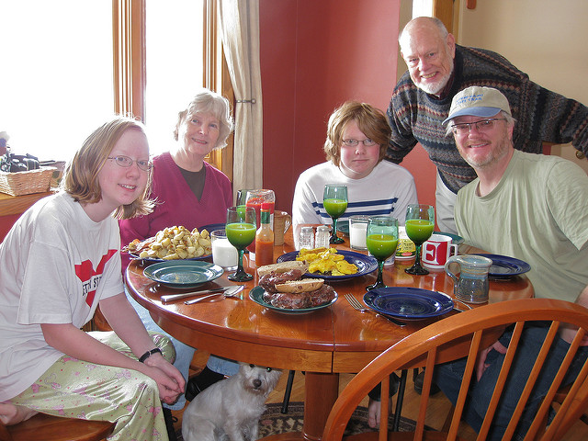
Family Time

Slide 7
Presents

Slide 8
The Nativity

Slide 10
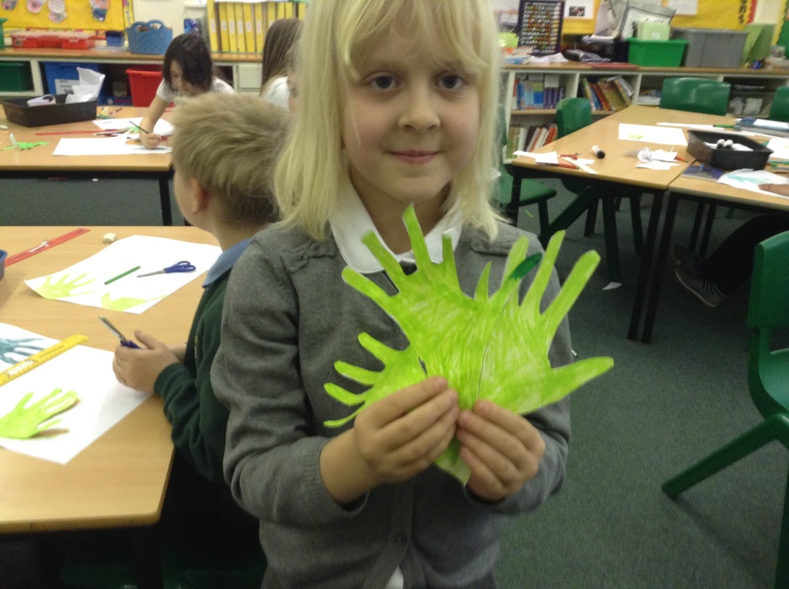
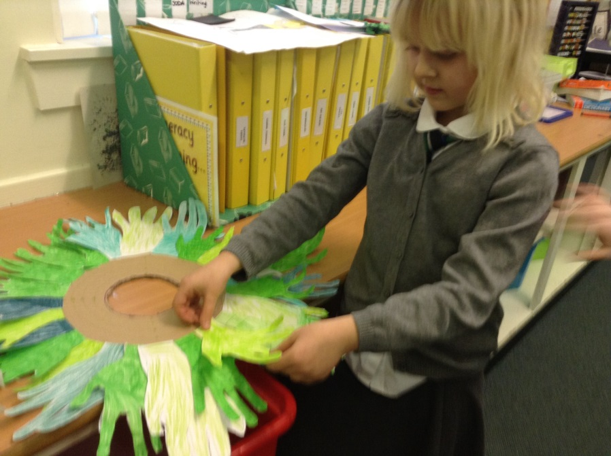
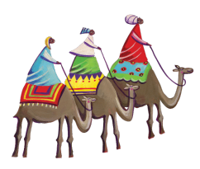
HOPE
The Advent wreath is a special symbol. The evergreen leaves mean everlasting life. The circle of the wreath (with no beginning and no end) reminds us of the eternity of God and the four candles are the four weeks of Advent.

Slide 11
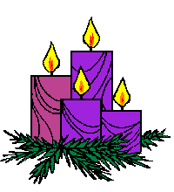
The Advent Wreath

Slide 12
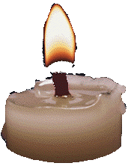
We will now light the first candle on our Christmas Wreath.
HOPE

Slide 13
Stay Awake (Clap, clap)
Be Ready (Clap, clap)
You do not know the hour when the Lord is coming.
Stay Awake (Clap, clap)
Be Ready (Clap, clap)
The Lord is coming soon.
Alleluia! Alleluia!
The Lord is coming soon

Slide 14
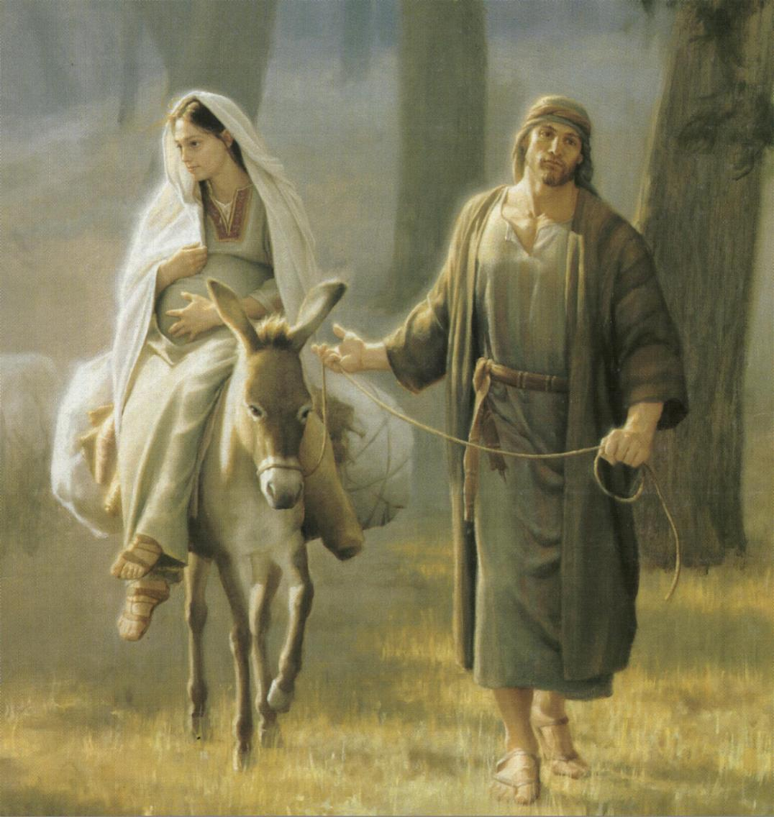
HOPE

Slide 15
HOPE

Slide 16
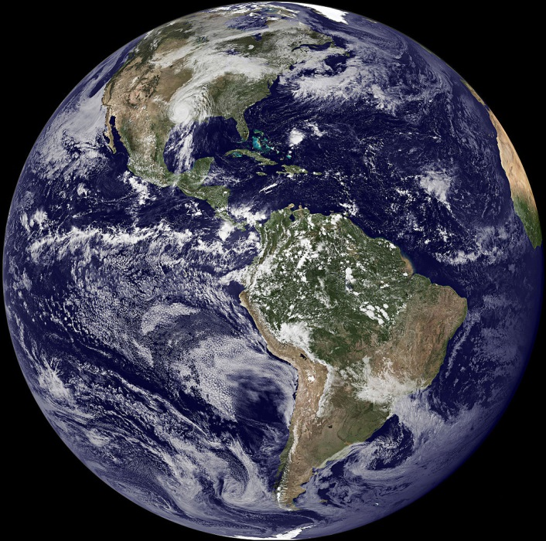
‘The earth is the Lord’s and everything in it, the world and all who live in it’ (Psalm 24:1)
HOPE

Slide 17
What are your hopes for the future?

Slide 18
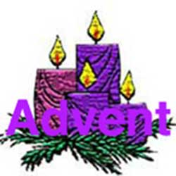
Advent days virtue excitement nativity thankful

Slide 19
Advent is a time when we prepare for the coming of Jesus.
December 25th is when Jesus was born.
Various traditions are celebrated by people from a variety of countries
Everybody who celebrates Christmas are God’s good friends.
Nativities are good fun to watch
Together we can give out Christmas cards.

Slide 20
HOPE
Loving God,
Your Son was the greatest gift for the world.
Help us to remember all that he taught us
about loving our sisters and brothers,
wherever they live in the world.
Amen

Slide 21
P5/6 have been raising money for those children who are still in Syria

Slide 22
Hopeful
https://youtu.be/235gUd4oTv4

