Slide 2
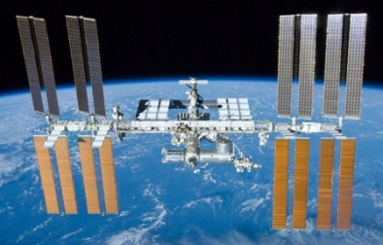
Two kilograms of rocket (Eruca sativa) seeds were launched on Soyuz 44S on 02 September 2015 with European Space Agency (ESA) astronaut Andreas Mogensen and his crew, arriving on the International Space Station (ISS) two days later.

Slide 3
British astronaut Tim Peake, was launched into space 15 December 12:03 GMT from Baikonur in Kazakhstan.

Slide 4
Tim Peake was heading to the International Space Station.

Slide 5
British ESA astronaut Tim Peake will take charge of the seeds while on the ISS for his Principia mission starting in December.

Slide 6
Primary 1 are waiting!

Slide 7
What is ‘rocket’?

Slide 8
After being held for about six months in microgravity, the seeds will be returned to Earth with astronaut Scott Kelly, currently planned for March 2016.

Slide 9
Seeds return to Earth

Slide 10
We will receive one red packet and one blue packet of seeds each containing a minimum of 100 seeds. One contains seeds that have travelled to space and the other contains seeds that have remained here on Earth.

Slide 11
Blue or Red? We have made a tree diagram of our predictions of whether the RED or the BLUE packets have the ‘space’ seeds inside

Slide 12
The seeds will all be grown on our classroom windowsill – but they will need to be labelled!

Slide 13
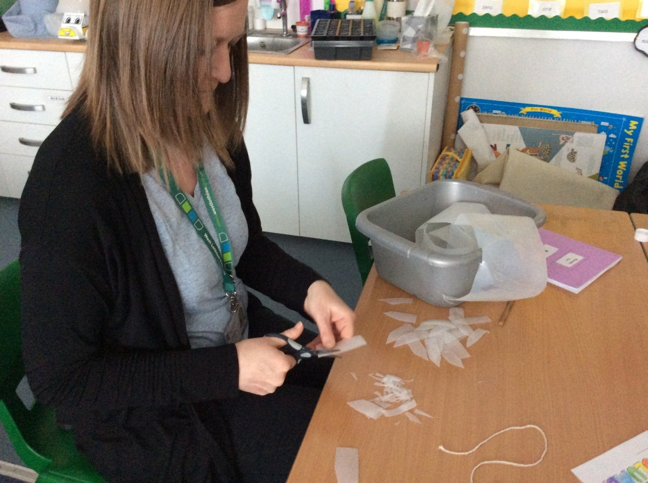
Mrs Smith has cut out our seed labels using plastic milk cartons.

Slide 14
We will need 100 red labels and 100 blue labels. So keep cutting Mrs Smith!

Slide 15
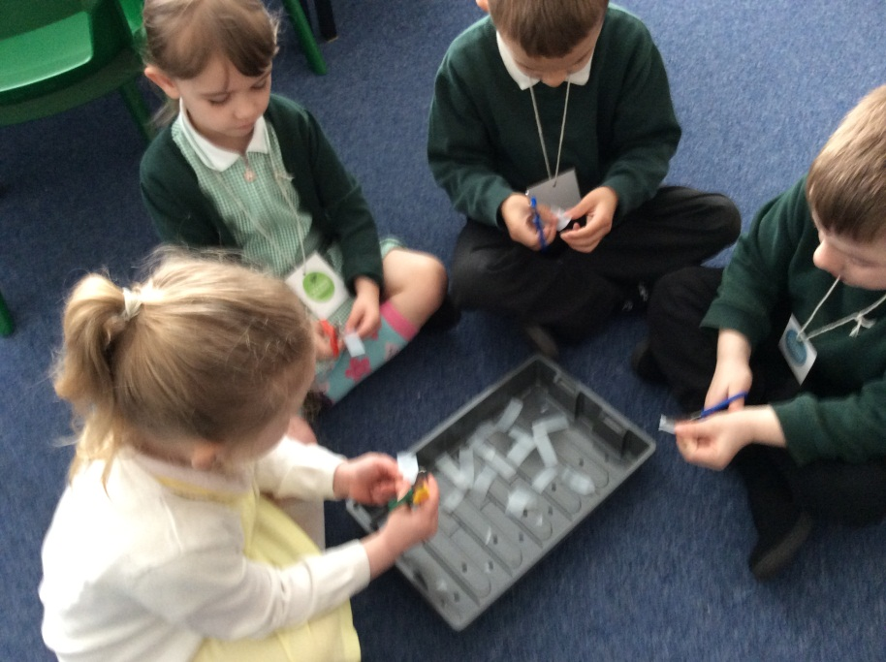
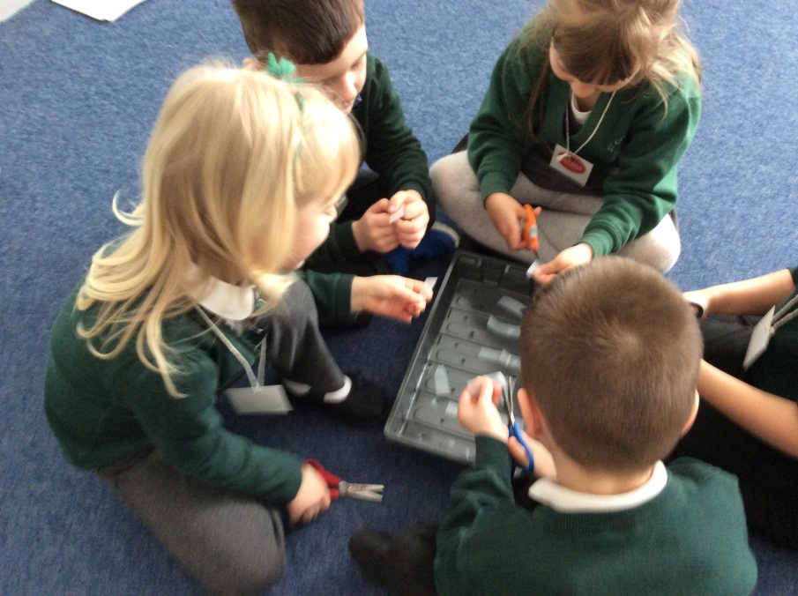
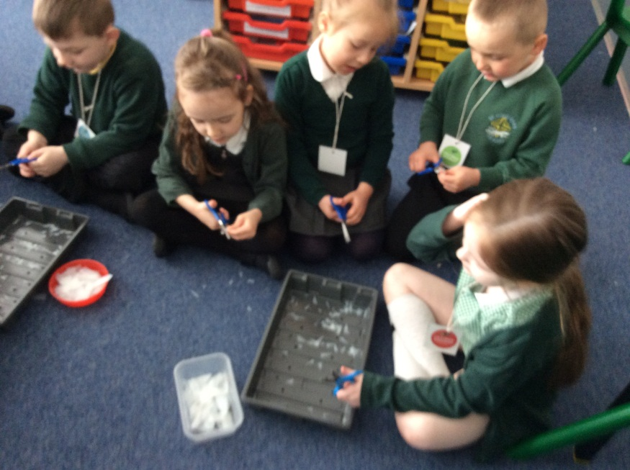

Slide 16
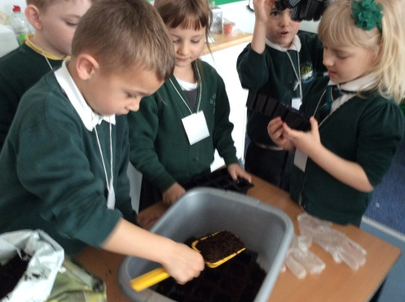
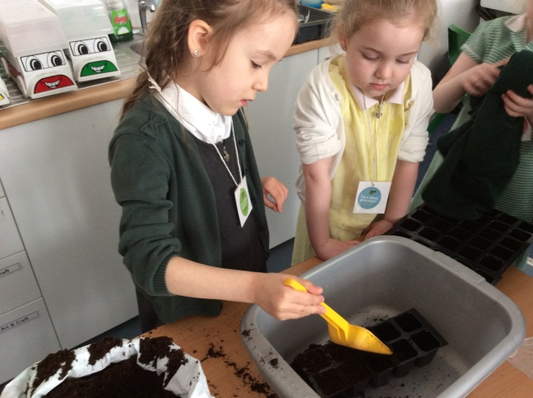
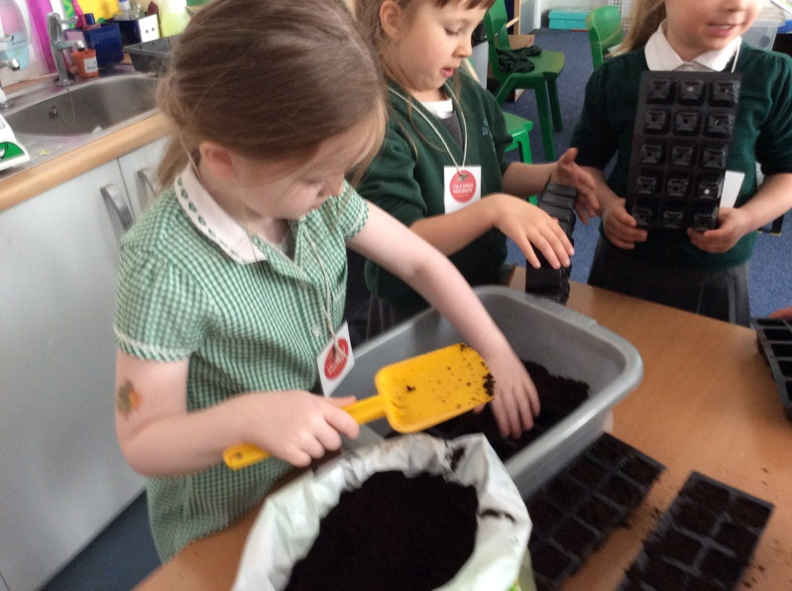
Today we filled each cell with compost.

Slide 17
Next we need to put 1 seed in each module.
SEEDS HAVE NOT ARRIVED!!!!!

Slide 18
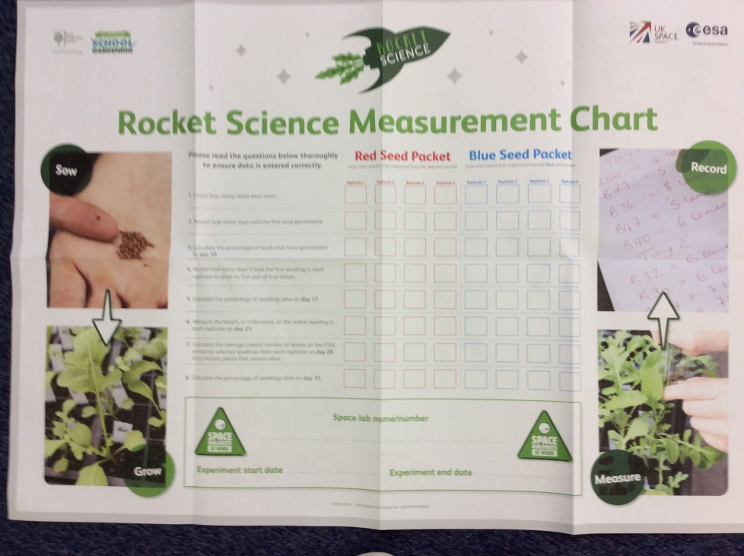
With support from Primary 5/6 we will measure and record similarities or differences in plant growth between the two seed packets and record this on the Measurement Chart.

Slide 20
Questions

Slide 21
1
Count how many seeds were sown.

Slide 22
2
Record how many days until the first seed germinated.

Slide 23
3
Calculate the percentage of seeds that have germinated by Day 10.
Help P5/6!

Slide 24
4
How many days did it take for the seedlings to grow their first true leaves?

Slide 25
5
Calculate the number of seedlings alive on Day 17
Help P5/6

Slide 26
6
Measure the height , in millimetres, of the tallest seedling in each set – on Day 21.

Slide 27
7
Calculate the average (mean) number of leaves on FIVE randomly selected seedlings from each set on Day 28. P5/6

Slide 28
8
Calculate the percentage of seedlings alive on Day 35.

Slide 29
What happens next?
The experiment is finished and we can enter all the results from our Measurement Chart into the national Rocket Science database website.

Slide 30
What will happen to the seedlings?
Unfortunately – for health and safety reasons we are not allowed to eat the rocket grown from these seeds!

Slide 31
