Slide 1
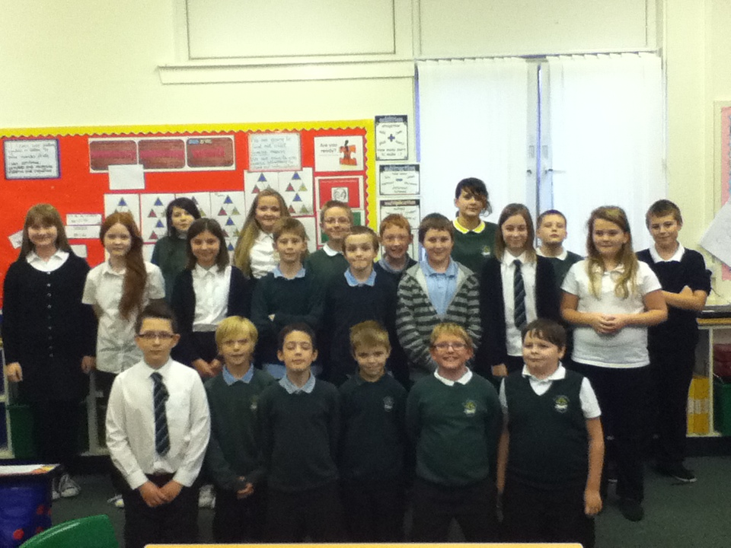
P6/7 Highlights Of The Year 2014/15

Slide 2
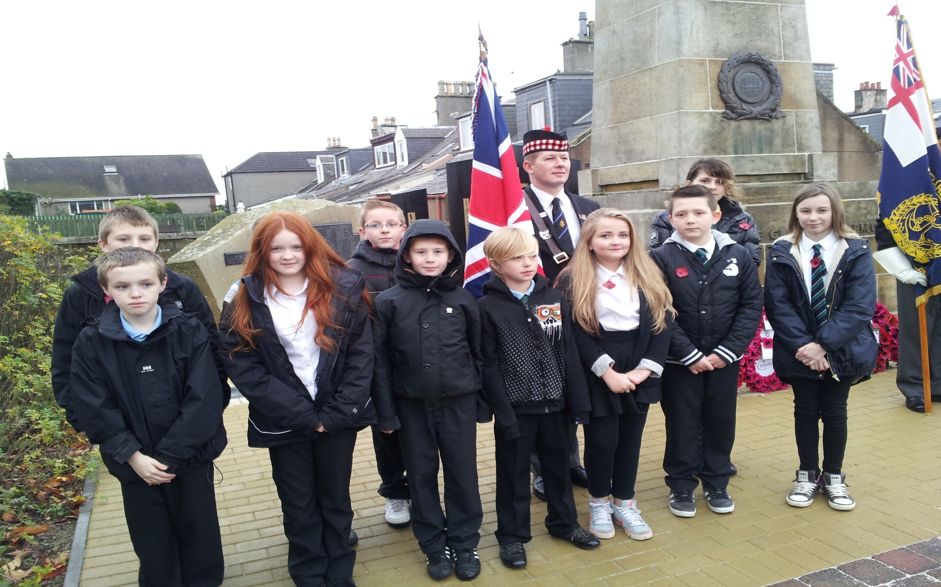
We will remember…

Slide 3
The Activity Zone

Slide 4
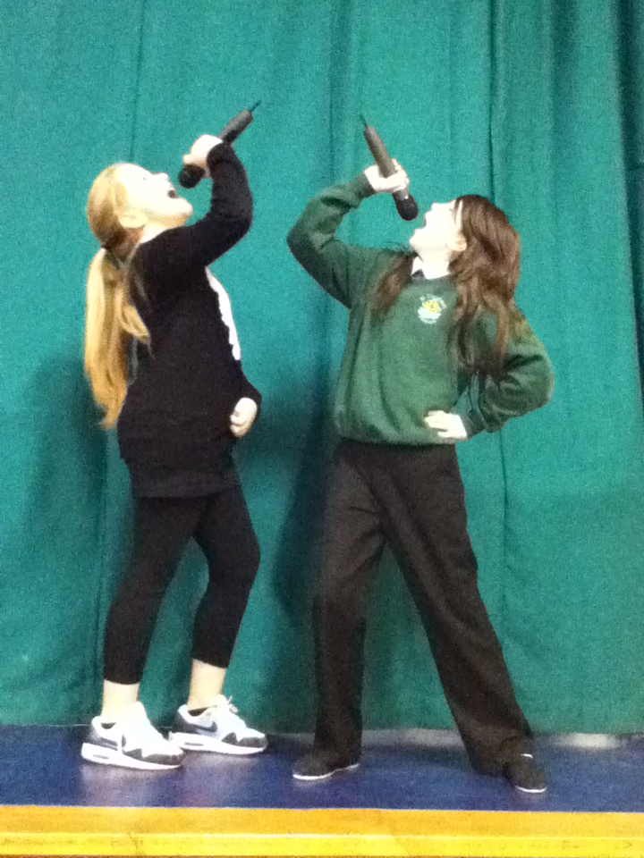
P6/7’s Got Talent!

Slide 5
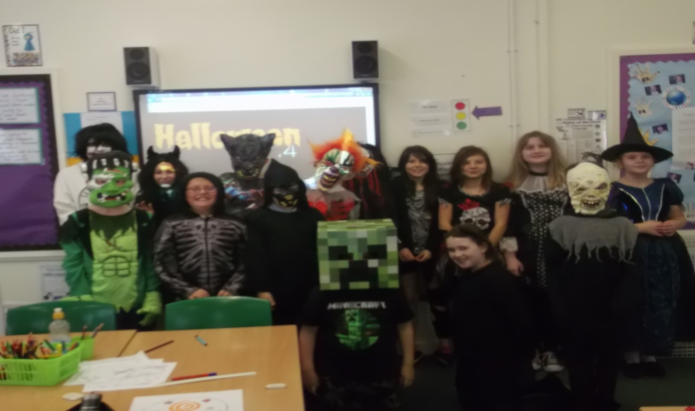
Be scared… very scared!

Slide 6
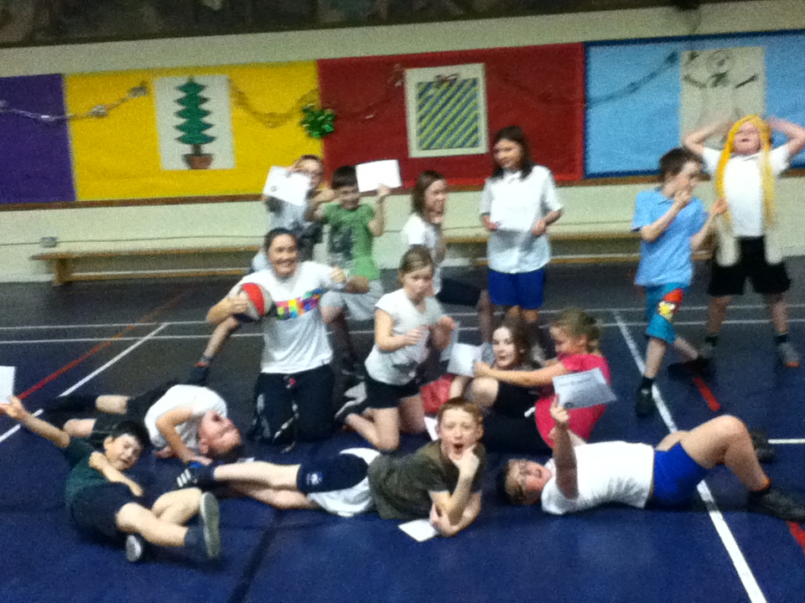
Basketball After School Club?

Slide 7
P6/7 Christmas Tea Light Factory

Slide 8
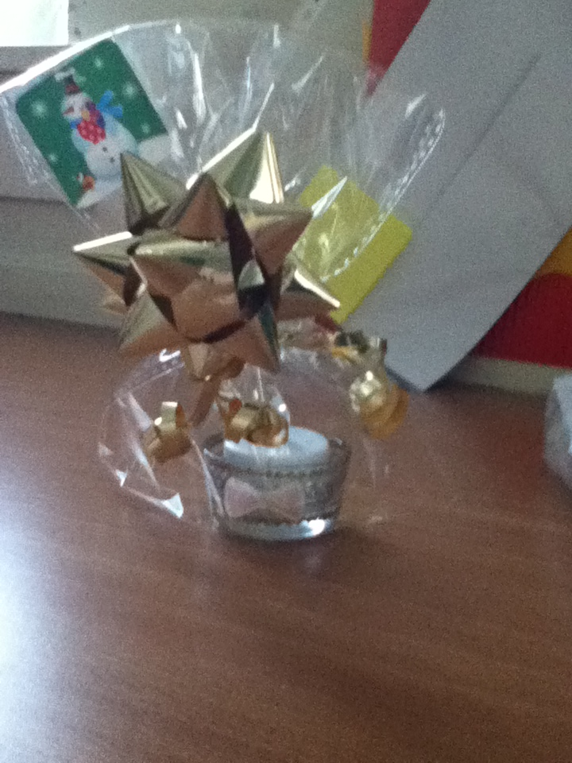
What a lovely tea light!

Slide 9
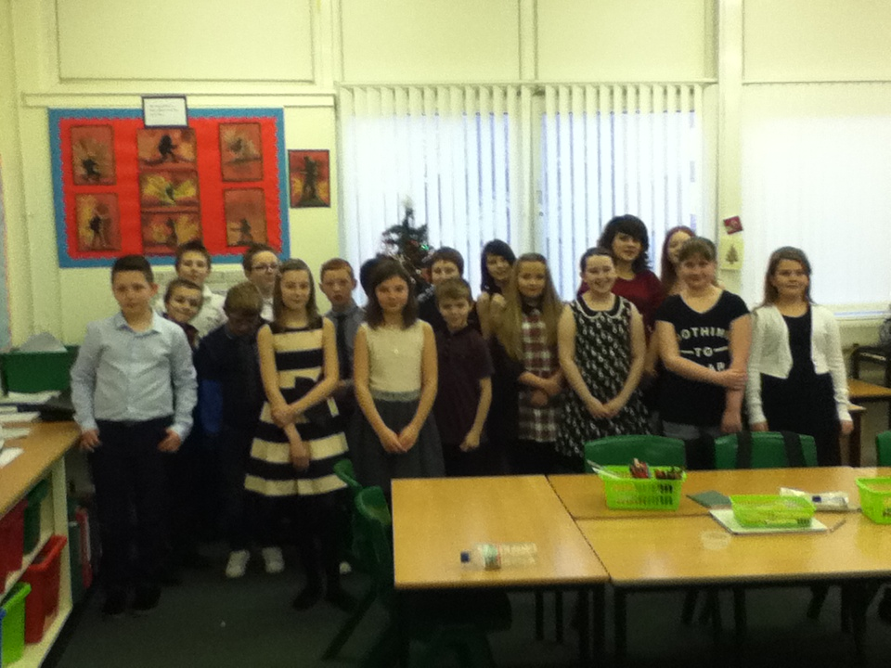
Let’s party!

Slide 10
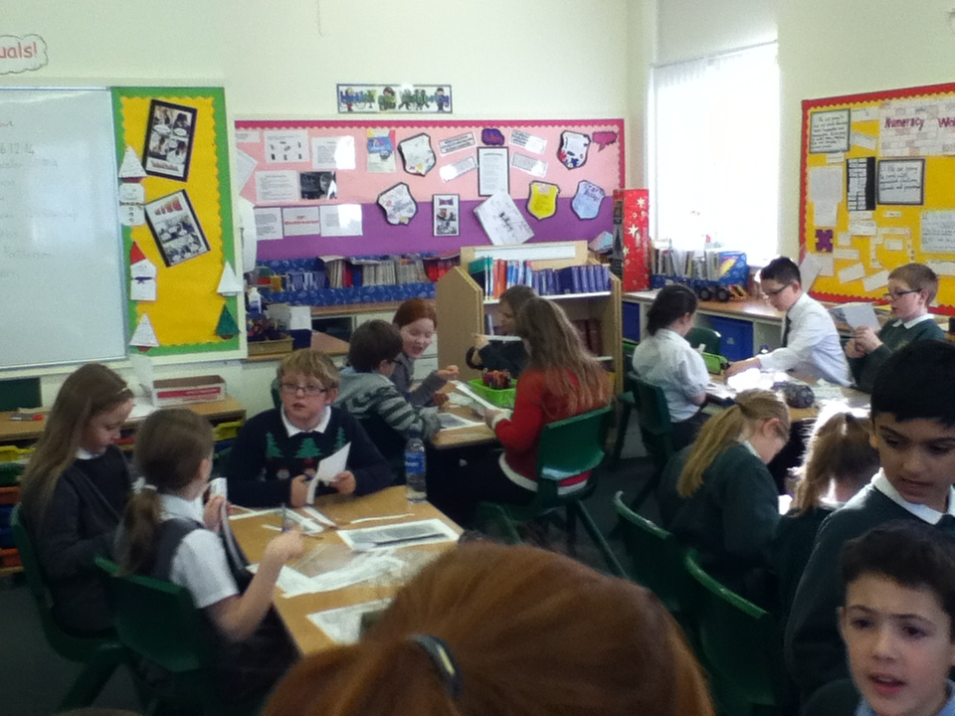
Which human rights are being broken when you’re homeless?

Slide 11
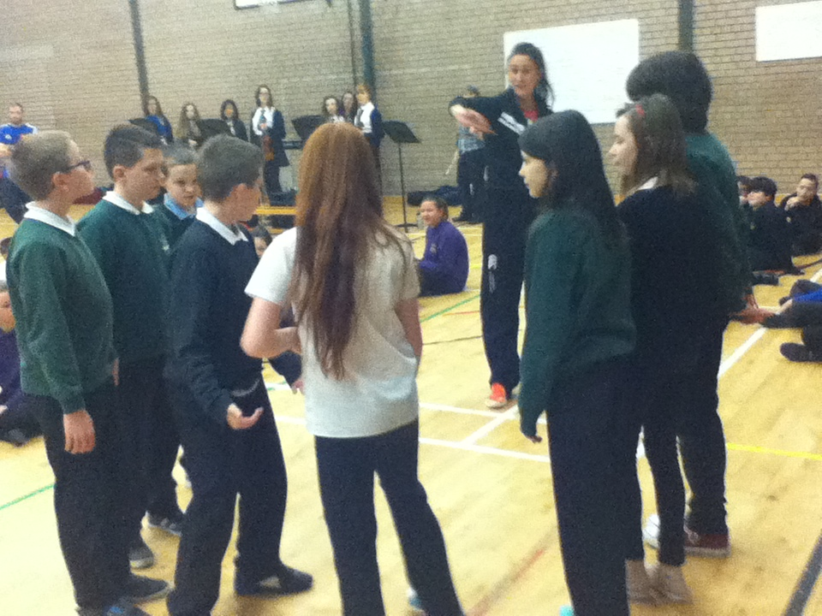
Dancing at the Ceilidh was great fun!

Slide 12
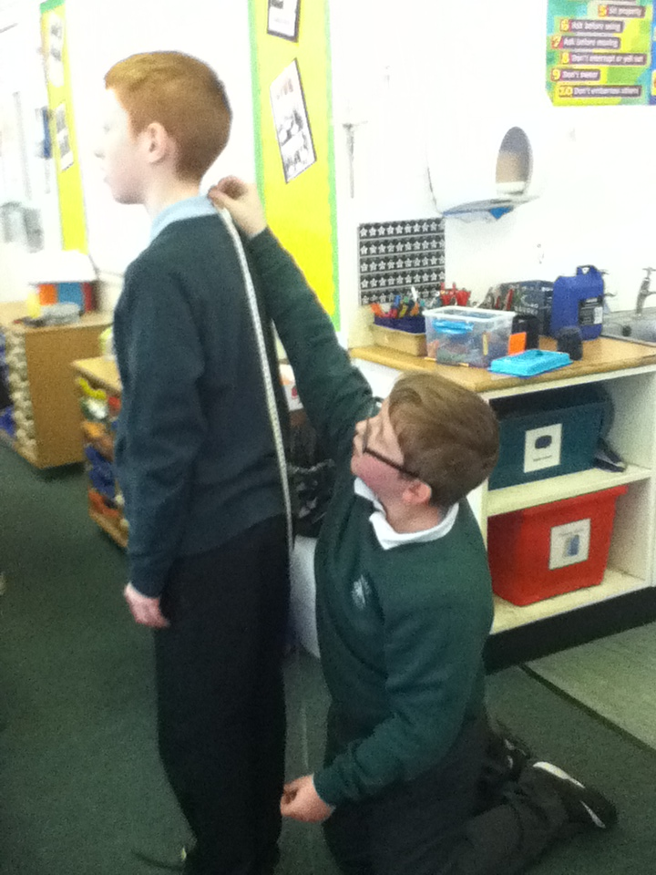
We can measure!

Slide 13
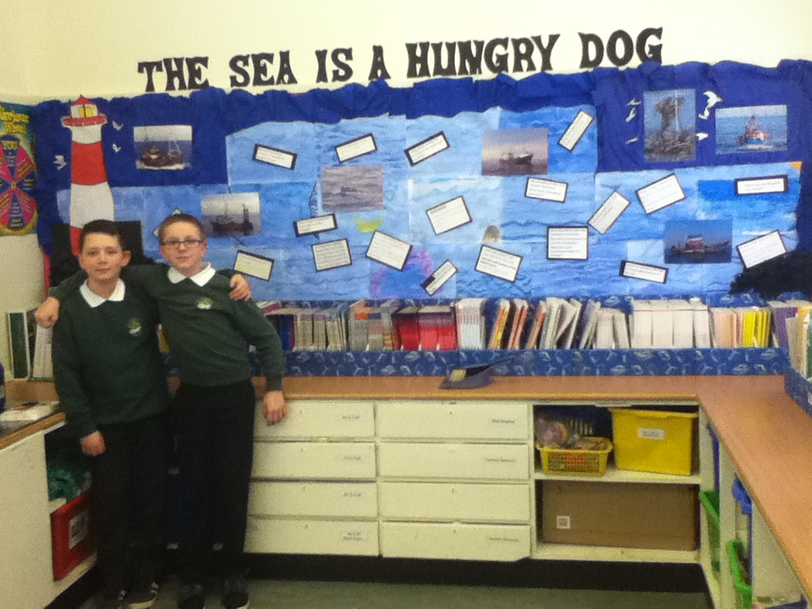
Creative Writing with Mrs. Mitchell.

Slide 14
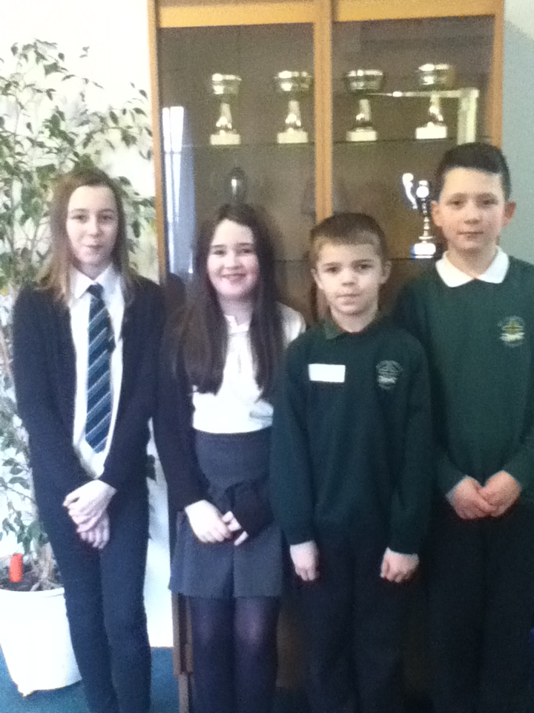
Rotary Club Quiz Winners!

Slide 15
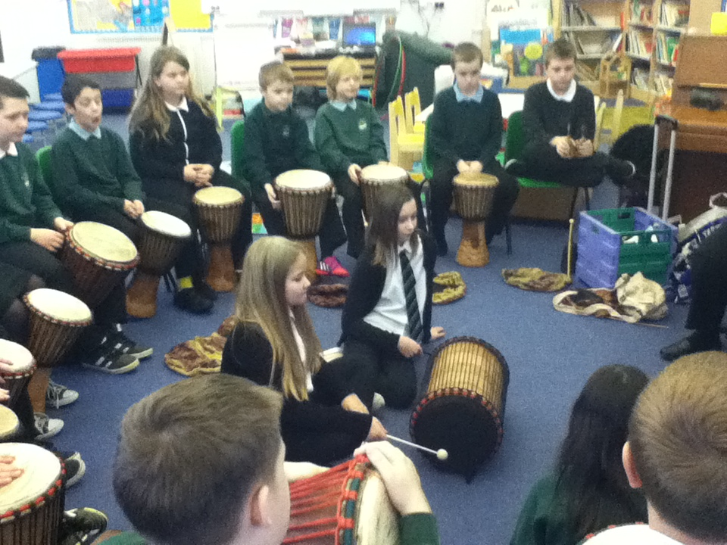
We are very musical! Thank you Mrs. Steele.

Slide 16
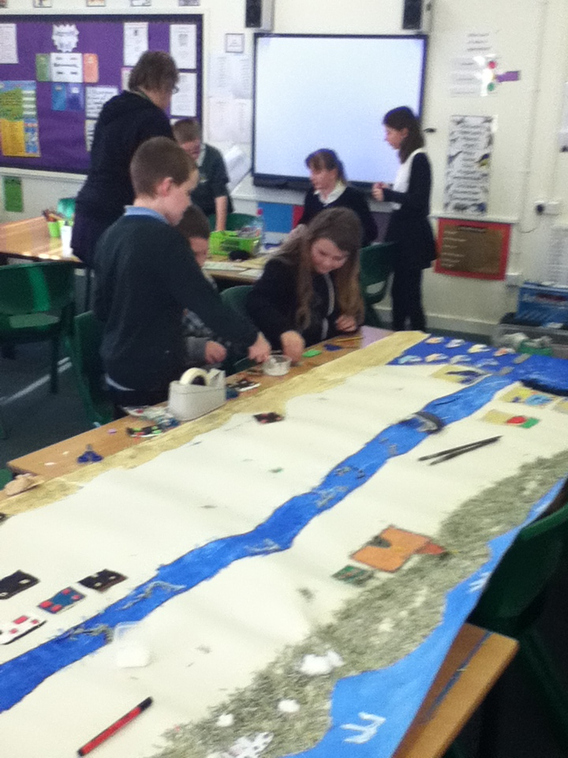
Making Fisher Brig.

Slide 17
“Silver Darlings” art work with Mr Bennet.

Slide 18
Fisher Brig- oor Scots Fishing Village.

Slide 19
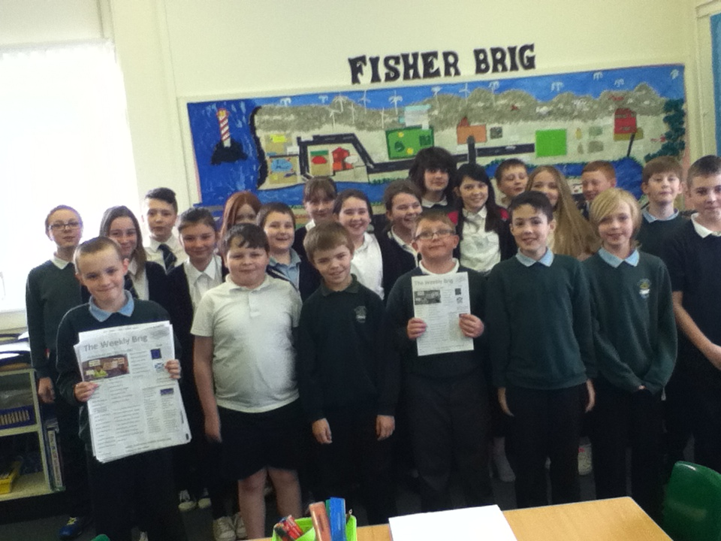
Our Class Newspaper

Slide 20
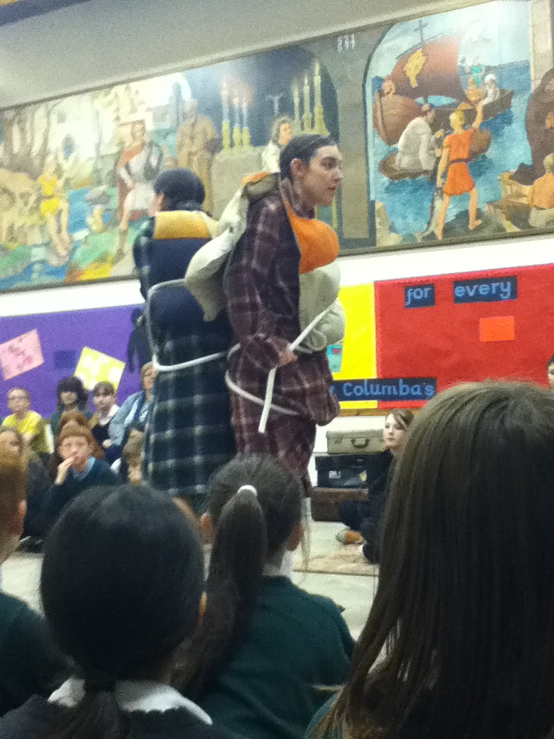
“Lifeboat” a WW11 Drama.

Slide 21
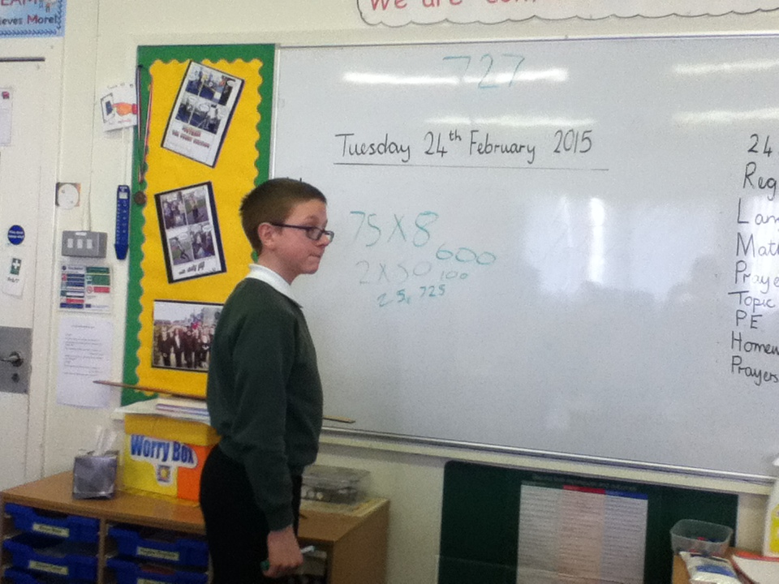
SODA – What strategies would you have used to make 727?

Slide 22
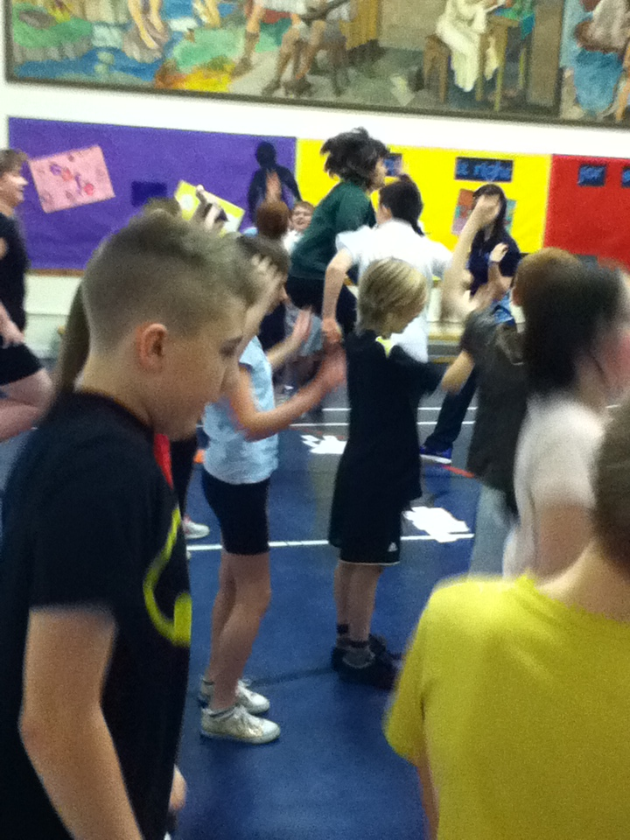
Fitness Bingo!

Slide 23
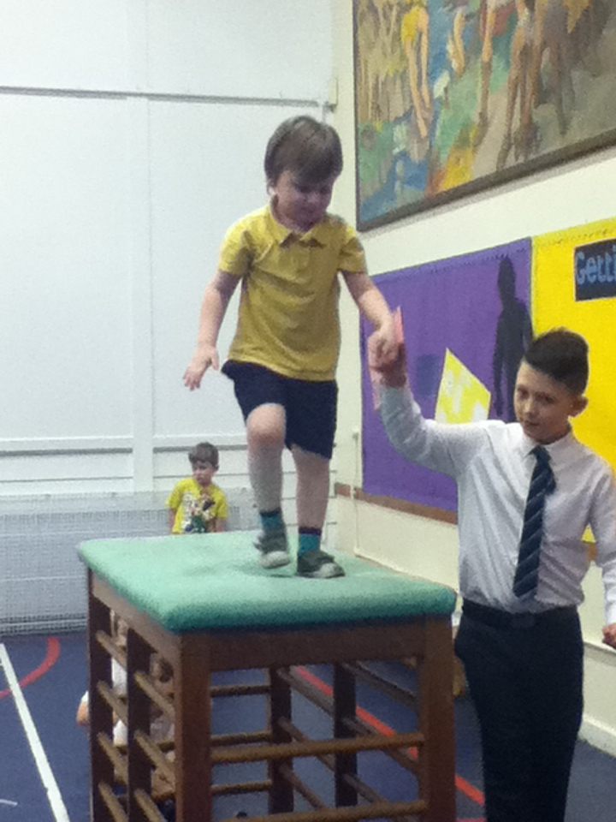
Helping “Our Buddies” with gymnastics!

Slide 24
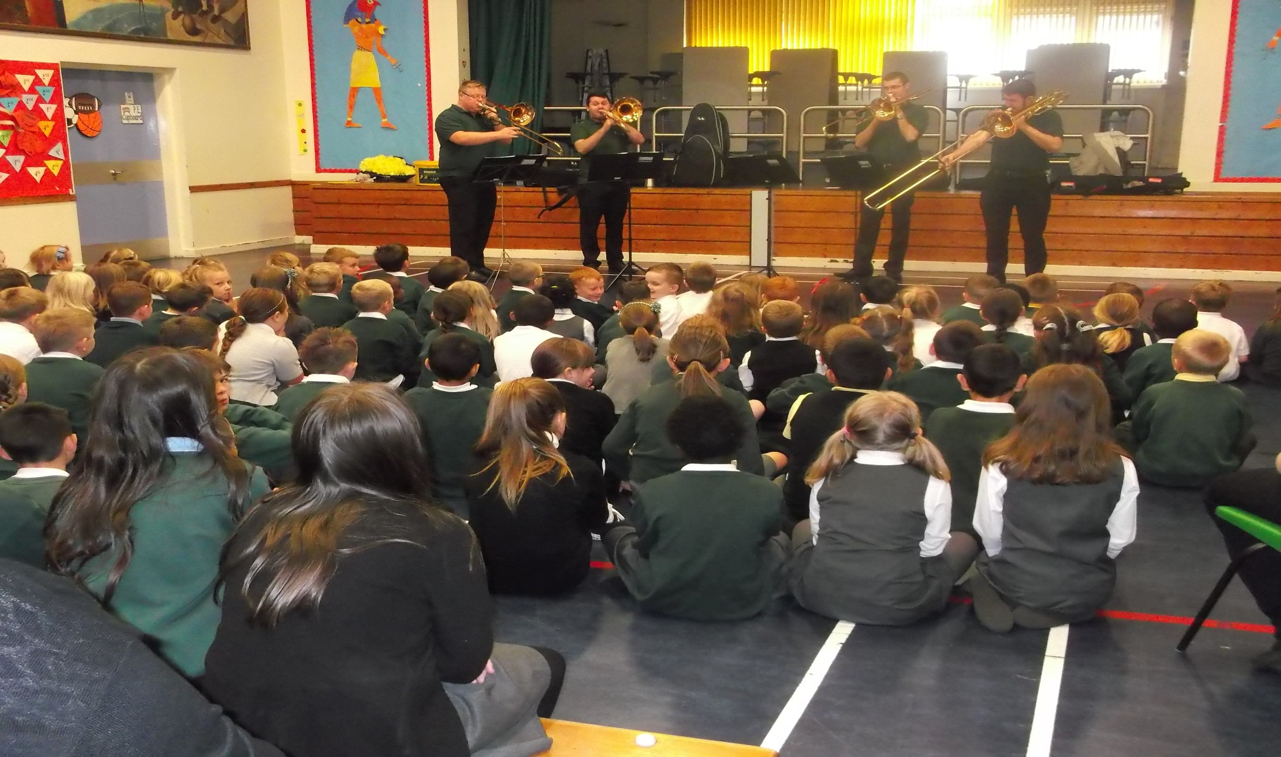
The Four Trombones

Slide 25
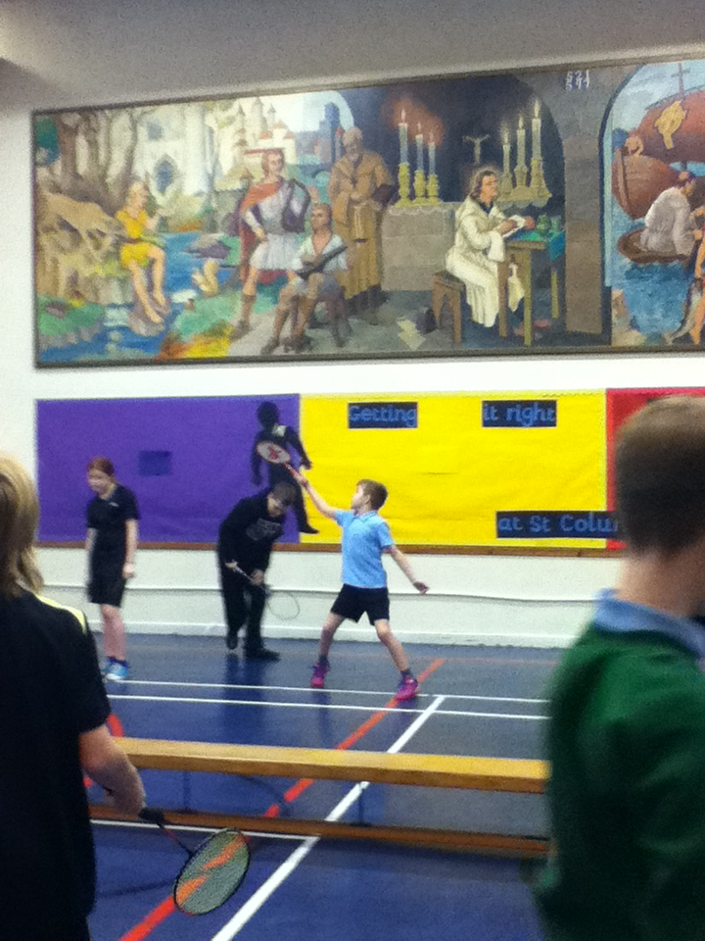
Getting better at badminton!

Slide 26
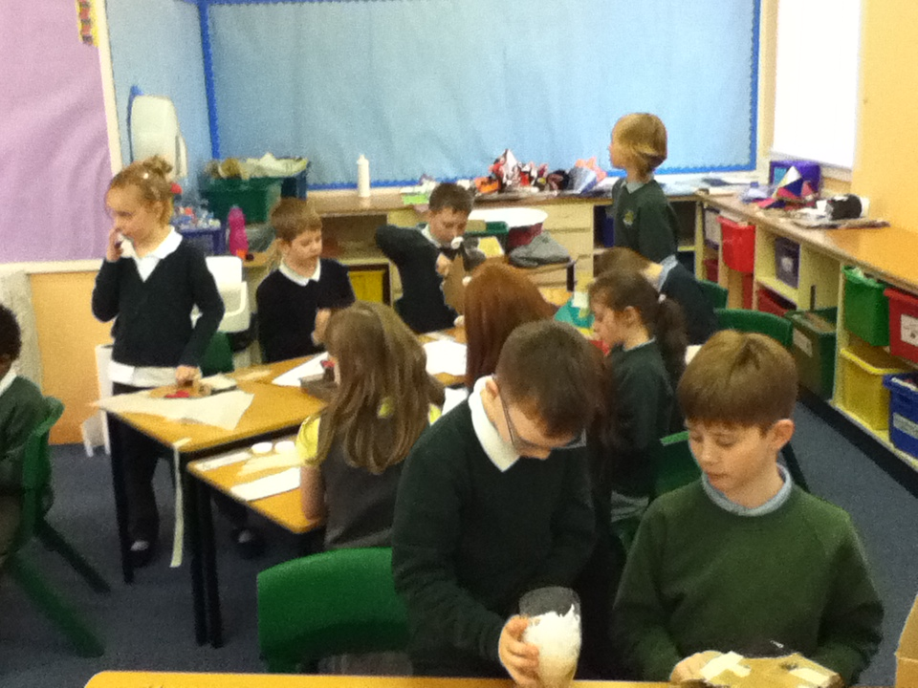
Making “Whirry Bangs” with P3.

Slide 27
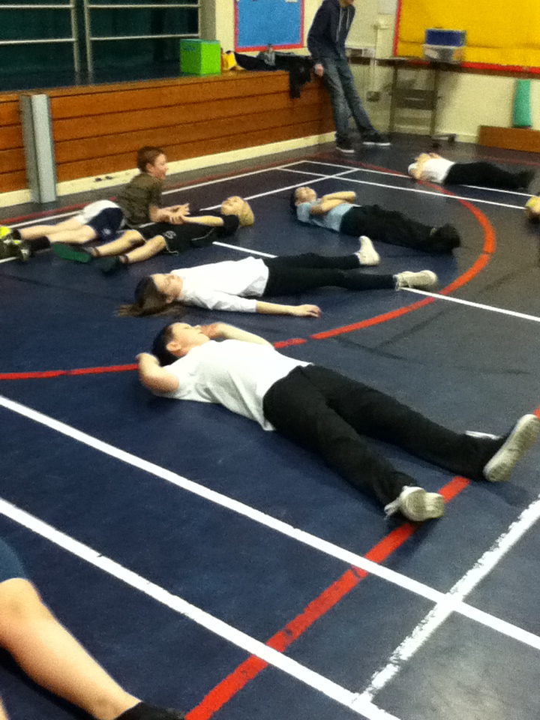
Healthy Living!

Slide 28
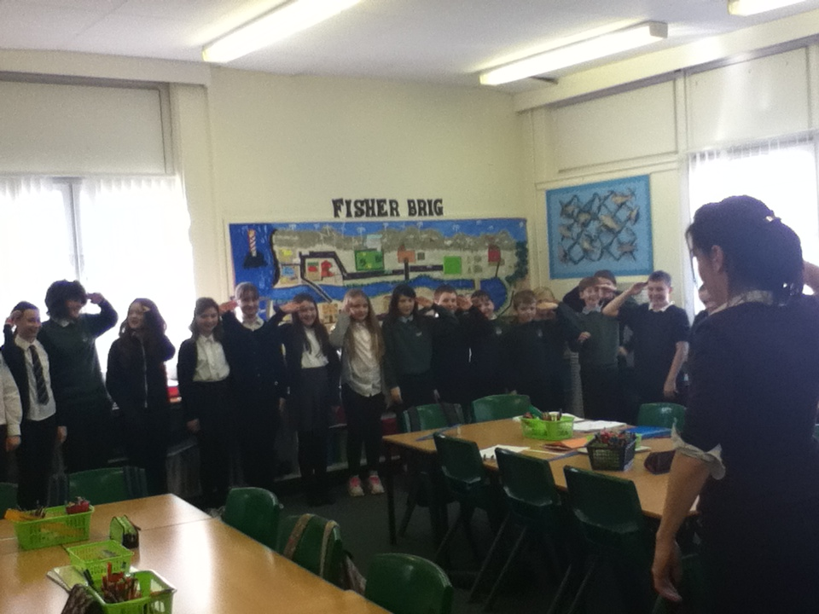
Bonjour!

Slide 29
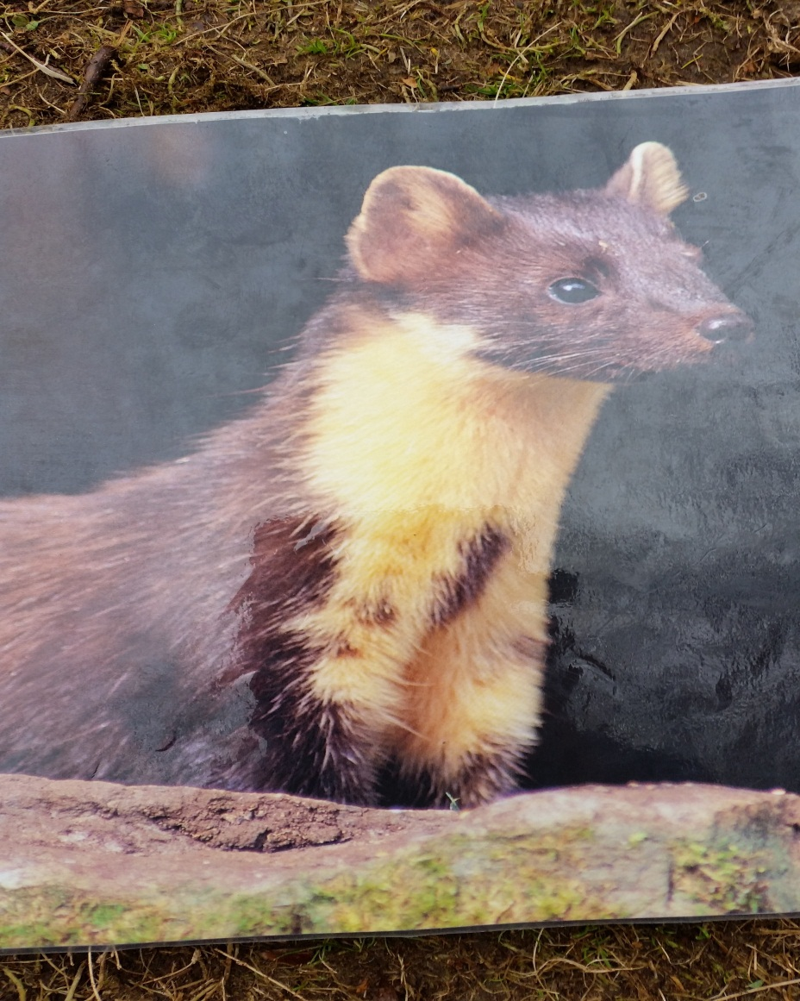
Pesky Pete…

Slide 30
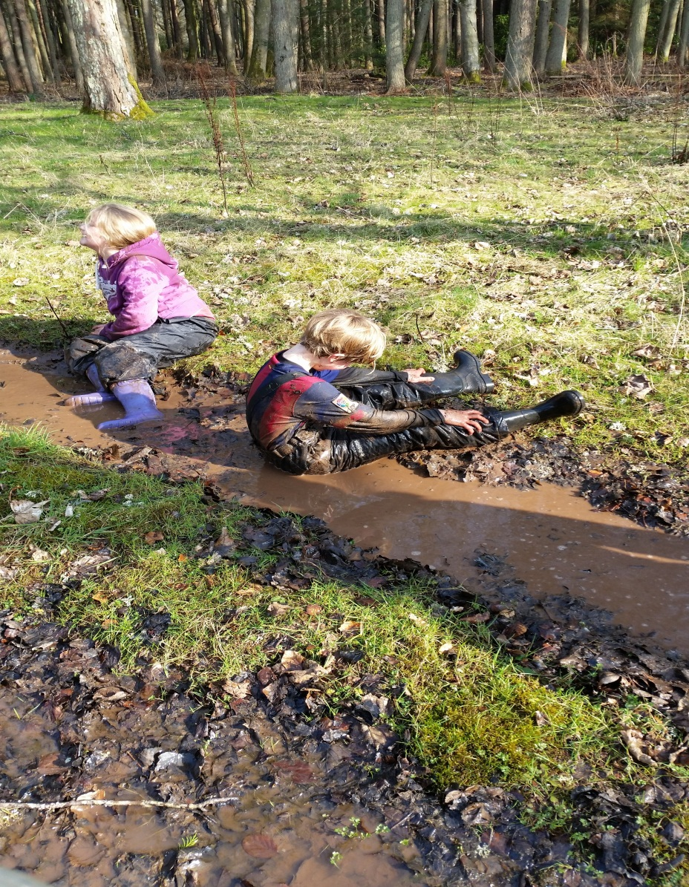
Getting down and dirty at Belmont Camp!

Slide 31
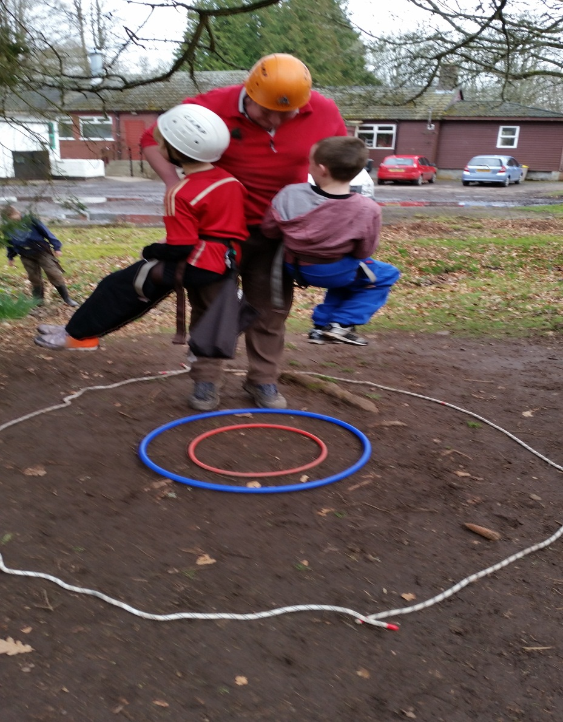
Weightlifting with Josh!

Slide 32
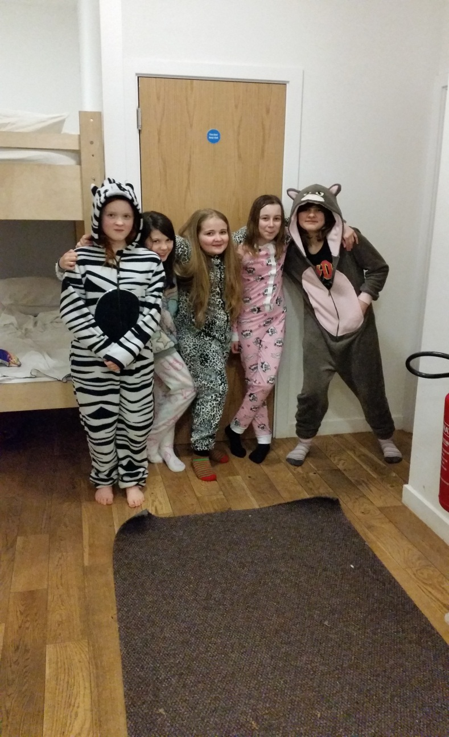
The Girls Dorm…

Slide 33
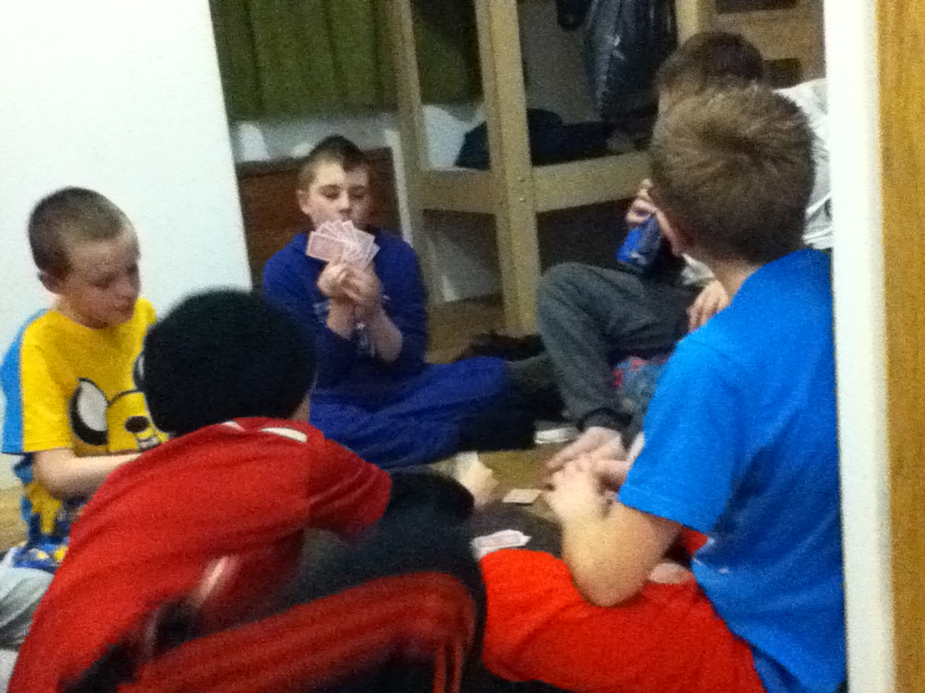
The Boys Dorm…

Slide 34
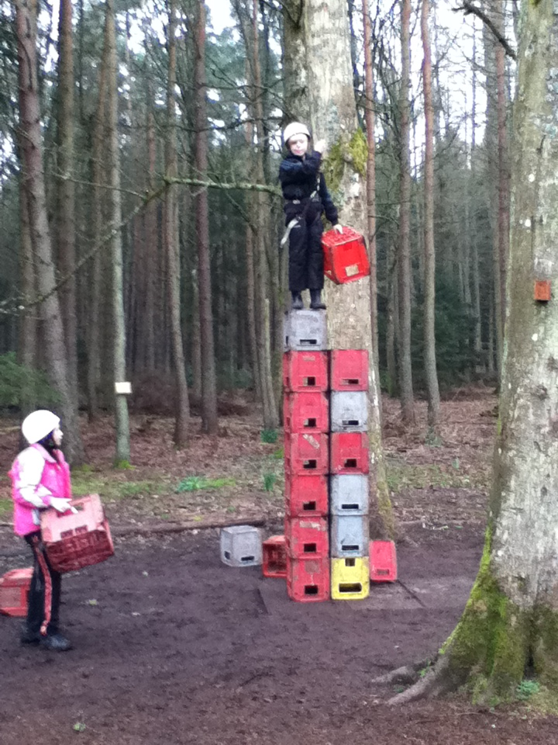
Facing new challenges…

Slide 35
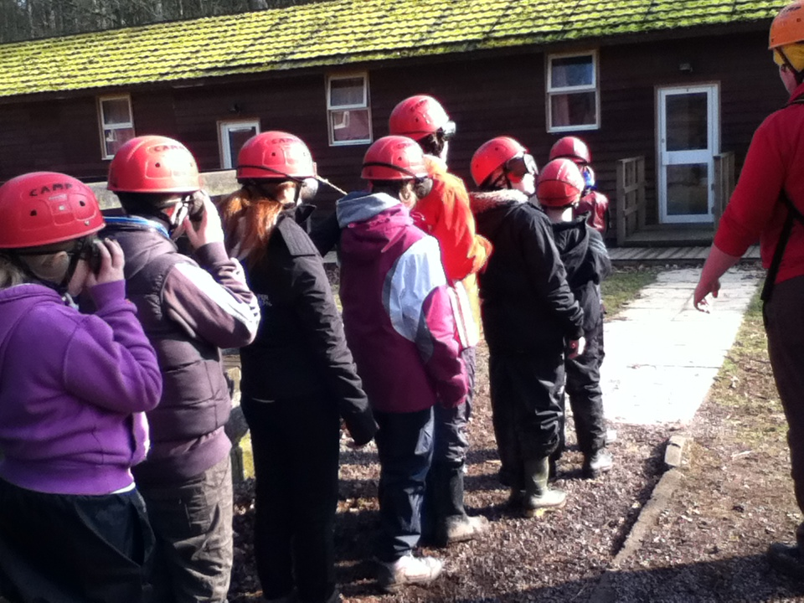
Trusting one another…

Slide 36
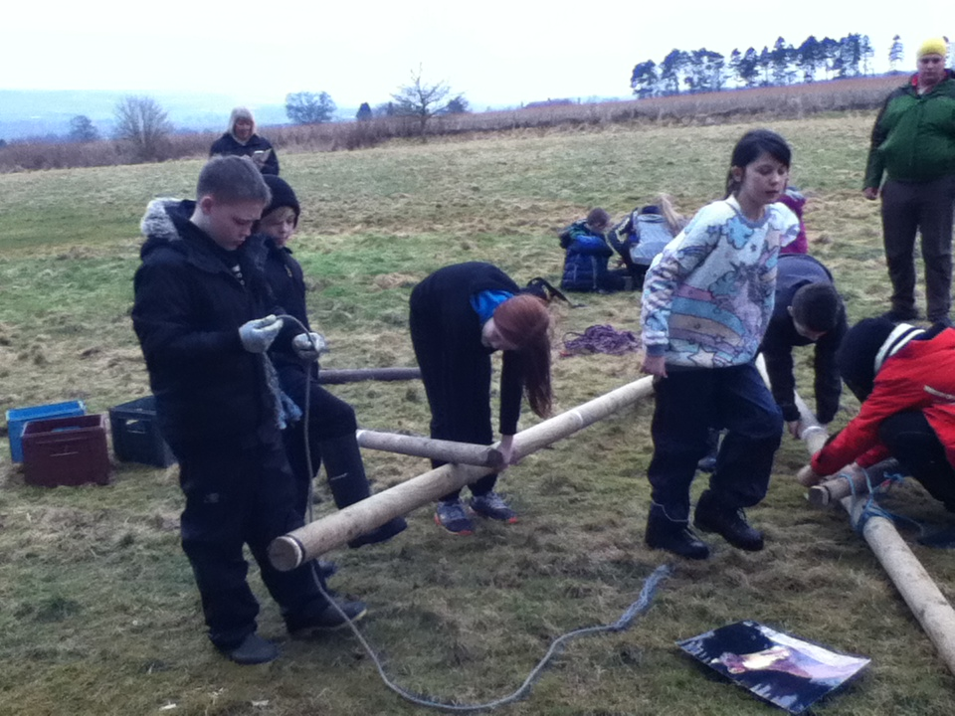
Working together as a team…

Slide 37
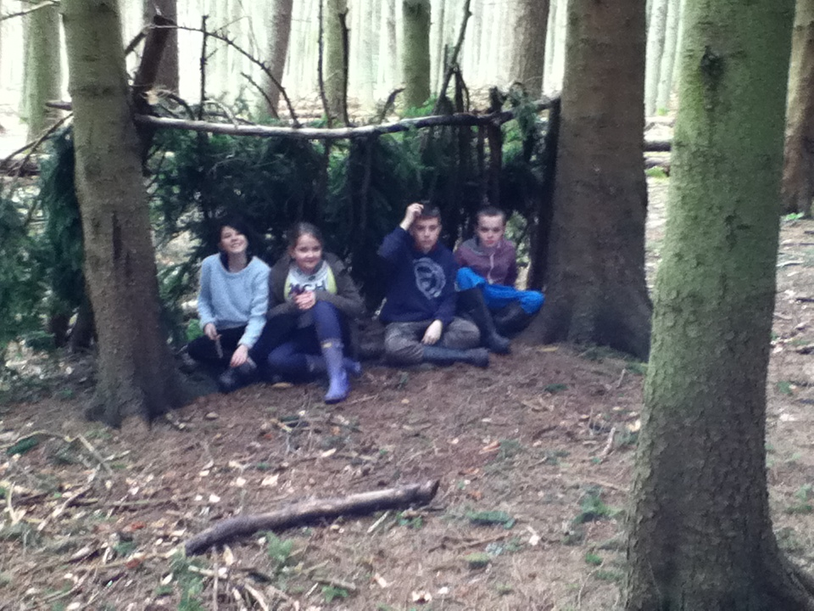
Outdoor living… Belmont style!

Slide 38
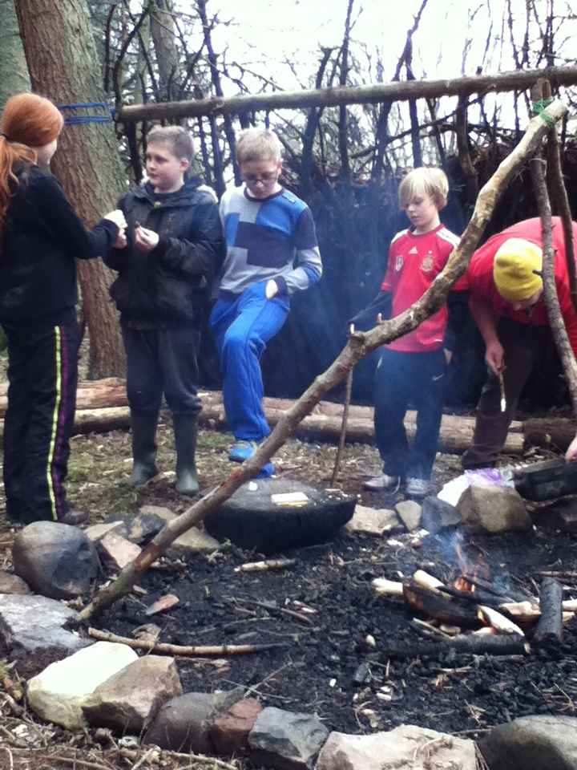
Cooking…

Slide 39
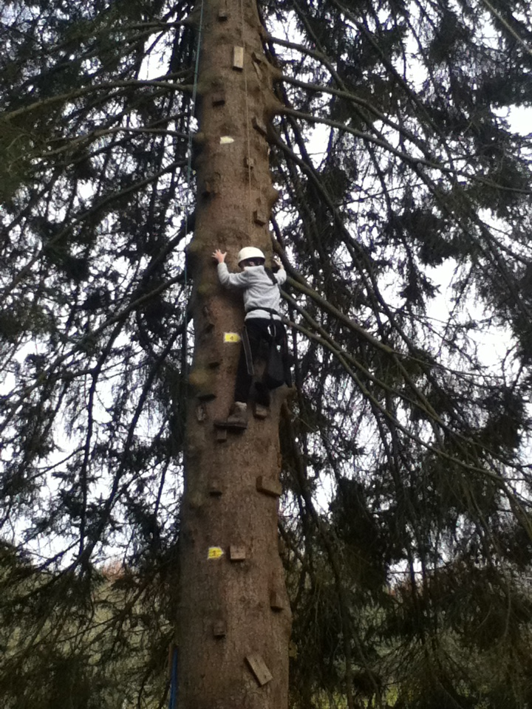
Only 8m to go!

Slide 40
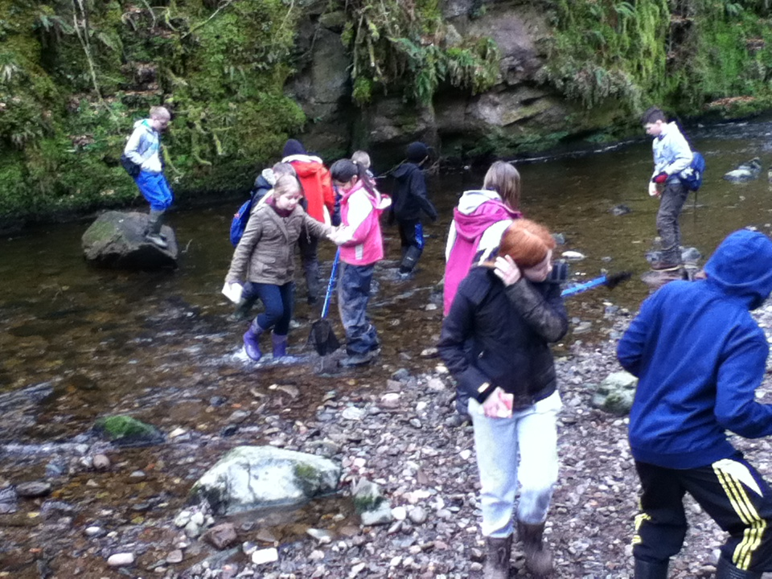
Exploring the river…

Slide 41
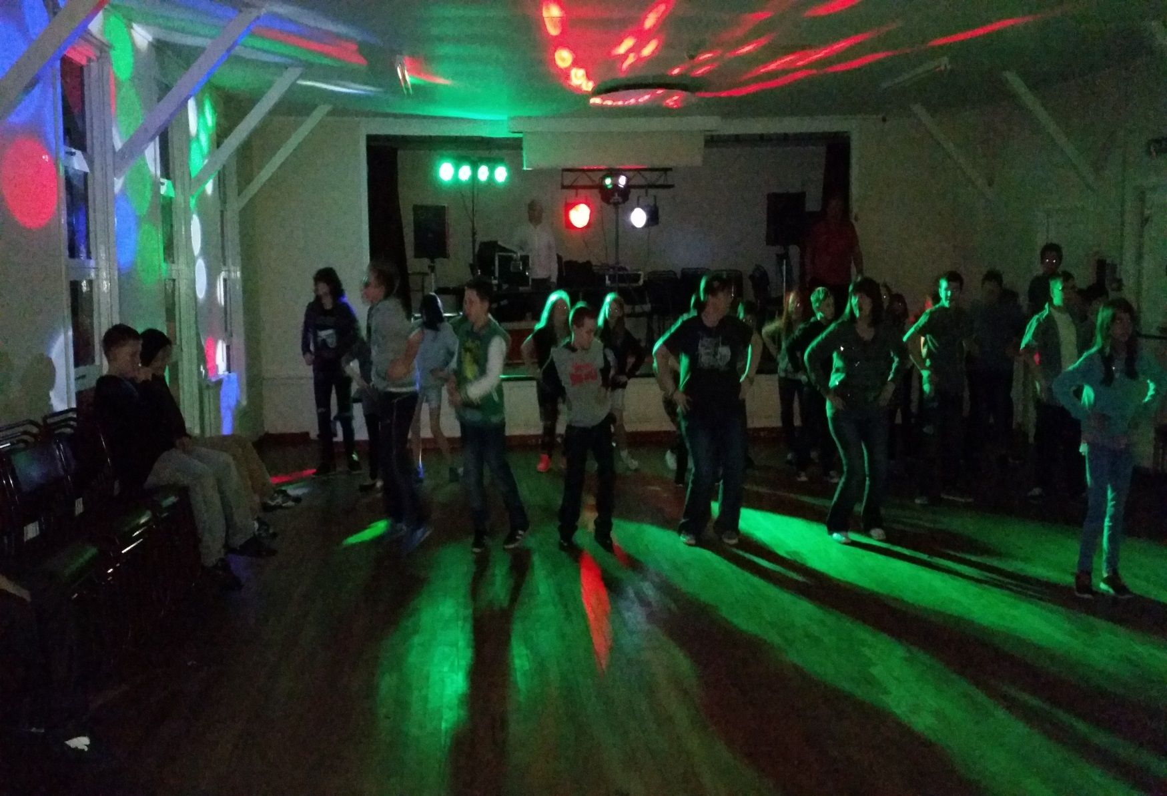
Thursday Night Fever…!

Slide 42
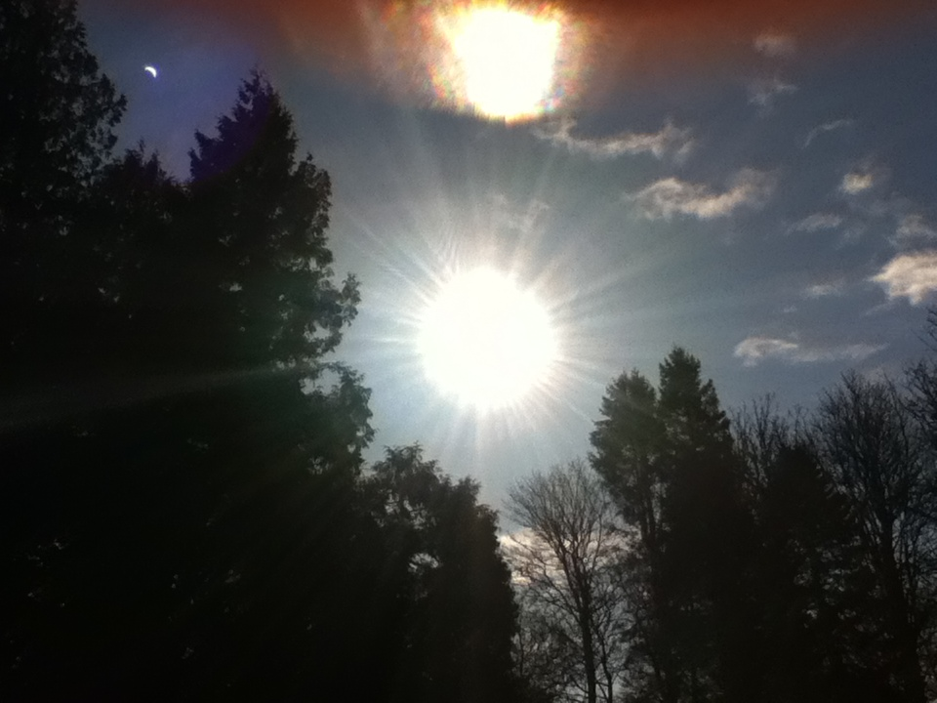
The Eclipse!

Slide 43
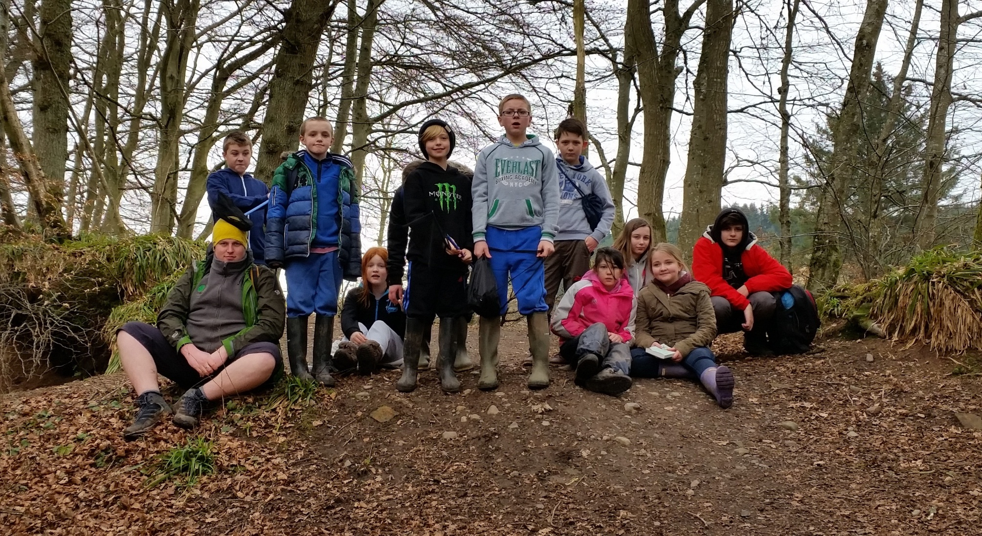
Camp 2015

Slide 44
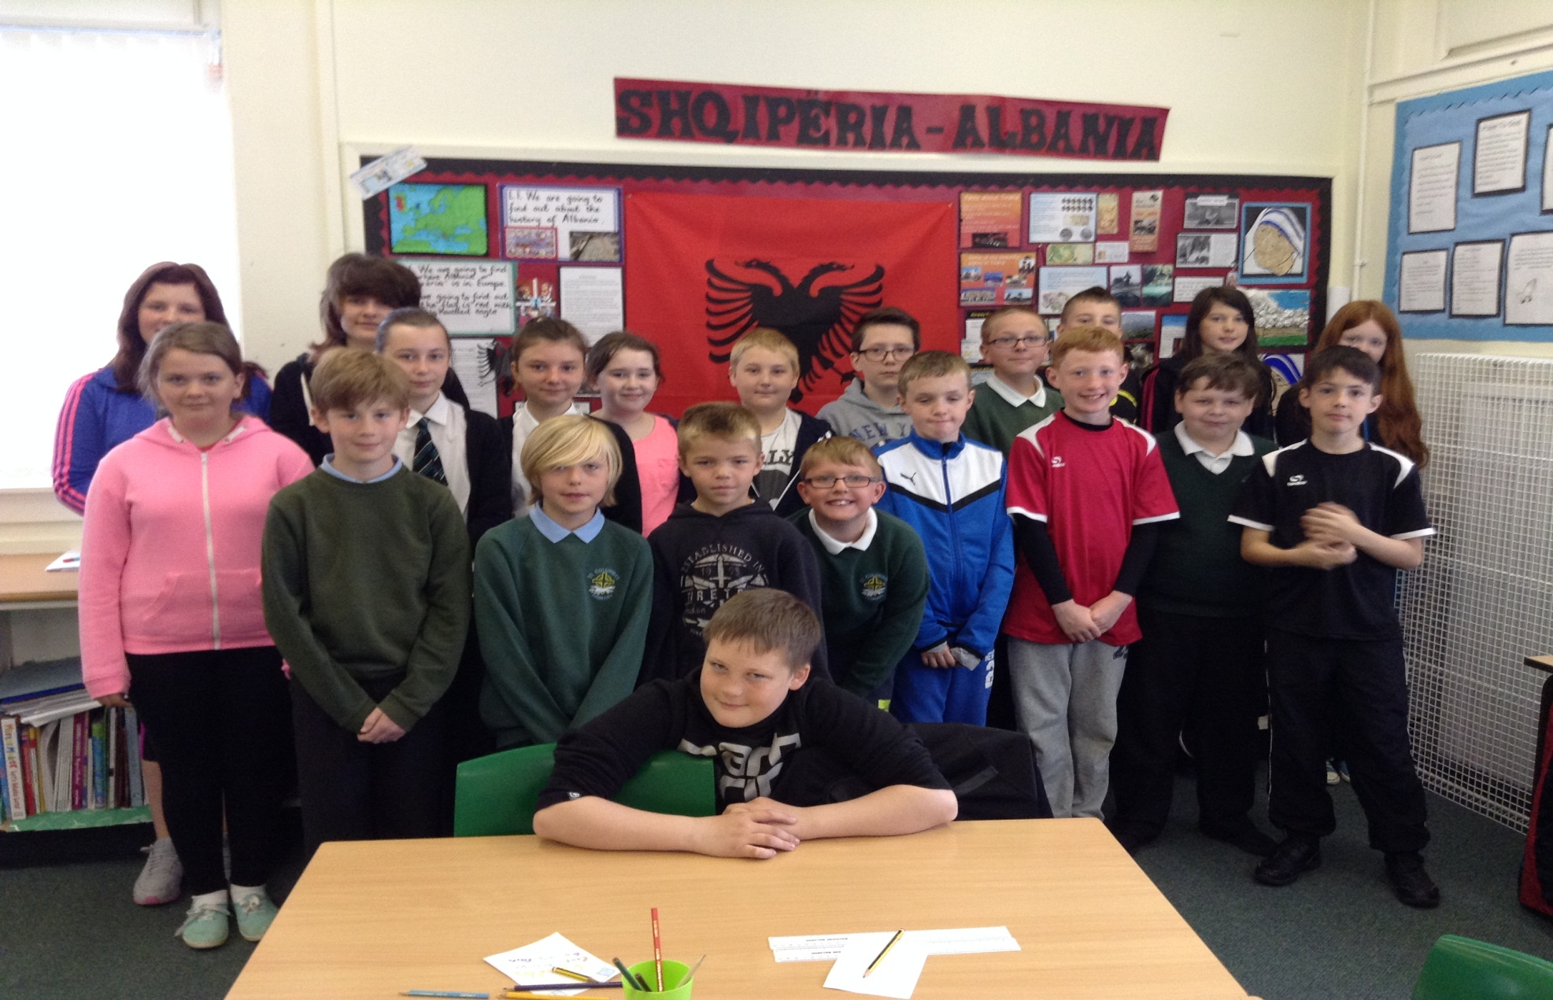
Shqipëria-Albania

Slide 45
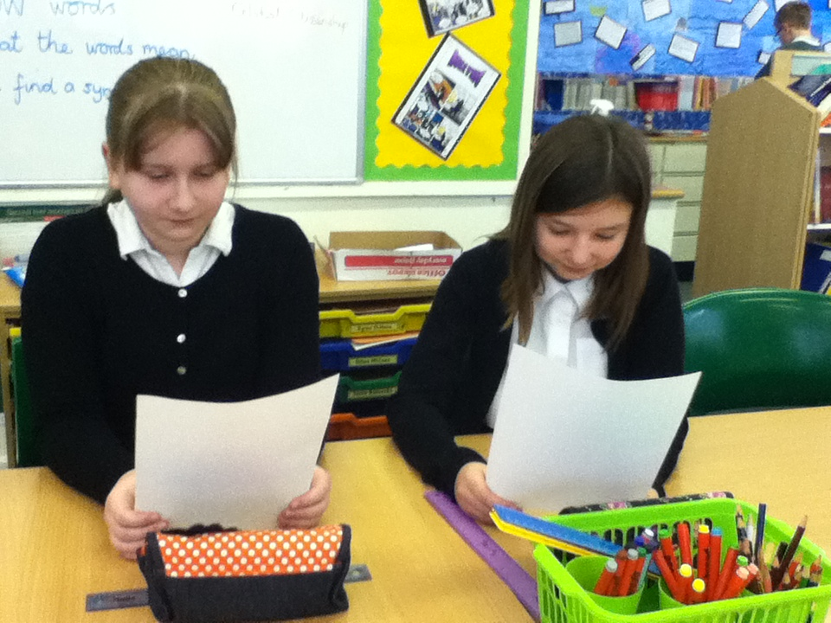
Reading the news . Practising for our Sky Skills Studio Visit.

Slide 46
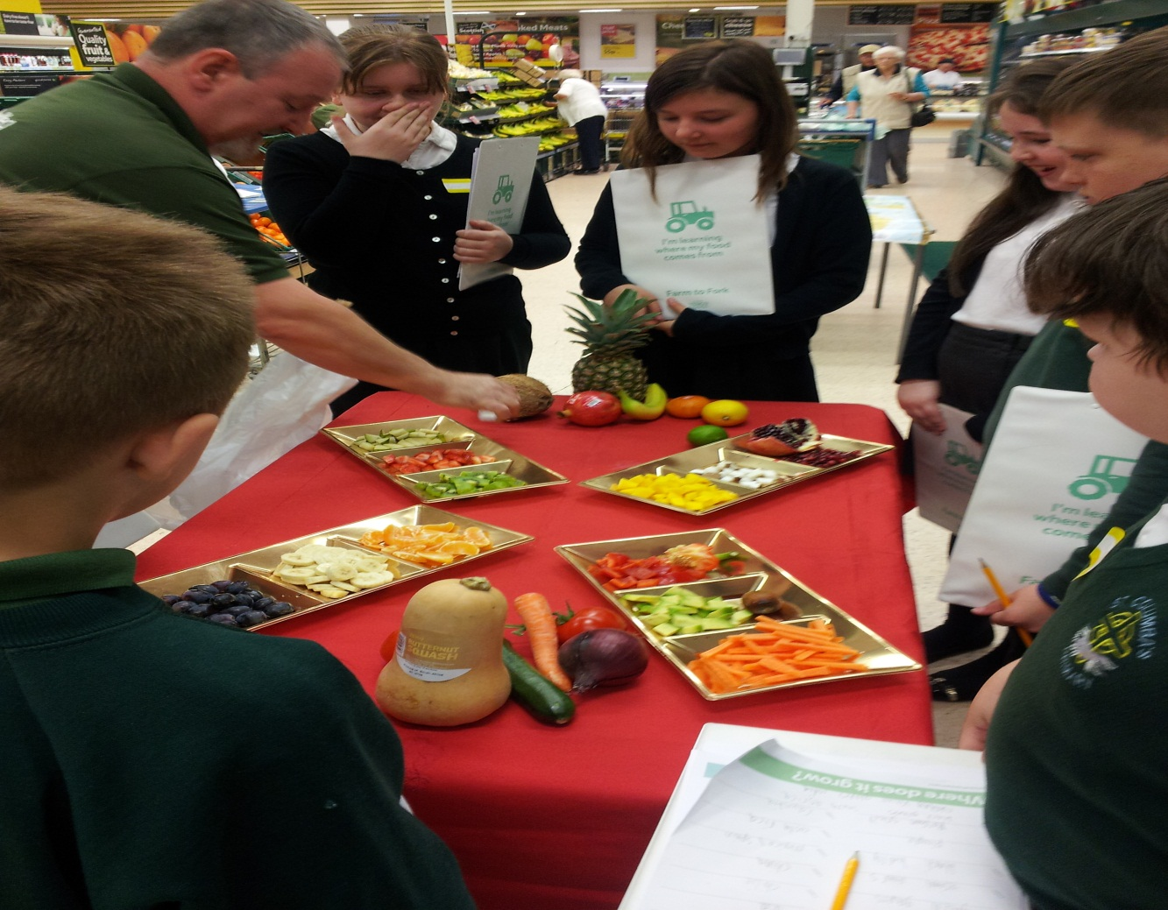
Tasting fruits and vegetables from around the world at Tesco’s.

Slide 47
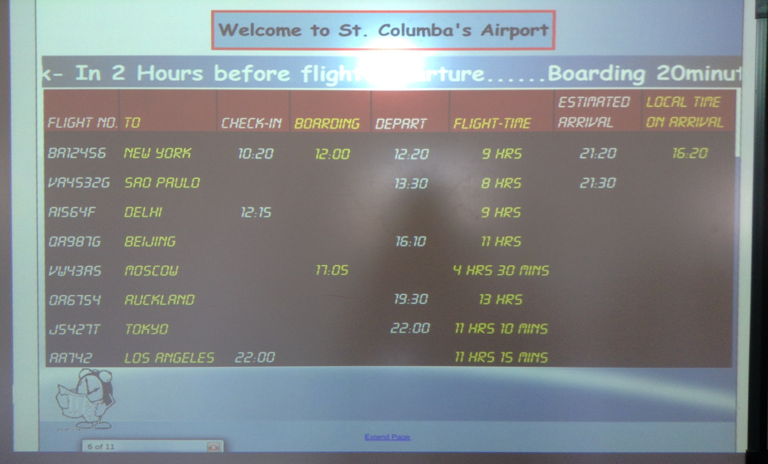
Did you know we had an airport?

Slide 48
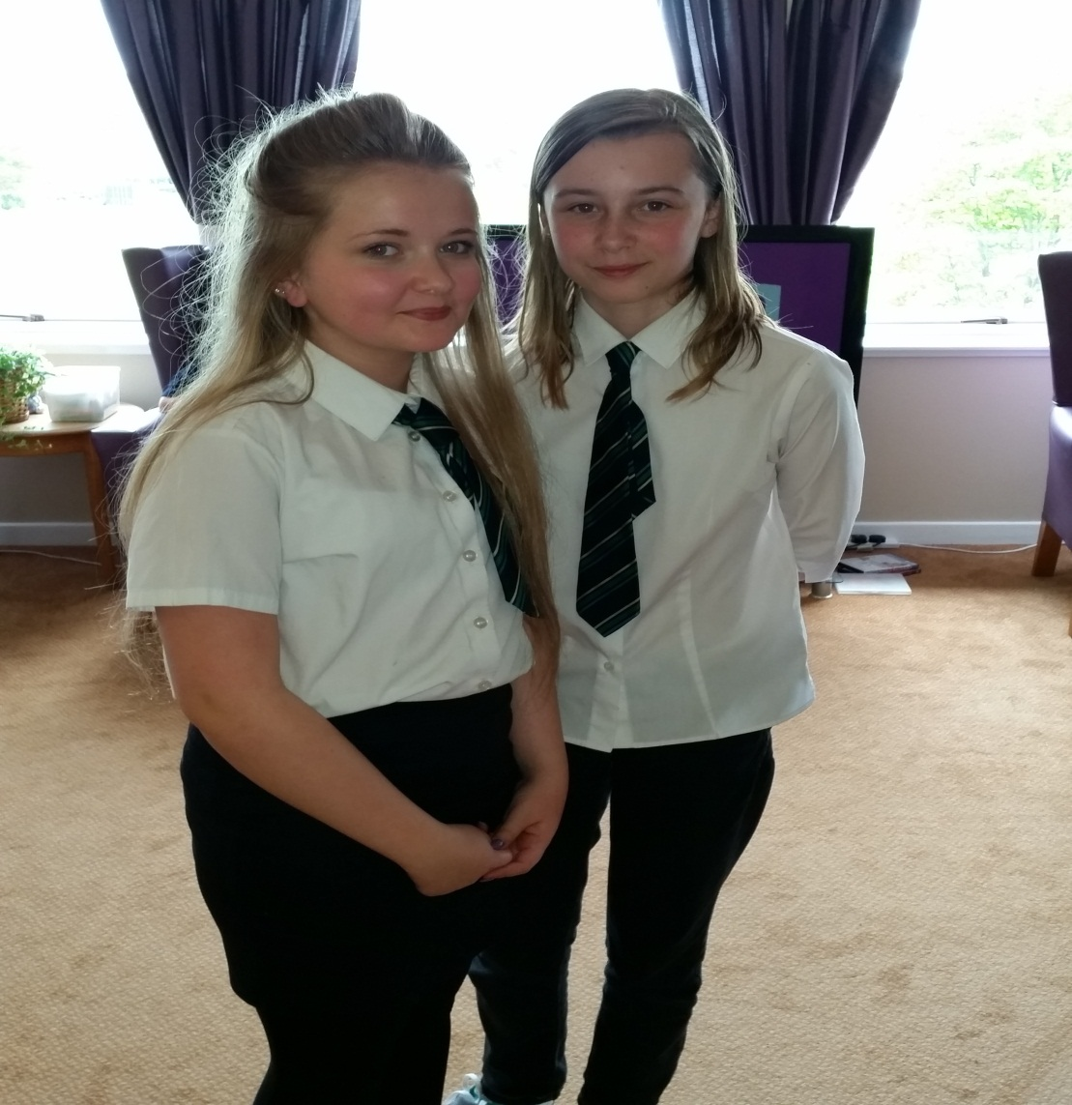
Visiting and talking to residents at Meadowvale Nursing Home.

Slide 49
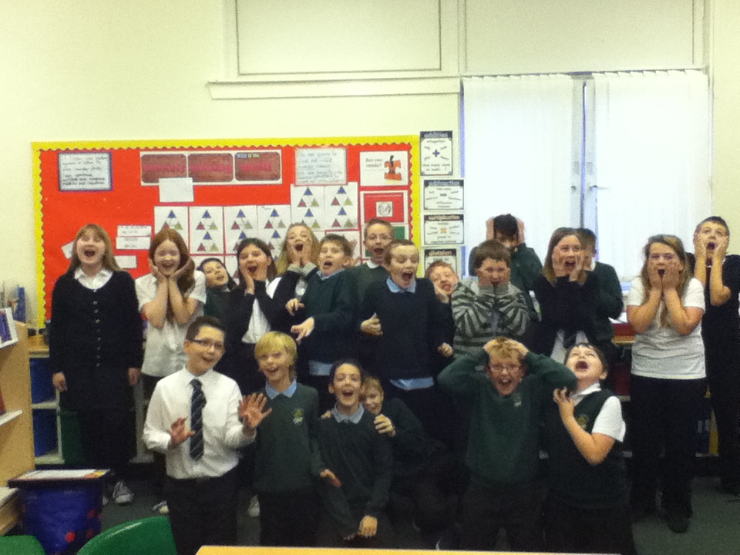
What a busy year!

