Slide 1
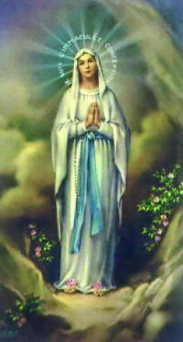
Our Lady
Primary 5/6
Notes:
Welcome to our Assembly Today, as a school, we will honour our Lady Let us pray - Our Father

Slide 2
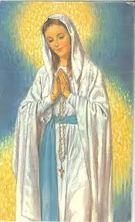
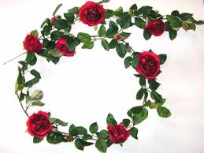
Mary the Mother of God
During the month of May we honour Our Lady, the Mother of God. We can do this by reciting the Rosary. The Rosary is the traditional devotion in honour of the Mother of God. Combining vocal and mental prayer. It is made up of 20 decades which are divided into 4 parts of decades, each of which we recall our Lord’s life, passion and Glory.
The Rosary is the prayer which is most pleasing to Our Lady. The word Rosary means a garland or wreath of roses and each prayer said in the Rosary is a spiritual rose offered to our blessed Mother.

Slide 3
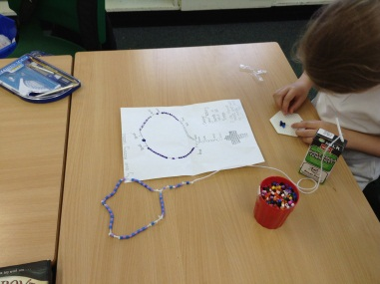
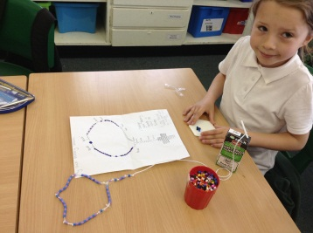
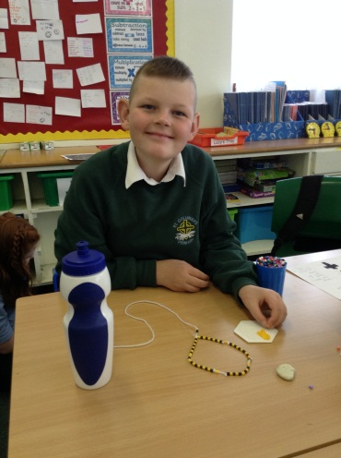
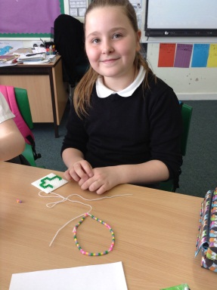
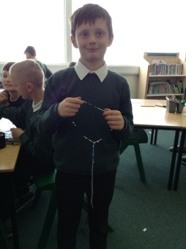
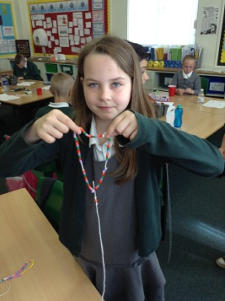
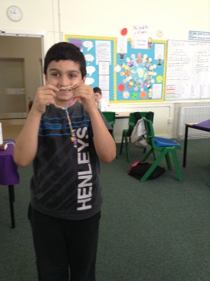
Primary 5/6 designed and then made their own set of Rosary beads…. aren’t they wonderful?

Slide 4
Ave Maria
1. As I kneel before you,
as I bow my head in prayer,
take this day, make it yours
and fill me with your love.
Ave, Maria, gratia plena,
Dominus tecum, benedicta tu
2. All I have I give you,
ev’ry dream and wish are yours;
mother of Christ, mother of mine,
Present them to my Lord
Notes:
Please join in with our Hymn

Slide 5
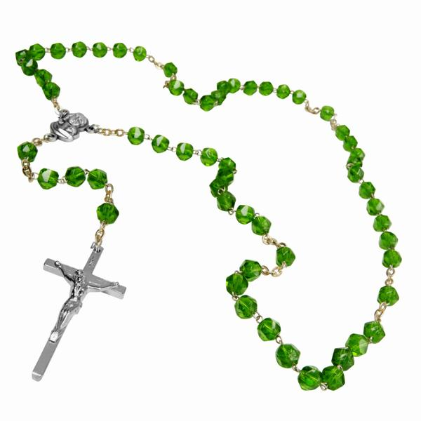
The 5 joyful Mysteries
The Annunciation
The Visitation
The Nativity
The Presentation in the Temple
The Finding in the Temple
Notes:
The Rosary is a special set of prayers to God that help us to remember the most important events in the lives of Mary and Jesus. These events are called the Mysteries. There are 20 mysteries altogether. Today we are going to look at the 5 Joyful mysteries a little more closely.

Slide 6
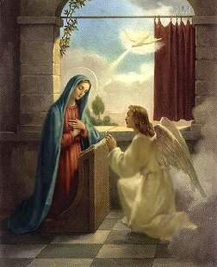
The Annunciation
Because Mary was a very special person, God sent an Angel to ask her to be the mother of Jesus. She said “yes” even though she was a little afraid. The Angel told her to name the baby Jesus.

Slide 7
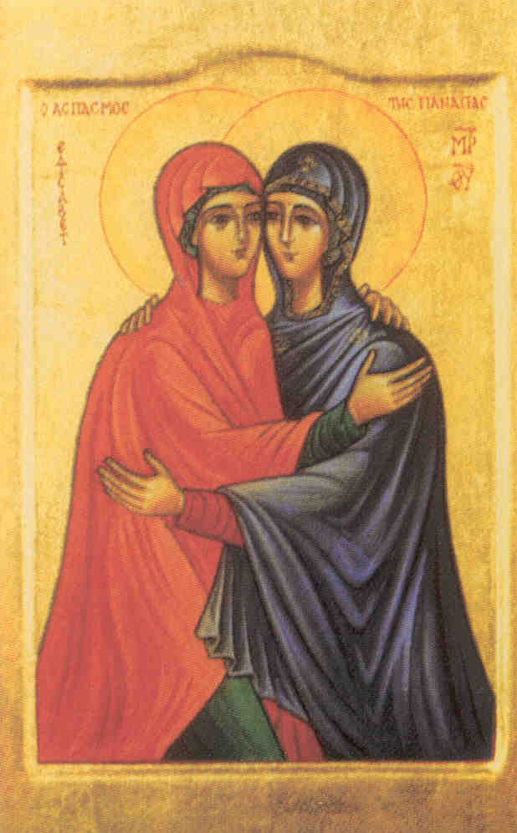
The Visitation
Mary was told by the Angel that her cousin, Elizabeth, was going to have a baby too. Mary went to visit Elizabeth to help her. Elizabeth became the mother of John the Baptist, who preached about the coming of Jesus.

Slide 8
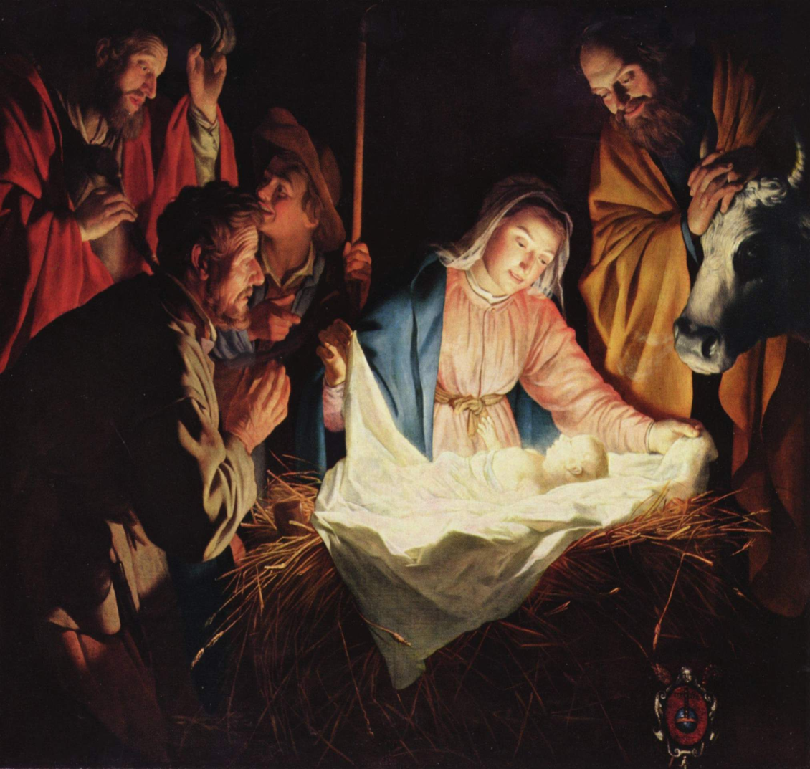
The Nativity
Jesus was born in a stable in the city of Bethlehem. When he was born, Mary and her husband Joseph were very happy and promised to take care of him.

Slide 9
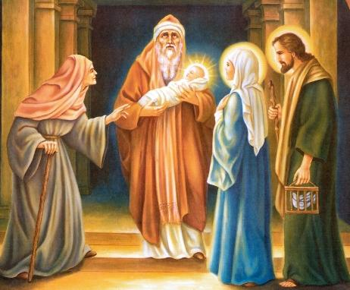
The Presentation in the Temple
After he was born, Mary and Joseph took Jesus to the temple in Jerusalem. At the temple, they presented Jesus to God and thanked God for giving them a son to love and cherish.

Slide 10
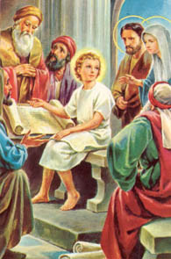
The Finding in the Temple
When he was a little older, Jesus went to a service at the temple with Mary and Joseph. After the service, he stayed to talk to the teachers. Mary and Joseph thought he was lost and were very glad to find him there.
www.youtube.com/watch?v=i6MvzhrvnMs
Notes:
Now we will watch a short clip as Mary describes the day she and Joseph lost Jesus.

Slide 11
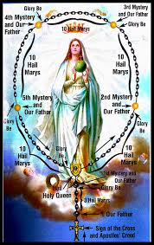
The Rosary
Together as a school we will say the first decade of the Rosary, led by primary 5/6, to honour Our Lady.
please join in.

Slide 12
Holy virgin by Gods Decree
Holy Virgin, by God’s Decree,
you were called eternally;
that he could give his Son to our race.
Mary, we praise you, hail full of grace.
Ave, ave, ave, Maria
By your faith and loving accord,
as the handmaid of the Lord,
you undertook God’s plan to embrace.
Mary, we thank you, hail, full of grace.

Slide 13
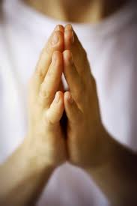
Bidding Prayers
We pray for all those who suffer and those who care for them, as Mary knew the agony of her son's suffering when she stood at the foot of the cross.
May God bless all those who suffer.
Lord Hear us
Response: Lord, Graciously hear us
We pray for our family and friends and all those who care for us, may Mary protect them all with her prayers. Lord, hear us.
Response: Lord, graciously hear us.

Slide 14
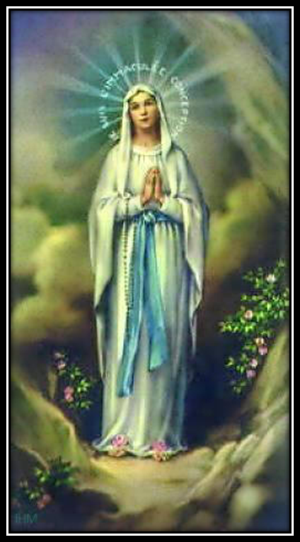
Our Lady
P5/6
Notes:
Thank you for listening to our assembly and remember to keep Mary in your prayers

