Slide 1
How the Weekly Brig was made
P6/7

Slide 2
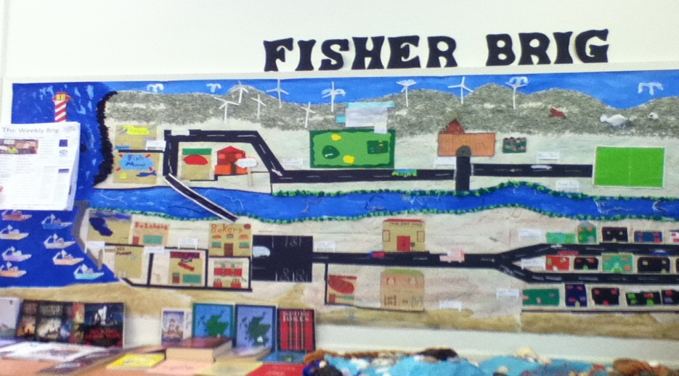
The Main Idea
After a discussion with Miss Angus we came up with an idea to make a newspaper for our fishing village ‘Fisher Brig’.

Slide 3
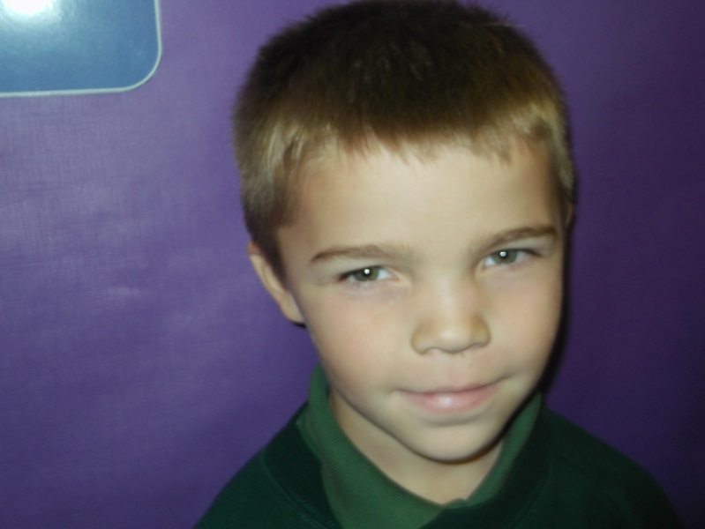
Naming Our Newspaper
Ethan came up with a name for our newspaper “The Weekly Brig” and we all agreed.

Slide 4
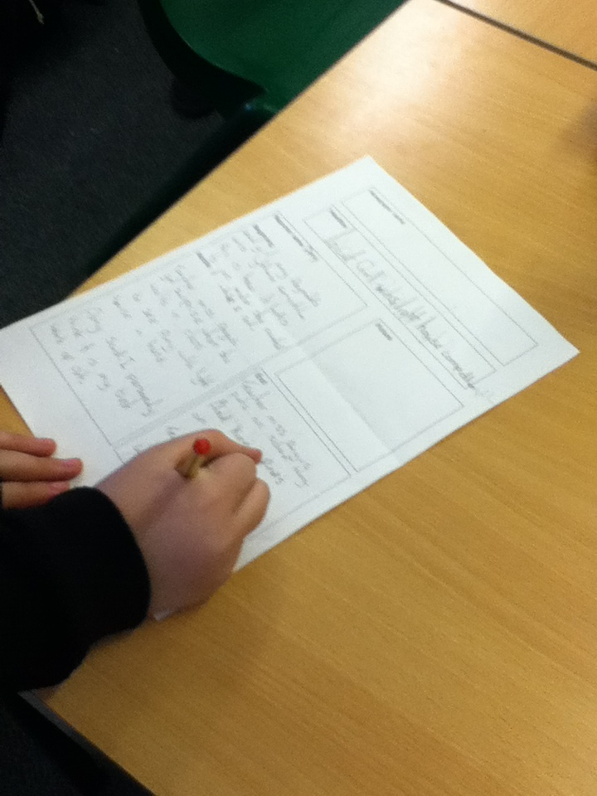
Planning The Article
First we discussed as a class, and then planned what we were going to write about .

Slide 5
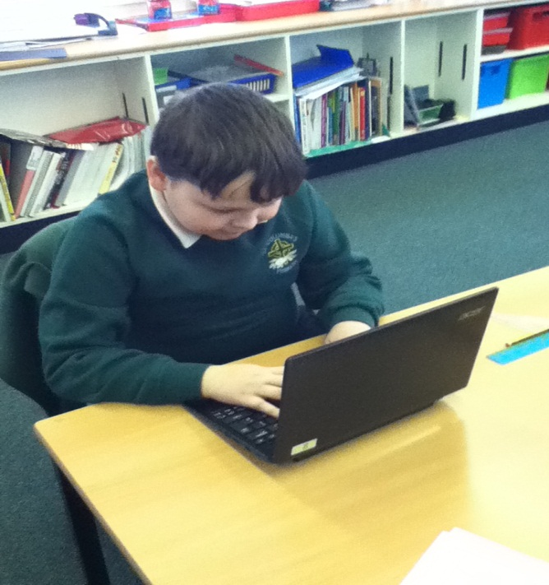
Typing it up
Once we had finished planning the article we typed it up on a notebook.

Slide 6
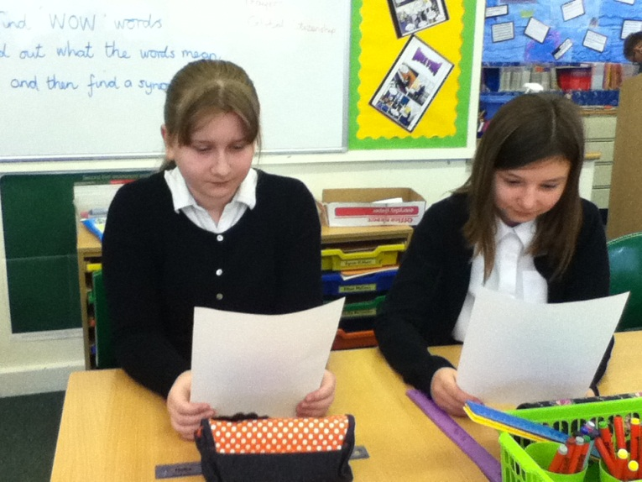
Checking and Editing
We all read and checked each other’s work for spelling mistakes, punctuation and any other errors.

Slide 7
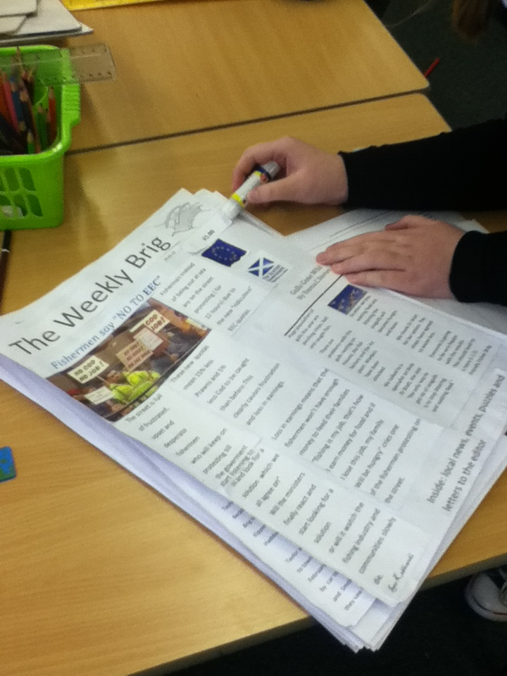
Setting it out
Then we printed them out and stuck them on A3 paper.

Slide 8
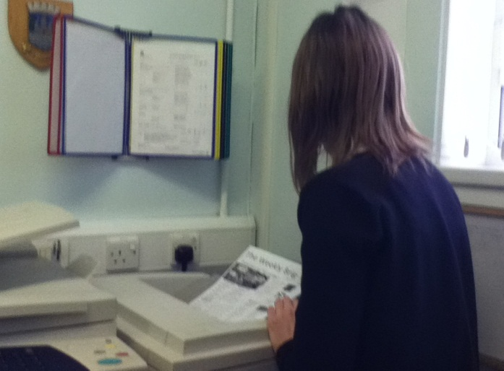
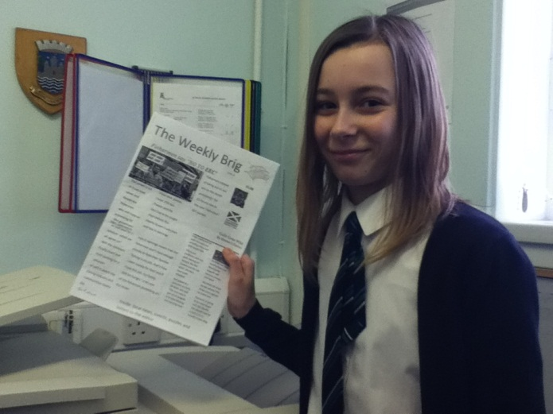
Publishing
Finally we printed out lots of copies and we are ready to sell them.

Slide 9
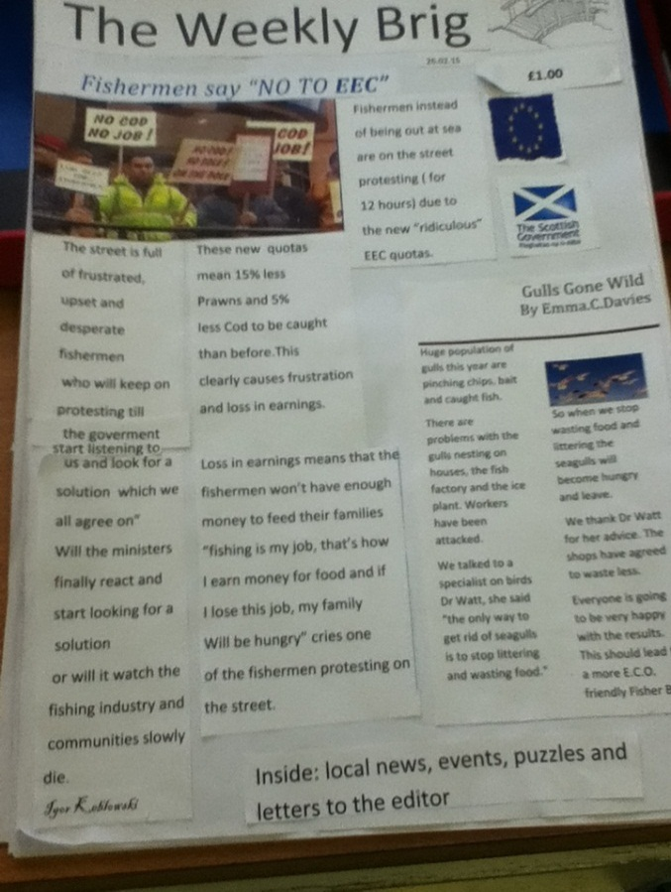
Finishing
The newspaper is a bargain
at only £1! All profits are
going to the Wee Box
Appeal for SCIAF.
Orders will be taken if
sold out.

