Slide 1
Friday 19-6-20
Good Morning Everyone!

Slide 2
Today’s Timetable
Daily Exercise
Sumdog Challenge
Saint Kentigern
Music
Art
Video Task
Prayer

Slide 3
Daily Exercise
A bit of disco francais to start the day:-
https://www.youtube.com/watch?v=KVhfIgghOPw
Or join the Body coach at 9am

Slide 4
Sumdog Maths Challenge
Please continue with the Maths Challenge I have set for you on Sumdog. This is a really good way to improve your knowledge of the Maths topics we have covered this year.
This is the final day of the Maths Challenge. Please try to complete it by the end of the day. If you have log-in details for IDL Maths please continue to access this as normal.
SUMDOG

Slide 5
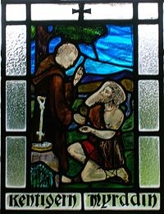
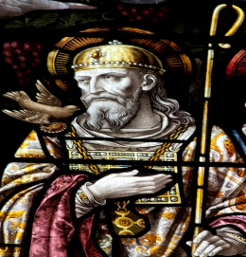
Saint Kentigern
Saint Kentigern is also known as Saint Mungo.
Watch the video below to find out more about him:-
https://www.facebook.com/sanctafamiliamedia/videos/2172334726428963/
The symbols of the miracles associated with Saint Kentigern can be found in Glasgow’s coat of arms.

Slide 6
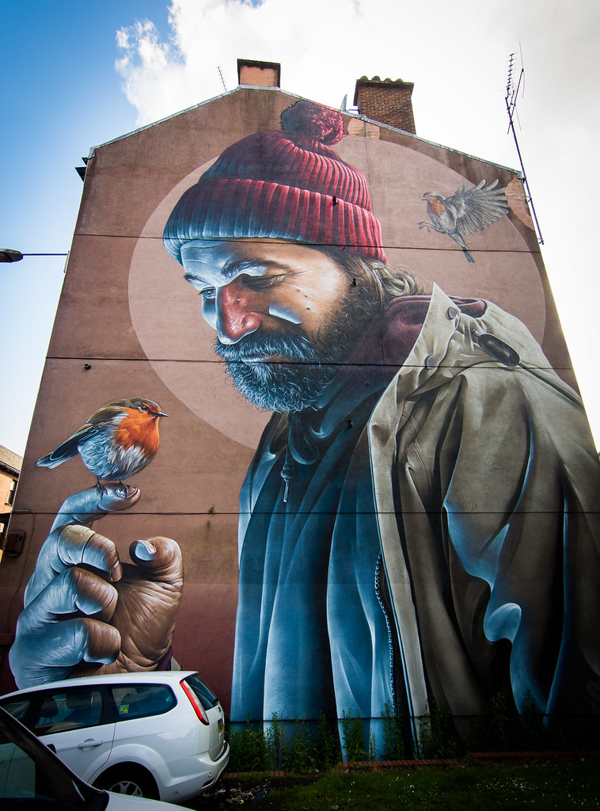
Art Mural of St Mungo in Glasgow

Slide 7
Music
Click on the link below to join in with the daily activity from the National Youth Choir of Scotland.
https://youtu.be/Sg0wgzcmsqc

Slide 8
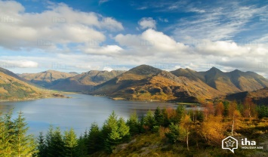
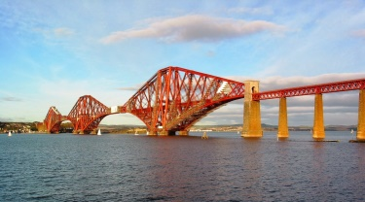
Art
I thought it would be good to do a bit of landscape drawing today. I was trying to connect it to your topic but found it difficult to find any related videos.
I have therefore given you a choice, either to do a landscape drawing, which is not particularly Scottish or to draw a Scottish landmark.
Here are 2 videos on how to draw a landscape. You don’t have to exactly the same drawing, you could change some small aspects of it eg. the kind of trees you draw etc.
https://www.youtube.com/watch?v=Q5YJQ33l35c
https://www.youtube.com/watch?v=4SCKBwQYMuA
Or why not choose a Scottish landmark to draw and send it to VisitScotland. [You need to check with your parents if you are allowed to send your picture] Click on the link below:-
https://www.visitscotland.com/see-do/attractions/arts-culture/sketching-scotland/
Enjoy!

Slide 9
Video Task
Picture the scene. It’s your first day at high school and you can’t find your tie! You look EVERYWHERE for it, even in really bizarre places!! You are panic-stricken and it’s almost time to leave for the school bus. Where could it be?
Your task is to film yourself looking for your tie. You need to place your phone in a cupboard or a fridge etc. It has to be somewhere that is dark until you open it. This is really important as it will allow me to join your films together. The look on your face is important and you can say something if you like. Please note:-YOU DO NOT find your tie in the video.
Please see the next slide for some inspiration and an example of what your video should look like. Happy filming!

Slide 10
Example Video

Slide 11
A prayer to end our day
Take a few moments to say a short prayer for all your family.

