Slide 1
Yes! Today is the big day for your Teddy Bears Picnic
Let’s get ready.

Slide 2
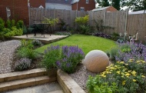
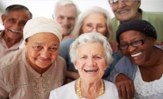
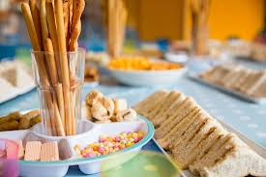
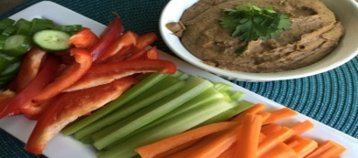
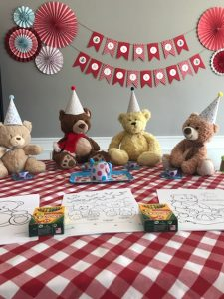
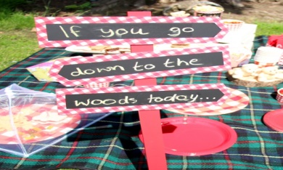
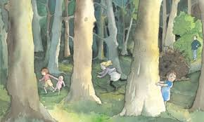
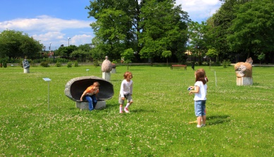
Let’s check your list of things to do.
The Location
Who is coming?
Is your food ready?
Are your decorations up?
Are your games organised?

Slide 3
Now all you have to do is have fun! Remember to share your photographs on twitter.

