Slide 1
Thursday 18-6-20
Good Morning Everyone!

Slide 2
Today’s Timetable
Daily Exercise
Sumdog Times Tables Task
Reading
Topic
Prayer

Slide 3
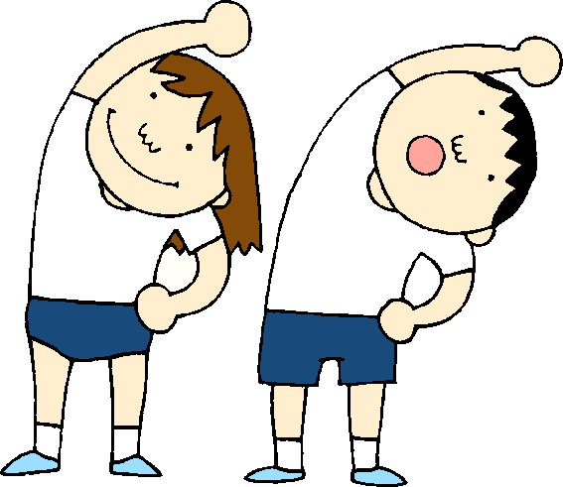
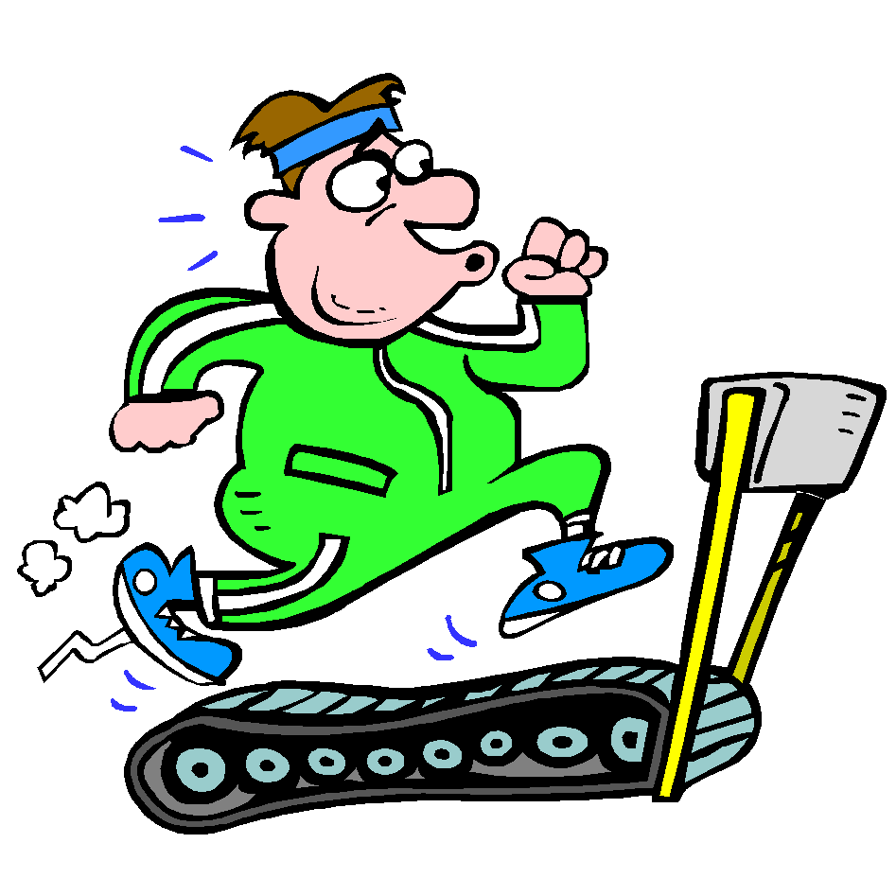
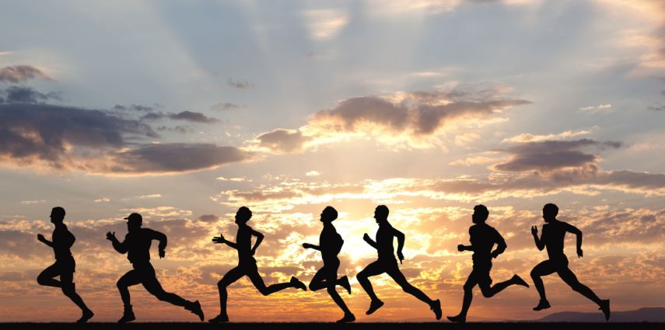
Daily Exercise
Today’s challenge is:-
https://www.youtube.com/watch?v=uqLNxJe4L2I
You could also go for a run or a walk or join the Body Coach at 9am.

Slide 4
Morning Starter
You still have today and tomorrow to complete this week’s Maths Challenge on Sumdog. If you have already completed this task, I have set an additional Times Table Challenge which is available for today only. I will award points tomorrow.
If you have log-in details for IDL Maths please continue to access this as normal.
SUMDOG

Slide 5
Literacy
Today, we’re going to do read the next 6 chapters of ‘Wonder’. [‘Genetics 101’, ‘The Punnett Square’ ‘Out with the Old’, ‘October 31’, ‘Trick or Treat’ and ‘Time to Think’]. The chapters are all very short.
Click on the link to listen to the story.
https://www.youtube.com/watch?v=Q0dxGGfVcdY&feature=emb_rel_pause
Your task, today, is just to listen to the story. There is no written task.

Slide 6
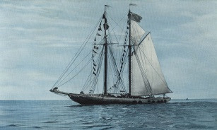
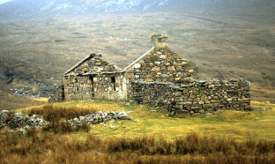
The Clearances
After the brutal treatment of the highland communities by the Duke of Cumberland[Butcher Cumberland], laws were introduced which prohibited the speaking of the Gaelic language, the wearing of tartan and the playing of the bagpipes. However, as if this was not bad enough, life became even harder for this community.
Landowners decided it was more profitable to have sheep on their land rather than small crofts. Whole communities were brutally evicted and forced from their homes and land. Although this has become known as The Clearances, nowadays we would call this ‘genocide’. Many people were forced to live close to the coast where they tried to live off the sea, many of them faced famine and died of starvation. Others were burned in their homes or forced to leave Scotland to emigrate to Canada and the USA to start a new life. This is the reason why, even today, the highlands are under populated and appear empty. They were not always like this.

Slide 7
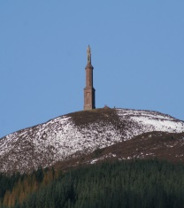
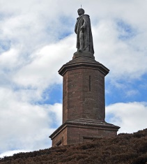
The Duke of Sutherland
One rich landowner, who was notorious for his brutal treatment of the highland people and communities in the North of Scotland, was the Duke of Sutherland. Ironically there is a statue in honour of this ruthless man, which stands on a hilltop above the village of Golspie. For many years, many people have supported the idea of the statue being removed and with the recent removal of statues after the Black Lives Matter protests, this discussion has once again come to the fore.
Your task: - Read the powerpoint attached to the blog.
Please also watch the short animation:-
https://www.youtube.com/watch?v=fYTbxnMgCfk
Here is the statue to the Duke of Sutherland. What are your thoughts? It is a very imposing statue, looking down on highland villages. Should it be taken down?
https://www.youtube.com/watch?time_continue=2&v=G5A19Z_YGSM&feature=emb_logo

Slide 8
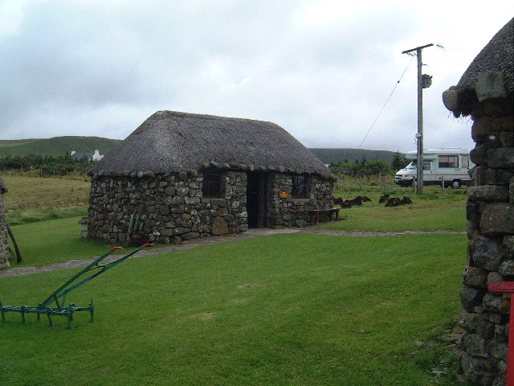
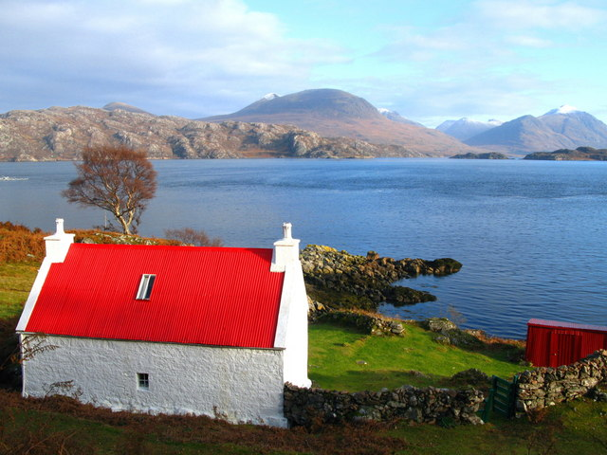
Tour of Highland Folklore Museum
Watch the following video:-
https://www.youtube.com/watch?time_continue=10&v=qY1Jjr0FWaY&feature=emb_logo
Try to sketch a highland cottage or blackhouse as shown towards the end of the video.

Slide 9
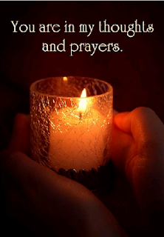
A prayer to end our day
Take a few moments to say a short prayer for all the key workers who are working hard during the lockdown.

Slide 10
Well done!
Well done for working hard today!

