Slide 1
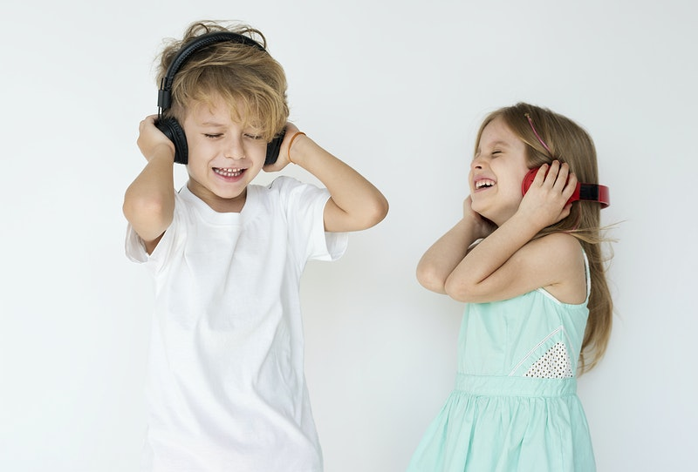
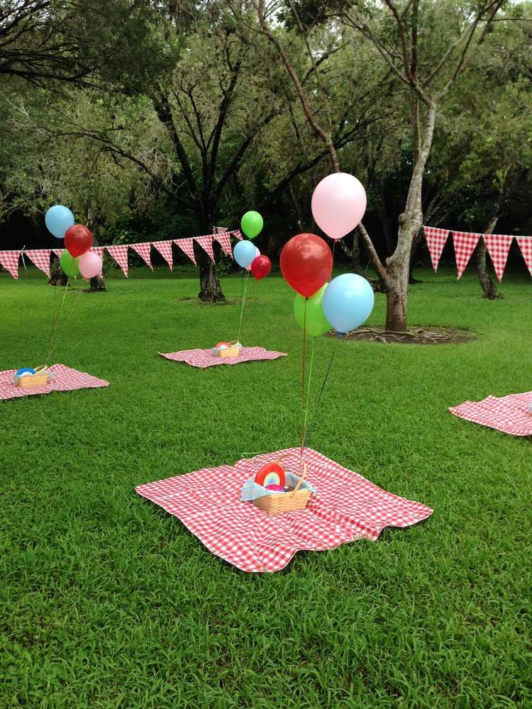
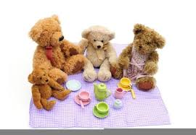
Thursday 18th June
MORNING BOYS AND GIRLS
Today we are going to be continuing our planning for our Teddy Bears’Picnic on Friday.
Can you sing along with the song? Can you learn the words off by heart?
The words and link are on the next slide.

Slide 2
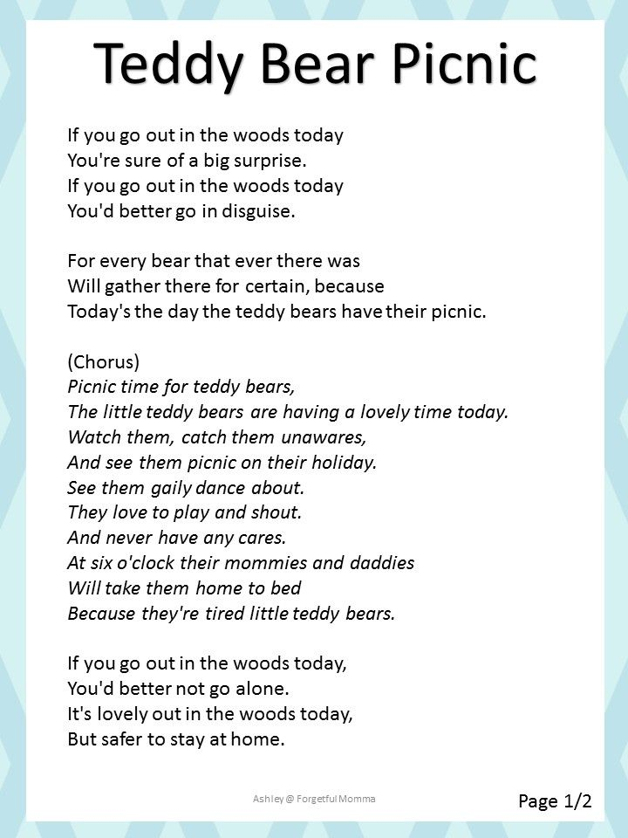
https://www.youtube.com/watch?v=uxFIGWm9M6w

Slide 3
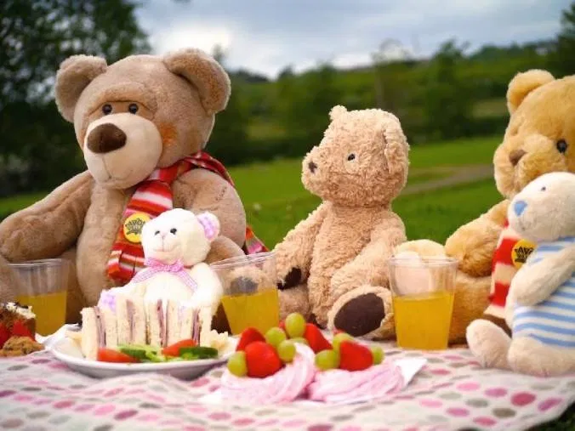
Let’s do some more planning for our Teddy Bears’ Picnic

Slide 4

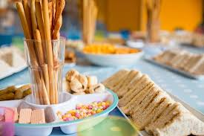
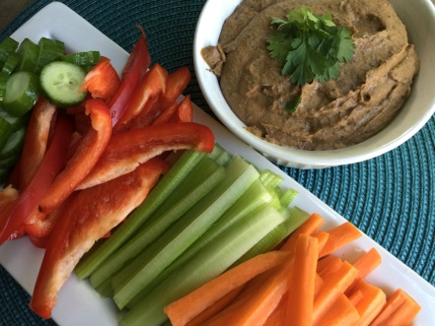
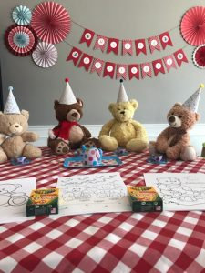
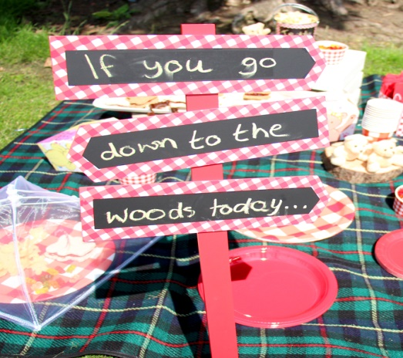
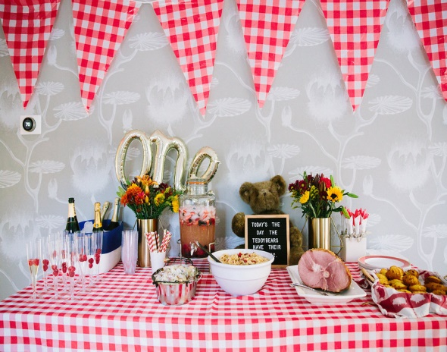
Make a list of things to do.
First of all you need a menu. What will you have to eat and drink at your picnic?
Discuss with your grown up what ingredients etc. you will need.
Make a list. Decide when you will prepare it. What will you serve the food in?
Will you have decorations at your picnic? Decide what you would like. Have a look around the
house to see what you could use. Plan /design before you start. Have fun!

Slide 5
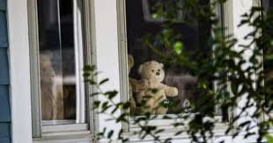

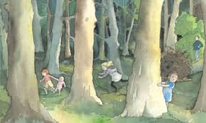

Can you think of some games you could play? (Remember Social Distancing.)
How about Hunt the Teddy? Let’s see if you can think of, or invent some more games.
Why don’t you listen to this song while you are planning?
https://www.youtube.com/watch?v=mZfAf1SNRUY

Slide 6
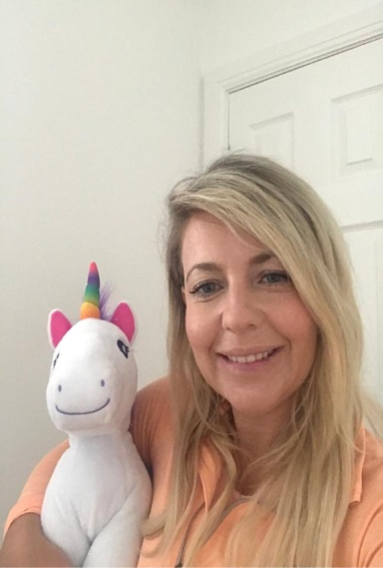
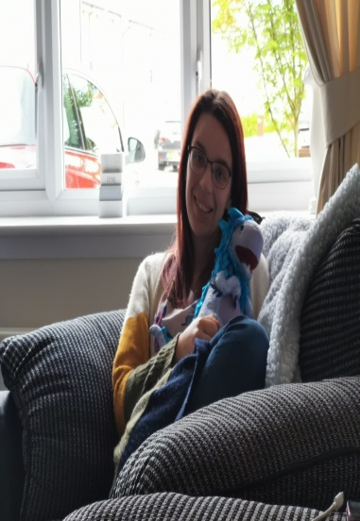
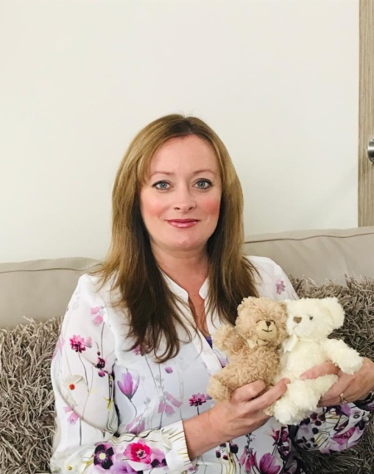
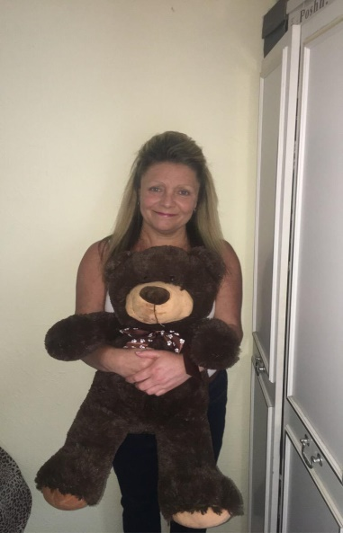
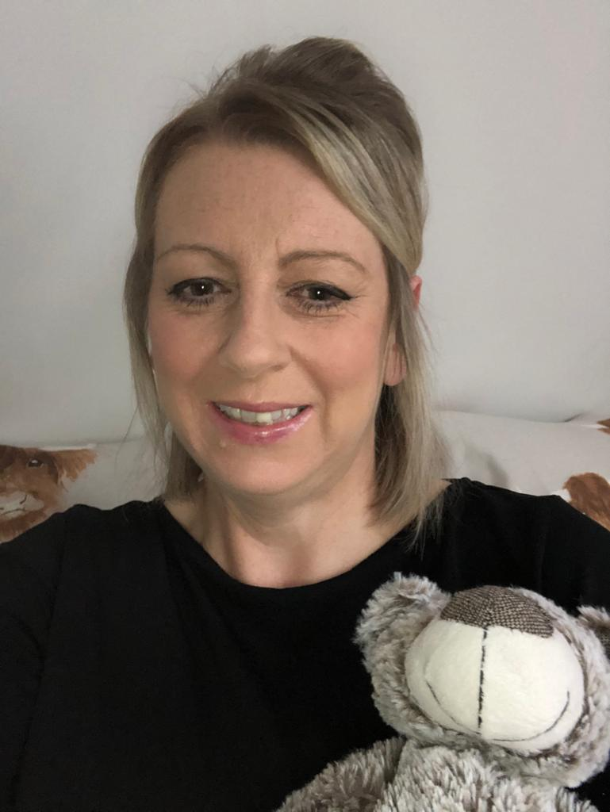
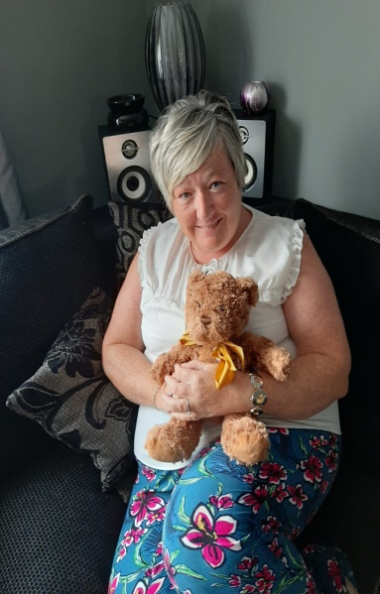
More Big People Who Love Their Teddies.

Slide 7
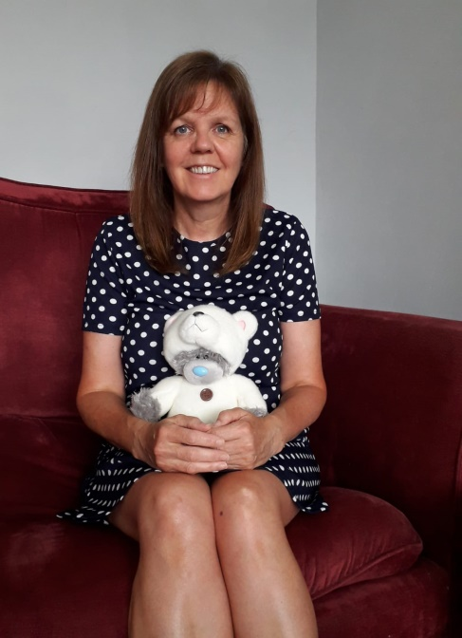
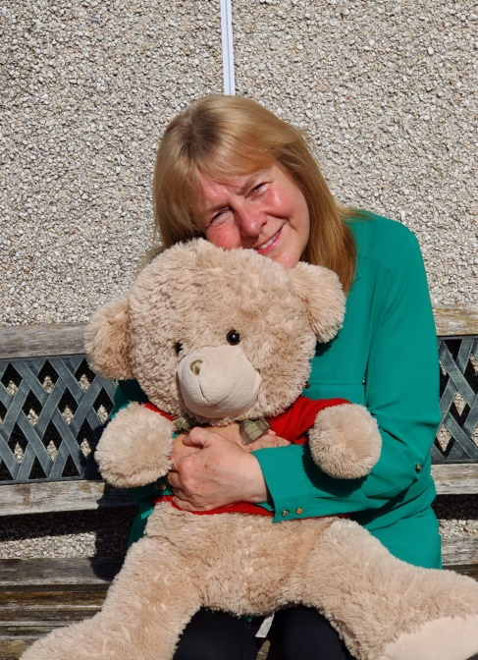
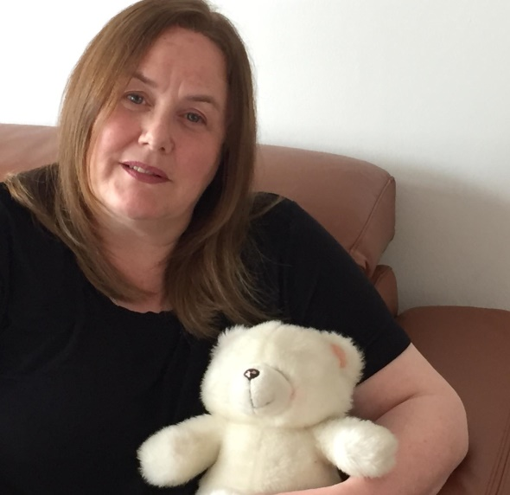
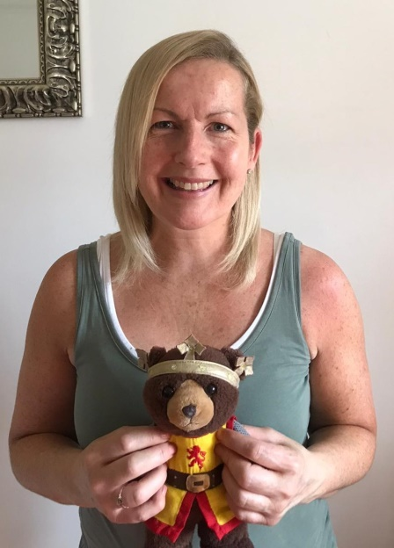
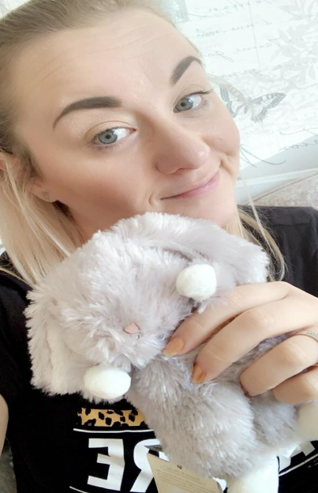
More Big People Who Love Their Teddies.

Slide 8
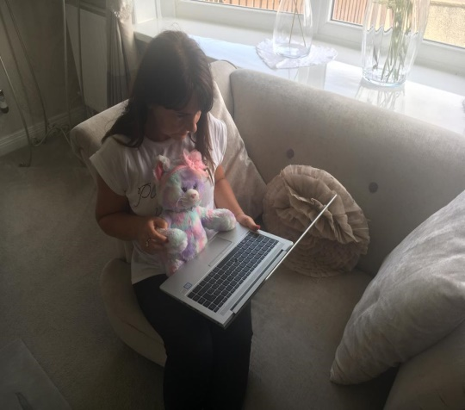
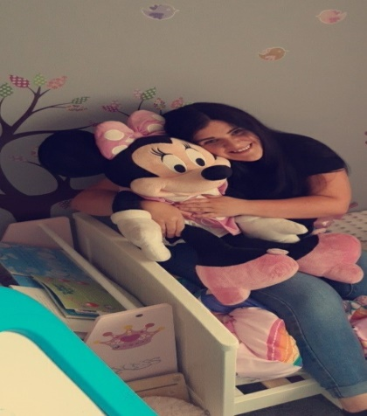
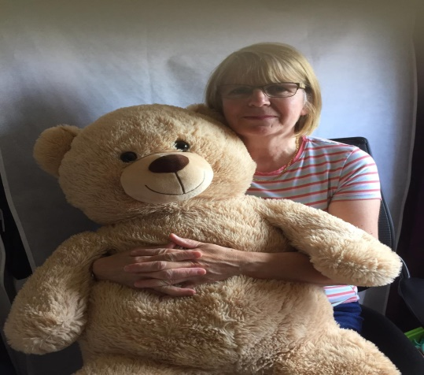
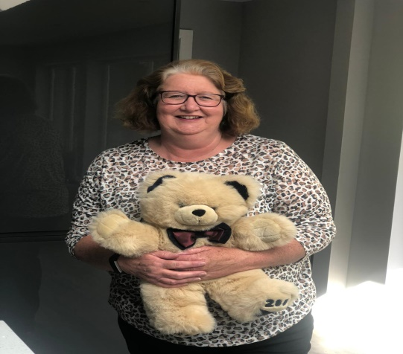
Even More Big People Who Love Their Teddies.

Slide 9
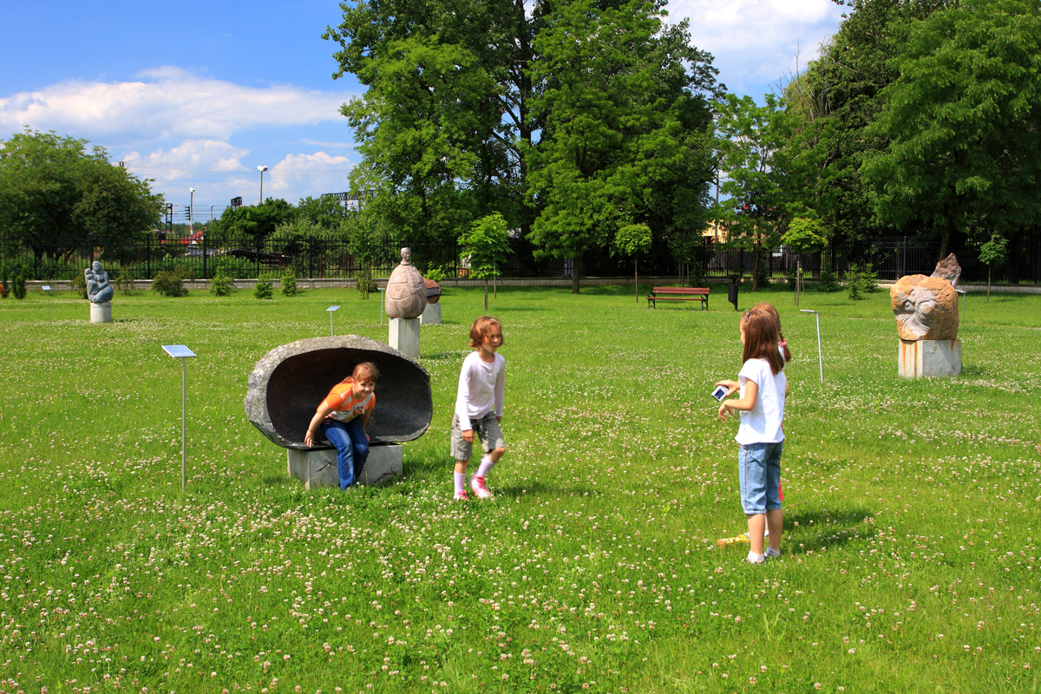
Tomorrow is the big day!
Have a rest after all your hard work. You could go outside and practise your games.

