Slide 1
Good Morning P5/4
Week 13 Home Learning
Thursday 18th June 2020

Slide 2
Aujord’hui c’est jeudi dix-huit juin.
Je suis content(e)
Je suis d’accord
Je suis mal
Il fait mauvais.

Slide 3
Class Trip!
As part of our Europe topic, every day this week we are going to be virtually visiting a European city and learning more about it!
Today, we are visiting:
BARCELONA!
Who’s excited? I know I am!
There is a new folder in teams called ‘Class Trip’ where you will find all resources for this week.

Slide 4
Passport
Remember, each time you visit a new city/landmark make sure to write it in your passport. You could create a stamp like mark for each one.

Slide 5
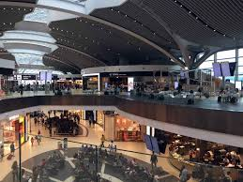
Looks like we have arrived at Rome Airport!
Here is an information video about the place.
https://www.youtube.com/watch?v=8rS9RxJiBwk
Timetable Research –
We arrive at Leonardo da Vinci International Airport (FCO) at 09:00am on Thursday 17th June.
What time is the flight to Barcelona (BCN)?
Where does the plan change over?
How long will the journey take?
What airline will you fly with?
Now time for the plan journey!
Here is a video!
https://www.youtube.com/watch?v=vTmK1mDL4-U

Slide 6
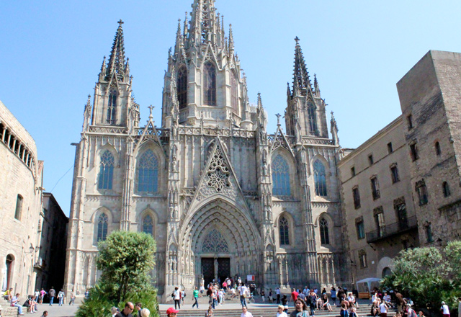
Here is a 360 degree video of Rome to give a brief overview of all the famous sights.
https://www.youtube.com/watch?v=7wNDMd8-9K8
First stop – Cathedral of Barcelona
https://catedralbcn.org/index.php?lang=en
Here is a virtual tour:
https://www.youtube.com/watch?v=INg3N-tHWdo
Maths
What sort of shapes can you see in the building architecture?
What sort of shapes can you see in the windows?

Slide 7
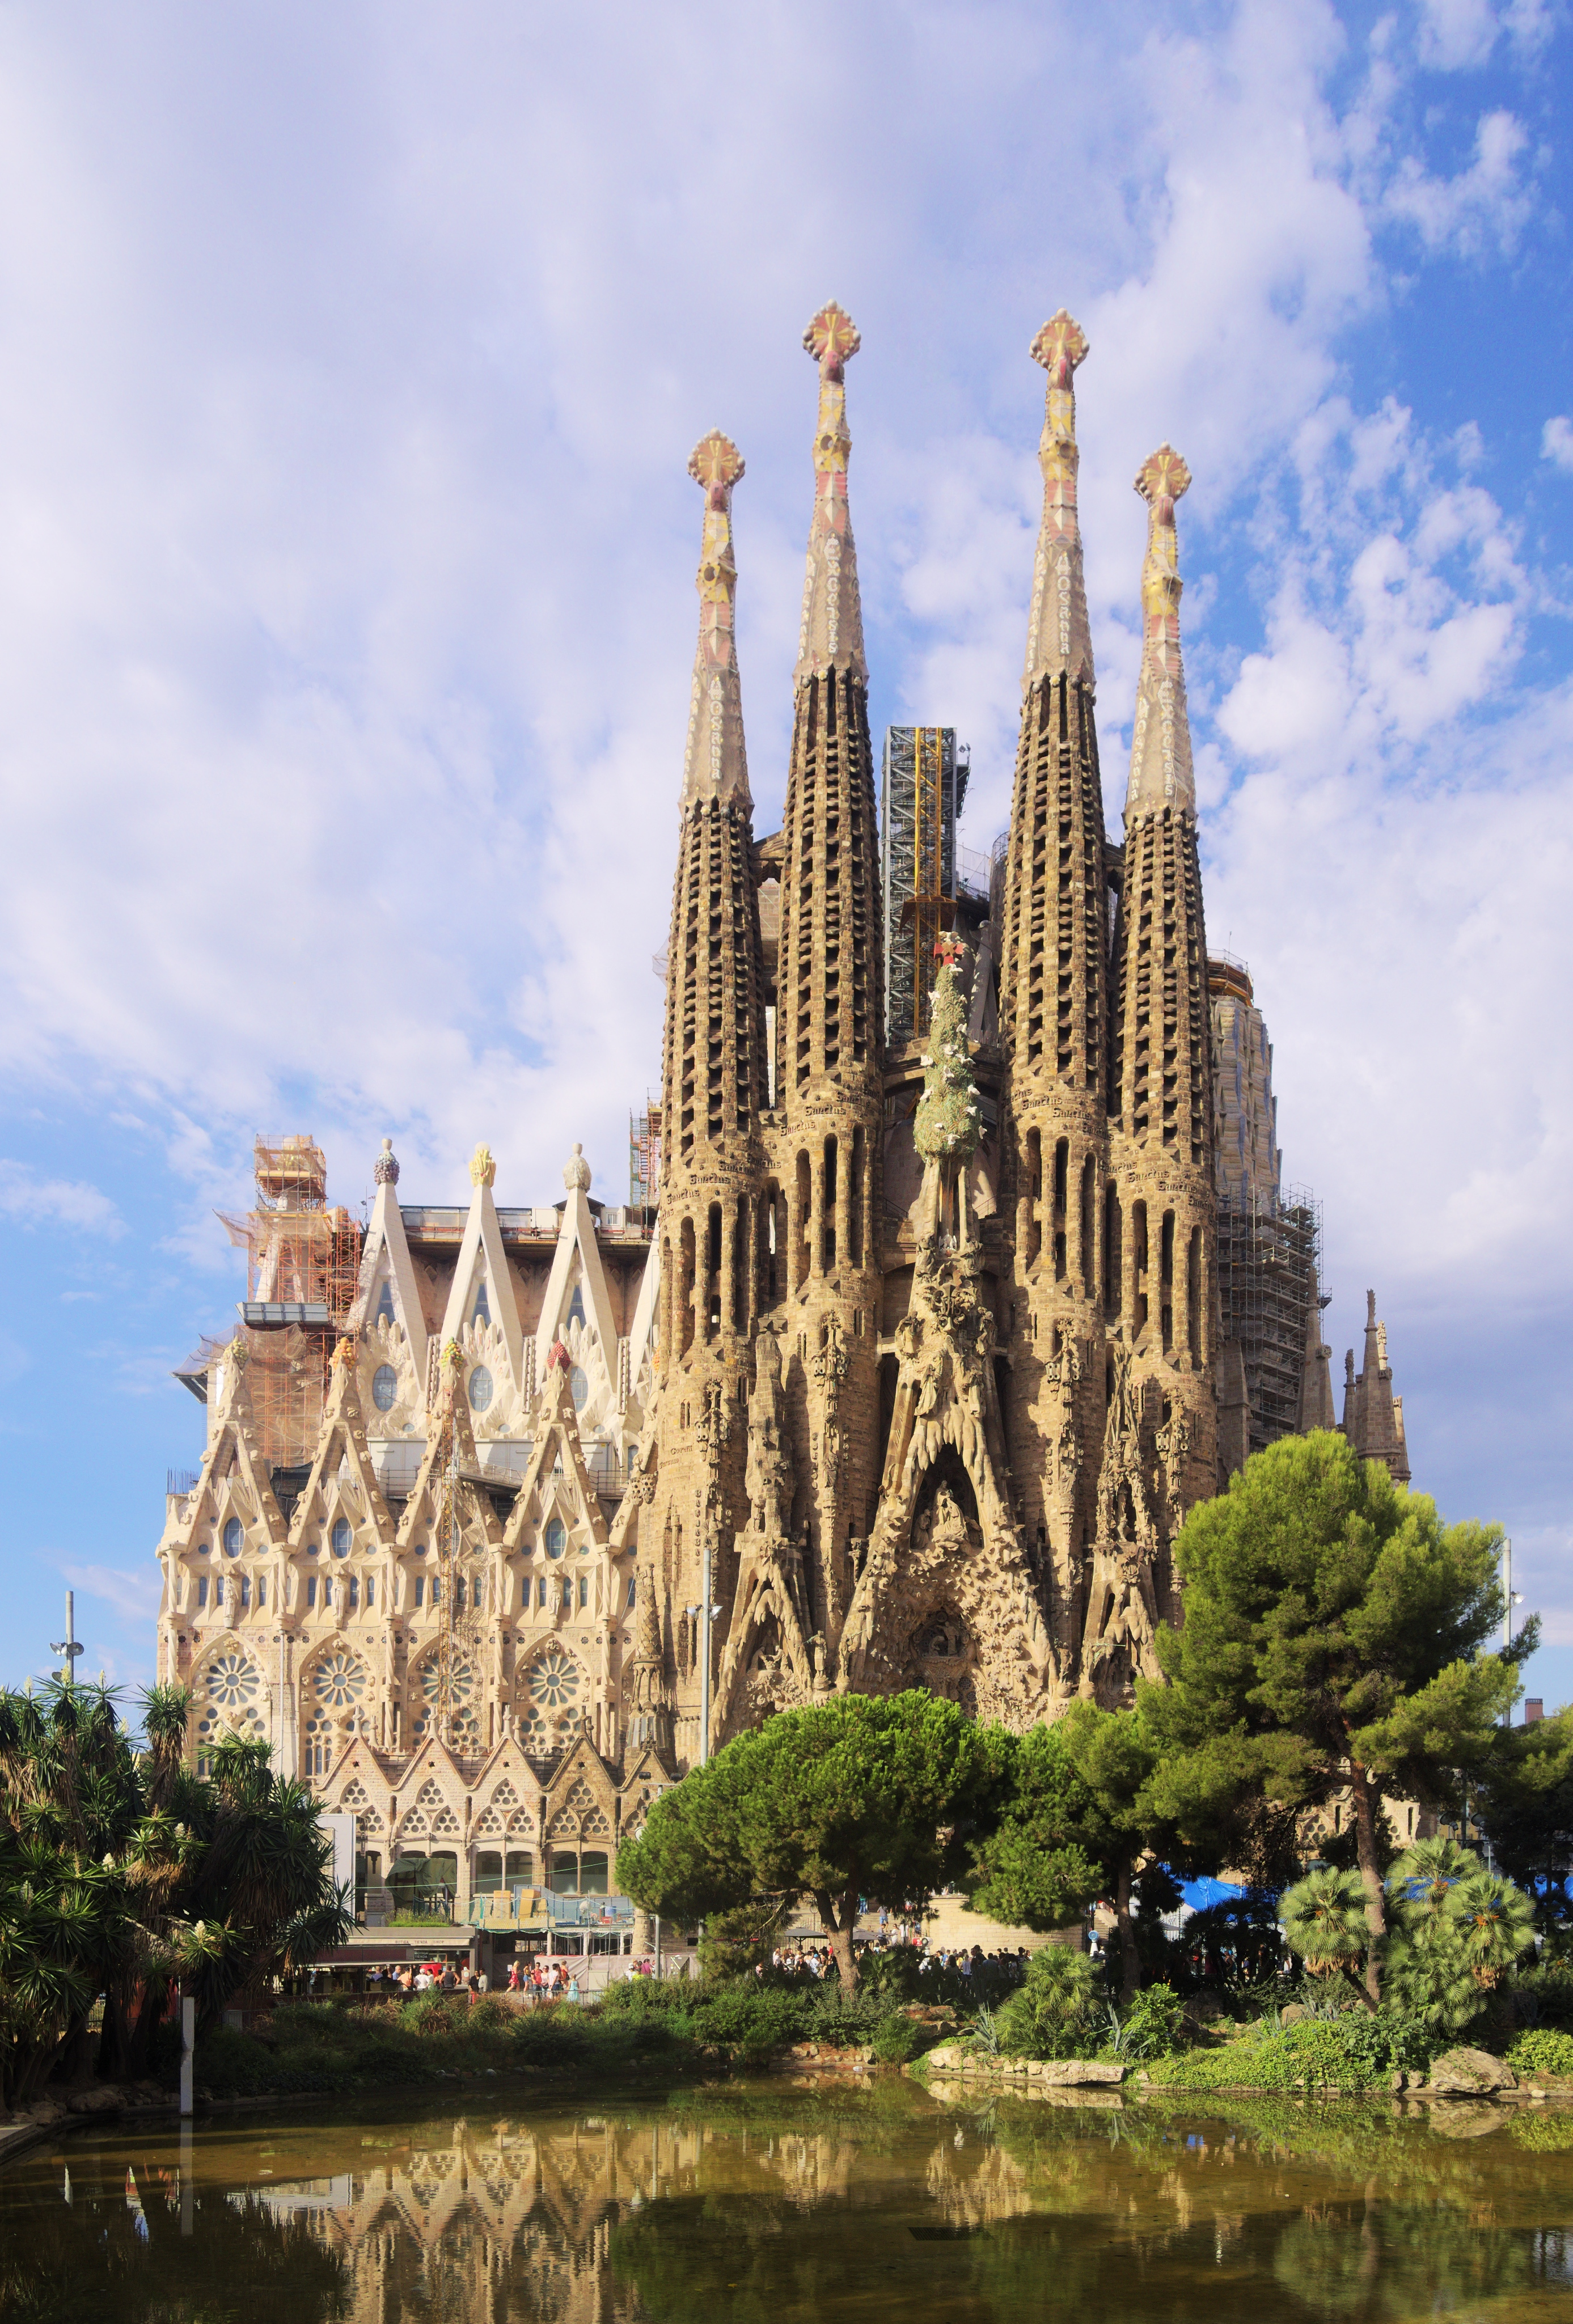
Second Stop – Sagrada Familia
https://www.youtube.com/watch?v=94h6pppF2aY&t=12s
Reading Comprehension
Complete these reading comprehension about the man who built the Sagrada
familia:
Groups 1 and 2
Group 3
Group 4

Slide 8
Lunch Stop!
In Italy, they are very famous for a few delicacies.
Some famous Spanish dishes you could try are:
Paella
Churros
Tortilla
Do not worry if you don’t have food/resources in your house, you could always
draw an Italian pasta dish.
If making one, please ask an adult for help.
Challenge
Spain is famous for tapas restaurants – you could research what these are.

Slide 9
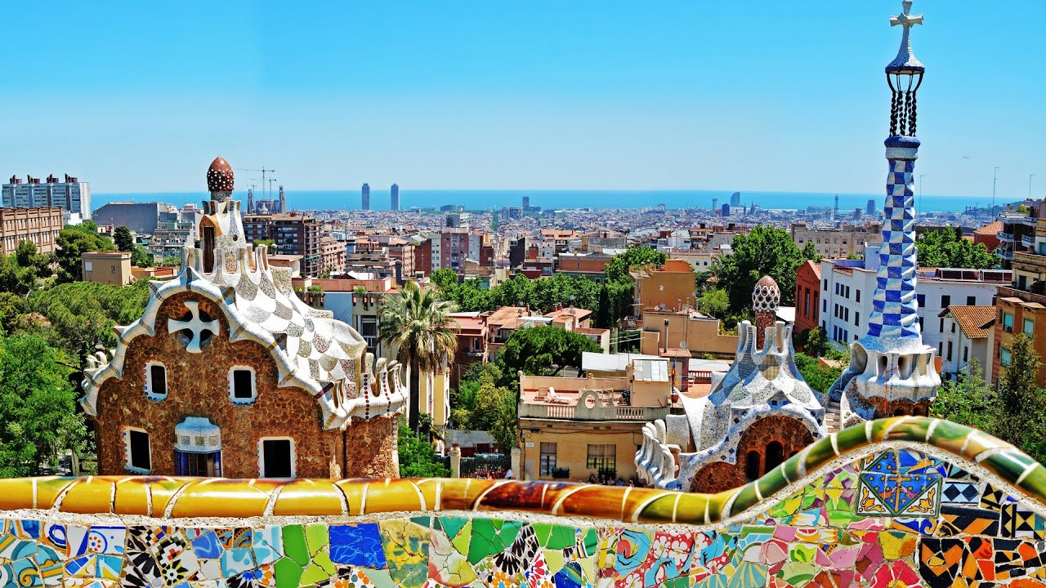
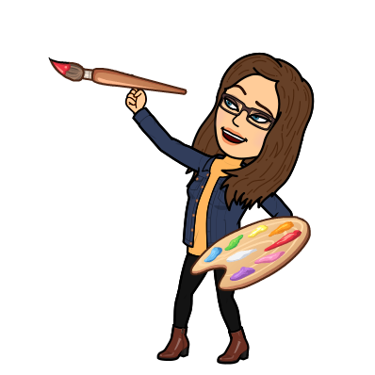
Third Stop – Park Guell
https://parkguell.barcelona/en?q=en
https://www.youtube.com/watch?v=H8sofjHtEq8
Art
Why not try and make your own mosaic, following this youtube video:
https://www.youtube.com/watch?v=p3hGrnep6W0
If you do not have the resources, you could always ‘take your pencil for a walk’:
https://www.youtube.com/watch?v=S2pS4pcnJy0

Slide 10
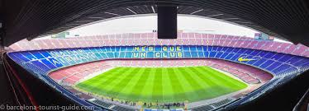
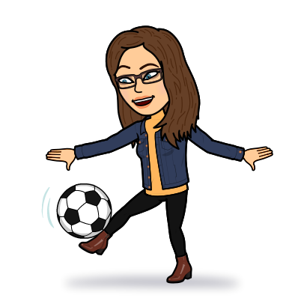
Final Stop of the Day – Barcelona football stadium (Camp Nou)
https://www.youtube.com/watch?v=UDkyCPhZ6nw
PE
Lionel Messi is a player for Barcelona who is famous for his football technique.
Here is a video of how to try to do some of his skills:
https://www.youtube.com/watch?v=_5sCeWY7Vlg – why don’t you have a shot!

Slide 11
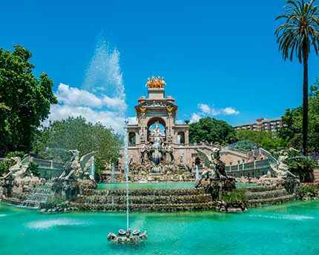
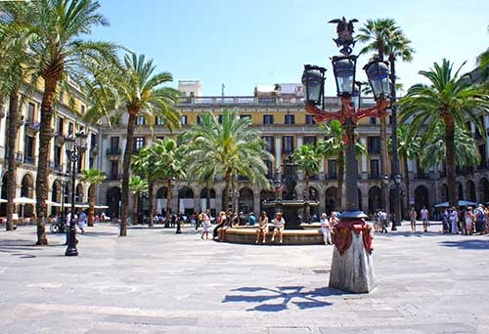
The end of the day
I hope you have enjoyed our third city on our virtual class trip.
There are some other places in Barcelona that we could have visited, there a few additional links below if you wish to look at a few more landmarks.

Slide 12
Additional surprise
Paris had the Disney firework display, Barcelona has this…click next slide.

