Slide 1
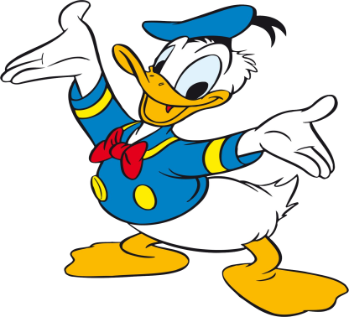
Wednesday 17-6-20
Good Morning Everyone!

Slide 2
Today’s Timetable
Daily Exercise
Sumdog Maths Challenge
Reading
Topic
Virtual School Trip
Prayer

Slide 3
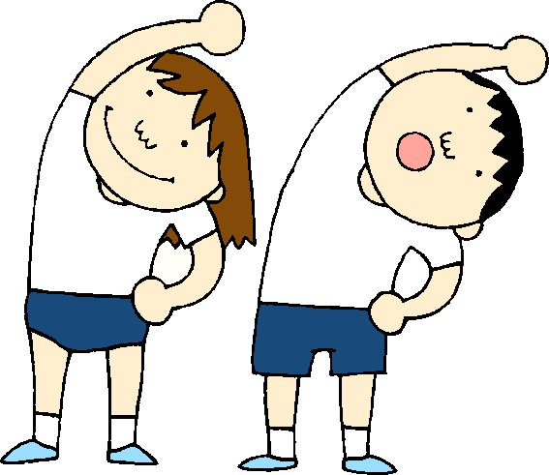
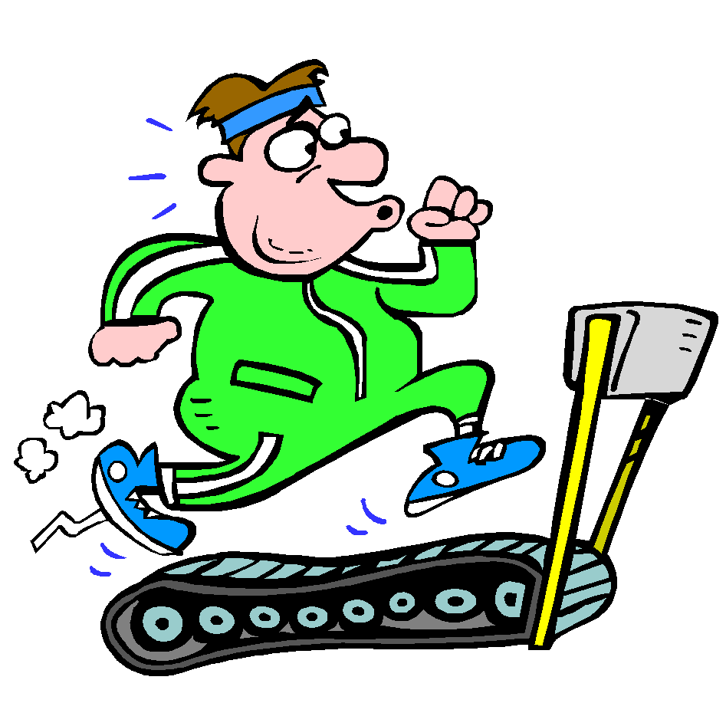
Daily Exercise
Today’s challenge is:-
https://twitter.com/WLPENetwork/status/1268086721645817856?s=20
Or join the Body coach at 9am

Slide 4
Sumdog Maths Challenge
Please continue with the Maths Challenge I have set for you on Sumdog. This is a really good way to improve your knowledge of the Maths topics we have covered this year.
This task is available until Friday. Please try to complete it by then. If you have log-in details for IDL Maths please continue to access this as normal.
SUMDOG

Slide 5
Literacy
Today, we’re going to do read the next 6 chapters of ‘Wonder’. [‘High School’, ‘Major Tom’ ‘After School’, The Padawan Bites the Dust’, ‘An Apparition at the Door’ and ‘Breakfast’]. The chapters are all very short.
Click on the link to listen to the story.
https://www.youtube.com/watch?v=OZkikMZmNsk
Your task, today, is just to listen to the story. There is no written task.

Slide 6
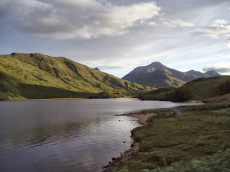
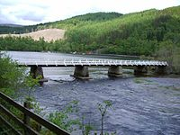
Jacobite Treasure
Watch the following clip to learn how the Jacobite legacy lives on in modern Scotland and where the treasure is allegedly buried.
https://www.bbc.co.uk/programmes/p076jk0s
Your task is to find Loch Arkaig on a map of Scotland.

Slide 7
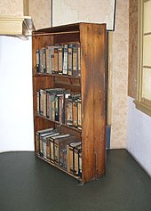
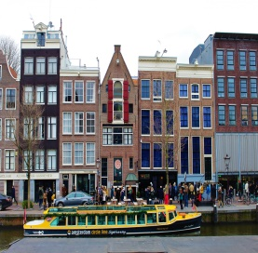
A Virtual School Trip to Anne Frank’s House
Do you remember learning about Anne Frank?
Click on the link to visit the secret annex where she hid from the Nazis
Learn above the revolving bookcase which covered the entrance to their hiding place.
https://www.annefrank.org/en/anne-frank/secret-annex/
Your task is to write down 5 interesting facts or things you enjoyed learning from this virtual tour and post them on Teams.
Enjoy your trip to Amsterdam!

Slide 8
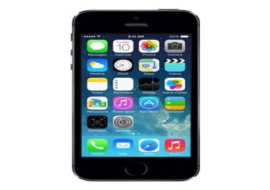
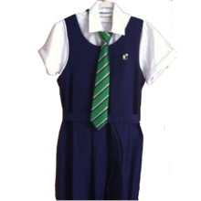
Video Task
Picture the scene. It’s your first day at high school and you can’t find your tie! You look EVERYWHERE for it, even in really bizarre places!! You are panic-stricken and it’s almost time to leave for the school bus. Where could it be?
Your task is to film yourself looking for your tie. You need to place your phone in a cupboard or a fridge etc. It has to be somewhere that is dark until you open it. This is really important as it will allow me to join your films together. The look on your face is important and you can say something if you like. Please note:-YOU DO NOT find your tie in the video.
Please see the next slide for some inspiration and an example of what your video should look like. Happy filming!
Please ensure you send the video to me this week. Thank you to those who have sent their videos to me already. However if you have sent a video with you finding or wearing your tie, you must redo your video. It does not work with the ending I have prepared for this.

Slide 9
Example Video

Slide 10
A prayer to end our day
Take a few moments to say a short prayer, thinking of those older members of our community who live in care homes. Ask God to protect them from the virus.

Slide 11
Well done!
Well done for working hard today!

