Slide 1
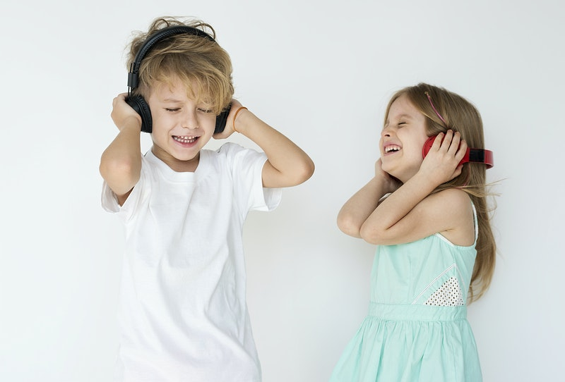
Wednesday 17th of June
MORNING BOYS AND GIRLS
Today we are going to be planning for a wee day out on Friday. I wonder what it is?
Have a listen to this song and see if this will give you a clue.
https://www.youtube.com/watch?v=uxFIGWm9M6w

Slide 2
Yes! We are going to have a Teddy Bears’ Picnic
Let’s get planning.

Slide 3
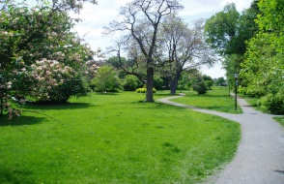
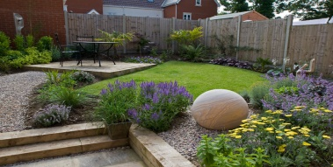
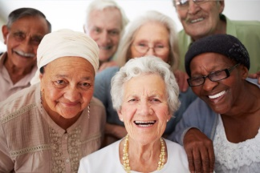
Make a list of things to do.
Decide where you are going to have the picnic?
What will you need? i.e. blanket etc.
Who will you invite? Which teddies will be there? If it is in the park or the garden will you be
able to invite other friends or family ? Who would it be? (Remember social distancing)
Design an invitation. Make it bright, colourful and don’t forget
to have the proper information on it.
Share your finished invitations.

Slide 4
Listen to a story about bears. You can mute the sound if you wish and read aloud.
https://www.youtube.com/watch?v=NhCvDL31DTE
https://www.youtube.com/watch?v=aL356cZVfPg
https://www.youtube.com/watch?v=F05vfPzkTCw

Slide 5
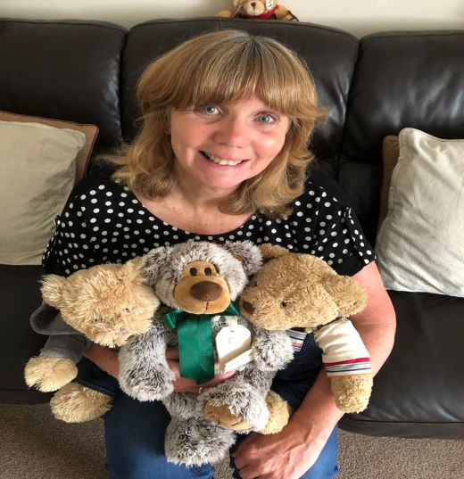
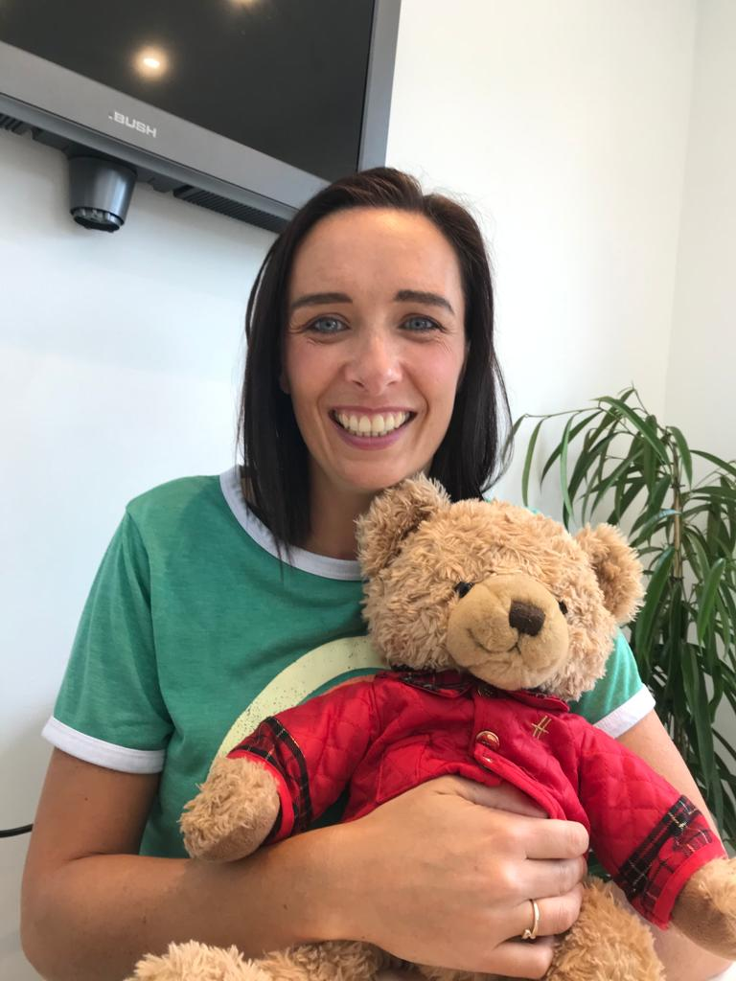
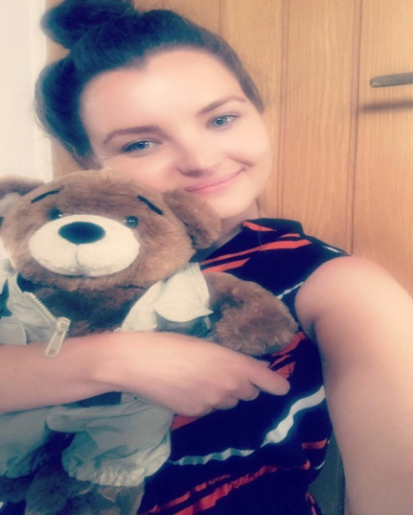
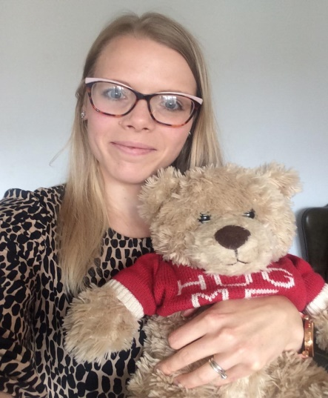
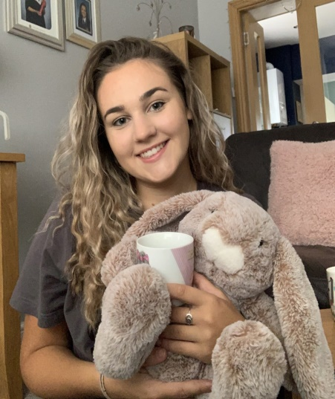
Just to let you know. Big people love their teddies too!

Slide 6
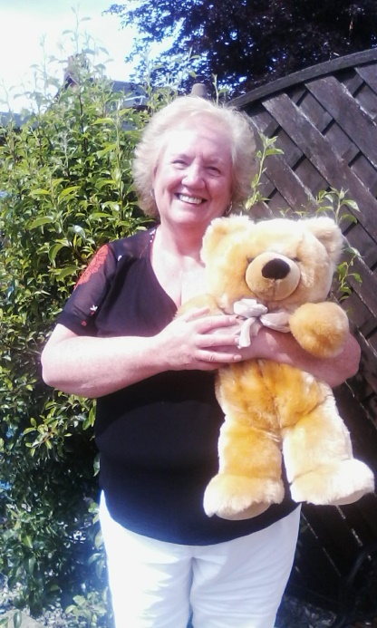
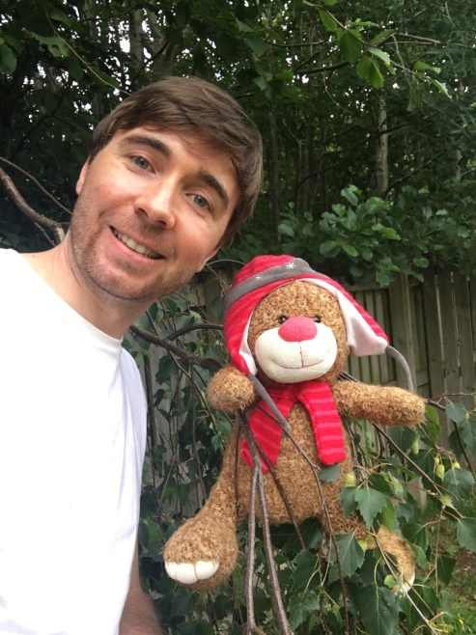
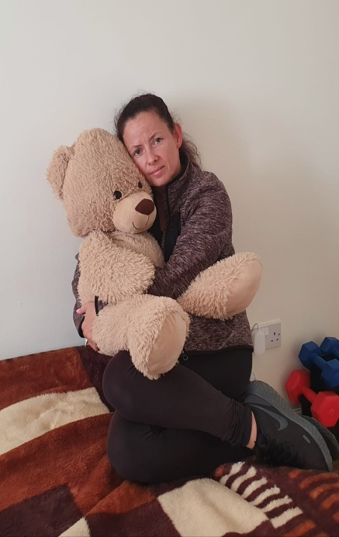
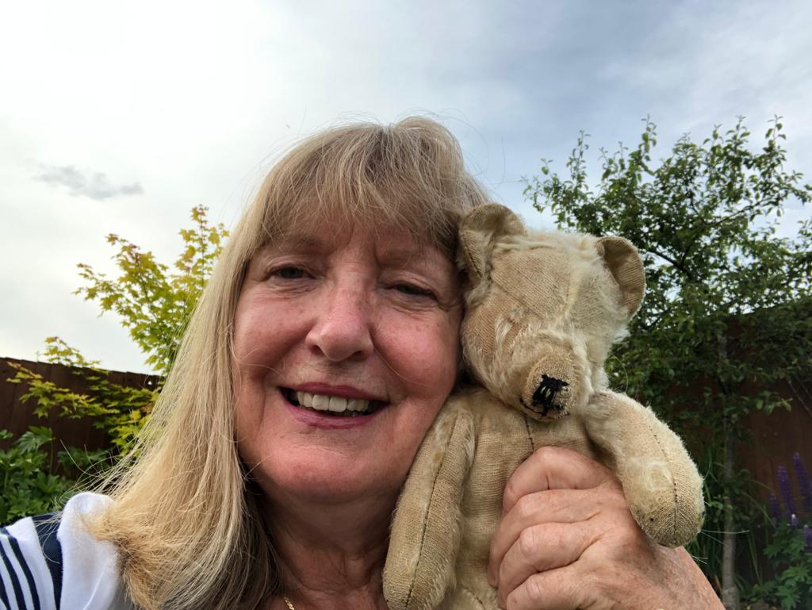
Just to let you know. Big people love their teddies too!

Slide 7
Why don’t you relax after your hard work with some yoga.
https://www.youtube.com/watch?v=KAT5NiWHFIU&t=3s
More planning instructions tomorrow.

