Slide 1
Good Morning P5/4
Week 13 Home Learning
Wednesday 17th June 2020

Slide 2
Aujord’hui c’est mercredi dix-sept juin.
Je suis content(e)
Je suis d’accord
Je suis mal
Il fait mauvais.

Slide 3
Class Trip!
As part of our Europe topic, every day this week we are going to be virtually visiting a European city and learning more about it!
Today, we are visiting:
ROME!
Who’s excited? I know I am!
There is a new folder in teams called ‘Class Trip’ where you will find all resources for this week.

Slide 4
Passport
Remember, each time you visit a new city/landmark make sure to write it in your passport. You could create a stamp like mark for each one.

Slide 5
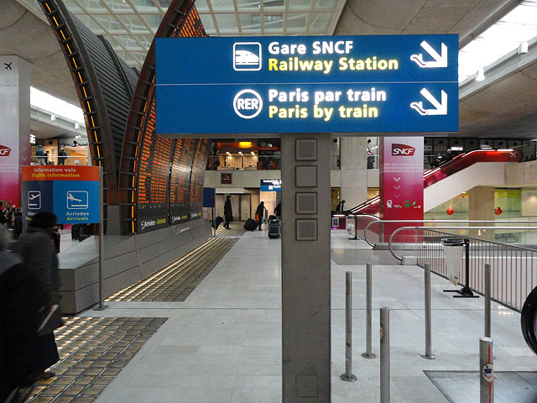
The most efficient way to travel from Paris to Rome is by TGV high-speed train.
Here is a video of some of these trains in action.
https://www.youtube.com/watch?v=UjgbK1ZmucE
Timetable Research – https://www.eurail.com/en/get-inspired/trains-europe/high-speed-trains/tgv
How much is it to make a reservation in 1st class on a train going from France to Italy?

Slide 6
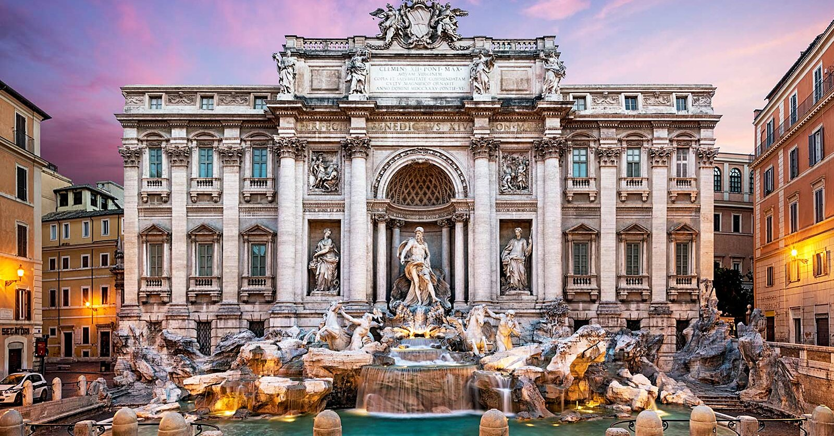
Here is a 360 degree video of Rome to give a brief overview of all the famous sights.
https://www.youtube.com/watch?v=GyV_0prNVVc
First stop – Trevi Fountain
Here is a virtual tour:
https://www.youtube.com/watch?v=5zoNWVOPzyo
Maths
Can you find out:
When the Trevi fountain was built/completed?
How long ago was that in years?
How wide is the Trevi fountain in centimetres?

Slide 7
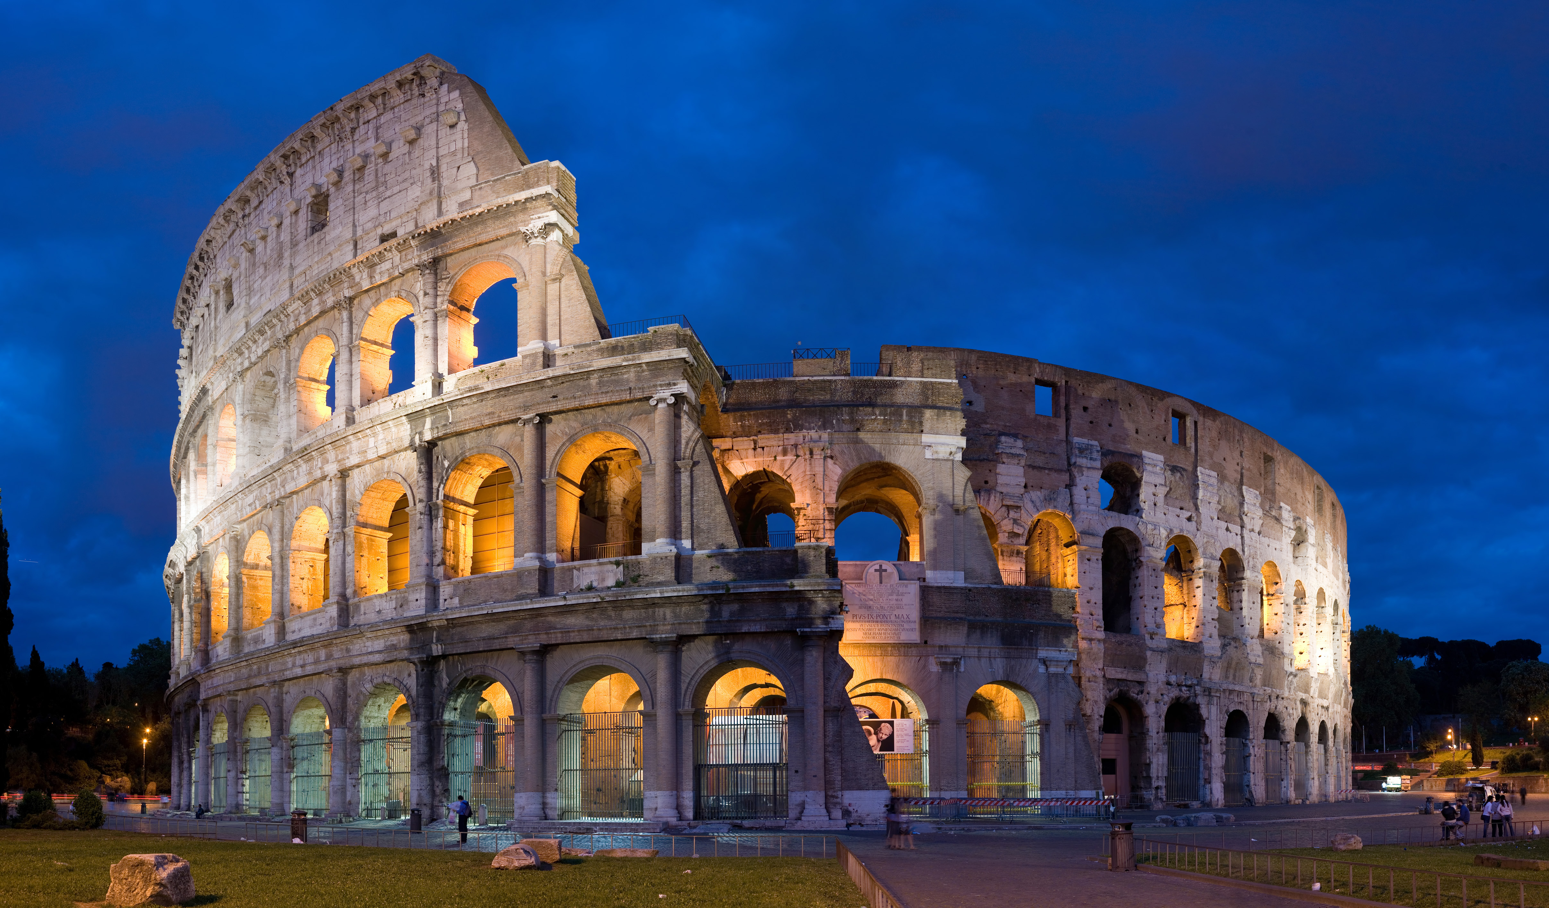
Second Stop – The Colosseum
https://www.youtube.com/watch?v=hxpBPStoIZ8
Research
Complete this Wonders of the World worksheet on the Colosseum.

Slide 8
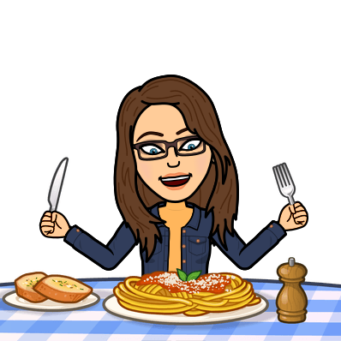
Lunch Stop!
In Italy, they are very famous for a few delicacies. In particular, pasta.
Some famous pasta dishes you could try are:
Pesto Pasta
Spaghetti Carbonara
Ragu
Do not worry if you don’t have food/resources in your house, you could always
draw an Italian pasta dish.
If making one, please ask an adult for help.
Pasta dishes may also be more suitable for dinner than lunch.

Slide 9
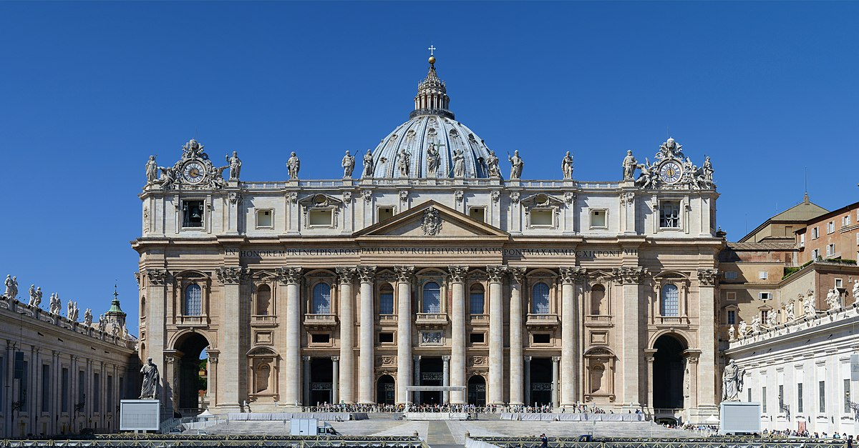
Third Stop – St Peters Basilica, The Vatican City
https://www.youtube.com/watch?v=BVMmb6Qc8fI
Here is a video of our current Pope being announced at St Peters Basilica.
https://www.youtube.com/watch?v=C17YBeTZwyc
R.E.
Research the Hierarchy of the Catholic church, from becoming a priest, to the
steps taking to become Pope.

Slide 10
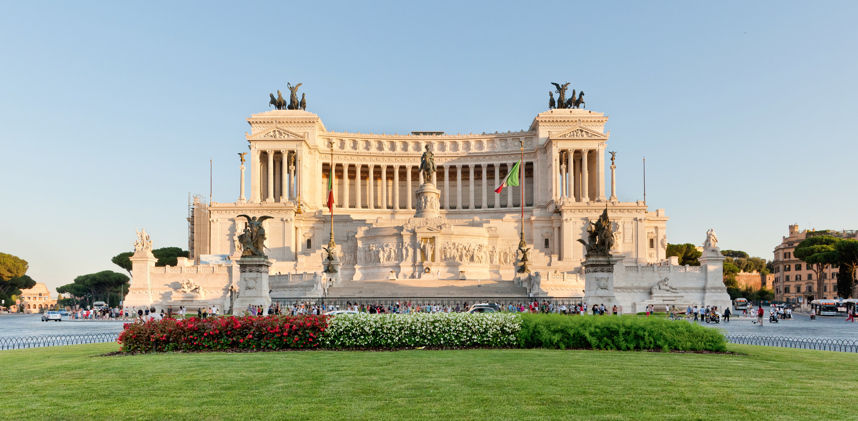
Final Stop of the Day – Victor Emmanuel II monument
https://www.youtube.com/watch?v=8D_xzREJvGk
Art
Can you draw a picture of how you visualise Ancient Rome to be in the time that Victor Emmanuel II was king?

Slide 11
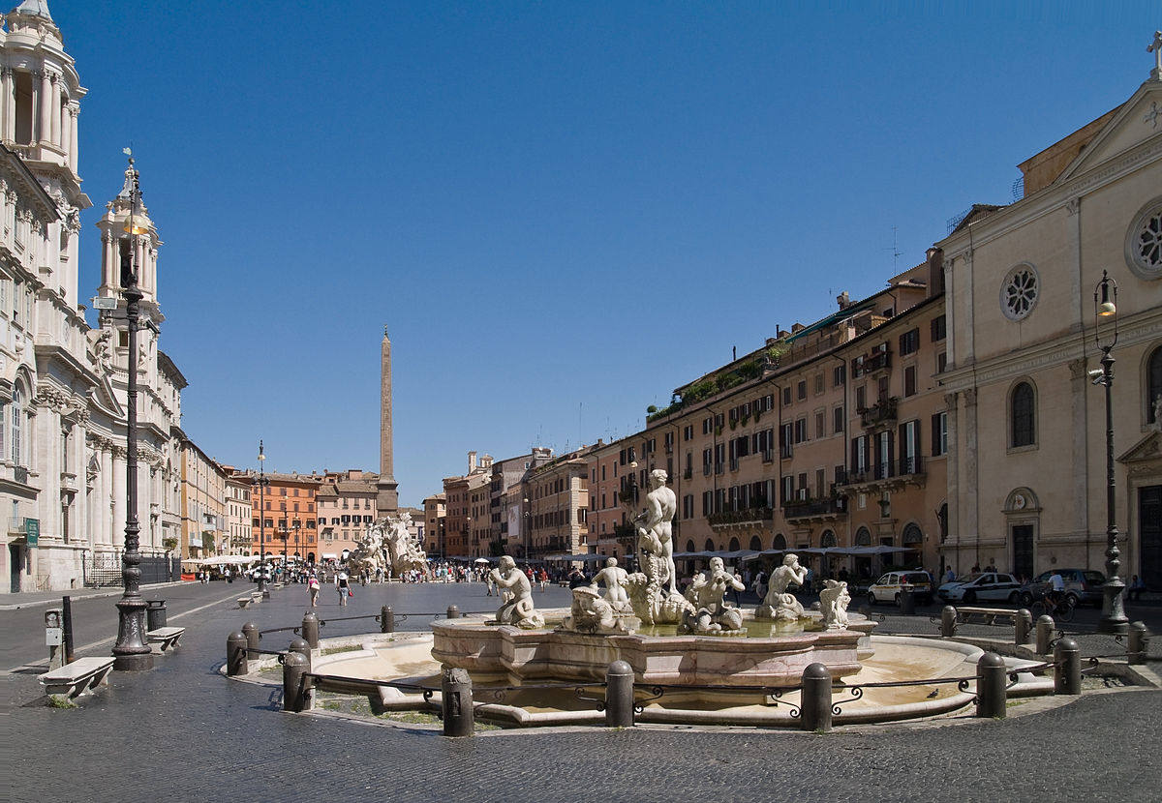
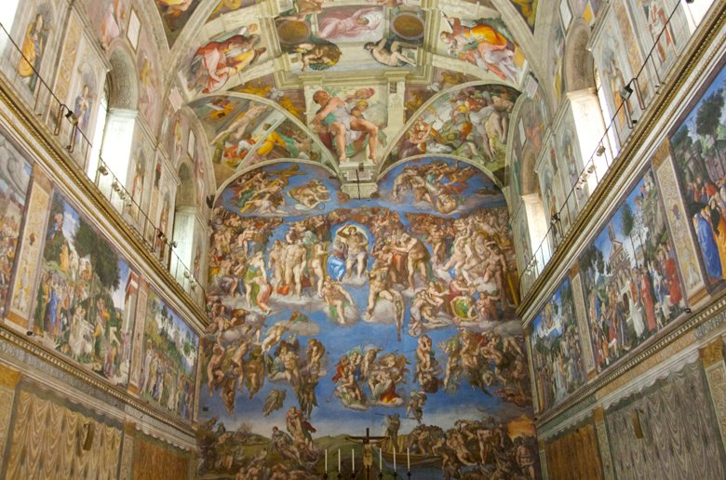
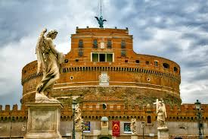
The end of the day
I hope you have enjoyed our third city on our virtual class trip.
There are some other places in Rome that we could have visited, there a few additional links below if you wish to look at a few more landmarks.

