Slide 1
Tuesday 16th June 2020
Good Morning Primary 4!
French: Bonjour la class! Ca Va?
Quelle est la date aujourd’hui?
Aujourd’hui cest Mardi 16th June 2020

Slide 2
Morning News!
LI: I can listen carefully to information
Have any of you been watching the news lately?
We used to watch it every day in class so today, lets have a watch!
TASK:
1) Watch today’s news - make sure you are listening carefully!
2) In your jotter, write down 5 questions about the news.
Post your questions on Teams and challenge one of your friends
(or me!) to answer the questions.
https://www.bbc.co.uk/newsround/news/watch_newsround

Slide 3
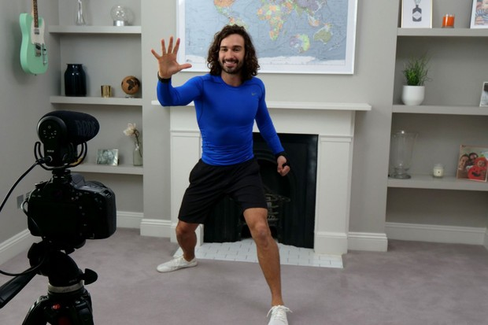
Health and Wellbeing
LI: I can keep fit and healthy
Keep getting fit with Joe Wicks!
I’ve been doing a bit of exercise every day. A little bit and often will keep you really fit!
If you don’t fancy doing a Joe Wicks, go on a walk with your parents (always take an adult) or set up your own mini circuit!
https://www.youtube.com/user/thebodycoach1

Slide 4
Spelling (slide 1)
LI: I am using strategies to help me spell words
Today, we are continuing to look at our new phoneme!
The ‘oo’ phoneme.
Some ‘oo’ words are…
shook - prune - flew - clue - put
TASK ON THE NEXT SLIDE

Slide 5
Spelling (slide 2)
LI: I am using strategies to help me spell words
TASK: think of and write down as many ‘oo’ words as you can using the ‘ue’ and ‘u’ representations
ue | u
clue | put

Slide 6
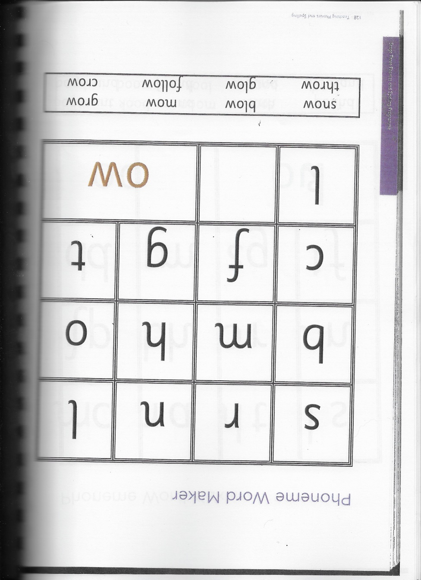
Spelling Slide 1 (David Walliams Group)
TASK: practise words that include the ‘ow’ (e.g. snow) phoneme
Write down the letters on the sheet.
Cut out all of the letters and the ‘ow’ sound.
Use the ‘Say / Make/break / blend / read / write strategy to practise the ‘ow’ words on your sheet. (See next slide for details).

Slide 7
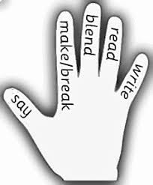
Spelling Slide 2 (David Walliams Group)
1. SAY - say the word day?’
2. MAKE/BREAK - make the word day with your letters.
3. BLEND - SOUND OUT the letters by running your finger below the letters and then BLEND the sounds together to make the word.
4. READ - read the word.
5. WRITE - WRITE the word below it.

Slide 8
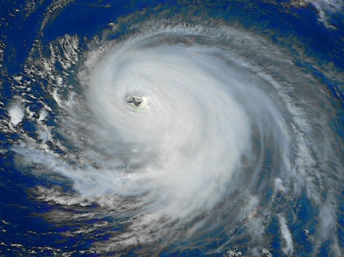
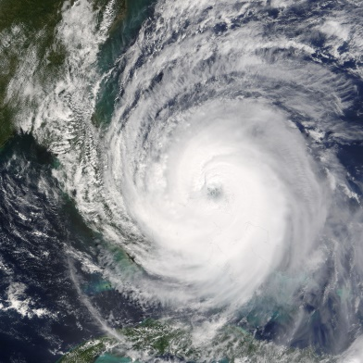
Reading (slide 1)
L.I I am using different reading strategies to help me understand my book
NOTE: We are having a little break from our normal reading activities this week because Mrs Moffat’s class are working on something different! We will get back to our normal books next week.
TASK: read the new books assigned to you on Epic! and then use the information to create a fact file. The theme is hurricanes!
There are some fact file templates on Teams – go to ‘Files’ / ‘Natural Disasters’ / ‘Fact file templates’. You can design your own fact file style if you would prefer to do this!

Slide 9
Reading (slide 2)
L.I I am using different reading strategies to help me understand my book
All reading groups log into Epic! and your books will have been assigned to you.
Tom Fletcher / Roald Dahl =
David Walliams =

Slide 10
Maths
L.I. I am practising my times tables
I have set you another Sumdog challenge today!
Well done with your fractions challenge last week.
Today’s challenge covers the 3, 4, 6 and 9 x tables.
There will be a lot of activities so only do as much as you can manage. Don’t feel that you have to do the whole thing!
Enjoy!

Slide 11
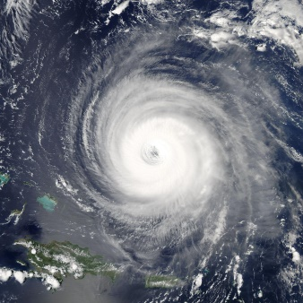
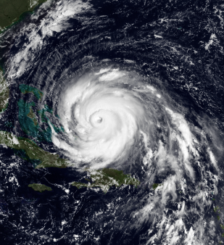
Topic
Natural Disasters
Well done to everyone who completed Rebekah’s quiz yesterday!
Today, our ‘Topic Teacher’ is…
Xavier with his PowerPoint and quiz about hurricanes!
Today, I’d like you to answer Xavier’s quiz questions in your jotters.
Post them and tag Xavier on Teams so that he can see your answers!
See the following slides for Xavier’s lesson.

Slide 12
Xavier’s Lesson (slide 1)

Slide 13
Xavier’s Lesson (slide 2)

Slide 14
Xavier’s Lesson (slide 3)

Slide 15
Feel free to leave comments / questions on Teams throughout the day and I will try my best to get back to you. Enjoy your day, Primary 4!

