Slide 1
Tuesday 16th of June
Good Morning Primary 3!
Bonjour la class! Ca Va?
Can you say todays date in French?
Aujourd’hui c’est (M…………) 16th (J…………) 2020
Watch ‘Quel temps fait il?” and see if you can describe todays weather.
Begin by saying - Aujourd’hui c’est …
https://www.youtube.com/watch?v=eBvJVOuBPXI

Slide 2
Stage 3: Common word revision Can you read all of the words below?
begin follow often letter woman write answer began heat page walk water picture once until through sing morning colour kind put most light high stop list different must sentence late

Slide 3
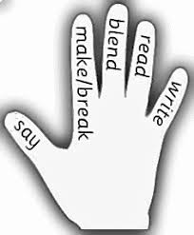
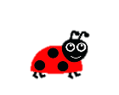
Spelling
LI: We are learning to spell common words correctly.
This weeks common words are:
Monday Tuesday Wednesday Thursday Friday
Saturday Sunday
Can you spell each day of the week correctly?
Remember – Days of the Week always get a capital letter!
Can you think of other words that always get a capital letter?

Slide 4
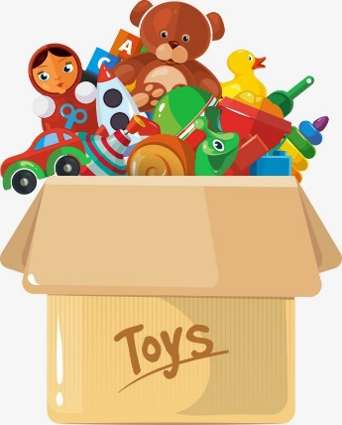
Reading Comprehension
LI: We are learning to read fluently and answer simple questions about what we have read.
I have attached a reading comprehension worksheet to this blog post all about toys. You can look at them online or print them off. Please choose a worksheet that best suits your child.
Activities
Read through the chosen activity together.
Are there any words that you don’t know the meaning of? How could you find out what they mean?
Answer the questions at the bottom of the sheet. You can do this orally or write the answers in your jotter (the answers are also attached to each worksheet).

Slide 5
Story Happy Right Now
https://www.youtube.com/watch?v=U1bDLm1NhbI

Slide 6
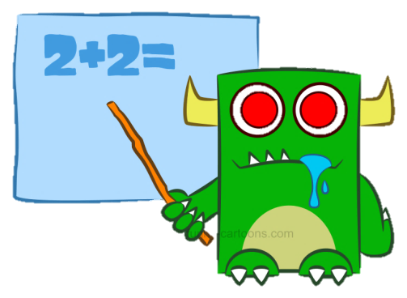
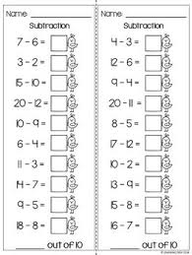
Numeracy Activities
LI: We are learning to develop a range of addition and subtraction strategies.
For this activity, I would like you to time yourself and see how quickly you can answer these questions.
You can say the answers to someone in your house or you can write them down.

Slide 7
Can you solve these addition problems?

Slide 8
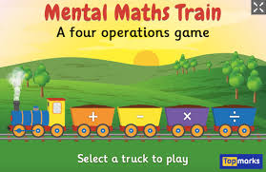
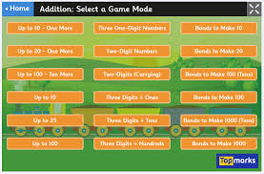
Numeracy Game
Mental Maths Train - https://www.topmarks.co.uk/maths-games/mental-maths-train
Click on either the + or – button.
When you click on addition, you can choose any category to complete.
Red Square – Easy
Blue Square – Medium
Yellow Square - Hard

Slide 9
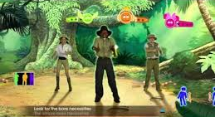
Health and Wellbeing
LI: We are learning to identify different features of dance and perform steps and routines.
Just Dance – Bare Necessities
(you can do the dance yourself or with a family member!)
https://www.youtube.com/watch?v=HUvCgpUrqo8

Slide 10
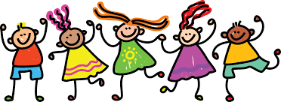
Great work P3! Enjoy the rest of your day! ☺

