Slide 1
Tuesday 16th June

Slide 2
Timetable
Daily exercise
French starter
Spelling
Reading
Maths
STEM

Slide 3
Daily exercise
Cosmic Yoga - https://www.youtube.com/watch?v=tbCjkPlsaes
Joe Wicks - https://www.youtube.com/watch?v=png9xGaRvGE
LI: We are learning to move our body well, exploring how to manage and control it, finding out how to use and share space.

Slide 4
French

Slide 5
Spelling – I am learning to use various spelling strategies.
S | SS | C | Se | Ce
Sack Suggest Scream Separate Sensible Service | Actress Address Assist Distress Glass | Saucer City Circle Place Cease Ice Twice | Sense Cease Practise | Service Peace Sequence Sentence
Partner spell – either you test someone or they test you.

Slide 6
Literacy Starter
How many words can you make out of:
Blue hairbands. (10 minutes)

Slide 7
Reading – I am learning to decipher the meaning of a word.
Read the next chapter from your book at home. Select 6 tricky words or words that you are not familiar with.
Use the metalinguistic strategies to work out the meaning of these words.
Once you have written down what you think each word means, check its meaning in a
dictionary. Remember that some words have more than one definition, so you need to
select the most appropriate meaning for the word in the context of the text you are
reading.
Copy down the most appropriate definition of the word into your jotter.
Remember to use the correct spelling, punctuation and neat handwriting and presentation
at all times.
If you cannot remember how to use the strategies select 6 words, write what you think, what someone else thinks and then dictionary definition.
Strategies – RO – Read on, RB – Read back, FW – Familiar word, RW – Replace word, PD – Partner discuss

Slide 8
Maths Starter
Which one is heavier:
a. an elephant or a cheetah?
b. a feather or a phone?
Emma bought 3 tubs of hot chocolate each weighing 350grams each.
What is their total weight:
a. in grams
b. in kilograms
Mrs Brown buys 3 cakes from the bakery, each cake weights 800 grams.
a. What is the total weight of the cakes, in grams?
b. What is their total weight in kilograms?

Slide 9
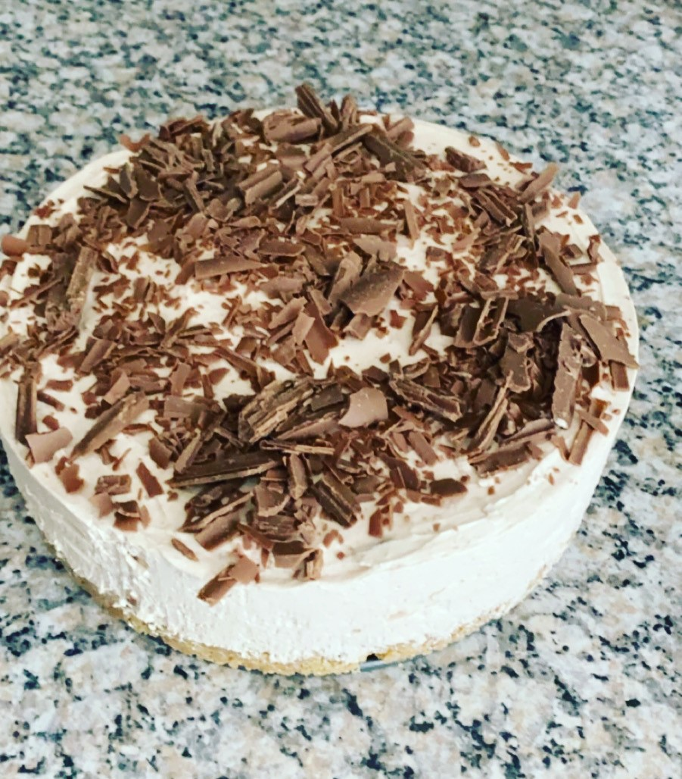
Weight – I can solve problems on weight
Miss Kerr enjoys making cheesecake. You need 600grams of soft cheese to make the mix for one cake. If Miss Kerr wanted to make 3 cheesecakes how much soft cheese would she need? (Write the answer in grams and also in kilograms)
Miss Kerr likes to decorate her cheesecakes with grated chocolate. I need 320 grams for the top of the cake. It comes in packs of 80grams. How many would I need to buy for one cake?
How many would I need to buy for 3 cakes?
How many grams of chocolate will I have used in total for the 3 cakes?
To make the base of each cheese cake I need 250grams of digestives, how much do I use in total? ( show the answer in grams and in kilograms)
For example 650gram or 0.65kg

Slide 10
I can solve problems on weight
Gillian has two dogs. One called Bear who is a Labrador and one called Squeak who is a Yorkshire terrier.
Bear weights 29kg and Squeak weights 4.3kg.
How much does Bear weigh in grams?
How much does Squeak weigh in grams?
How much heavier is Bear than Squeak? ( write your answer in both grams and Kilograms.)

Slide 11
Maths answers
Starter
Elephant
Phone
1050 grams
1.05kg
2400grams
2.4 kg
Slide 1
1800 grams or 1.8kg
1 cake = 4
3 cakes = 12
960 grams of chocolate
750 grams or 0.75kg
Slide 2
29,000g
4.300g
24.7 kg or 24,700 grams

Slide 12
STEM – Lego Challenge
Draw your design first – it could be based on a real building such as the Eiffel tower or the Tower of London.
Think about when your drawing your building, how many bricks or resources will you need to build it.
Think about the structure of the building especially if your building a replica of the Eiffel tower. How are you going to make the point at the top?
What kind of maths may you use when carrying out this task?
If you don’t have lego, you can use any other building resources you have or just leave it as a drawing.

