Slide 1
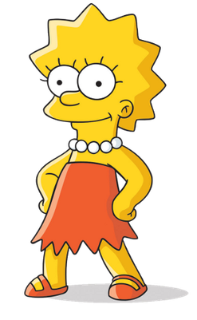
Tuesday 16-6-20
Good Morning Everyone!

Slide 2
Today’s Timetable
Daily Exercise
Sumdog Maths Challenge
Reading
Topic
Virtual School Trip
Tie Video
Prayer

Slide 3
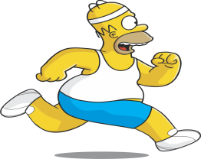
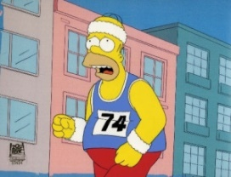
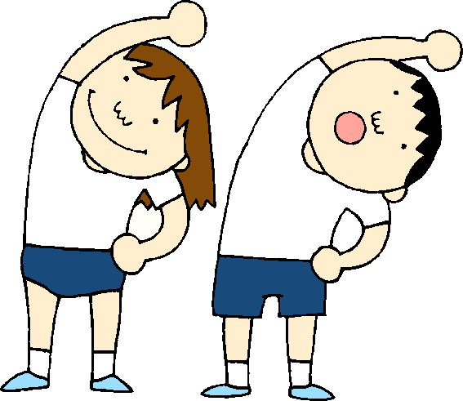
Daily Exercise
Today’s daily challenge:-
https://www.youtube.com/watch?v=fAUckPMJKSY
Or join the Body Coach at 9am.

Slide 4
Maths Challenge
Today, I have set a Sumdog Challenge for you to do. This challenge will cover most Maths topics we have covered this year.
This task is available until Friday. Please try to complete it by then. If you have log-in details for IDL Maths please continue to access this as normal.
SUMDOG

Slide 5
Reading
Today, we’re going to do read the next 4 chapters of ‘Wonder’. [‘A Tour of the Galaxy’, ‘Before August’ ‘Seeing August’ & ‘August Through the Peephole’]
Click on the link to listen to the story.
https://www.youtube.com/watch?v=QcMQVvWLfPM
I am not giving you any written tasks this week. Please get comfortable and just enjoy listening to the story.

Slide 6
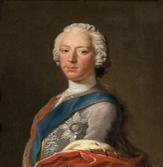
What happened to Bonnie Prince Charlie?
After the Battle of Culloden, Bonnie Prince Charlie escaped to the Western Isles. For 5 months, he remained in hiding from the British Army who were desperate to catch him.
A reward of the equivalent of £15million in today’s money, was offered to anyone who told the British army of Bonnie Prince Charlie’s whereabouts but no one betrayed him.
There is a very famous story of one occasion when a highland girl named Flora MacDonald helped Bonnie Prince Charlie escape to the Isle of Skye by dressing him as her maid.
This famous song is about his escape to Skye with Flora MacDonald
https://www.youtube.com/watch?v=3wIeTgOZ4jU
https://www.youtube.com/watch?v=BHz_ypPDnrU
5 months later a French ship arrived to rescue Bonnie Prince Charlie and take him to France.
He remained in France for many years, suffering from depression and alcoholism. He died in Rome in 1788, aged 67. He is buried in St Peter’s Basilica in Rome, along with his brother, Henry and his father, King James VIII of Scotland. The only king to be buried in St Peter’s.

Slide 7
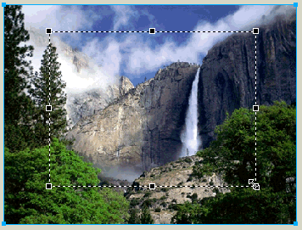
Virtual School Trip to Yosemite National Park
Yosemite National Park is an incredibly beautiful National Park in California. This area is frequently subject to Natural Disasters including landslides, wildfires and earthquakes. It is an area which was explored and appreciated by Scottish naturalist, John Muir over 100 years ago. He persuaded the US government to set up National Parks to protect these areas. Have you heard of the John Muir Way in Scotland? There’s one in the USA, too. Click on the link to start on your virtual tour. Use the caption button on the control bar to find out information about each area of the park.
https://www.virtualyosemite.org/
Can you find the answer to these 3 questions:-
What is the height of the Yosemite Falls?
How long are the Tuolumne Meadows?
The El Capitan rock face is made of what kind of rock?
Extra:-To learn about grizzly bears in Yosemite, watch this short clip:-
https://www.nps.gov/media/video/view.htm?id=587443BA-1DD8-B71B-0BA9F830CE167295

Slide 8
Video Task
Picture the scene. It’s your first day at high school and you can’t find your tie! You look EVERYWHERE for it, even in really bizarre places!! You are panic-stricken and it’s almost time to leave for the school bus. Where could it be?
Your task is to film yourself looking for your tie. You need to place your phone in a cupboard or a fridge etc. It has to be somewhere that is dark until you open it. This is really important as it will allow me to join your films together. The look on your face is important and you can say something if you like. Please note:-YOU DO NOT find your tie in the video.
Please see the next slide for some inspiration and an example of what your video should look like. Happy filming!
Please ensure you send the video to me this week. Thank you to those who have sent their videos to me already. However if you have sent a video with you finding or wearing your tie, you must redo your video. It does not work with the ending I have prepared for this.

Slide 9
Example Video

Slide 10
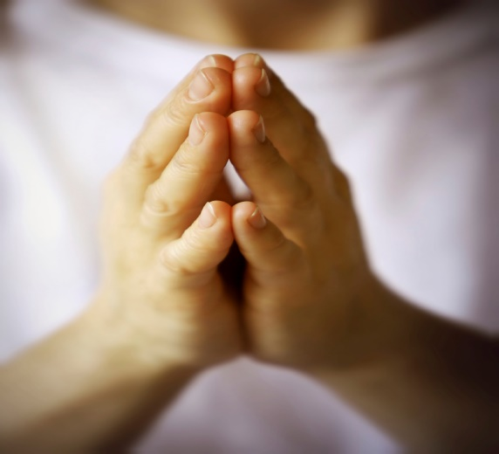
A prayer to end our day
Please take a few moments to say a prayer for all the doctors, nurses and care staff who are constantly working very hard to save lives.

Slide 11
Well done!
Well done for working hard today!

