Slide 1
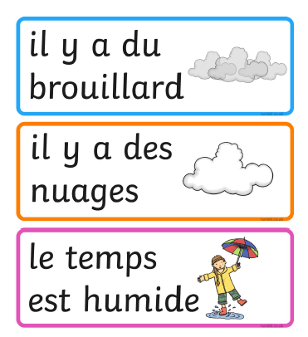
Tuesday 16th of June
French: Bonjour la class! Ca Va?
Aujourd’hui cest M____ 16th J____ 2020
L.I- To describe the weather in French
Quel temp fait-il aujourd’hui?= What is the weather like today?
Il... It is…
Rainy Foggy
Sunny Cloudy
Windy Wet

Slide 2
Literacy
LI: We are learning to read and spell this weeks common words.
Sing with Mr Mac- Boom shake the Alphabet https://www.youtube.com/watch?v=Emb2yvwAHtc
Common words:
Stage 2 words- three, room, long, tree
Stage 3 words-Monday, Tuesday, Wednesday, Thursday, Friday
Write your words out and underline the vowels in red.
Choose a couple of your words and write a sentence for each one.
Challenge – Can you find any of your spelling
words in a book or magazine?

Slide 3
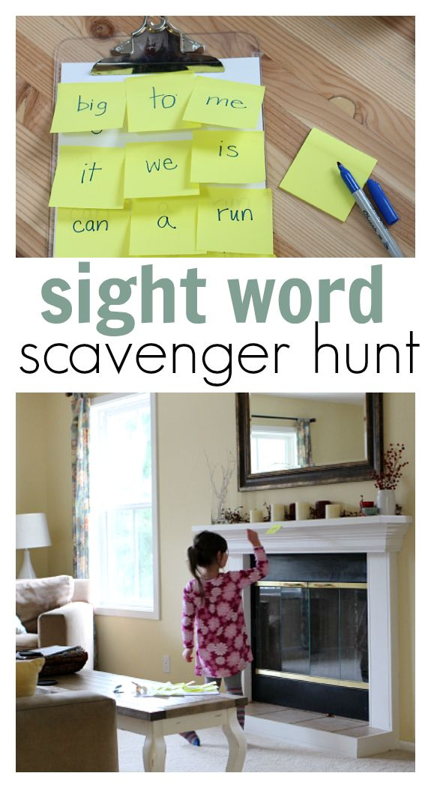
Common word Scavenger Hunt L.I – I use my knowledge of sounds and patterns to read words
Task - ask an adult to write out your tricky words on sticky notes and hide then around the house. Have a list of the tricky words you are looking for and go and search for them.
Have fun!

Slide 4
Stage 2: Common word revision
five time life line home more school Mrs take gave cold don’t every find want girl father head mother jump four miss never these
well will fell call

Slide 5
Stage 3: Common word revision
begin follow often letter woman write answer began heat page walk water picture once until through sing morning colour kind put most light high stop list different must sentence late

Slide 6
Literacy
LI: We are learning to read fluently and answer simple questions about what we have read.
Oxford Owl Website – https://www.oxfordowl.co.uk/?sellanguage=en&mode=hub
1 – Spend 10-15 minutes reading your book.
2 – Choose an activity from the list below to complete.

Slide 7
Story Time:
https://www.youtube.com/watch?v=HfIuIQaOLlY

Slide 9
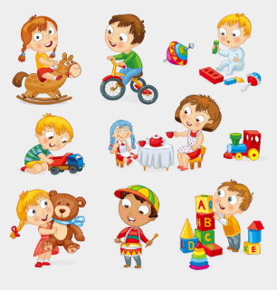
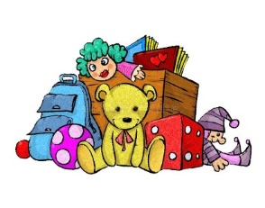
Toys – Show and Tell
Day 2
L.I – When talking I can share relevant information and experiences with others.
We would like to know the following:-
What your favourite toy is?
Why it is your favourite toy?
Does it do anything special?
Some words that describe your favourite toy.
We would love to hear all about your favourite toy. You can share your toy with us and all your friends on the school twitter page. *Remember not to use your name.
We can’t wait to hear from you!

Slide 10
I hope you have enjoyed your lessons today. It would be lovely to hear how you got on. Enjoy the rest of your day Primary 2/3!

