Slide 1
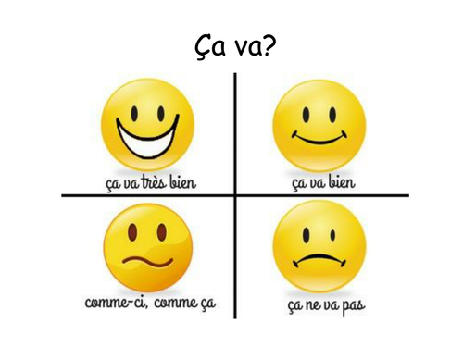
Tuesday 16th June
Good morning primary 1!
Bonjour la class! Ca va?

Slide 2
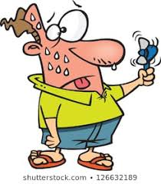
Use our story from yesterday “House for
Sale” to complete the next activity.
Here can you find out what the true statement is each time– A or B?

Slide 3
Mum and Dad liked the house. A
Mum and Dad liked the caravan. B
Kipper pulled out his own tooth. A
Kipper pulled the wallpaper down. B
Kipper jumped on the bed. A
Kipper jumped on the chimney. B

Slide 4
Kipper went through a chair. A
Kipper danced on a chair. B
Kipper poured paint over Biff and Chip. A
Kipper poured paint all over himself! B

Slide 5
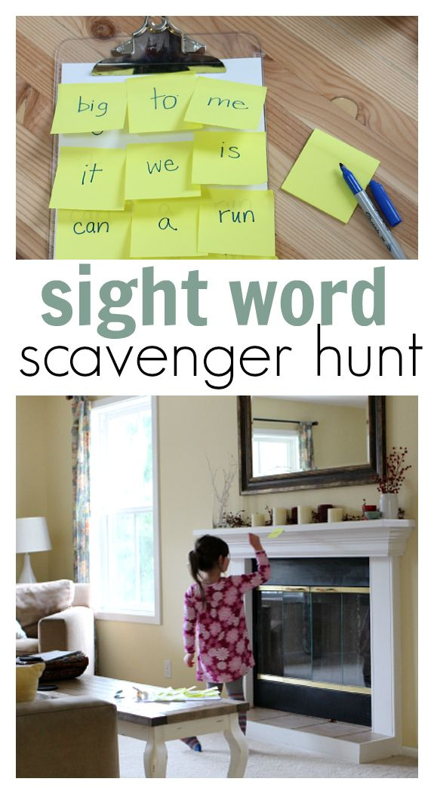
Common word Scavenger Hunt L.I – I use my knowledge of sounds and patterns to read words
Task - ask an adult to write out some common words we have been learning on sticky notes and hide then around the house.
Have a list of the tricky words you are looking for and go and search for them.
Have fun!

Slide 6
Story Time
https://www.youtube.com/watch?v=HfIuIQaOLlY

Slide 7
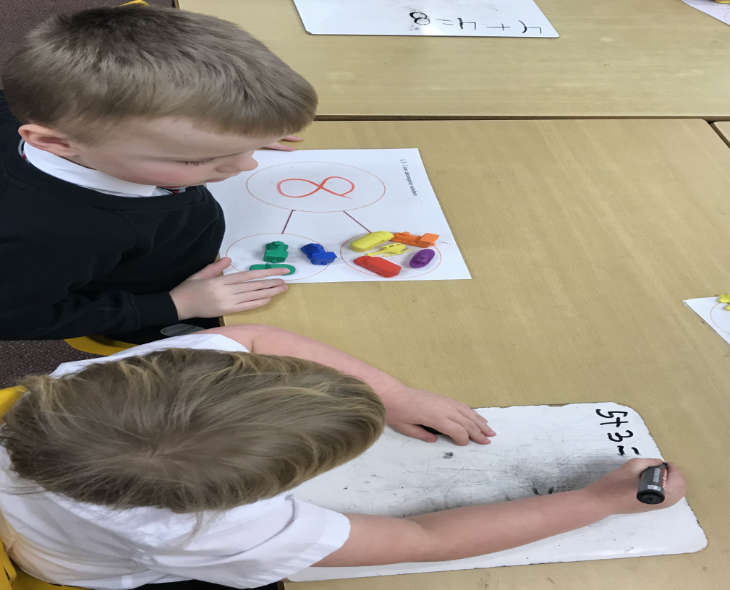
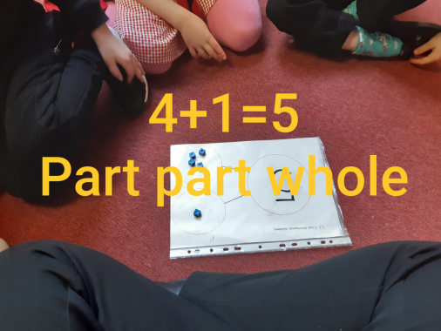
Maths Revision
L.I- We are learning to find the missing number in a maths problem using the part, part, whole method.
Warm up- https://www.youtube.com/watch?v=CyYh1raLGBs
Watch this lesson – https://www.youtube.com/watch?v=Mvm0y1Qr_JQ
Here is an example of us using this method. You could draw it out to help you work out the problems on the next slide.
5+[ ]= 8
the missing number
would be 3
3
8
5

Slide 8
Numeracy- Try these in your jotter

Slide 9
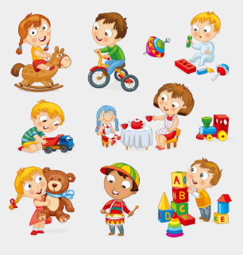
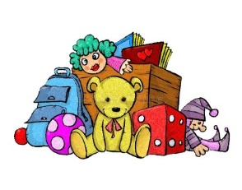
Toys – Show and Tell
Day 2
L.I – When talking I can share relevant information and
experiences with others.
We would like to know the following:-
What your favourite toy is?
Why it is your favourite toy?
Does it do anything special?
Some words that describe your favourite toy.
We would love to hear all about your favourite toy. You can share your toy with us and all your friends on the school twitter page. *Remember not to use your name.
We can’t wait to hear from you!

