Slide 1
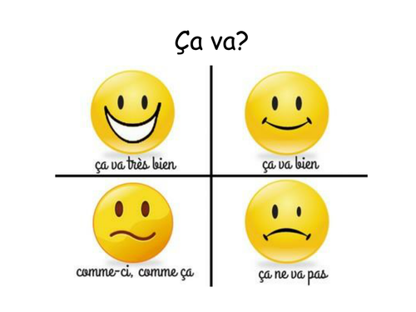


Tuesday 16th June
Good morning primary 2!
Bonjour la class! Ca va?

Slide 2

Literacy
ff
L.I – We are learning to read and write this weeks common words
Can you read the following common words?
three room long tree
Spelling Task
Beat the clock - How fast can you write your spelling words out neatly and correctly. Can you beat your time?
Attempt 1 | Attempt 2 | Attempt 3

Slide 3
Common word revision
five time life line home more school Mrs take gave cold don’t every find want girl father head mother jump four miss never these
three room long tree

Slide 4
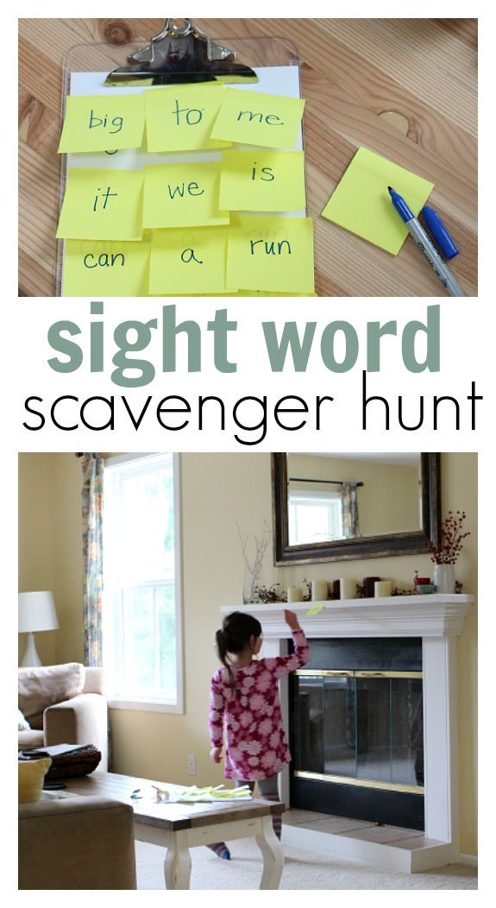
Common word Scavenger Hunt
L.I – I use my knowledge of sounds and patterns to read words
Task - ask an adult to write out your tricky words on sticky notes and hide then around the house. Have a list of the tricky words you are looking for and go and search for them.
Have fun!

Slide 5

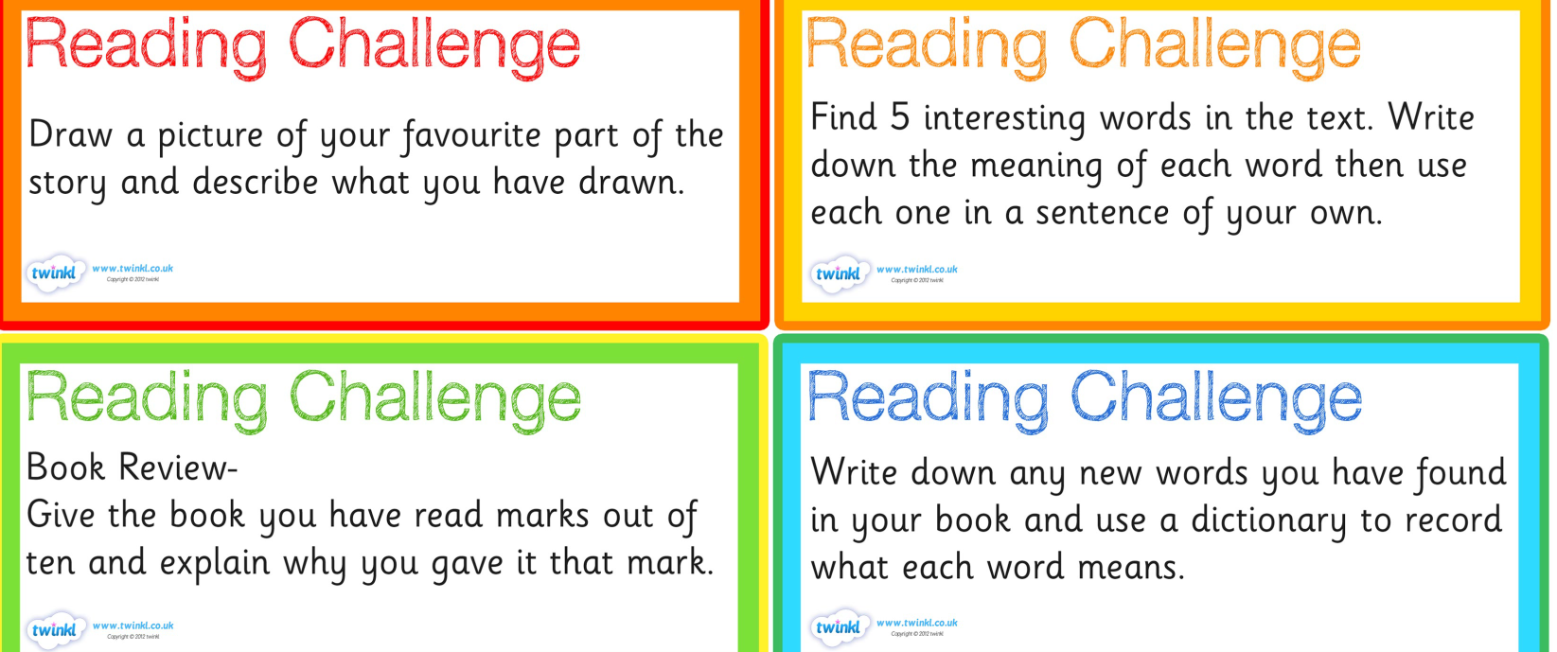
Literacy
LI: We are learning to read fluently and answer simple questions about what we have read.
Oxford Owl Website – https://www.oxfordowl.co.uk/?sellanguage=en&mode=hub
1 – Spend 10-15 minutes reading your book.
2 – Choose an activity from the list below to complete.
Username: stanothnysp12
Password: Homelearning*1

Slide 6

Story Time
https://www.youtube.com/watch?v=HfIuIQaOLlY

Slide 7
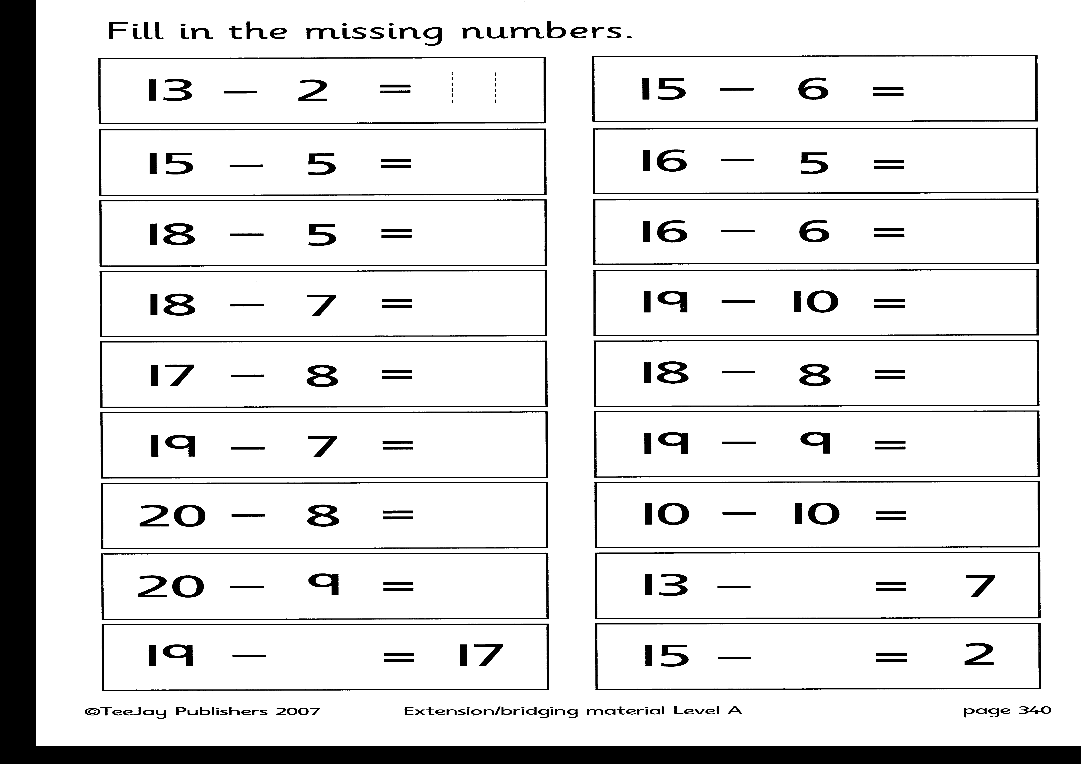
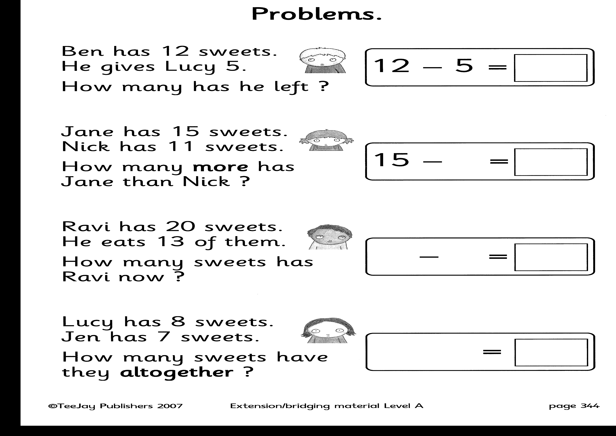

Slide 8

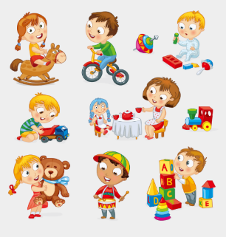
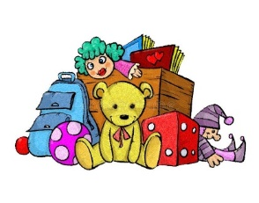
Toys – Show and Tell
Day 2
L.I – When talking I can share relevant information and
experiences with others.
We would like to know the following:-
What your favourite toy is?
Why it is your favourite toy?
Does it do anything special?
Some words that describe your favourite toy.
We would love to hear all about your favourite toy. You can share your toy with us and all your friends on the school twitter page. *Remember not to use your name.
We can’t wait to hear from you!

