Slide 1
Monday 15th June

Slide 2
Timetable
Daily exercise
French
Spelling
Reading
Maths
Art

Slide 3
Daily exercise
Today we would usually have P.E
I have attached below the Video of Joe Wicks.
https://www.youtube.com/watch?v=eQh4vTtzTEc
Or what about some Yoga?
https://www.youtube.com/watch?v=LhYtcadR9nw

Slide 4
French Starter

Slide 5
Spelling
S | SS | C | Se | Ce
Sack Suggest Scream Separate Sensible Service | Actress Address Assist Distress Glass | Saucer City Circle Place Cease Ice Twice | Sense Cease Practise | Service Peace Sequence Sentence
I am learning to use various spelling strategies.
Task - Diacritically mark 10 of your spelling words. ( you can select from any of the columns)

Slide 6
Literacy Starter – I am using spelling rules to help me spell words.
Rule 1:
Soft ‘g’ – coming before ‘e’ (judge)
Soft ‘g’ – coming before ‘i’ (ginger)
Soft ‘g’ – coming before ‘y’ (gym)
Look at the next slide for the task.

Slide 7
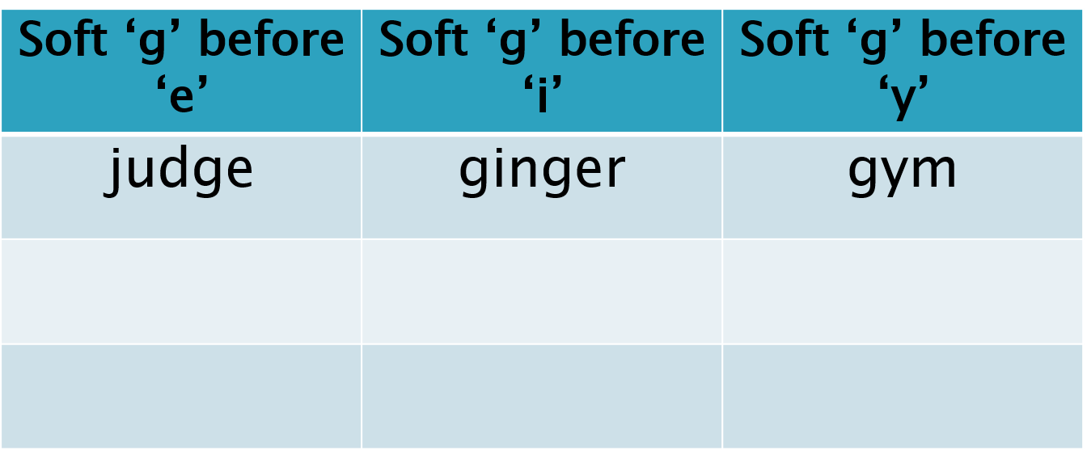
Literacy starter cont
TASK:
Draw a table in your jotters (example below) and write down as many soft ‘g’ words that you can think of!

Slide 8
Reading
https://www.bbc.co.uk/bitesize/clips/zrnxvcw
Watch the above video of Georges Marvellous medicine.
Who is the baddie and who is the good person in the story?
can you use the descriptive language in this clip to create a word bank of adjectives for a good character and one for a baddie?
See the example on the next slide/
Challenge – create your own medicine for George’s gran.

Slide 9
Example
Baddie | Goodie
“ Brilliant, unblinking eyes” | “ a welcoming smile”
“straggly dark hair” | “ a jolly personality”

Slide 10
Maths Starter
The recipe says I need 40 ml of milk and the only measuring spoon I have holds 3 ml.
How many 3 ml spoonfuls will I have to use and how much milk will be left over?
17 slices of lasagne were divided between 4 diners.
How many slices did each get and how many were left over?
When 100 paper clips are weighed, their total weight is 19.6 grams.
What is the weight of 1 paper clip?

Slide 11
Weight
We weight objects in kilograms and grams.
1kg (kilogram) = 1000 g (grams.)
E.g 5kg = 5000grams
7000grams = 7kg

Slide 12
I can change kilograms to grams and grams to kilograms.
Question 1 – change the following to grams
A) 6kg
B) 23kg
C)72kg
D)1kg 500g
E) 6kg 835g
F) 14kg 7g
G) 24kg 234g
Question 2 – change the following to Kg
2000g
3500g
9850g
13000g
1020g
65000g
18500g

Slide 13
Answers
Question 2 – change the following to Kg or kilograms and grams.
2000g – 2kg
3500g- 3.5kg
9850g - 9kg 850 grams
13000g – 13kg
1020g – 1kg 20g
65000g -65kg
18500g – 18.5 kg or 18kg and 500g
Question 1 – change the following to grams
A) 6kg – 6000grams
B) 23kg – 23000 grams
C)72kg – 72000 grams
D)1kg 500g – 1500grams
E) 6kg 835g – 6835 grams
F) 14kg 7g – 14700 grams
G) 24kg 234g - 24234 grams

Slide 14
Art
We are going to look at Landmark drawing. Watch the below video on how to draw landmarks by Ken Done who is a famous Australian artist.
Once you have watched the video choose a landmark the interests you. This could be one that we have looked at through our topic or another one in another country. For example the Eiffel tower.
Ken Done does very bright and vibrant pictures. Use your imagination to make your landmark stand out.
I cannot wait to see what you create.
https://www.bbc.co.uk/bitesize/clips/zdsb9j6

