Slide 1
Monday 15th June 2020
Good Morning Primary 4!
French: Bonjour la class! Ca Va?
Quelle est la date aujourd’hui?
Aujourd’hui cest Lundi 15th June 2020

Slide 2
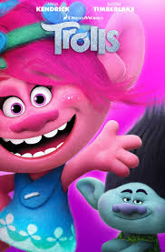
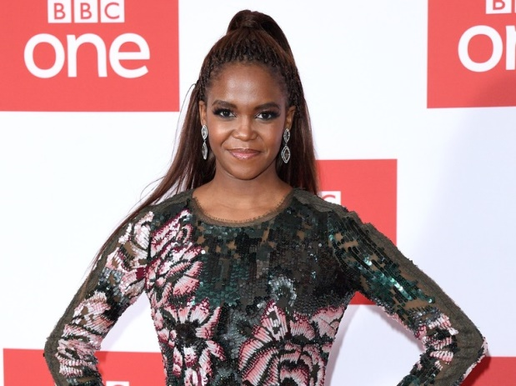
Health and Wellbeing
LI: We are learning to move our body well, exploring how to manage and control it, finding out how to use and share space.
Today, enjoy a dance class with Oti Mabuse from ‘Strictly Come Dancing’.
This dance lesson can be done by the whole family if you want!
The theme is ‘Trolls’ the movie.
Enjoy!
https://www.youtube.com/watch?v=MCeo6Q3p7Mc

Slide 3
Spelling (slide 1)
LI: I am using strategies to help me spell words
Today, we are starting a new phoneme!
The ‘oo’ phoneme.
Some ‘oo’ words are…
shook - prune - flew - clue - put
TASK ON THE NEXT SLIDE

Slide 4
Spelling (slide 2)
LI: I am using strategies to help me spell words
TASK: think of and write down as many ‘oo’ words as you can using the ‘oo’, ‘u-e’ and ‘ew’ representations
oo | u-e | ew
shook | prune | flew

Slide 5
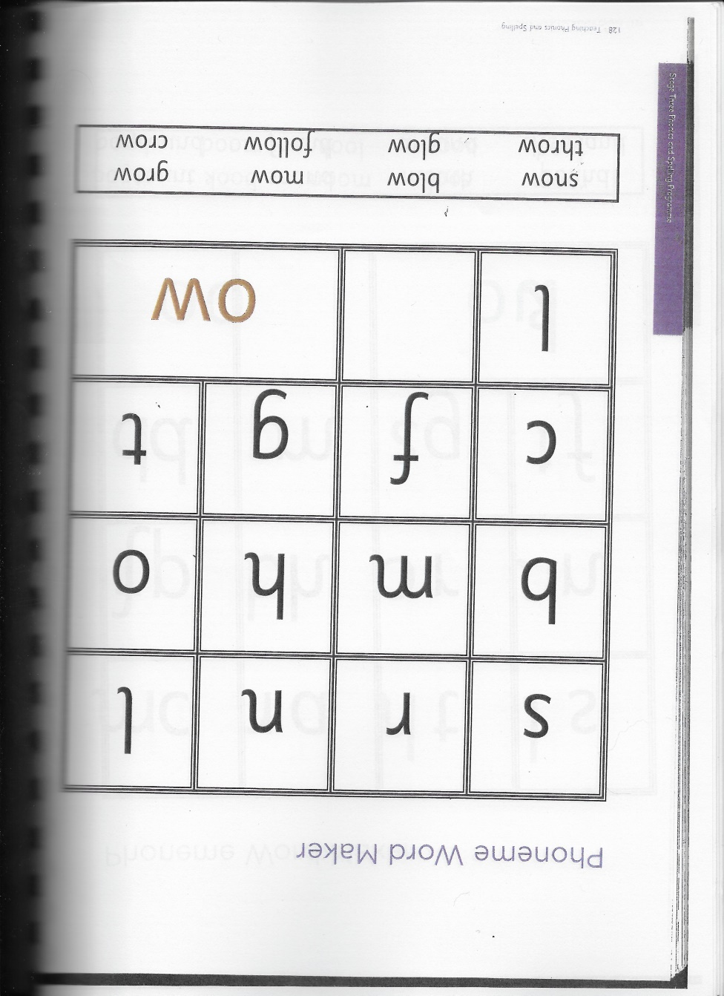
Spelling Slide 1 (David Walliams Group)
TASK: practise words that include the ‘ow’ (e.g. snow) phoneme
Write down the letters on the sheet.
Cut out all of the letters and the ‘ow’ sound.
Use the ‘Say / Make/break / blend / read / write strategy to practise the ‘ow’ words on your sheet. (See next slide for details).

Slide 6
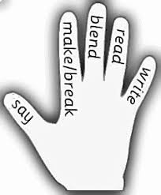
Spelling Slide 2 (David Walliams Group)
1. SAY - say the word day?’
2. MAKE/BREAK - make the word day with your letters.
3. BLEND - SOUND OUT the letters by running your finger below the letters and then BLEND the sounds together to make the word.
4. READ - read the word.
5. WRITE - WRITE the word below it.

Slide 7
Reading
L.I I am using different reading strategies to help me understand my book
Today is free reading!
Pick a book of your choice from home or on Epic!
Try and read a little bit and just enjoy it!

Slide 8
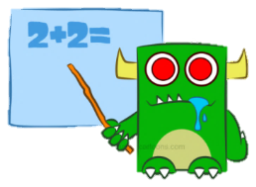
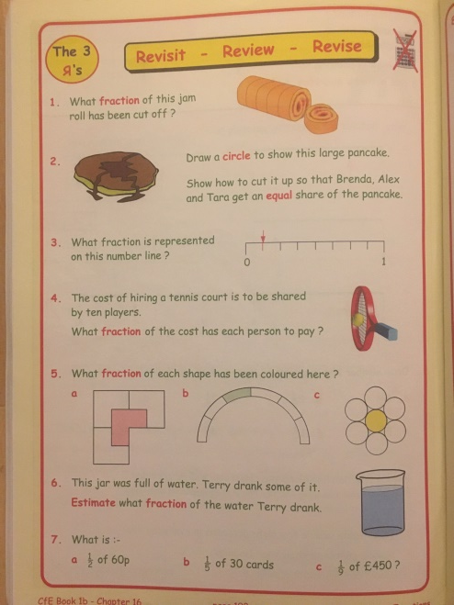
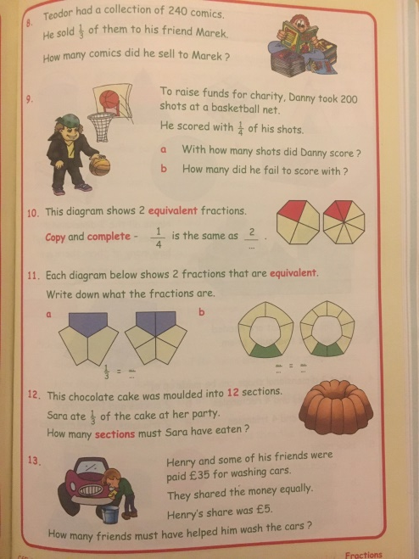
Maths (slide 1)
L.I. I am learning about fractions
TASK:
Try these Revisit – Review – Revise questions to see how much you have learned about fractions!
Download the sheets from Teams or the Blog and write the answers in your jotter.

Slide 9
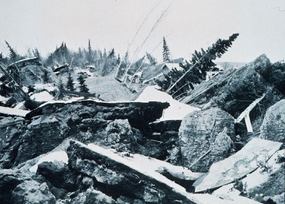
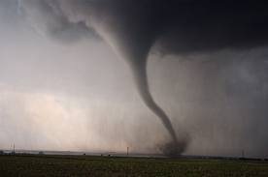
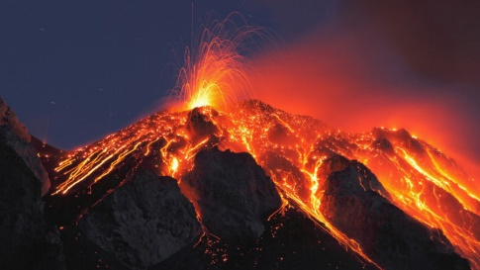
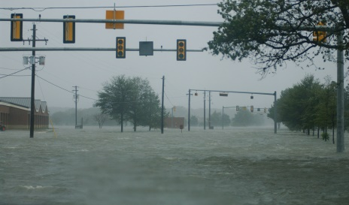
New Topic! (slide 1)
Natural Disasters
Well done to everyone who did all of the exciting tasks last week, including Aiden’s Quiz, Muno’s PowerPoint and Sofia’s experiment.
Today, our ‘Topic Teacher’ is…
Rebekah with her PowerPoint and quiz about various types of natural disasters!

Slide 10
New Topic! (slide 2)
Natural Disasters
TASK:
1) Download Rebekah’s PowerPoint from Teams – you will find in in ‘Files’ / ‘Natural Disasters’.
2) Complete Rebekah’s quiz by clicking on this link! https://forms.office.com/Pages/ResponsePage.aspx?id=oyzTzM4Wj0KVQTctawUZKUgZ8CSpNhVGnQQEYnfAg5xUMEhJRDRPVVRSUUMzT1ZINDdaVkdDWkFYRC4u
3) Enjoy!

Slide 11
Feel free to leave comments / questions on Teams throughout the day and I will try my best to get back to you. Enjoy your day, Primary 4!

