Slide 1
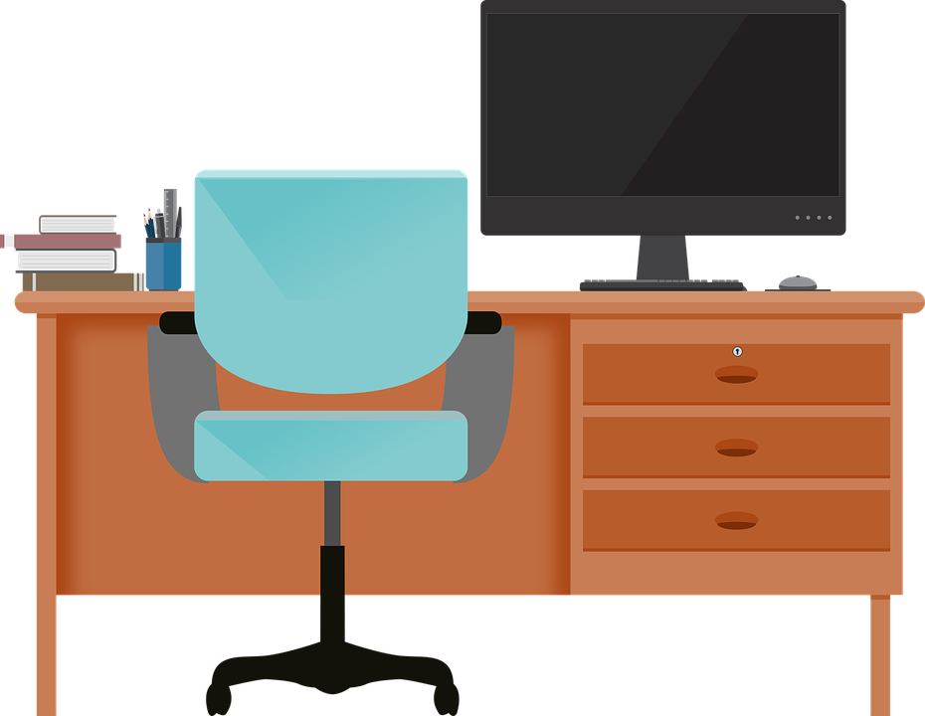
Good Morning P5/4
Week 13 Home Learning
Monday 16th June 2020

Slide 2
Aujord’hui c’est lundi trieze juin.
Je suis content(e)
Je suis d’accord
Je suis mal
Il fait mauvais.

Slide 3
Class Trip!
I have been thinking, we never got a chance to go on a class trip before we started home learning, so I have a way to make up for it I hope.
As part of our Europe topic, every day this week we are going to be virtually visiting a European city and learning more about it!
Today, we are keeping it close to home and visiting:
LONDON!
Who’s excited? I know I am!
There is a new folder in teams called ‘Class Trip’ where you will find all resources for this week.

Slide 4
Passport
In order to be able to travel, we will all need a passport.
Create a passport that you can use during this week. Here is a template you could use.
Remember to include:
A front cover
Your name
Your birthday
A picture of yourself
A page to write each country you visit.
A page to write all the landmarks you visit.
Each time you visit a new city/landmark make sure to write it in your passport. You could create a stamp like mark for each one.

Slide 5
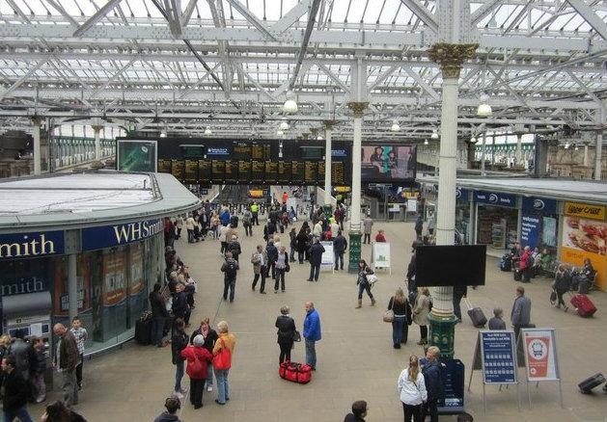
Looks like we have arrived at Edinburgh Waverly!
If you are interested in having a look around – Check out this video.
https://www.youtube.com/watch?v=wQovcOeXiB8
Timetable Research - https://www.scotrail.co.uk/
We arrive at Edinburgh Waverly at 8:50am on a Monday morning.
What is the next train we can get to London Kings Cross?
What time will that train arrive in London?
How long will the journey take?
Now time for the train journey!
Here is a video of one.
https://www.youtube.com/watch?v=jvAaxnT6K5E

Slide 6
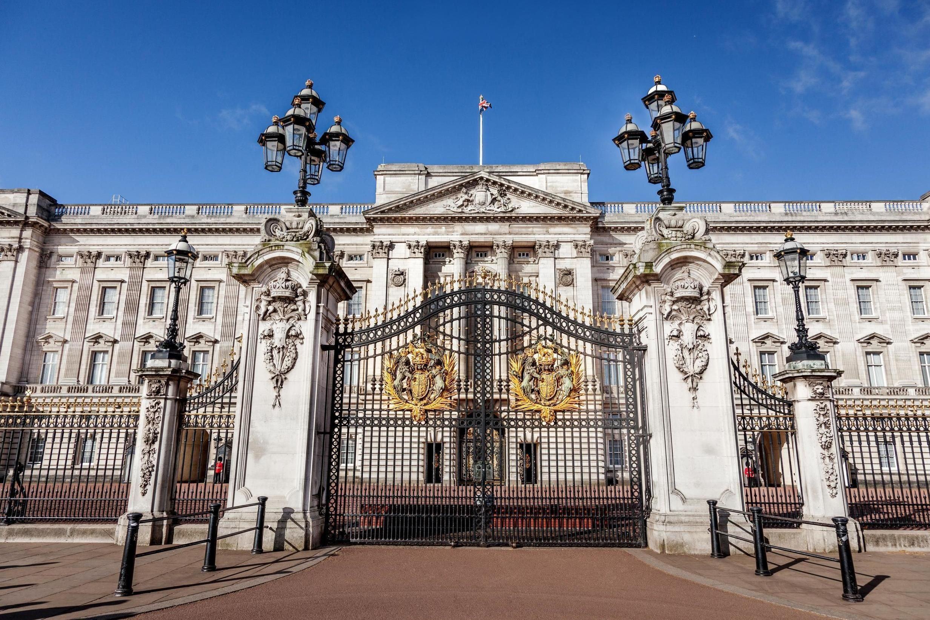
Click here for a 360 degree map of London to see famous landmarks
https://360.visitlondon.com/#
First stop – Buckingham Palace!
Here is some virtual tours of Buckingham Palace:
https://www.youtube.com/watch?v=FtGN2wK9g_s
https://www.royal.uk/virtual-tours-buckingham-palace
Reading Comprehension
Group 1
Group 2
Group 3
Group 4

Slide 7
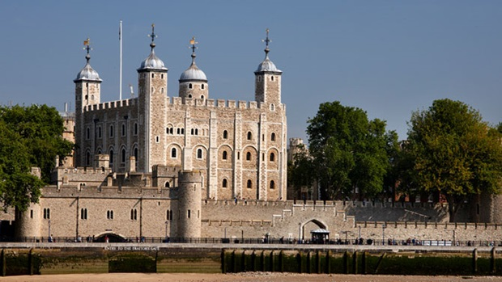
Second Stop – Tower of London
https://www.youvisit.com/tour/meadk
Research
What is a Beefeater?
Why are they called this?

Slide 8
Lunch Stop!
In Britain, we are very famous for our Afternoon Tea’s!
These include three parts.
Can you find out what these three parts are and then try to make your own, here is a video explaining how to create an afternoon tea.
https://www.youtube.com/watch?v=O6xXVe-Imd8&t=61s
Do not worry if you don’t have resources in your house, you could always draw an afternoon tea and label what you would have with yours.
If making one, please ask an adult for help.

Slide 9
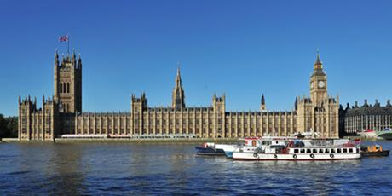
Third Stop – Houses of Parliament
https://www.parliament.uk/visiting/virtualtour/
https://www.youtube.com/watch?v=Jh_p5GcrWCQ
Art
Can you draw your own diagram of the House of Commons Chamber and label it correctly?

Slide 10
Final Stop of the Day – Royal Albert Hall
https://www.royalalberthall.com/your-visit/venue-and-seating-plan/virtual-tour/
https://www.youtube.com/watch?v=P7uhrgzKfXc
Can you list some of the events that happen at the Royal Albert Hall?
Here is a favourite of mine:
https://www.youtube.com/watch?v=nMvCkiEFflU

Slide 11
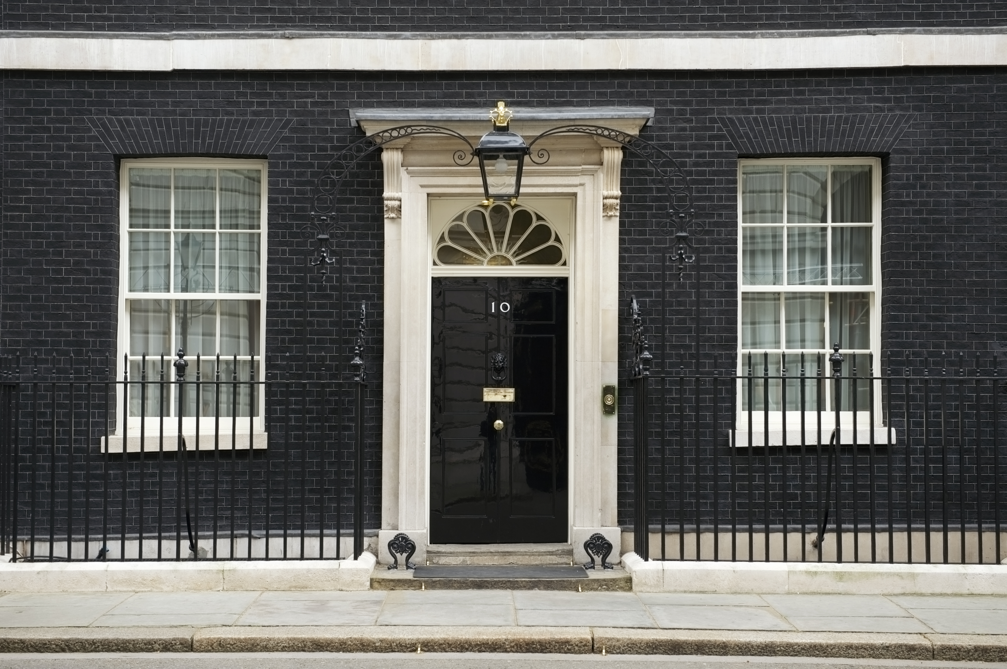
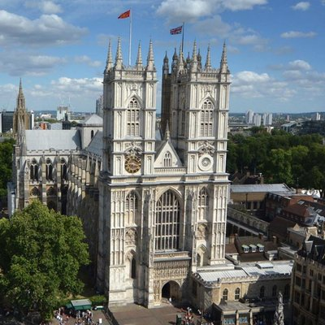
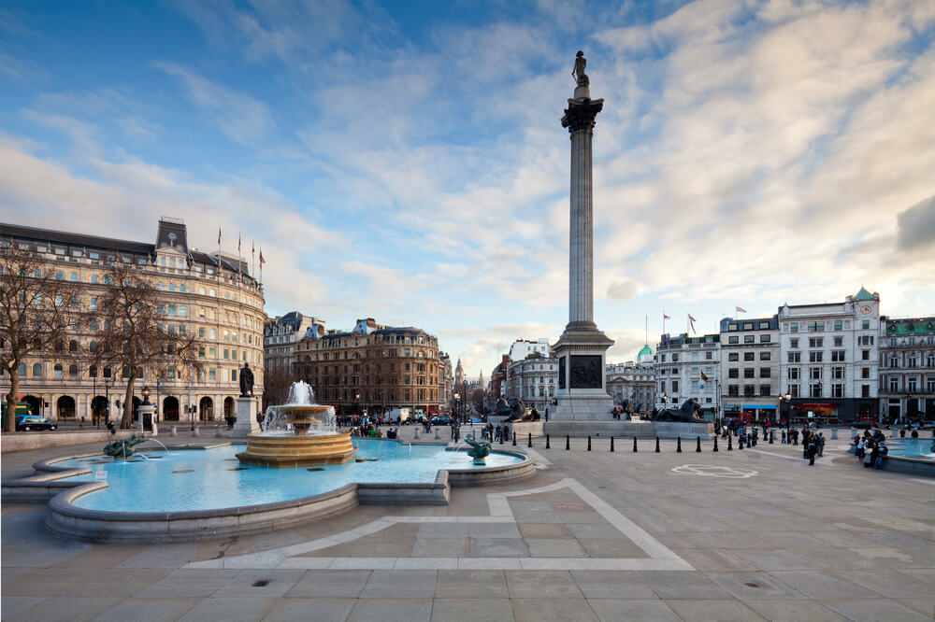
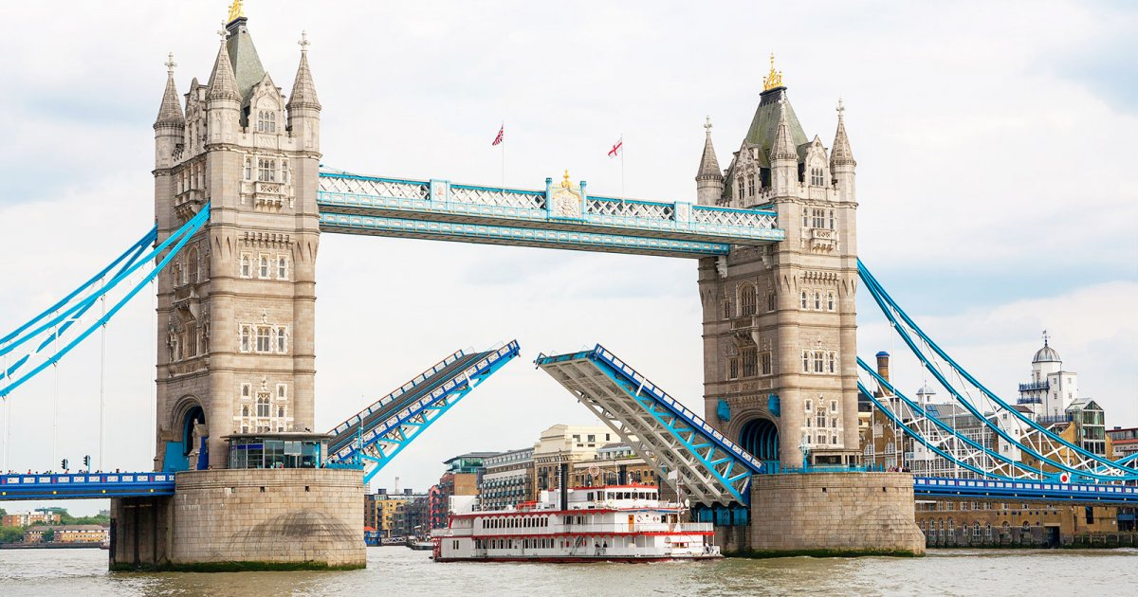
The end of the day
I hope you have enjoyed our first city on our virtual class trip.
There are so many other places in London that we could have visited, there a few additional links below if you wish to look at a few more landmarks.

