Slide 1
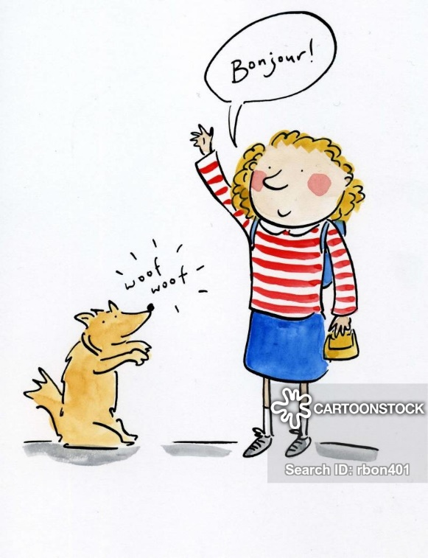
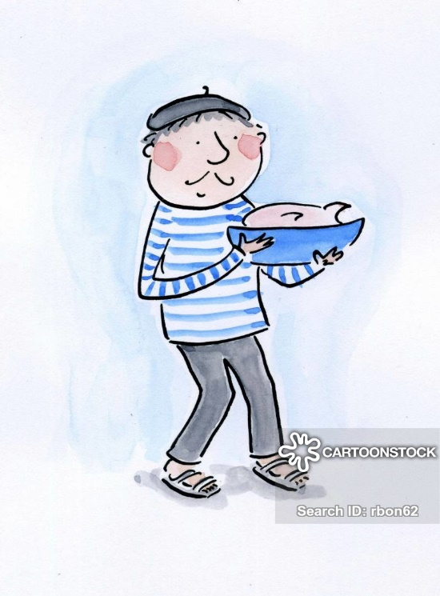

Monday 15th June
Good morning primary 2!
Bonjour la class! ca va?

Slide 2
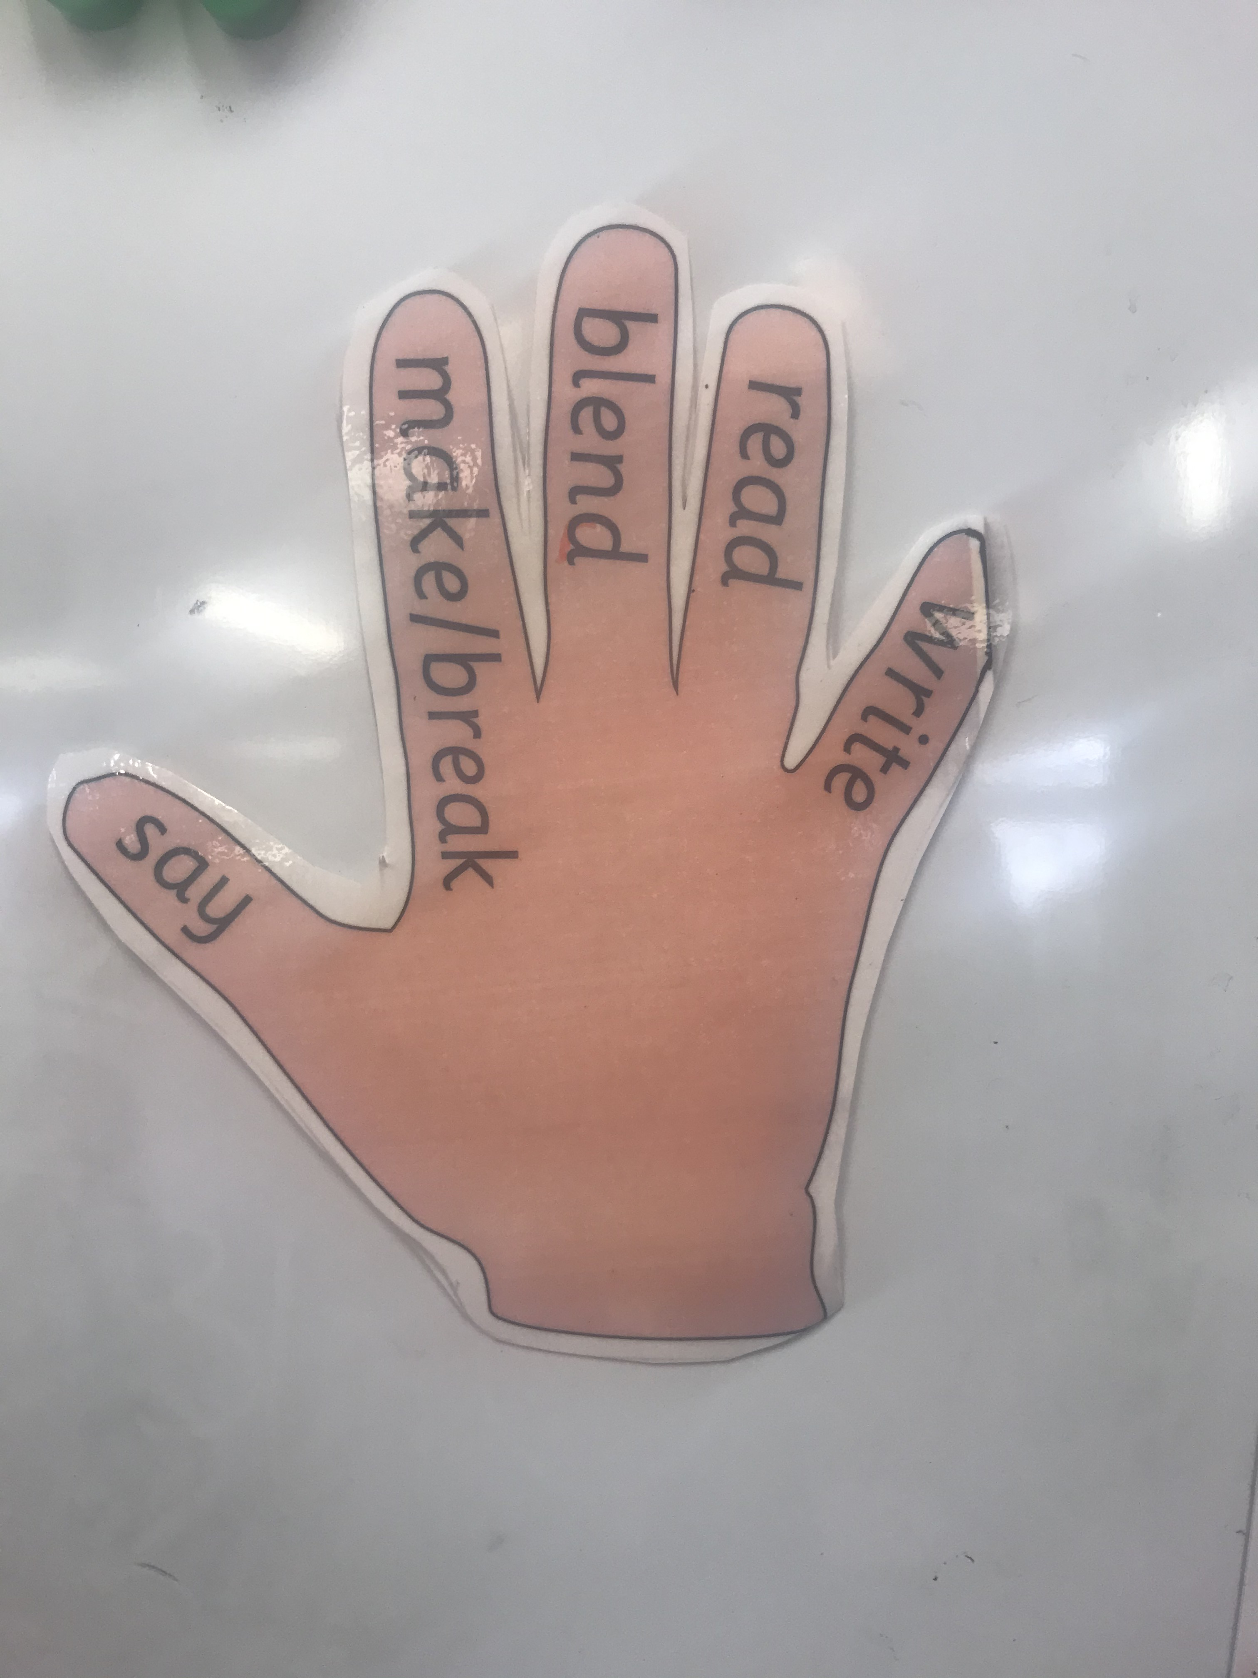
Literacy
L.I - I can recognise, read and make words containing the ‘ff’ phoneme.
Revise letter sounds – https://www.youtube.com/watch?v=qwOQvh_mJ4w
Watch -https://www.youtube.com/watch?v=nFqKUBZQhJA
Task 1 - Read phoneme story and highlight phoneme words
(items found in home learning pack)
Task 2 – Cut up the phoneme word maker and make the following words.
cliff
puff
gruff
fluffy
stiff
huff
cuff
sniff

Slide 3
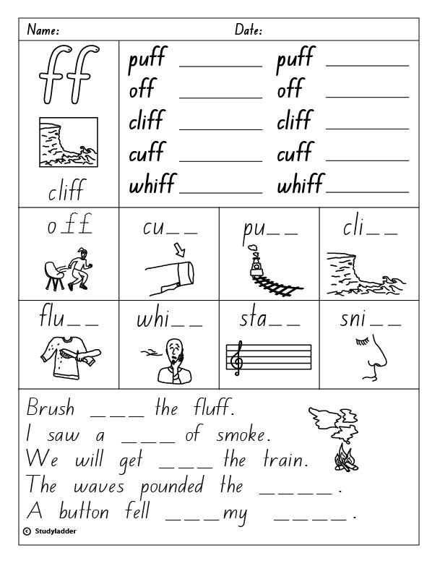
L.I – I can spell words containing the ‘ff’ phoneme.
Task – Can you complete this ‘ff’ worksheet in your jotter? I have also provided a word document on the blog in case you would like to print it off.
*Challenge
Choose an ‘ff’ word and write a super sentences in your jotter.

Slide 4



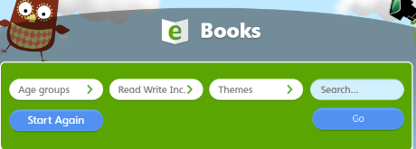
Oxford Owl Ebooks
*Choose a new book to read this week
Login to the following website : https://www.oxfordowl.co.uk/
Click on the following ‘My class login’ at the top of the page
Username: stanothnysp12
Password: Homelearning*1
Click on ‘My Bookshelf’
Click on ‘Series’ button and select Oxford Reading Tree
Scroll down the list of books and choose one suitable for your child. We advise you read one book per week as we sill set ‘read to write tasks’ for your child to complete.

Slide 5

Story time
https://www.youtube.com/watch?v=jNOYgRf5jes

Slide 6
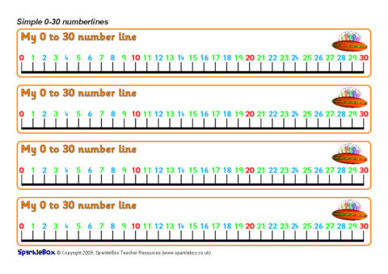
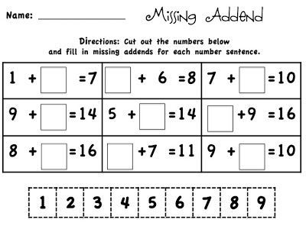
P2 Maths Revision
L.I – I can use my knowledge of addition and subtraction strategies to solve missing number problems.
Quick warm up, scroll down to adding quiz - https://www.bbc.co.uk/bitesize/articles/z6vm6v4
Watch - https://www.youtube.com/watch?v=sRQgXnd05VE
Can you solve these problems in your jotter?

Slide 7
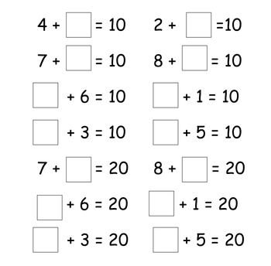
Here are some more for you to try!

Slide 8
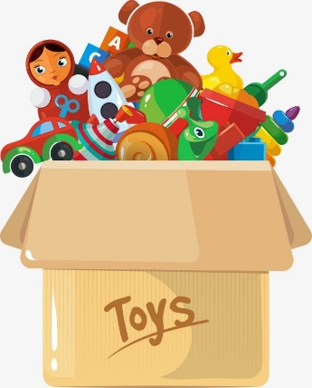
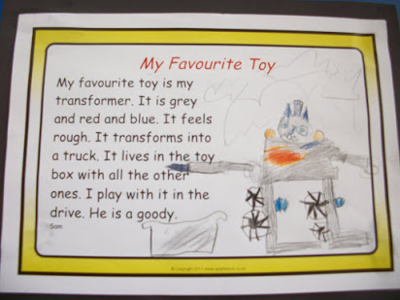
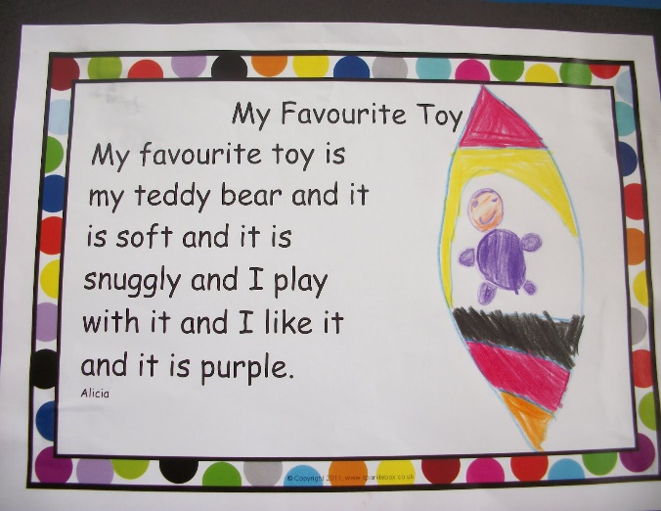
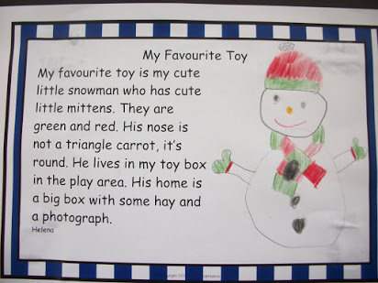
Toys – Show and Tell
Day 1
L.I – When talking I can share relevant information and
experiences with others.
During lockdown we have had to spend a lot of time in the house playing by ourselves! I would like to know your favourite toy to play with is and why?

Slide 9


Can you draw a picture of your favourite toy and use some words to describe it?
Word bank
Soft
Cuddly
Noisy
special
Messy
Fun
Cute
Fast
patched

