Slide 1
Friday 12th June
Good Morning Primary 4!
French: Bonjour la class! Ca Va?
Quelle est la date aujourd’hui?
Aujourd’hui cest Vendredi 12th Mai 2020
Listen to the days of the week song!
https://www.youtube.com/watch?v=Lpwf5N0rfVE

Slide 2
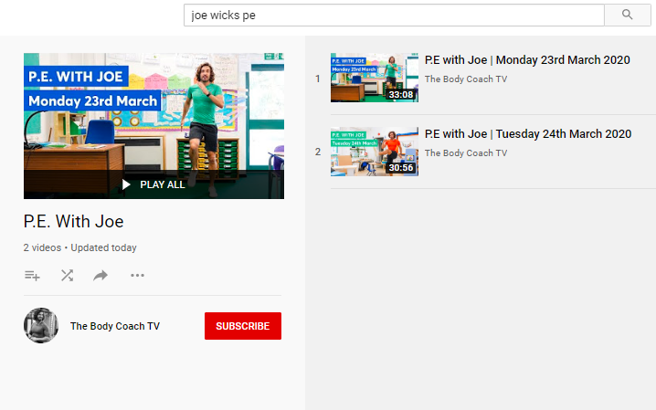
Health and Wellbeing
LI: We are learning to move our body well, exploring how to manage and control it, finding out how to use and share space.
P.E with Joe- Friday 12th June Video
(he is nearly as fun as Mr Martin, not quite, but nearly)
https://www.youtube.com/playlist?list=PLyCLoPd4VxBvQafyve889qVcPxYEjdSTl

Slide 3
Spelling (slide 1)
LI: I am using spelling rules to help me spell words
Yesterday, you used a fun spelling strategy to practise your ‘soft g’ spelling words. The rule is below:
Rule 1:
Soft ‘g’ – coming before ‘e’ (judge)
Soft ‘g’ – coming before ‘i’ (ginger)
Soft ‘g’ – coming before ‘y’ (gym)
TASK ON THE NEXT SLIDE

Slide 4
Spelling (slide 2)
LI: I am using spelling rules to help me spell words
TASK: write 5 ‘soft g’ sentences
Today, write 5 sentences. Each sentences must include one of the ‘soft g’ words from the online list. (see link below).
Your sentences MUST be different from the examples given on the webpage!
Challenge: write a paragraph instead of sentences!
Here is a list of ‘soft g’ words to help you!
https://www.spellzone.com/word_lists/list-1282.htm

Slide 5
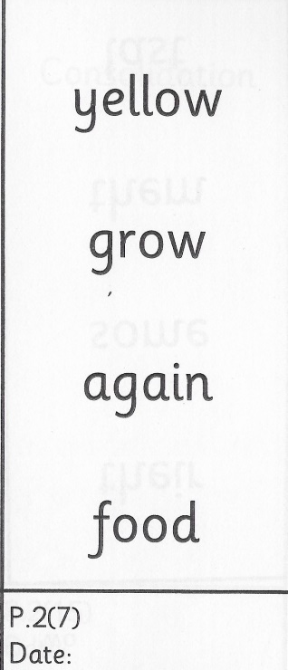
Spelling (David Walliams Group)
TASK:
Keep practising these common words for 1 more week! You’ll get a new set of words next week.
Remember to use the ‘Read, Write and Spell’ strategy to help you practise.
Example of how to practise your common words!

Slide 6
Handwriting
L.I. I can use joined up handwriting
Download the handwriting sheets from Teams or the Blog and practise in your jotters.
Some of the letters in this style of handwriting are a little bit different to our last activities but try them and decide which style you find the best! The differences are very small (e.g. the letter l goes straight up rather than looping at the top!)
PLEASE ONLY DO THE LETTER ‘B’ SHEETS TODAY (SHEET 3 AND 4)

Slide 7
BIG MATHS… BEAT THAT CHALLENGE!
LI: We are learning our times tables
On the next slide, you will find a link to an online timer and you will see a big version of a Big Maths Beat That challenge!
2. Your challenge is to answer as many questions as you can, as quickly as you can! Write down the answers in your jotter.
3. You should work out the answers in your head! (no cheating) If you are stuck on one, move onto the next one!
4. Once you have answered all the questions that you can, stop the timer and write your time down next to your answers.
5. Finally, use a calculator (https://www.online-calculator.com/) to check that your answers are correct. If any are wrong, correct them! If you got stuck on some, work them out!)
DID YOU BEAT YOUR TIME FROM LAST WEEK?

Slide 8
Time yourself!
https://www.online-stopwatch.com/

Slide 9
HAVE A GREAT WEEKEND, PRIMARY 4! WELL DONE FOR WORKING SO HARD. MR P

