Slide 1
Friday ^{12th} of June
Good Morning Primary 2!
Bonjour la class! Ca Va?
https://www.bbc.co.uk/teach/supermovers/ks1--ks2-mfl-french-greetings-with-ben-shires/zdpdvk7
L.I – I can say some simple greetings in French

Slide 2
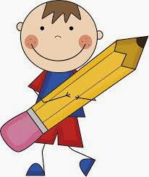
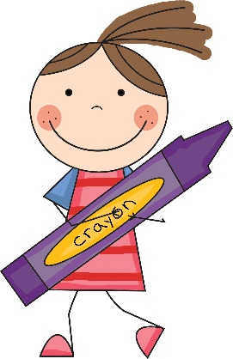
Literacy
L.I – We are learning to use our knowledge of common words and phonemes to spell, write and read words.
Watch - https://www.youtube.com/watch?v=YPW-ZkhRUPY
Activity - Dictation (read aloud to your child)
Read slowly to your child and encourage them to write independently in their jotter.
Tip – Help them sound out the letters in each word.
Remember core writing targets!
A boy called Will fell down the well. He broke his leg and had to miss his class school party. He found this very dull.

Slide 3
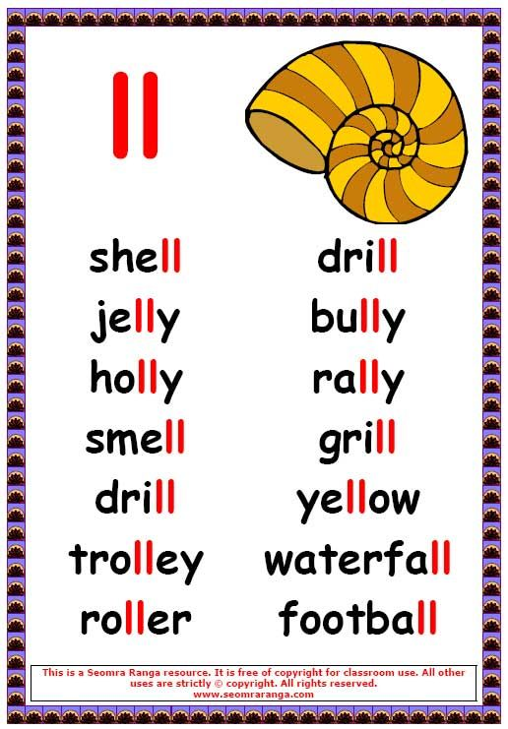
Can you read all the ‘ll’ words with me?
Watch -
https://www.youtube.com/watch?v=q5h4k_BmRKQ

Slide 4
Story time
https://www.youtube.com/watch?v=t6NUJ2JZz50&feature=youtu.be

Slide 5
Mathematics
Watch: https://www.bbc.co.uk/iplayer/episode/p089nn4k/bitesize-57-year-olds-week-1-1-maths-and-history
* I challenge you find a way to arrive at the target number ‘13’ using only three of the numbers listed below.
You can use any maths operation you choose!
13
+ -
2 3 4 5 6 7

Slide 6
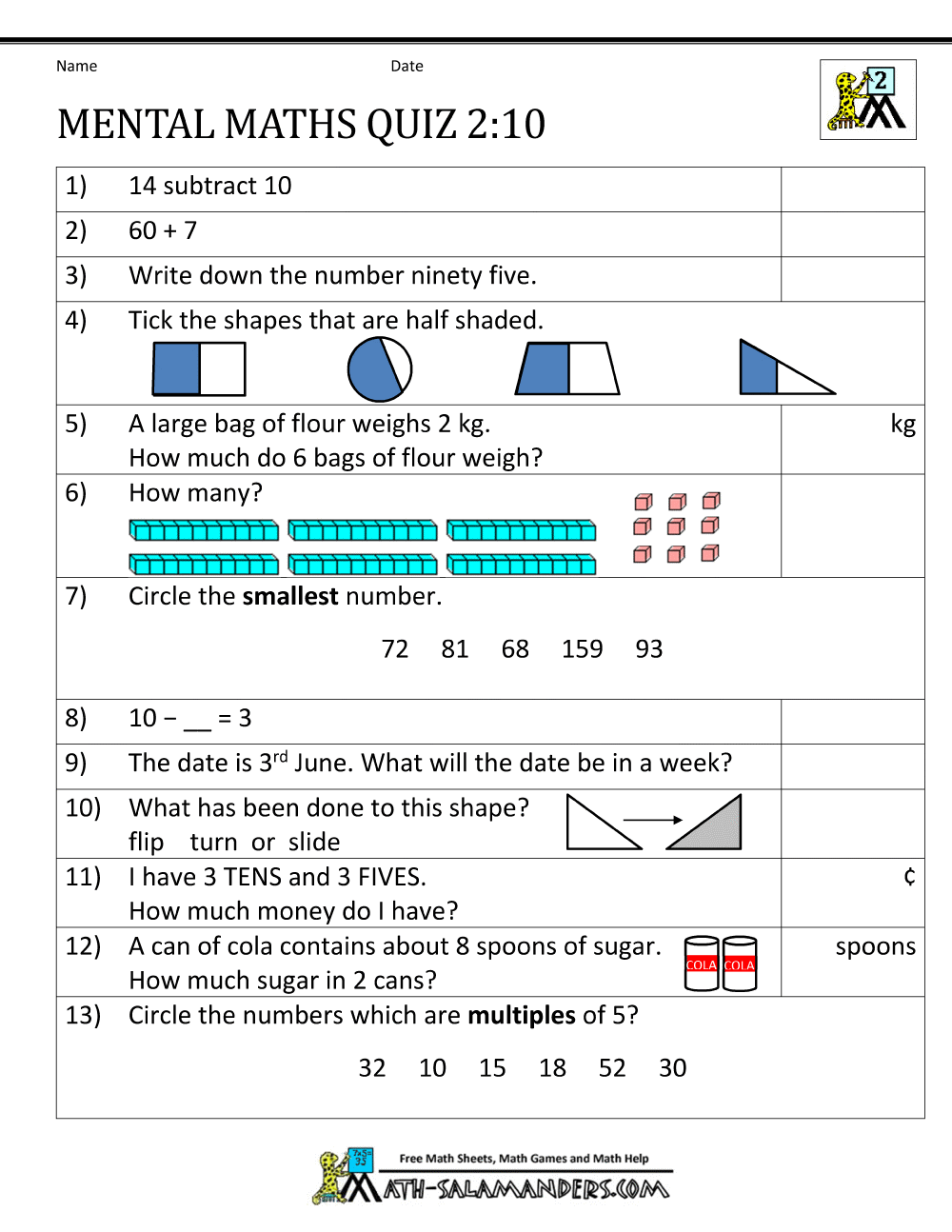
Can you complete these number questions in your jotter? *I have also provided this as a file if you wish to print it off

Slide 7
The Feast of St. Anthony- Saturday 13th of June
Saint Anthony is the Patron Saint of lost things. If you ever misplace something you can always ask St. Anthony for help.
Saturday is the Feat Day of St. Anthony. Usually we would celebrate at school together by going to mass.
We cannot be together in person but we can be in spirit. So why not watch mass tomorrow online with Father Sebastian.

Slide 8
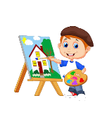
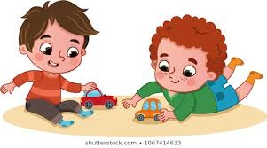
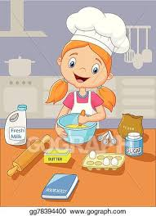
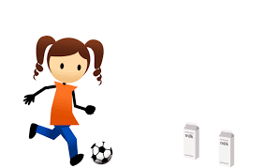
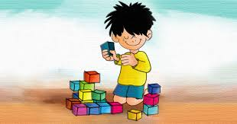
Fun Friday Activities
Article 31 – I have the right to play and relax.

Slide 9
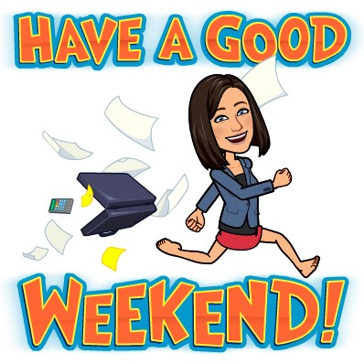
Have a lovely weekend and we will be back with more activities and lessons on Monday!

