Slide 1
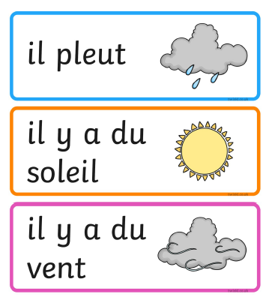
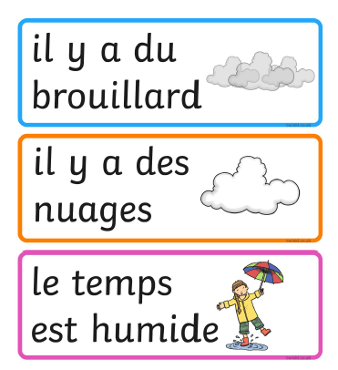
Friday 12th of June
French: Bonjour la class! Ca Va?
Aujourd’hui cest Vendredi 12th J____ 2020
L.I- To describe the weather in French
Quel temp fait-il aujourd’hui?= What is the weather like today?
Il... It is…
Rainy Foggy
Sunny Cloudy
Windy Wet

Slide 2
Literacy
LI: To use my phoneme and common word knowledge to spell accurately.
Spelling Day 5 : Sentence Dictation
Choose a dictation sentence from the list on the following slide.
Read aloud the sentence to your child first, for them to listen to it
in full.
Then re-read sentence again slowly, word by word(sounding out where necessary), allowing the child to write down each word independently.
Please encourage your child to:
- Have a go.
Think about what sounds can they hear in the word and chunk it into sounds they know.
Remember their core writing targets- full stops, capital letters, finger spaces.

Slide 3
Literacy: Sentence Dictation
Stage 2 Dictation
Will you help me cut this dress out?
I hit the cup and it fell and made a mess.
My toy fell down the well and I miss it a lot.
Stage 3 Dictation
In the morning I like to eat toast and jam.
My dog loves to walk through the woods.
I helped mum to carry the light bag of shopping home.

Slide 4
Reading- Stage 2 Common Words
will well fell call
I will be a year older on my birthday.
After the fair ground ride I did not feel well.
When I fell and cut my knee, I was very brave.
I call my grandpa every day, just to say hello.

Slide 5
Reading- Stage 3 Common Words
through, morning, colour, put, different, light, sentence
In the morning the sun light began to rise over the hill.
We drove through the night to get to the airport.
If you put different coloured paint together, they make a new colour.
This is the last common word sentence for you to read today.

Slide 6
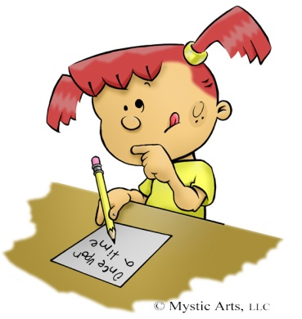
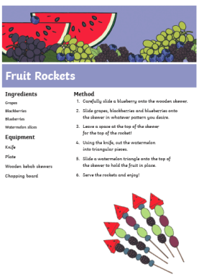
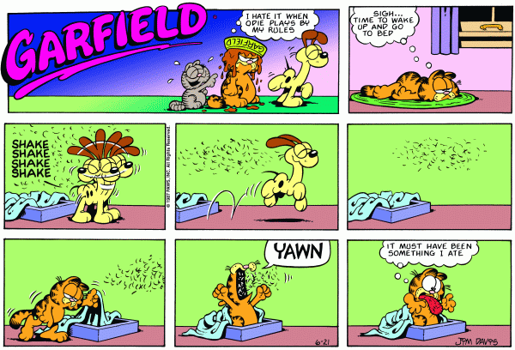
Literacy-Free Writing Friday
LI: To create a text of my choice
Set 15 minutes on a timer. Maybe your adult could do free writing at the same time as you?
Decide what type of writing you would like to do.
Collect all the writing tools you need to complete the task in time.
When the timer is up, share what you have done with each other.
Don’t forget you can send a picture of your work to our twitter! I would love you to share what you have written with me on our school twitter page!

Slide 7
Izzy Gizmo
https://www.youtube.com/watch?v=n5o_jShvHXM

Slide 8
Numeracy – Warm Up
LI: To use mental strategies to solve maths problems and be able to explain my strategy

Slide 9
2 + 3 + 2 = 7
2 + 3 + 2 = 7
4 + 4 – 1 = 7
9 – 2 = 7
5 + 2 = 7
3 + 3 + 1 = 7

Slide 10
www.stevewyborney.com

Slide 11
www.stevewyborney.com

Slide 12
Hit the Button
Choose which one you want to practise today
https://www.topmarks.co.uk/maths-games/hit-the-button

Slide 13
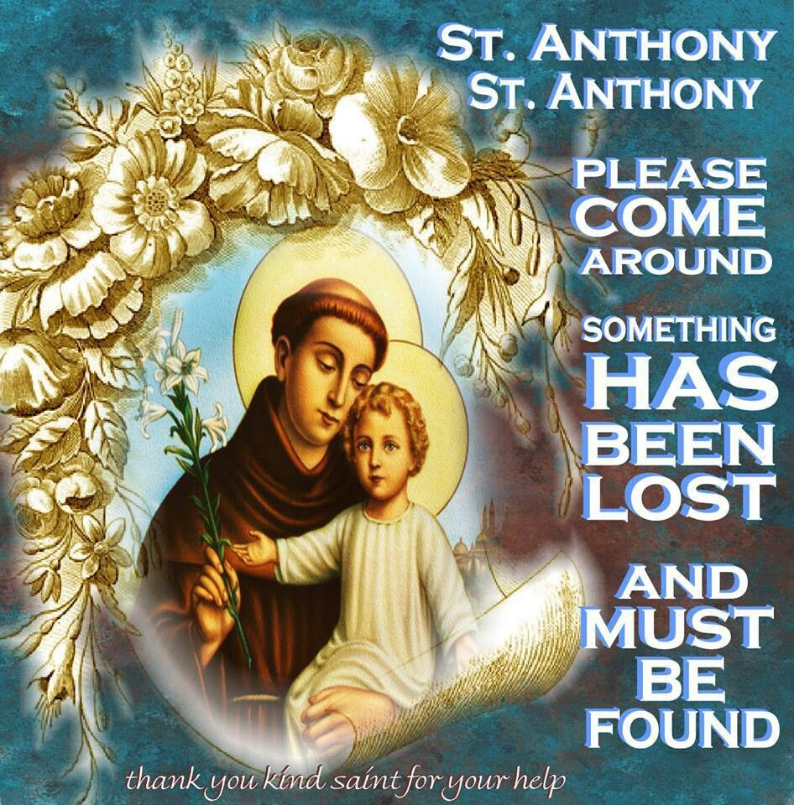
The Feast of St. Anthony- Saturday 13th of June
Saint Anthony is the Patron Saint of lost things. If you ever misplace something you can always ask St. Anthony for help.
Saturday is the Feat Day of St. Anthony. Usually we would celebrate at school together by going to mass.
We cannot be together in person but we can be in spirit. So why not watch mass tomorrow online with Father Sebastian.

Slide 14
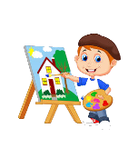
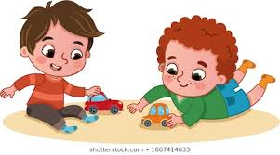
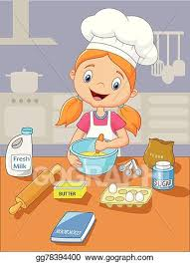
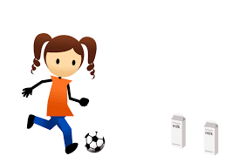
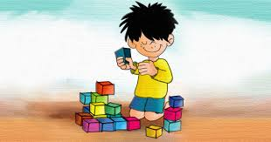
Fun Friday Activities
Article 31 – I have the right to play and relax.

Slide 15
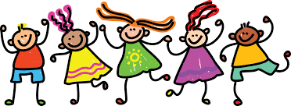
Well Done Primary 2/3 families! You have completed another week of online learning! Enjoy your weekend everyone. I will be ready to welcome you back on Monday morning. Mrs Doghudje

