Slide 1
Friday ^{12th} of June
Good Morning Primary 1!
Bonjour la class! Ca Va?
https://www.bbc.co.uk/teach/supermovers/ks1--ks2-mfl-french-greetings-with-ben-shires/zdpdvk7
L.I – I can say some simple greetings in French

Slide 2
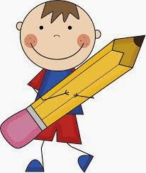
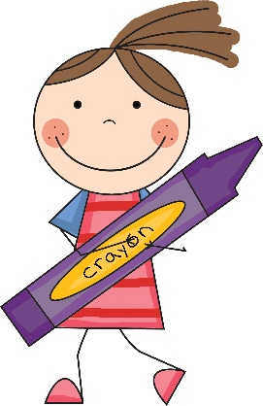
Literacy
L.I – We are learning to use our knowledge of common words and phonemes to spell, write and read words.
https://www.youtube.com/watch?v=1Qpn2839Kro
Activity -Jumbled sentences
1.
2.
Put the words in the correct order.
Tip –Write the sentence onto a piece of paper and cut it up.
Watch out for capital letters and full stops these will help you find the first and last word in the sentence.
a | red | I | duck. | saw
clock. | ten | is | It | on | the

Slide 3
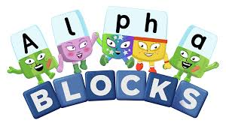
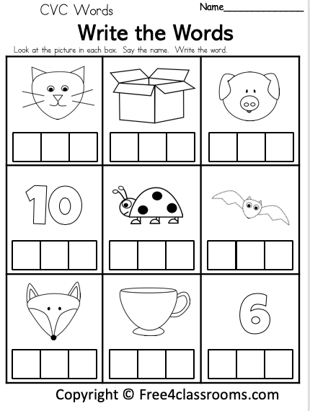
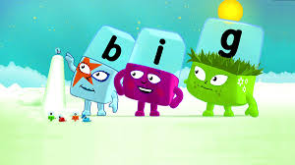
I can use my knowledge of sounds to make cvc words.
Missing letter quiz
https://www.bbc.co.uk/cbeebies/puzzles/alphablocks-missing-letter-quiz
School words quiz
https://www.bbc.co.uk/cbeebies/puzzles/alphablocks-school-words-quiz
Watch
https://www.bbc.co.uk/cbeebies/watch/alphablocks-web
Complete this worksheet

Slide 4
https://www.youtube.com/watch?v=t6NUJ2JZz50

Slide 5
Position and Movement
I am learning to describe and give directions
Watch
https://www.bbc.co.uk/bitesize/clips/zf7xn39

Slide 6
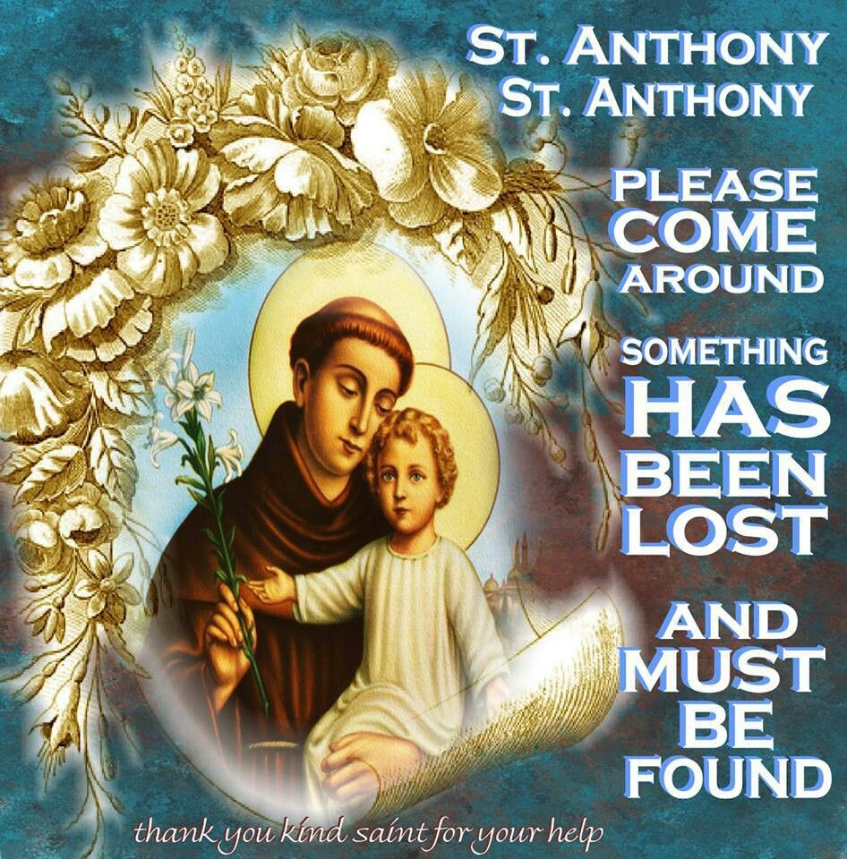
The Feast of St. Anthony- Saturday 13th of June
Saint Anthony is the Patron Saint of lost things. If you ever misplace something you can always ask St. Anthony for help.
Saturday is the Feat Day of St. Anthony. Usually we would celebrate at school together by going to mass.
We cannot be together in person but we can be in spirit. So why not watch mass tomorrow online with Father Sebastian.

Slide 7
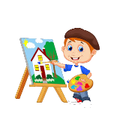
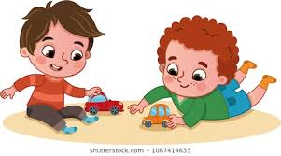
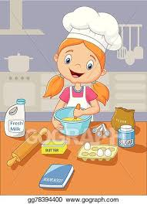
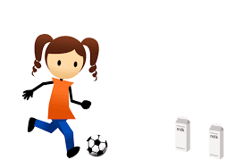
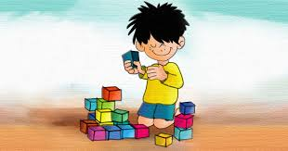
Fun Friday Activities
Article 31 – I have the right to play and relax.

Slide 8
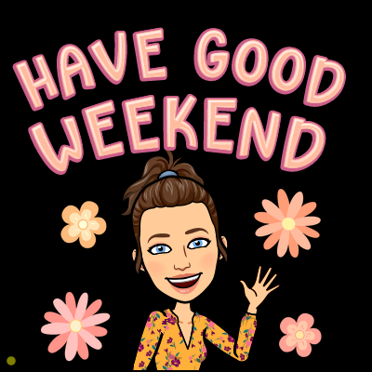
Have a lovely weekend and we will be back with more activities and lessons on Monday!

