Slide 1
Thursday 11th June

Slide 2
Daily Timetable
Daily exercise
French
Spelling
Writing
Maths
R.E – Miss Sloan (slide 9)

Slide 3
Daily exercise
Cosmic Yoga (on anytime) https://www.youtube.com/watch?v=flK2Nasd-AI
Why not try some Yoga, they do all different themes. Pick one that you like.

Slide 4
French

Slide 5
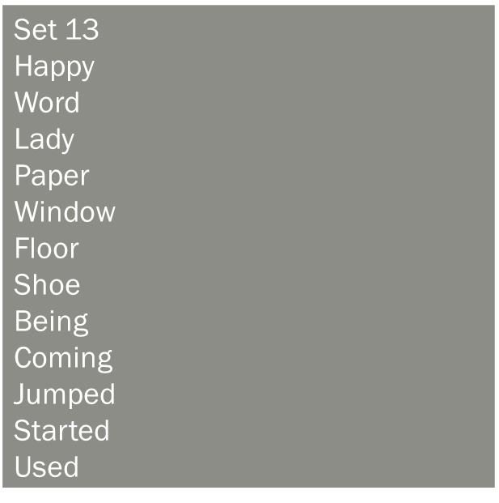
Spelling
I am learning to use various spelling strategies.
Choose 10 of your spelling words to diacritically mark.

Slide 6
Writing
L.I – we are learning to use our notes to create an informative leaflet.
I have attached in the Writing Channel in a word Document how to complete this task.
Or it is below on the blog.

Slide 7
Maths Starter
Complete a speed tables sheet or hit the button on either the 6,7,or 8 times table.

Slide 8
Maths
We are going to look at Grand Designs number two. You have created some super floor plans for your house but now we need to think about flooring.
I have attached the maths sheet below in the blog or you can find it in the maths channel on teams.
https://www.bbc.co.uk/bitesize/articles/zbcnf4j
The video above explains perimeter.

