Slide 1
Good Morning P5/4
Week 12 Home Learning
Thursday 11th June 2020

Slide 2
Aujord’hui c’est jeudi onze juin.
Je suis content(e)
Je suis d’accord
Je suis mal
Il y a du vent.

Slide 3
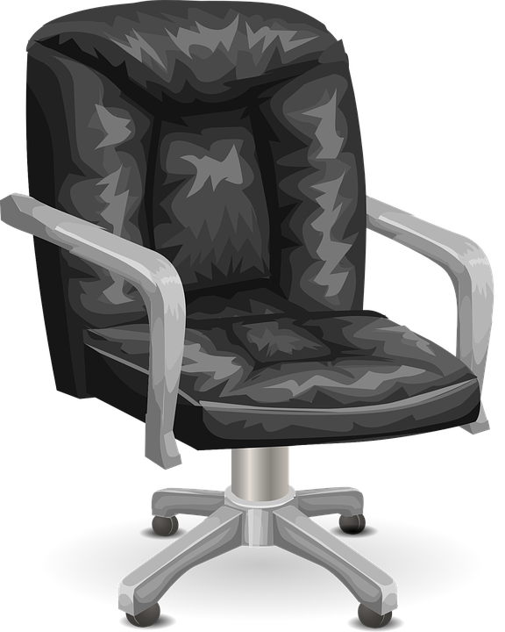
Morning Starter
Which one is heavier:
a. a train or a bus?
b. a desk light or a street light?
Lesley bought 2 bottles of sauce, each weighing 750 g.
What is their total weight:
a. in grams
b. in kilograms
Mr Braiden bought two jars of gherkins from the supermarket.
Each jar weighed 780 grams.
a. What is the total weight of the jars, in grams?
b. What is their total weight in kilograms?

Slide 4
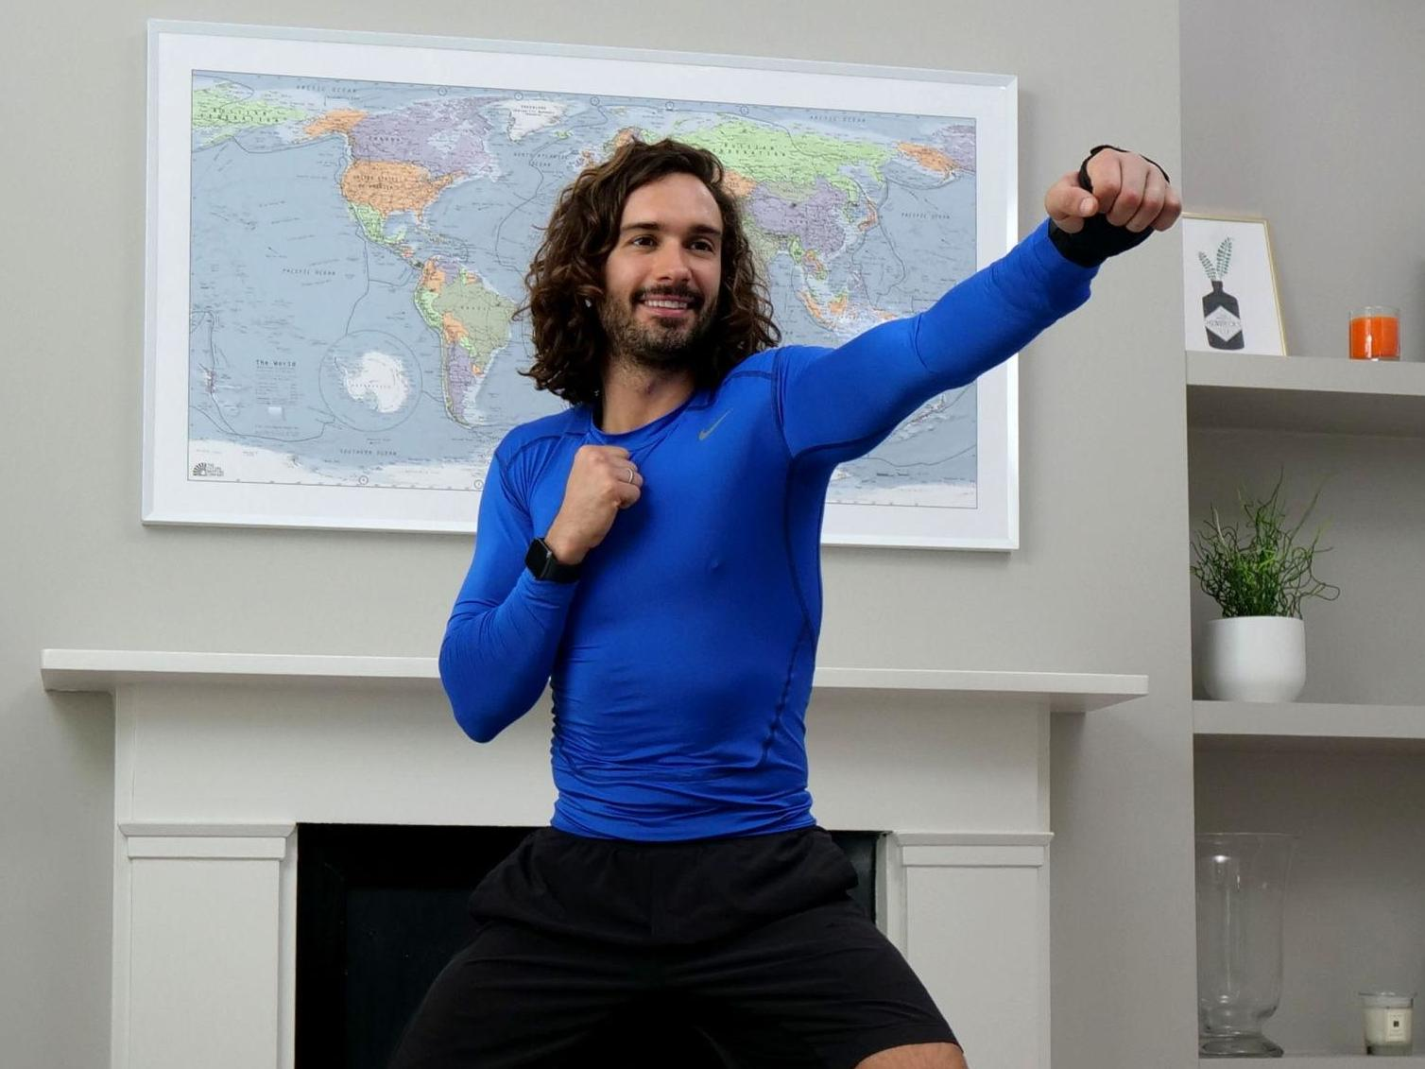
PE tasks
Thursday is normally a PE day for us so here are some ways you can choose to get
active today:
9am – Joe Wicks PE lesson –
11:30am – Dance Lesson with Oti Mabuse (Strictly professional) –
Any time – Cosmic Kids Yoga –

Slide 5
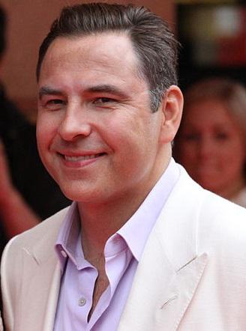
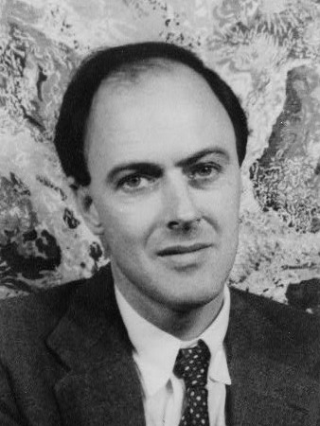
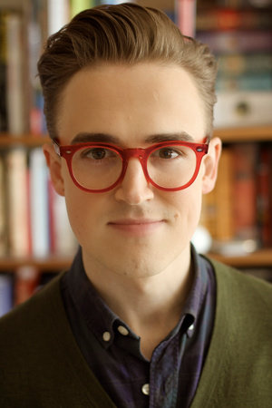
Spelling: Phonics Board
‘ow (owl)’
Read, Write, Spell
Common words
Reading: The Making of Milton
Task – Rhyming Game
Literacy Task Board
Spelling: Elkonin Boxes
Primary 4 – unit 5 ‘oo’ - Extension
Primary 5 – unit 12 ‘ch’ - Extension
Reading:
Task – Summarising
Spelling: Elkonin Boxes
Primary 4 – unit 5 ‘oo’ - Extension
Primary 5 – unit 12 ‘ch’ - Extension
Reading:
Task –
Metalinguistics

Slide 6
Writing Task
Thursday is normally our writing day, so here is a writing task for you to do:
Genre: Recount
L.I. – I can create a diary entry that is based on my experiences of the past few weeks of being in lockdown.
Success Criteria – Primary 5
Understand the purpose and audience.
Include a title to capture the reader’s attention
and tell what the recount is about.
Write in the past tense…He saw, looked, was,
were, had. Began with an opening paragraph
giving a summary of main events.
Use time words to connect events e.g. Firstly
Ensure the main events are organized into
chronological order.
Use topic sentences at the beginning of the
paragraph to say what the paragraph is about.
Join sentences together using more complex
connectives.
Use direct speech where relevant and appropriate.
Include a final paragraph that sums up the account.
Use photos/illustrations to engage the reader.
Success Criteria – Primary 4 and David Walliams Group
Understand why I am writing and who
will read my report (audience and purpose).
Include a title to say what the recount is about.
Write a paragraph which sets the scene, telling what your
subject or event is (when, who, what, where).
Write 2 or 3 paragraphs to describe the events in order.
Write about people, places and dates.
Use time connectives e.g. next, then, soon, afterwards.
Write in the past tense e.g. was, were, had, saw…The man
was standing in the rain. He had red slippers on. Then he ran…
Include a final paragraph that sums up the recount.
Use picture, photos or labelled diagrams to show what
happened.

Slide 7
Maths Task Board
Teejay 1b – pg. 178
Websites for all groups to use:
Remember there is a task on sumdog.
Teejay 1a – pg. 147
Teejay 2a – pg. 119 and 120
.

Slide 8
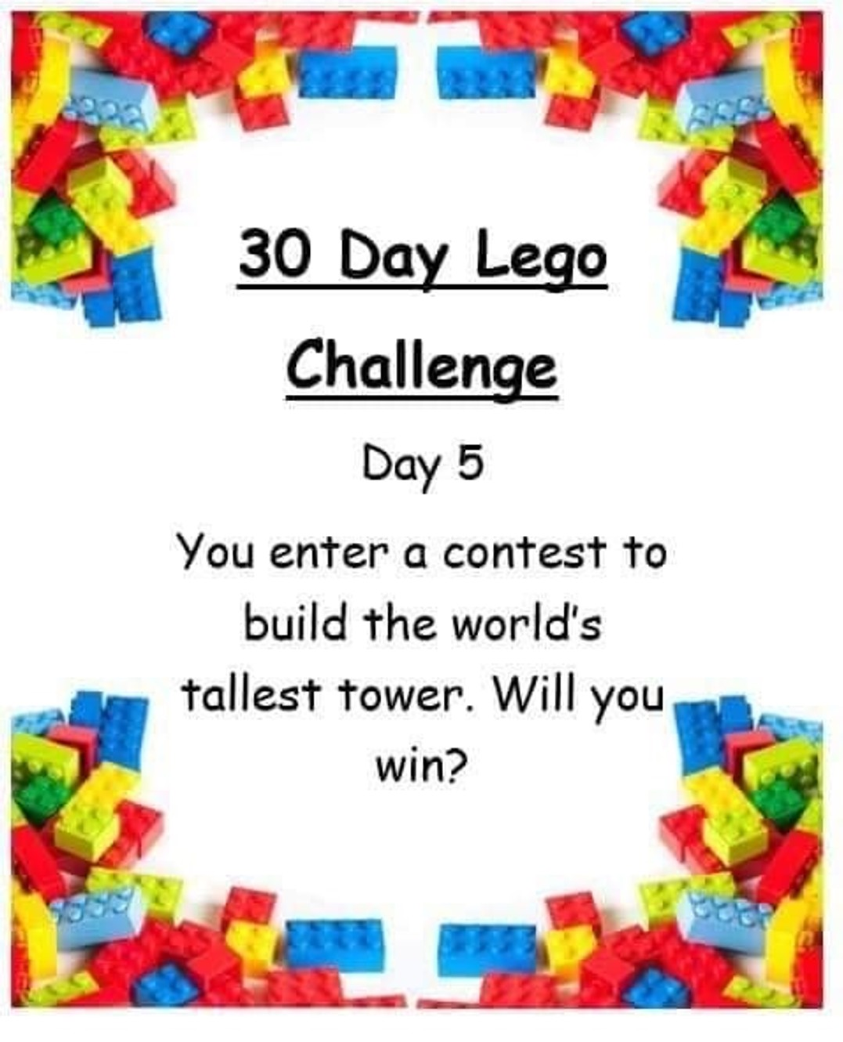
Lego Challenge
If you don’t have lego, you can use any other building resources you have or you can draw your design.
You could base your design off of a real life tower such as the Eiffle Tower or Tower of London.

