Slide 1
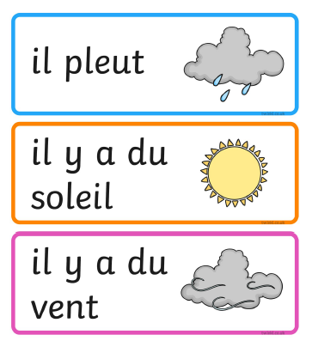
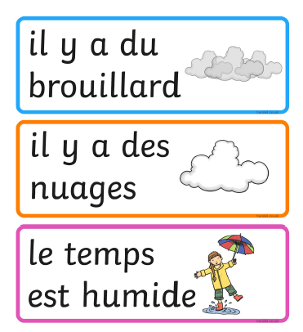
Thursday 11th of June
French: Bonjour la class! Ca Va?
L.I- To describe the weather in French
Quel temp fait-il aujourd’hui?= What is the weather like today?
Il... It is…
Rainy Foggy
Sunny Cloudy
Windy Wet

Slide 2
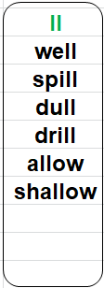
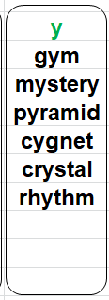
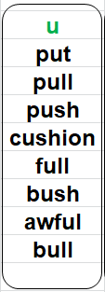
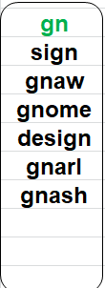
Literacy
LI: We are learning to spell words using our phoneme knowledge.
ABCDEFGHIJKLMNOPQRSTUVWXYZ
For todays activity, I would like you to play catch and spell. You will need a partner and ball that you can throw and catch. Each throw of the ball is one letter of the word. For example: b- throw-e- throw-l- throw-l-throw.
Stage 2 words Stage 3 Consolidation words

Slide 3
Reading Comprehension
Using your reading book from Oxford Owl
Can you discuss with someone:
Do you know the name of the Author?
Do you know the name of the illustrator?
What did you like about the book?
Is there anything you didn’t like about the book?
What was your favourite part?

Slide 4
https://www.youtube.com/watch?v=f0PJbx6cUFo
Today’s Story is Stand Tall Molly Lou Melon

Slide 5
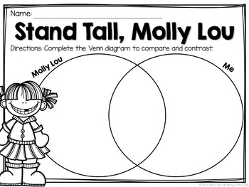
Today you are going to compare the way people feel. L.I.- I can write about my feelings. Molly Mae was different from the rest of the children. Did it bother her? Who gave her the advice to help her cope? What was the advice? Ronald Dunkin was very unkind to Molly Mae at first. What changed his mind? Draw the diagram and compare you and Molly Lou. Write the words in the Venn diagram. Will you be the same with some things?
Literacy-Writing

Slide 6
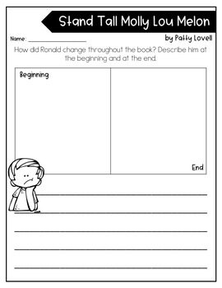
L.I.- I can write about my feelings. Can you think about how unkind Ronald was to Molly Lou at the beginning of the story. What changed him? Think of some words to describe him at the beginning of the story and the end. Then write about it. It can be as many sentences as you would like.
Literacy-Writing Challenge
Be Like
Molly Mae.
Don’t Be Like
Ronald

Slide 7
Numeracy – Warm Up
LI: To use mental strategies to solve maths problems and be able to explain my strategy
Splat

Slide 8
9
www.stevewyborney.com
Steve Wyborney

Slide 9
17
www.stevewyborney.com
Steve Wyborney

Slide 10
The total number of shapes is…
Splat!
How many shapes are under each splat? How do you know?
How else could you know?
Let’s look under the splats to see how many shapes are there.
What can we learn from this picture?
15
www.stevewyborney.com
Steve Wyborney

Slide 11
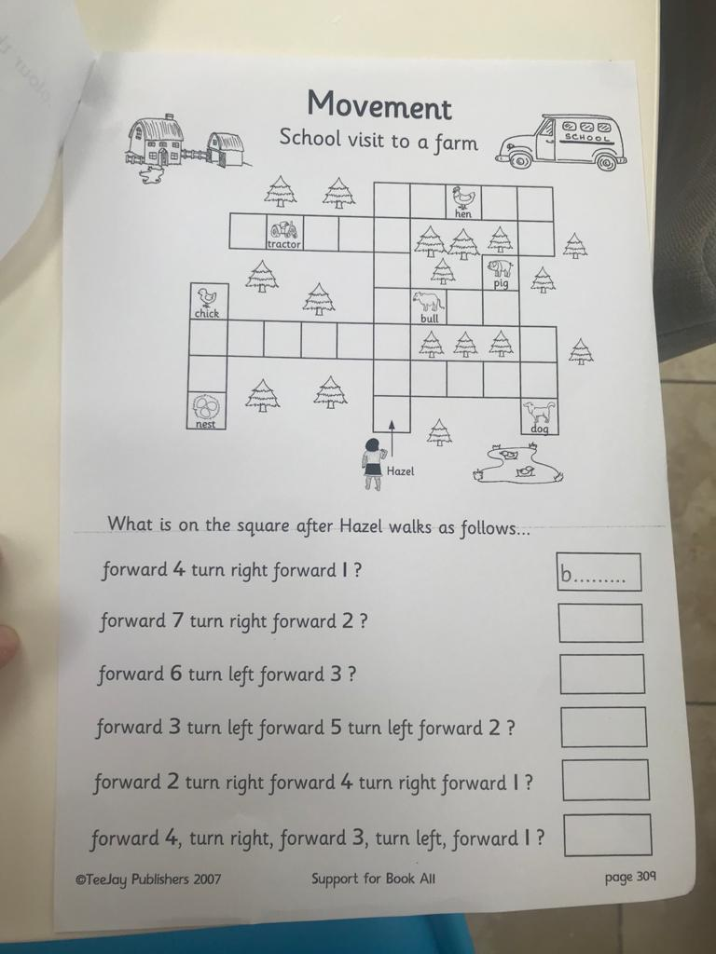
P2 Maths Activities
L.I – I can describe the position of an item using the correct language
Complete this page in your workbook.
Play: Blindfold Course
Make an obstacle course in your house or garden(use desks, chairs, etc.), put a blindfold on someone and help guide him/her through the course by giving instructions (e.g. walk forward 2 steps, turn left, take on small step, etc.).

Slide 12
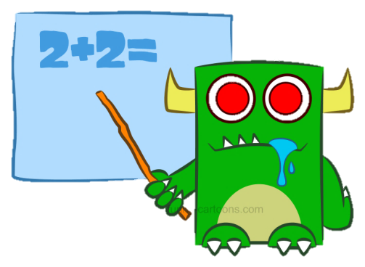
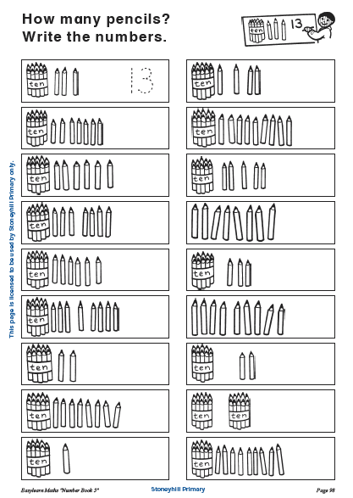
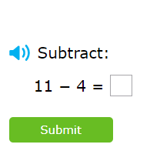
P3 Numeracy Activities
LI: To use counting on and addition strategies to find the total
Addition and Subtraction workbook
Please do this page of your
booklet.
2. IXL Maths:Subtracting 4 within 20 https://uk.ixl.com/math/year-2/subtracting-4

Slide 13
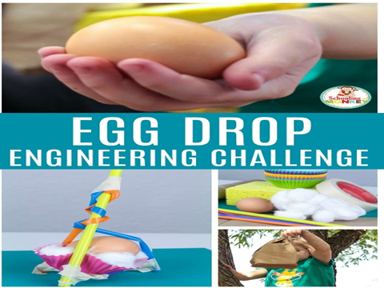
Day 3 and 4 Build your design and try it out!
Build your container and place the egg inside.
Drop the egg from someplace high. (Be sure it’s safe and an adult is with you.)
After you drop it look and see if your egg cracked or remained intact. (Remember to wash your hands after touching raw egg!

Slide 14
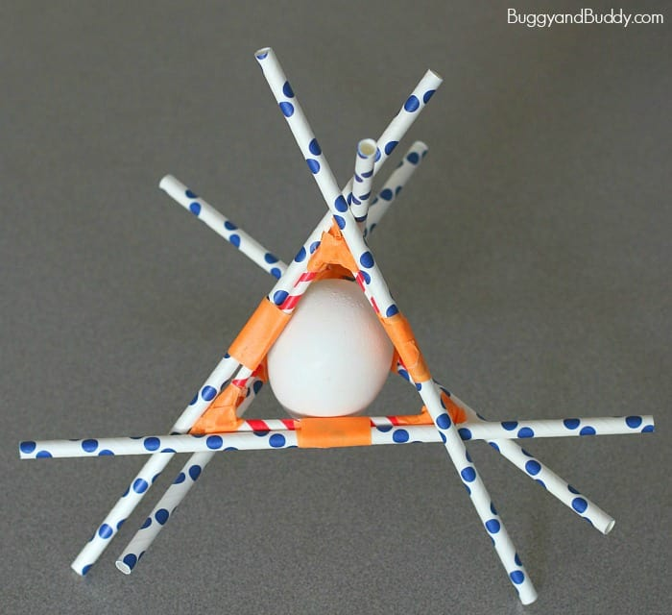
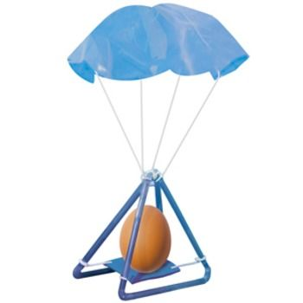
Some Ideas!
Some of these might not work! Trial and error is an important part of being an engineer!

Slide 16
Leave a comment on the blog about what you learned today. Enjoy the rest of your day Primary 2/3!

