Slide 1
Thursday 11th of June
French: Bonjour la class! Ca Va?
L.I- To describe the weather in French
Quel temp fait-il aujourd’hui?= What is the weather like today?
Il... It is…
Rainy Foggy
Sunny Cloudy
Windy Rainy

Slide 2
Reading- Common Words
These are some common words you had in P2.
Can you remember them?
take gave cold don’t
every find want girl
home more school Mrs
Choose a book, a comic , a newspaper etc
To see if you can find them in the text.
Using your reading book from Oxford Owl think about these questions and try and answer them. Don’t write them down just tell someone what you think.
Do you know the name of the Author?
Do you know the name of the illustrator?
What did you like about the book?
Is there anything you didn’t like about the book?
What was your favourite part?

Slide 3
https://www.youtube.com/watch?v=f0PJbx6cUFo
Today’s Story is Stand Tall Molly Lou Melon

Slide 4
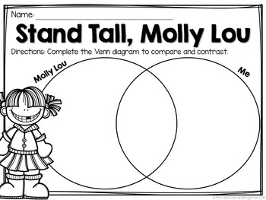
Today you are going to compare the way people feel. L.I.- I can write about my feelings. Molly Lou was different from the rest of the children. Did it bother her? Who gave her the advice to help her cope? What was the advice? Ronald Dunkin was very unkind to Molly Lou at first. What changed his mind? Draw the diagram and compare you and Molly Lou. Write the words in the Venn diagram. Will you be the same with some things?
Literacy-Writing

Slide 5
Writing Challenge If you want to!
Can you think about how unkind Ronald was to Molly Lou at the beginning
of the story. What changed him?
Think of some words to describe him at the beginning of the story and the end.
Then write about it. It can be as little or as many sentences as you would like.
Be Like
Molly Mae.
Don’t Be Like
Ronald.

Slide 6
Number Talks
Number Talks - You don’t have to write down the answers.

Slide 7
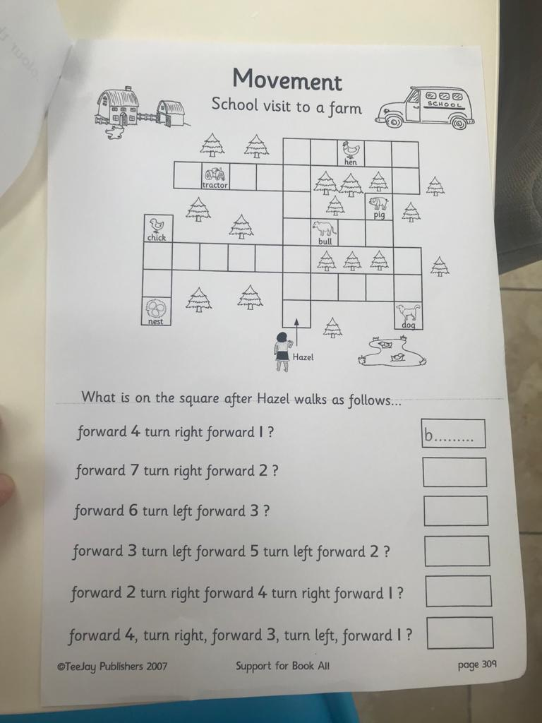
Mathematics Position and Movement
L.I – I can follow instructions and understand positional language.
Watch -
Position and Movement workbook – Complete page 309 ‘School visit to a farm in your workbook.
Blindfold Course. Make an obstacle course in your house or garden(use desks, chairs, etc.), put a blindfold on someone and help guide him/her through the course by giving instructions (e.g. walk forward 2 steps, turn left, take on small step, etc.).

Slide 8
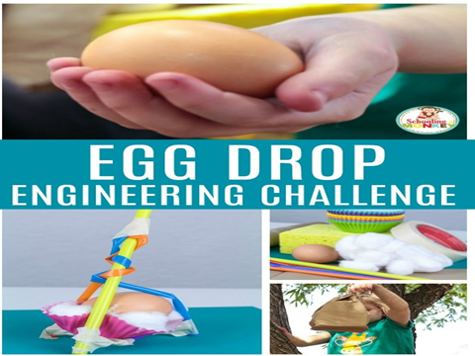
Day 3 and 4 Build your design and try it out!
Build your container and place the egg inside.
Drop the egg from someplace high. (Be sure it’s safe and an adult is with you.)
After you drop it look and see if your egg cracked or remained intact. (Remember to wash your hands after touching raw egg!

Slide 9
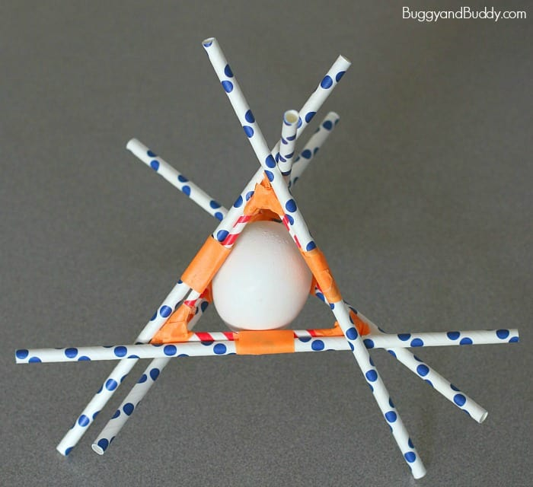
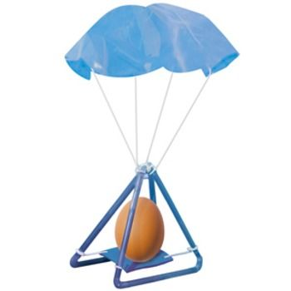
Some Ideas!
Some of these might not work! Trial and error is an important part of being an engineer!

Slide 11
Here is some peacful music to listen to. https://www.youtube.com/watch?v=5HrkXT5Bc9E It is very long so you don’t have to listen to all of it.

