Slide 1
Thursday 28th of May vendredi 28th juin
Good Morning Primary 1!
Sing the days of the week and have a little dance
https://www.youtube.com/watch?v=VD6SCq-OlhI
Sing days of the week in French
https://www.youtube.com/watch?v=Lpwf5N0rfVE

Slide 2
French
Learning Intention
To recognise the months of the year in French.
Success Criteria
To recognise and name the months of the year in French.
https://www.youtube.com/watch?v=7_u2SigckNQ
I have added voice clips to the next slides.

Slide 3
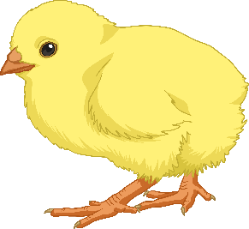
The Months - Les mois
janvier
January
février
February
mars
March
avril
April
mai
May
Juin
June

Slide 4
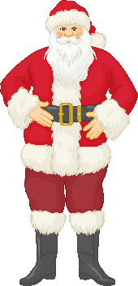
The Months - Les mois
juillet
July
août
August
septembre
September
octobre
October
novembre
November
décembre
December

Slide 5
Reading- Common Words
make like made
Choose a book, a comic , a newspaper etc
To see if you can find them in the text.
Using your reading book from Oxford Owl think about these questions and try and answer them. Don’t write them down just tell someone what you think.
Do you know the name of the Author?
Do you know the name of the illustrator?
What did you like about the book?
Is there anything you didn’t like about the book?
What was your favourite part?
Today why don’t you do your reading outside?

Slide 6
https://www.youtube.com/watch?v=NiXNuYOWDtY

Slide 7
In today’s story the crayons don’t seem to get along because they are all different. In the end they learn that being different is what makes them all so special and if they were all the same then pictures or life would be very boring.

Slide 8
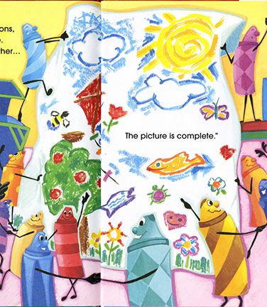
Writing
God made us all in his image with our own set of unique gifts and talents.
He loves us all equally.
For your writing task today I would like you to draw a picture of yourself then underneath write something you love about yourself.
I love being me because…
Remember

Slide 9
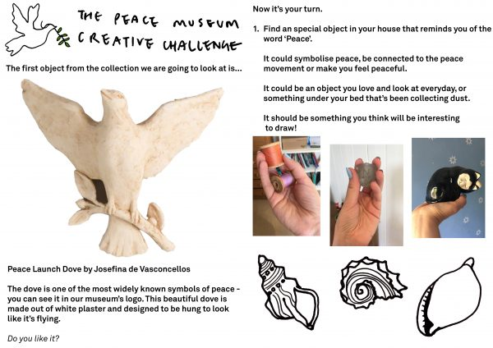
Minnie Vinnies
Symbols of Peace
Your challenge today is to have a look around your house for an object that represents peace or makes you feel peaceful, then draw it.
Watch this clip for more details-
https://peacemuseum.org.uk/pmcreativechallenge-week-1/
Your finished piece can be shared with the Peace Museum on Twitter using #PMcreativechallenge and with The Minnie Vinnies on Twitter @SSVPyouth,

Slide 10
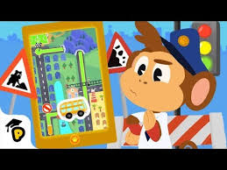
Mathematics Position and Movement
L.I – I can follow instructions and understand positional language.
Blindfold Course.
Make a simple obstacle course in your house or garden.
Put a blindfold on someone and help guide him/her through the course by giving instructions
(e.g. walk forward 2 steps, turn left, take on small step, etc.).
Watch
https://www.youtube.com/watch?v=N53w1cz4ogo

Slide 12
Day 3 and 4 Build your design and try in out!
Build your container and place the egg inside.
Drop the egg from someplace high. (Be sure it’s safe and an adult is with you.)
After you drop it look and see if your egg cracked or remained intact. (Remember to wash your hands after touching raw egg!

Slide 13
Challenge questions
Try dropping the egg from increasing heights. Does it eventually stop working?
If your initial design did not work, redesign it and try to improve it. Can you get it work the next time?

Slide 14
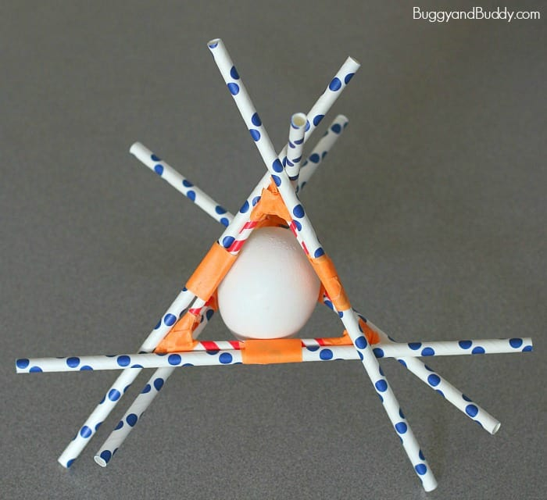
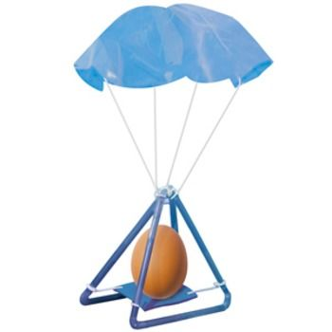
Some Ideas!
Some of these might not work! Trial and error is an important part of being an engineer!

Slide 15
Here is some peacful music to listen to. https://www.youtube.com/watch?v=5HrkXT5Bc9E It is very long so you don’t have to listen to all of it.

