Slide 1
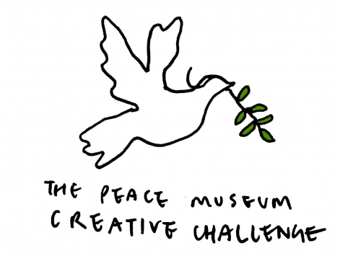
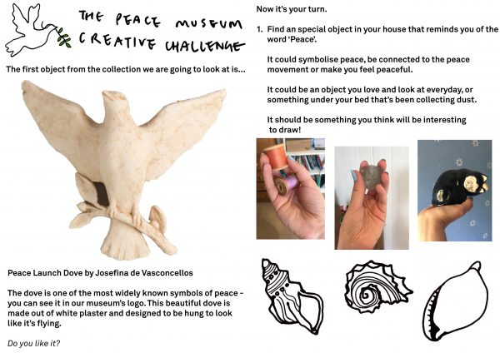
Minnie Vinnies
Symbols of Peace
Your challenge today is to have a look around your house for an object that represents peace or makes you feel peaceful, then draw it.
Watch this clip for more details-
https://peacemuseum.org.uk/pmcreativechallenge-week-1/
Your finished piece can be shared with the Peace Museum on Twitter using #PMcreativechallenge and with The Minnie Vinnies on Twitter @SSVPyouth,

