Slide 1
Wednesday 10th of June
Good Morning Primary 3!
Bonjour la class! Ca Va?
Can you say todays date in French?
Aujourd’hui c’est (M…………………) 10th (J…………) 2020
LI: To say simple greetings in French
Watch: Bonjour! Bonjour!
https://www.youtube.com/watch?v=atNkI6QFZ50

Slide 2
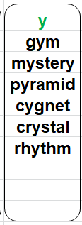
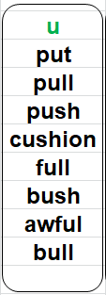
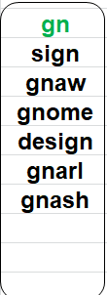
Literacy
Stage 3 Phonics: consolidation
LI: We are learning to recognise, read and make words containing the “y” “u” and “gn” phonemes
Re-read you’re phoneme stories for the 3 above sounds and check you can read all the highlighted words correctly.
Roll and spell using the word lists.

Slide 3
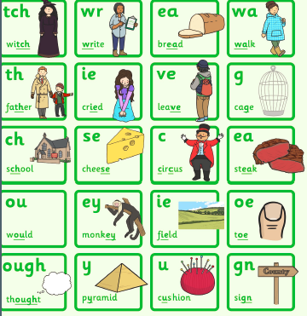
Stage 3 Sounds Revision
L.I. I can use knowledge of sounds, letters and patterns to read words.

Slide 4
Story time
https://www.youtube.com/watch?v=G8WrScDZVes

Slide 5
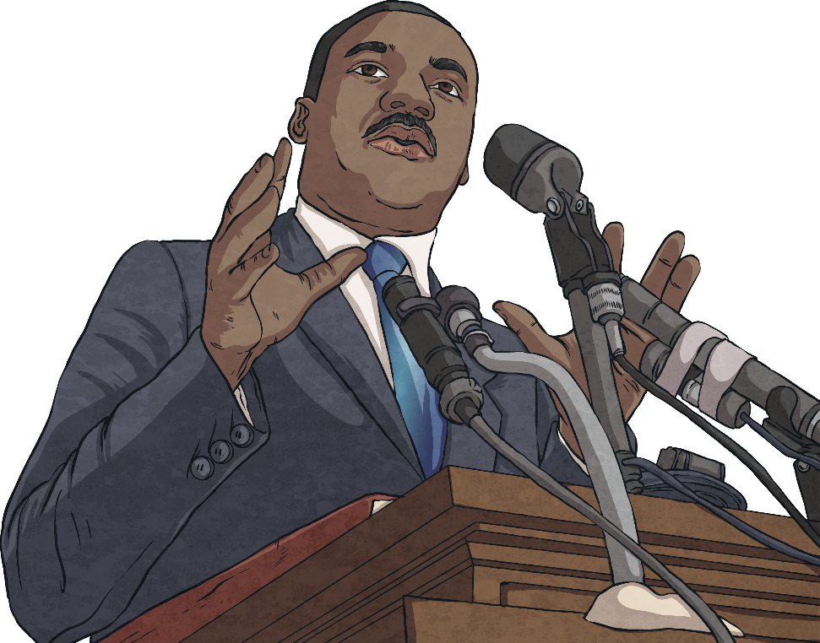
Hopes and Dreams
“I have a dream.”
This is part of a famous speech given by Martin Luther King Jr. in 1963.
His dream was that all people, regardless of race or colour, would be treated as equals.
Notes:
There have been many famous people in history who have also had hopes and dreams for the future. This is Martin Luther King Jr. He was very famous for making a speech in 1963 where he used the word hope a lot. His hope was that all people regardless of race or colour would be treated as equals. In all parts of the world that is something that people continue to hope for.

Slide 6
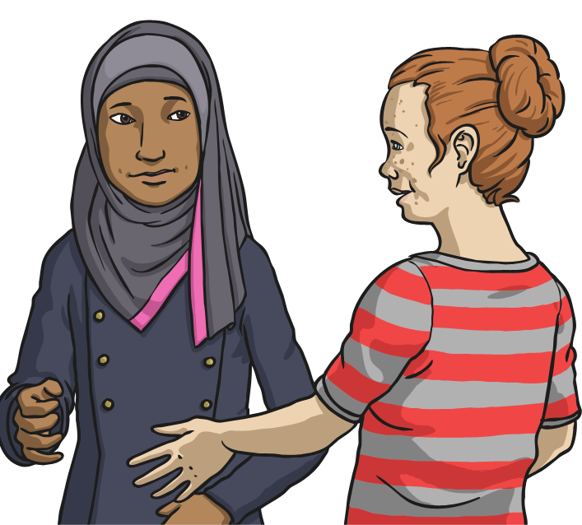
Hopes and Dreams
What are your hopes and dreams?
Perhaps you have a hope or dream for yourself or one for a wider group of people.
I hope that…
I like to think that…
I dream that one day…
Notes:
Perhaps you have a hope or dream for yourself or for a wider group of people. Have a think about that now and write it down if you can or tell an adult what you think. What is important to you, what would you like to change ? How could you make the world a better place to live in ?

Slide 7
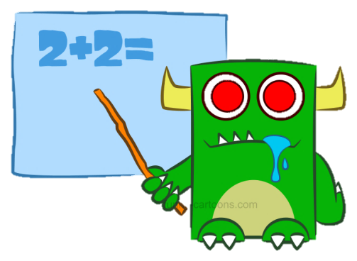
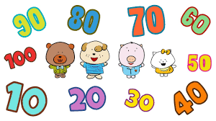
Numeracy – Warm Up
LI: We are learning to count forwards and backwards.
Choose 2 actions (for example – clap hands and snap fingers)
Count forwards and backwards in 3s to 30.
Count forwards and backwards in 10s to 100.
Count forwards and backwards in 100s to 1000.

Slide 8
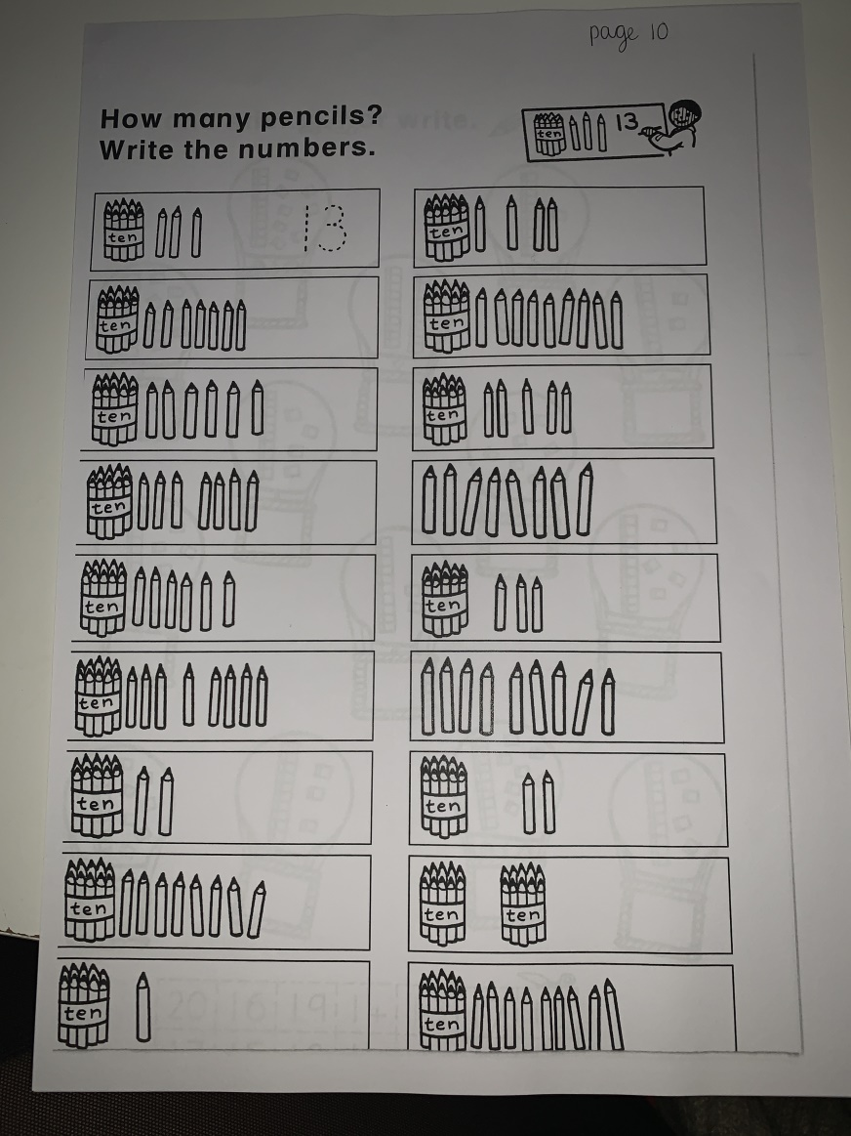
Numeracy Activities
LI: We are learning to develop a range of addition and subtraction strategies.
1. Addition and Subtraction Booklet – Page 10
2. Spend 20 mins on Sumdog practising your maths skills.

Slide 9
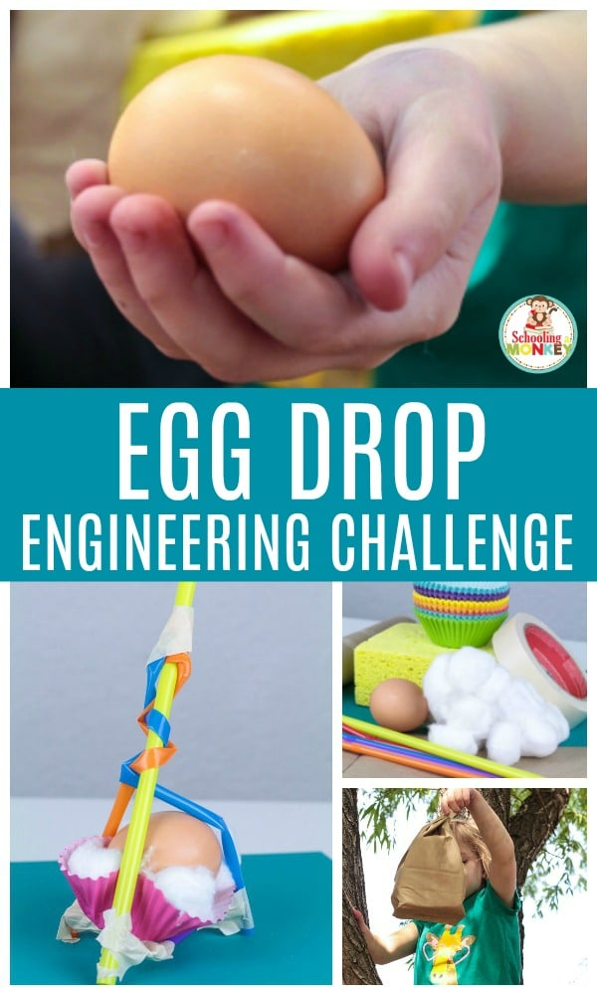

Slide 10
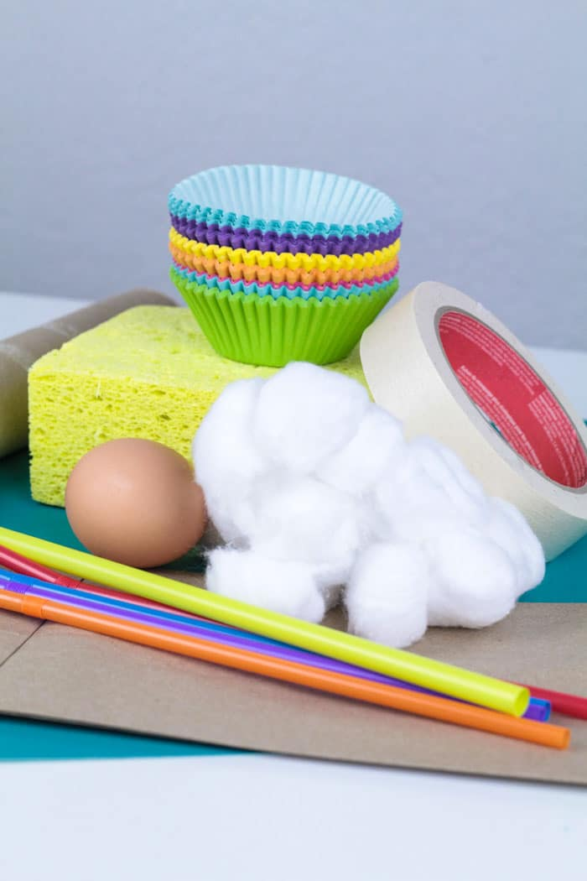
Day 2 –
Collect your materials
Some things you could use- Please use recycled materials
Raw eggs
(buy some cheap ones so you can make multiple attempts)
bubble wrap
cotton balls
Carrier bags
plastic food containers
string
tape
egg carton

Slide 11
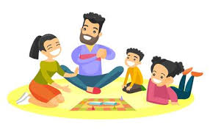
I hope you enjoyed your activities today! Now it’s time to have a play and get some fresh air! ☺

