Slide 1
Wednesday 10th June

Slide 2
Timetable
Daily Exercise
French
Spelling
Reading
Maths
Health and Well – being

Slide 3
Daily exercise
Wednesday is normally a PE day for us so here are some ways you can choose to get
active today:
(Some of these people are almost as fun as Mr Martin, but not quite!)
Joe Wicks 9am live - https://www.youtube.com/watch?v=rAX6Q236CwI
Oti Mabuse 11:30am (strictly dancer) https://www.youtube.com/watch?v=btD_HCO1FT4
Cosmic Yoga (on anytime) https://www.youtube.com/watch?v=flK2Nasd-AI

Slide 4
French – I am learning to describe my appearance.
Draw a picture of yourself.
Can you write what your hair colour/hair type is?
Colour of Eyes?
Your height?
J’ai les yeux…… ( I have … eyes).
J’ai les yeux bleus. (blue)
J’ai les yeux verts. (green)
J’ai les yeux noisette. ( hazel)
J’ai les yeux marron. (brown)
J’ai les yeux gris. (grey)
J’ai…
les cheveux noirs (black hair)
les cheveux bruns/marron (brown)
les cheveux blonds (blonde)
les cheveux chantains (chestnut brown)
les cheveux roux (red)
Courts/mi- long/longs ( short/mid length/longs)
Boucles (curly)
Raides (straight)
Je suis (I am)
Je suis Grand (e) tall
Je suis Petit (e) small

Slide 5
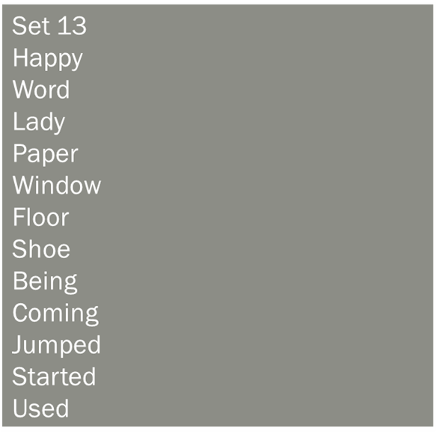
Spelling
I am learning to use various spelling strategies. Rainbow Spell your words.

Slide 6
Reading
L.I- I can summarise a piece of text in my own words.
Read the next chapter in your book from home and summarise the main points of the text in your own words.

Slide 7
Maths Starter
How many seconds are in 1 and a half minutes?
How many minutes are in an hour?
How many minutes are in 1.5 hours?
Convert 120 minutes to hours?
Convert 180 minutes to hours?
How long is it from 6:25 am to 9:35 am?
How long is it from 18:35 to 20:55?

Slide 8
Maths Starter answers
How many seconds are in 1 and a half minutes? 90 seconds
How many minutes are in an hour? 60 minutes
How many minutes are in 1.5 hours? 90 minutes
Convert 120 minutes to hours? – 2 hours
Convert 180 minutes to hours? 3 hours
How long is it from 6:25 am to 9:35 am?3 hours 10 minutes
How long is it from 18:35 to 20:55? 2 hours 15 minutes

Slide 9
Volume – I am learning to convert millilitres to litres
When we converted litres to millilitres we x by 1000. We are going to do the opposite this time.
To convert millilitres to litres we need to divide by 1000.
We divide by 1000 as there is a 1000 ml in a litre.
For example 7200 ml divided by 1000 = 7.2 litres

Slide 10
Volume Questions
A) 2000ml
B) 3200 ml
C) 14000 ml
D) 34000 ml
E) 2170 ml
F) 350 ml
G) 20 ml

Slide 11
Answers
A) 2 litres
B) 3.2 litres
C)14 litres
D) 34 Litres
E) 2.17 litres
F) 0.35 litres
G) 0.02 Litres

Slide 12
Health and Well- being
I want you to think about the following:
How does the ear work?
How do you chat to your friends if you can’t hear?
How quickly can you learn the alphabet in sign language? And can you teach someone in your house?
https://www.bbc.co.uk/bitesize/topics/zgdmsbk/articles/zkdkmfr
Watch the video to answer the questions.
You can also play the human ear quiz at the bottom of the page.

