Slide 1
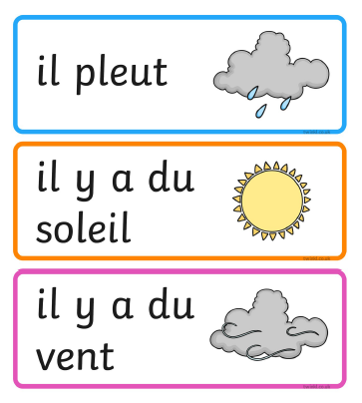
Wednesday 10th of June
French: Bonjour la class! Ca Va?
L.I- To describe the weather in French
Quel temp fait-il aujourd’hui?= What is the weather like today?
Il... It is…
Rainy
Sunny
Windy

Slide 2

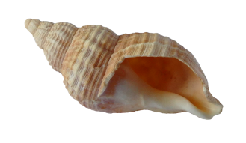

Literacy
L.I. I can recognise words which contain this sound.
This week we are doing the ‘ll' sound.https://www.youtube.com/watch?v=r3YtQuyS1fc
Once again you are going to become a detective.
Look around your house or garden for things which contain the ll sound.
Sound them out then try to write them.
i.e. Shell sh ell shell
Good Luck!

Slide 3

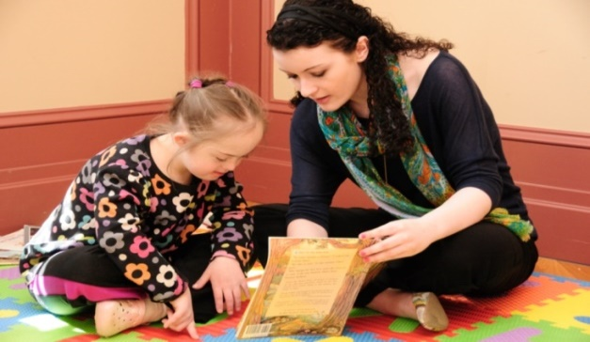
Reading
https://www.oxfordowl.co.uk/?sellanguage=en&mode=hub
username: stanothnysp12 password: Homelearning*1
LI: We are learning to read and spell this weeks common words.
Using your online reading book from yesterday can you look for your spelling words.
well will fell call
When or if you find your spelling words show them to someone.
In your jotter can you write one sentence using all of the spelling words?
Plan it before you write.

Slide 4

Today’s Story
https://www.youtube.com/watch?v=G8WrScDZVes

Slide 5
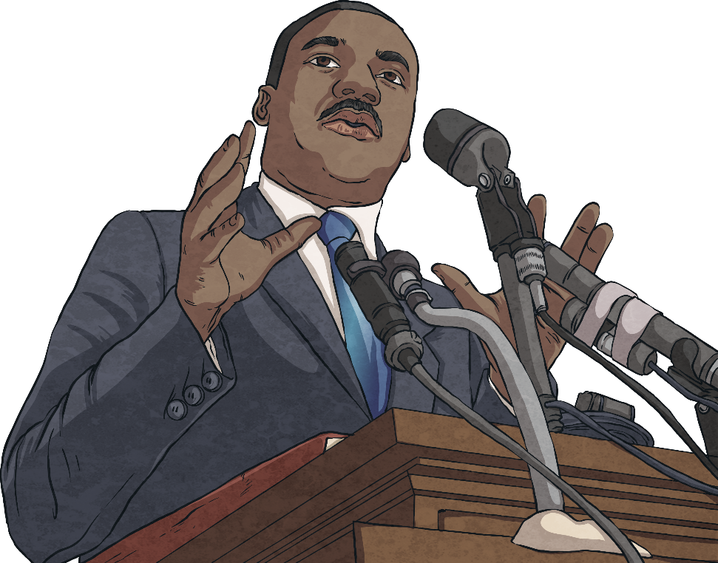

Hopes and Dreams
“I have a dream.”
This is part of a famous speech given by Martin Luther King Jr. in 1963.
His dream was that all people, regardless of race or colour, would be treated as equals.
Notes:
There have been many famous people in history who have also had hopes and dreams for the future. This is Martin Luther King Jr. He was very famous for making a speech in 1963 where he used the word hope a lot. His hope was that all people regardless of race or colour would be treated as equals. In all parts of the world that is something that people continue to hope for.

Slide 6
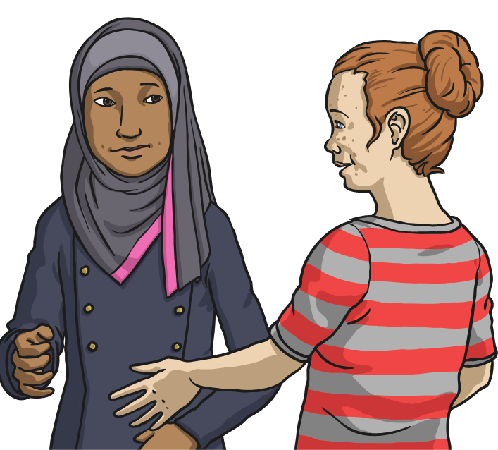
Hopes and Dreams
What are your hopes and dreams?
Perhaps you have a hope or dream for yourself or one for a wider group of people.
I hope that…
I like to think that…
I dream that one day…
Notes:
Perhaps you have a hope or dream for yourself or for a wider group of people. Have a think about that now and write it down if you can or tell an adult what you think. What is important to you, what would you like to change ? How could you make the world a better place to live in ?

Slide 7

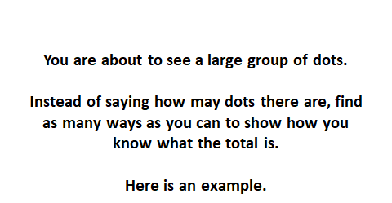
Numeracy – Warm Up
LI: To use mental strategies to solve maths problems and be able to explain my strategy

Slide 8
2 + 3 + 2 = 7
2 + 3 + 2 = 7
4 + 4 – 1 = 7
9 – 2 = 7
5 + 2 = 7
3 + 3 + 1 = 7

Slide 9
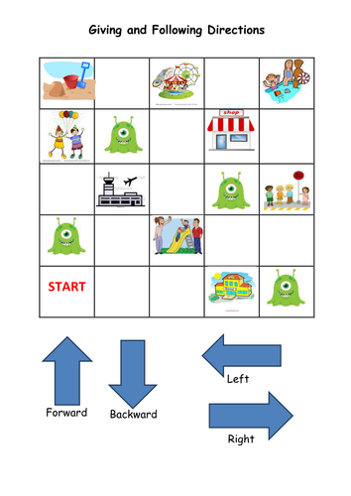
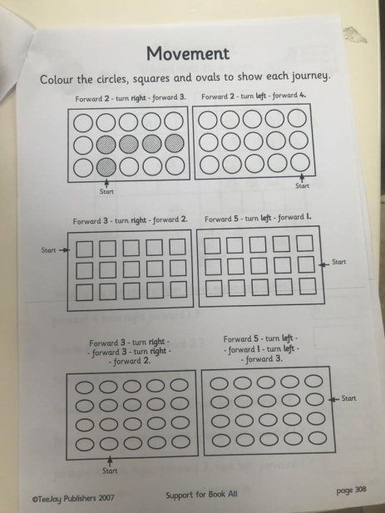
Mathematics
Position and Movement
L.I – I can follow instructions and understand positional language.
Watch -https://learnenglishkids.britishcouncil.org/short-stories/the-treasure-map
Position and Movement workbook – Complete page 308 ‘Showing a Journey’ in your workbook.
Try playing this direction game again.
https://learnenglishkids.britishcouncil.org/word-games/directions
Using your direction words can you send someone successfully to another room or part of your garden?

Slide 10
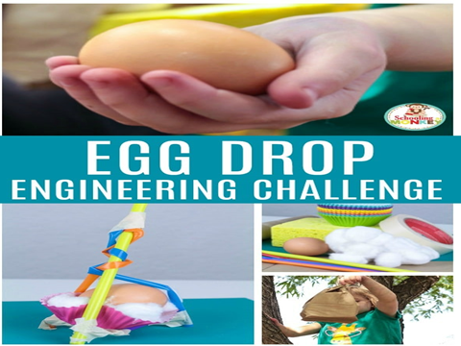
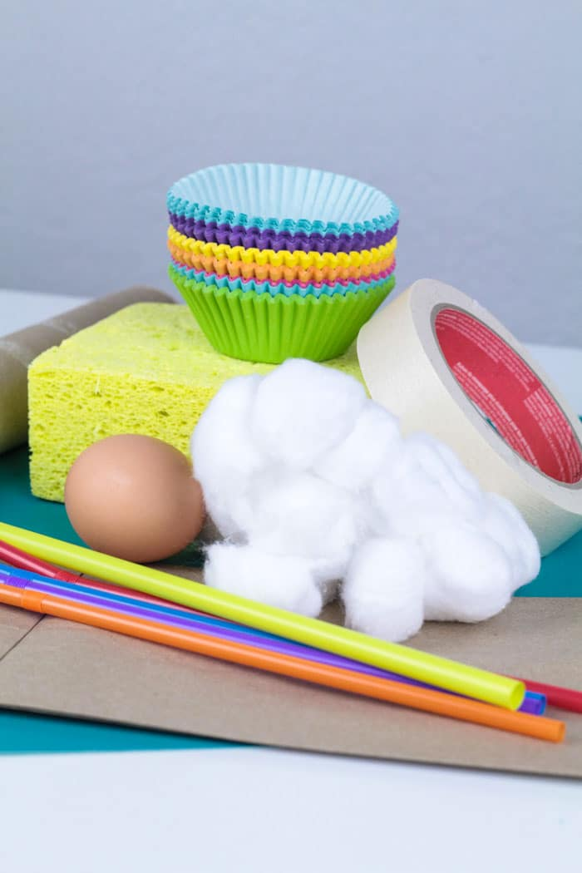
Day 2 –
Collect your materials
Some things you could use- Please use recycled materials
Raw eggs
(buy some cheap ones so you can make multiple attempts)
bubble wrap
cotton balls
Carrier bags
plastic food containers
string
tape
egg carton

Slide 11
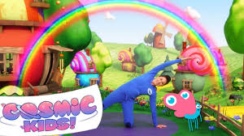
Relax and exercise with Cosmic Kids https://www.youtube.com/watch?v=pT-s1-phgxs
Let’s do the story about Coco the Butterfly

Slide 12

I hope you have enjoyed today’s learning and managed to go outdoors to play.

