Slide 1
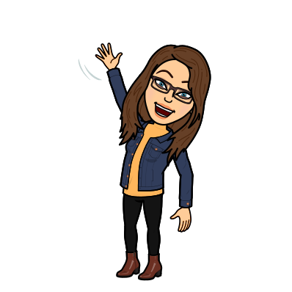
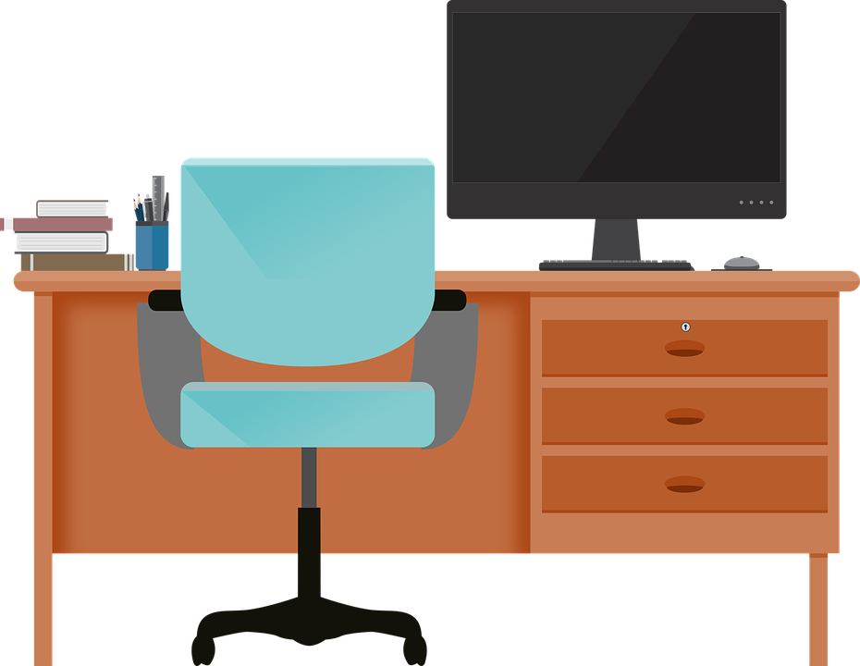
Good Morning P5/4
Week 12 Home Learning
Wednesday 10th June 2020

Slide 2
Aujord’hui c’est jeudi dix juin.
Je suis content(e)
Je suis d’accord
Je suis mal
Il fait mauvais.

Slide 3
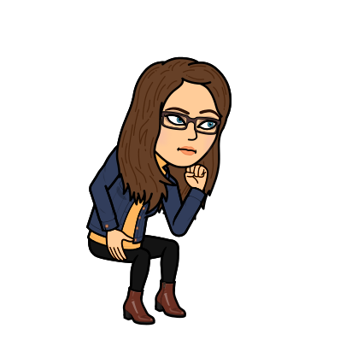
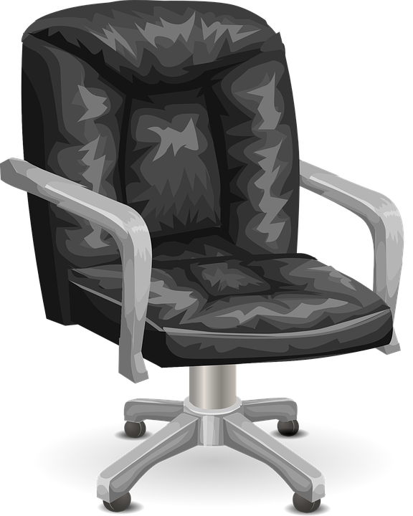
Morning Starter
The recipe says I need 40 ml of milk and the only measuring spoon I have holds 3 ml.
How many 3 ml spoonfuls will I have to use and how much milk will be left over?
17 slices of lasagne were divided between 4 diners.
How many slices did each get and how many were left over?
When 100 paper clips are weighed, their total weight is 19.6 grams.
What is the weight of 1 paper clip?

Slide 4
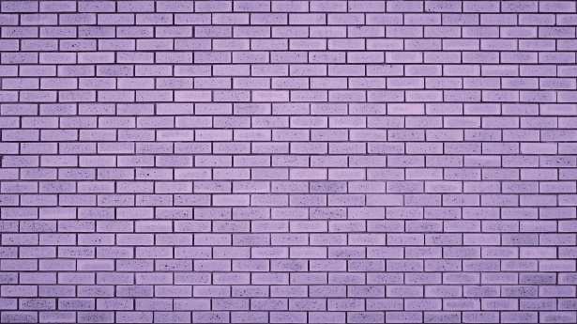
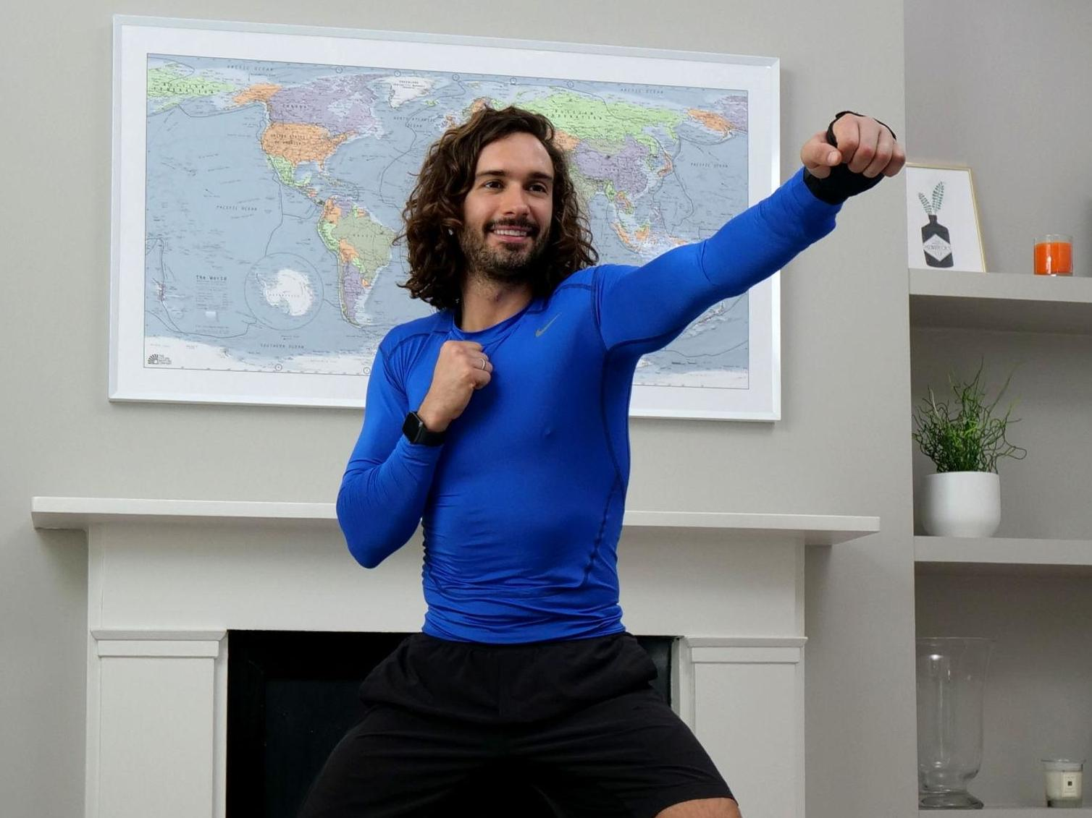
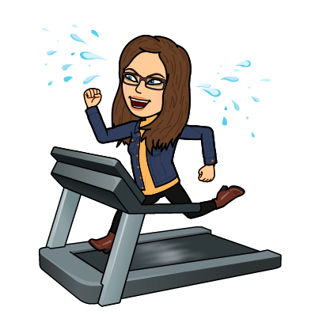
PE tasks
Wednesday is normally a PE day for us so here are some ways you can choose to get
active today:
9am – Joe Wicks PE lesson –
11:30am – Dance Lesson with Oti Mabuse (Strictly professional) –
Any time – Cosmic Kids Yoga –

Slide 5
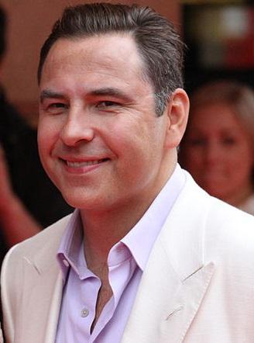
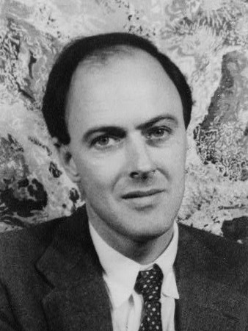
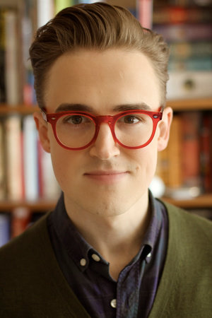
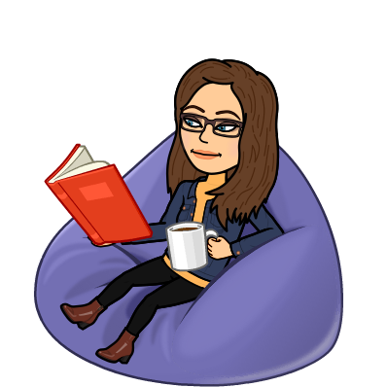
Spelling: Phonics Board
‘ow (owl)’
Read, Write, Spell
Common words
Reading: The Making of Milton
Task – Making a courage jar
Literacy Task Board
Spelling: Story of
Primary 4 – unit 5 ‘oo’ - Extension
Primary 5 – unit 12 ‘ch’ - Extension
Reading:
Task – Prior Knowledge
Spelling: Story of
Primary 4 – unit 5 ‘oo’ - Extension
Primary 5 – unit 12 ‘ch’ - Extension
Reading:
Task –
Visualiser

Slide 6
Maths Task Board
You are learning about how to measure a perimeter.
Watch the videos and do the activities on this website.
https://www.bbc.co.uk/bitesize/articles/zbcnf4j
Websites for all groups to use:
All groups have a task on sumdog.
Estimating Length
You are learning about how to measure a perimeter.
Watch the videos and do the activities on this website.
https://www.bbc.co.uk/bitesize/articles/zbcnf4j

Slide 7
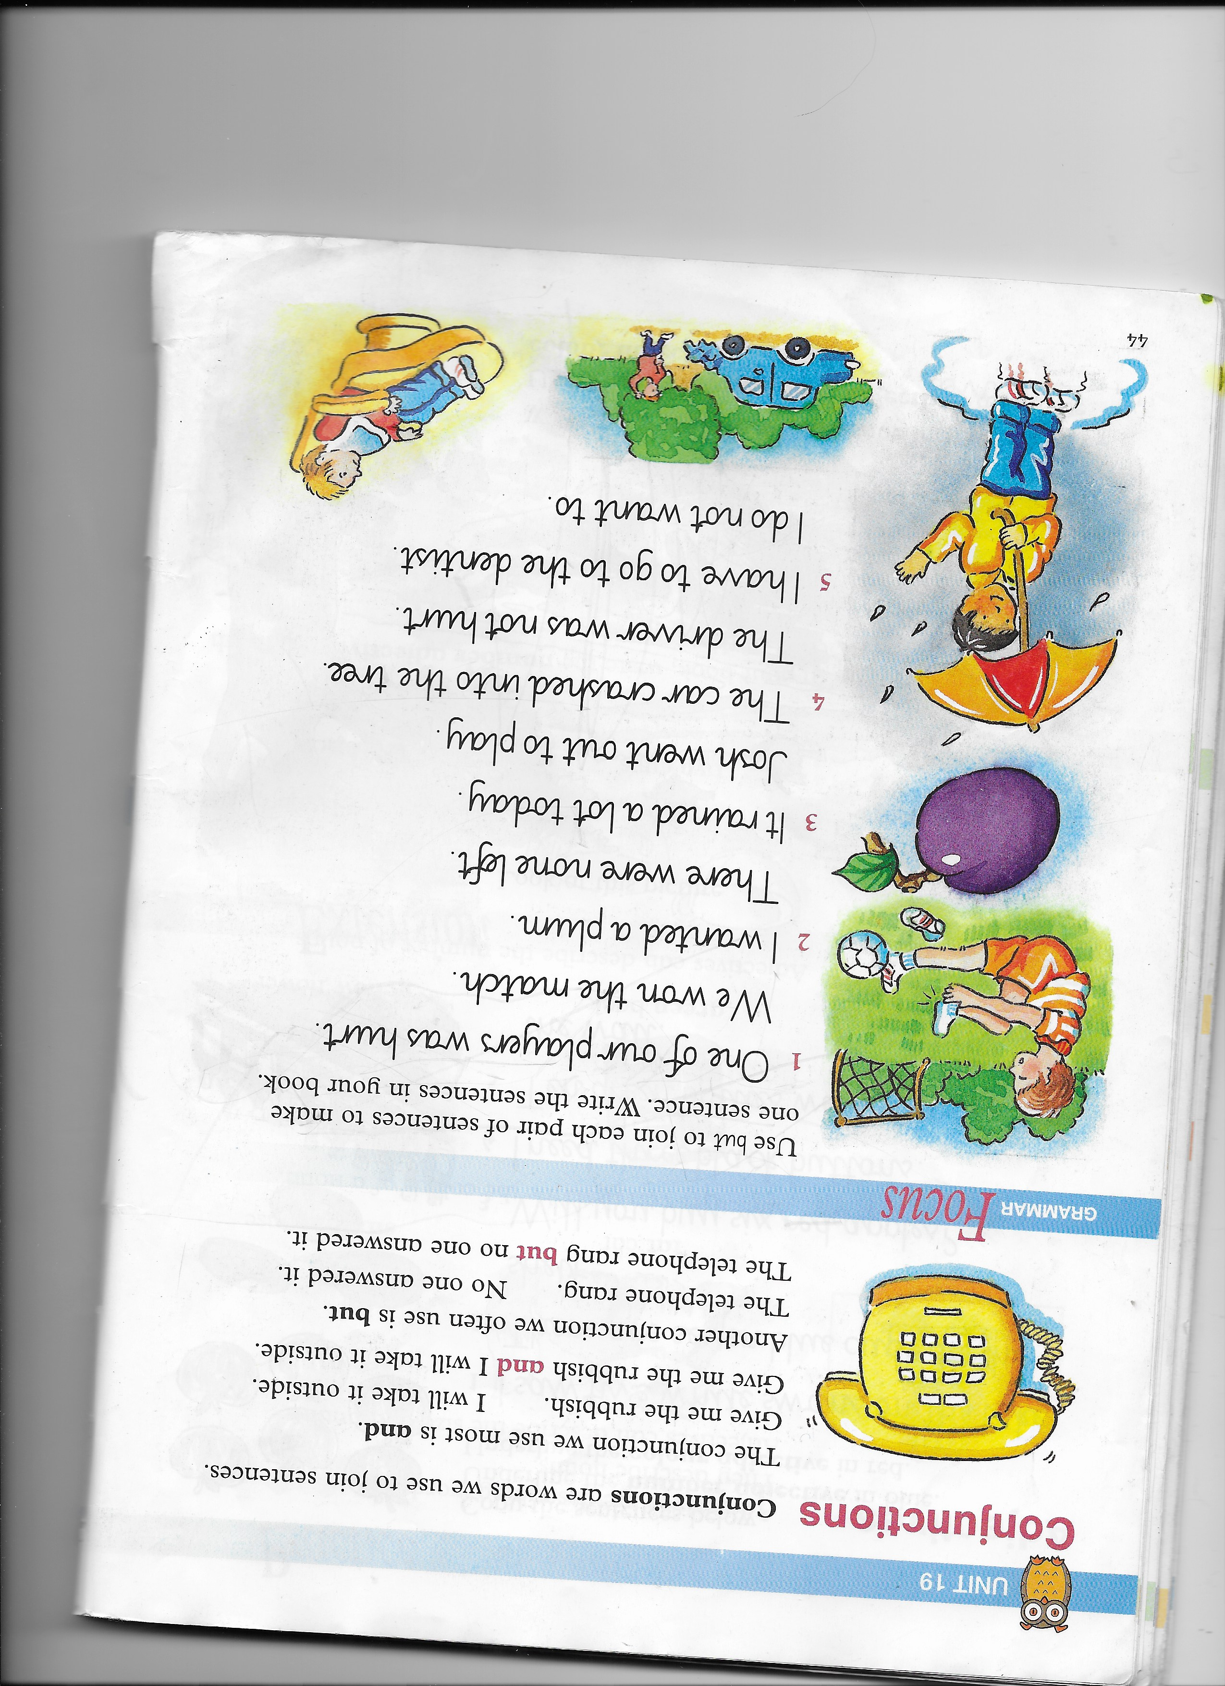
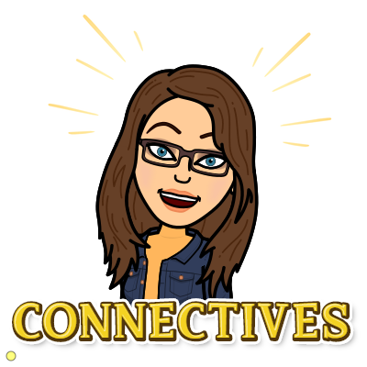
Grammar task – Group 1
Nelson Grammar Book 1 Unit 19.
L.I. I can revise conjunctions.

Slide 8
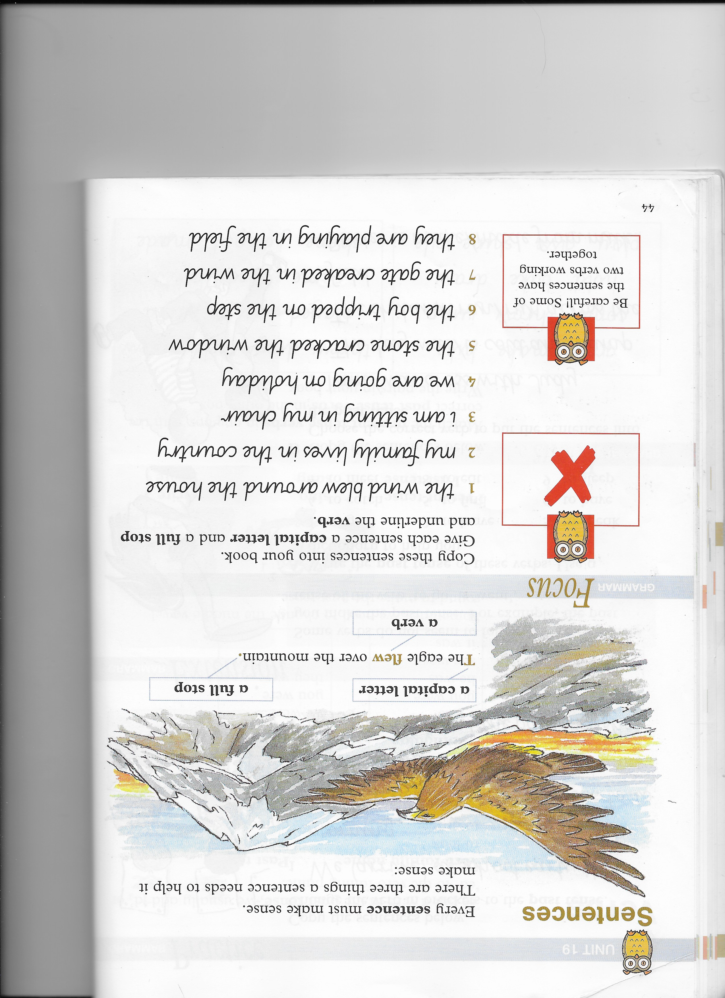
Grammar task – Group 2
Nelson Grammar Book 2 Unit 19.
L.I. I can revise sentence structure.

Slide 9
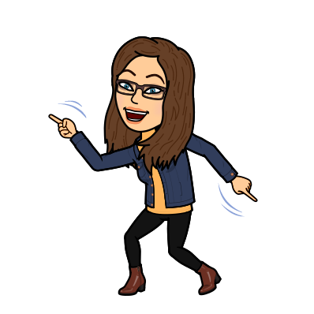
Health and Wellbeing Task
This week we will be looking at the respected part of SHANARRI. Today is about Healthy Lifestyles.
We all need to think about the good things that happen to us. This improves our wellbeing. Make sure at the end of each school day or before bed we take time to focus on the positives.
So, with an adult, share the small moments that made you happy. Try this every day this week and then try to make it a good habit!
Get the adults to ask you every day about the “magic moments”!
I will also try to include my own ‘magic moments’ in my signing off message at the end
of each day!

