Slide 1
Monday 09th June 2020
Good Morning Primary 4!
French: Bonjour la class! Ca Va?
Quelle est la date aujourd’hui?
Aujourd’hui cest Mardi 09th June 2020

Slide 2
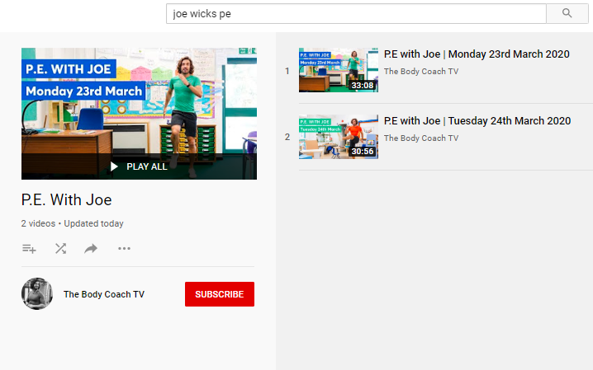
Health and Wellbeing
LI: We are learning to move our body well, exploring how to manage and control it, finding out how to use and share space.
P.E with Joe- Tuesday 09th June Video
(he is nearly as fun as Mr Martin, not quite, but nearly)
https://www.youtube.com/playlist?list=PLyCLoPd4VxBvQafyve889qVcPxYEjdSTl

Slide 3
Spelling (slide 1)
LI: I am using spelling rules to help me spell words
Yesterday, you found lots of words that used the follwing spelling rule…
Rule 1:
Soft ‘g’ – coming before ‘e’ (judge)
Soft ‘g’ – coming before ‘i’ (ginger)
Soft ‘g’ – coming before ‘y’ (gym)
TASK ON THE NEXT SLIDE

Slide 4
Spelling (slide 2)
LI: I am using spelling rules to help me spell words
TASK: 20 minutes of soft ‘g’ spelling games
Click on the link below to access a selection of free spelling games that allow you to further explore ‘soft g’ words.
Enjoy!
https://www.spellzone.com/word_lists/games-1282.htm

Slide 5
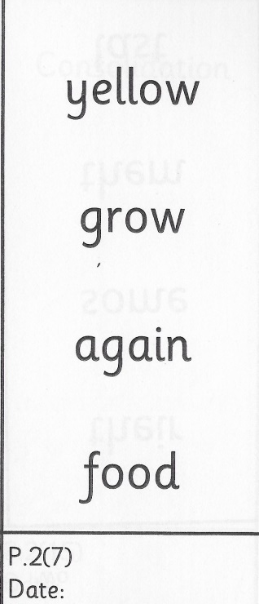
Spelling (David Walliams Group)
TASK:
Keep practising these common words for 1 more week! You’ll get a new set of words next week.
Remember to use the ‘Read, Write and Spell’ strategy to help you practise.
Example of how to practise your common words!

Slide 6
Reading
L.I I am using different reading strategies to help me understand my book
Reading:
David Walliams – Describing feelings – bicycle worries
Roald Dahl – Chapter 6 and 7 – Visuliser
Tom Fletcher – You have a new book on Epic! Called ‘The Bolds’ Chapter 1 – Prior Knowledge

Slide 7
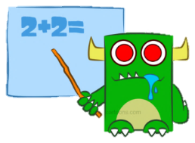
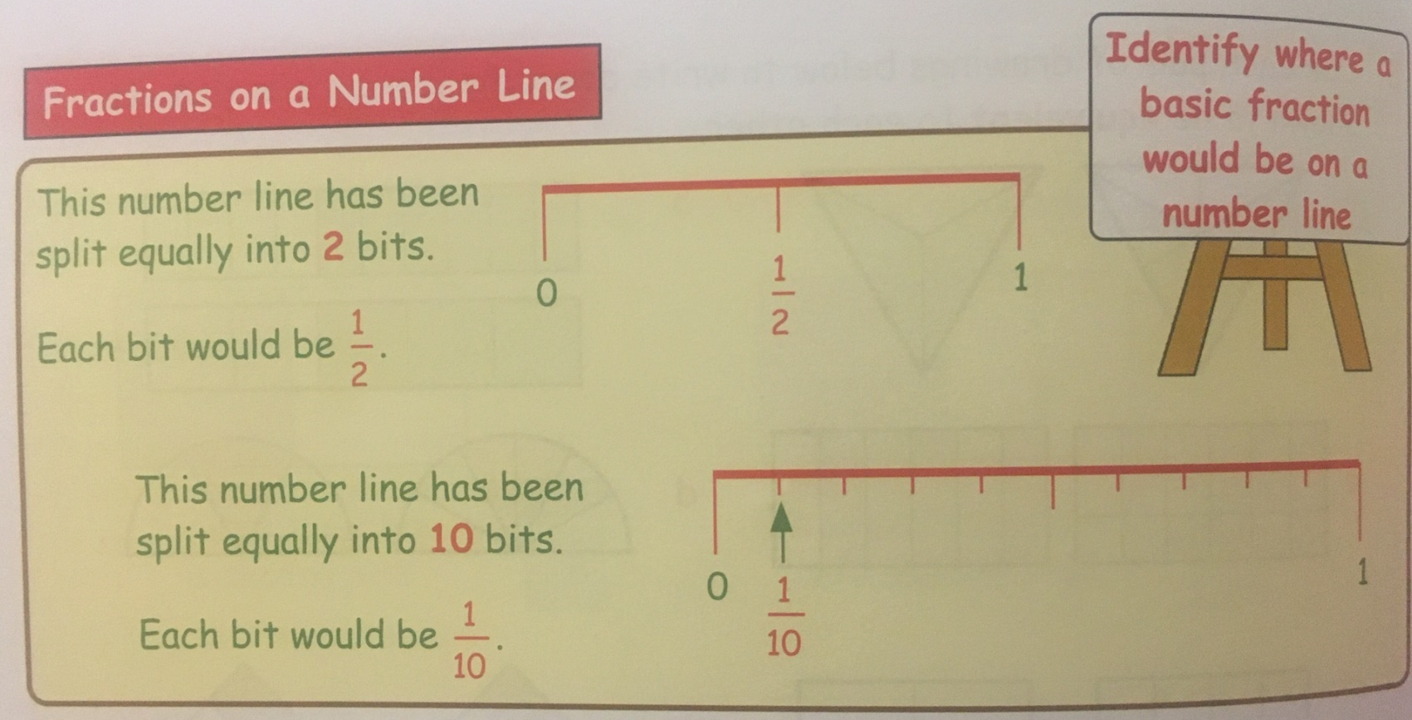
Maths (slide 1)
L.I. I am learning about fractions
When we first discussed fractions, we used number lines to get a better understanding of them.
Today, you have a little revision task to secure you understanding.

Slide 8
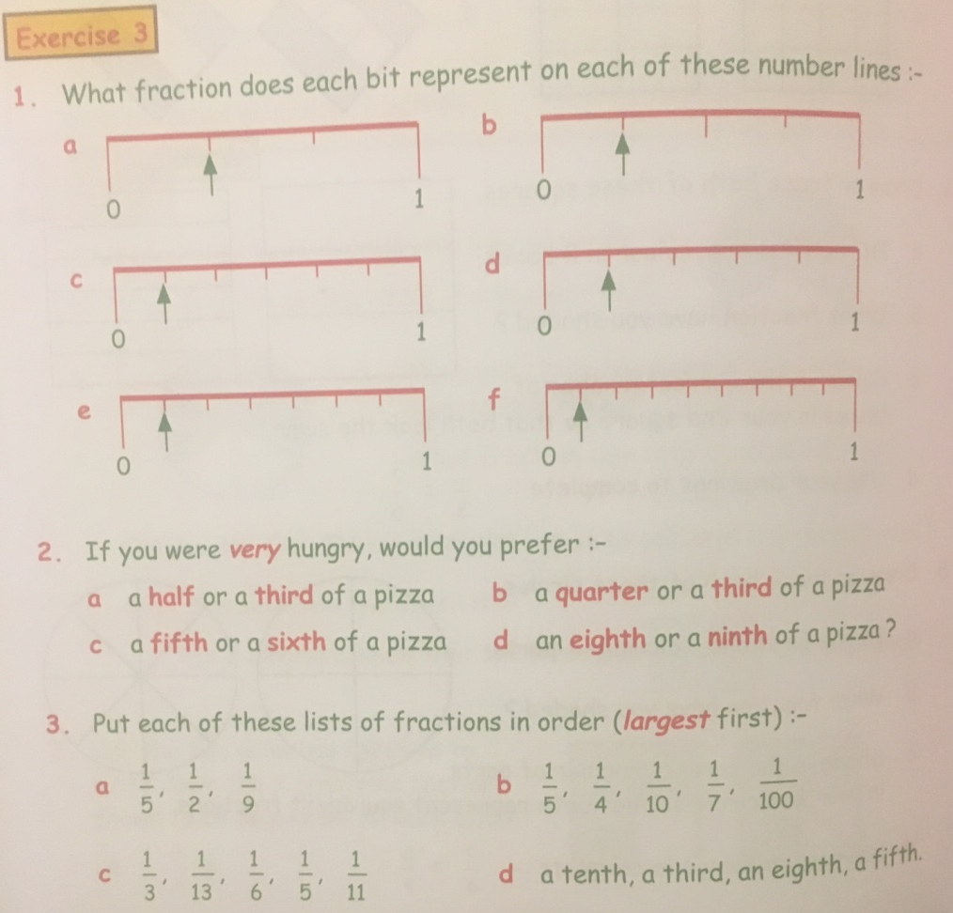
Maths (slide 2)
L.I. I am learning about fractions
TASK: Complete the number line / ordering fractions activity page – use your jotter to record your answers
Download the page from Teams or the Blog to get a closer look!

Slide 9
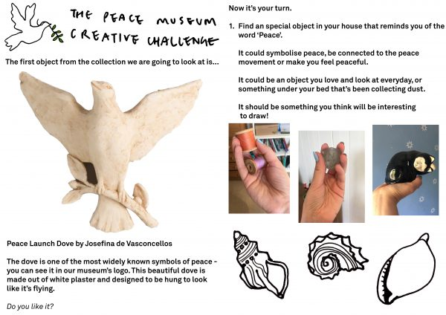
R.E. Minnie Vinnies
Symbols of Peace
Miss Sloan has set you an R.E. task today! Your challenge is to have a look around your house for an object that represents peace or makes you feel peaceful, then draw it.
Watch this clip for more details-
https://peacemuseum.org.uk/pmcreativechallenge-week-1/
Your finished piece can be shared with the Peace Museum on Twitter using #PMcreativechallenge and with The Minnie Vinnies on Twitter @SSVPyouth,

Slide 10
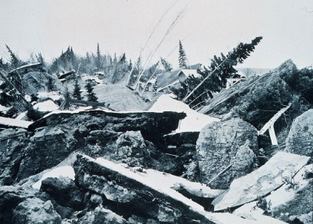
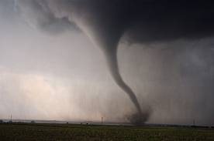
New Topic! (slide 1)
Natural Disasters
Yesterday, to kick off our exciting new topic, I asked you to create a lesson all about natural disasters.
You came up with some fantastic ideas, which we will use on our daily PowerPoints!
Our first ‘Teacher of the Topic’ is Aiden Berry!
(It seems right to give Aiden the first go as he thought of the topic and he’s made an amazing quiz!)
Other people who have already submitted lessons are…
Sofia , Rebekah and Xavier - they will get their lesson on a PowerPoint too at a later date!

Slide 11
New Topic! (slide 2)
Natural Disasters
TASK:
Click on the link to try Aiden’s excellent quiz about tornadoes and find out how much you know!
https://forms.office.com/Pages/ResponsePage.aspx?id=oyzTzM4Wj0KVQTctawUZKUgZ8CSpNhVGnQQEYnfAg5xURExFMDZQTzhMWEM4TVFMUEdJWDNSMEU4Ny4u

Slide 12
Feel free to leave comments / questions on Teams throughout the day and I will try my best to get back to you. Enjoy your day, Primary 4!

